Slide 1

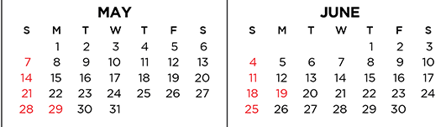
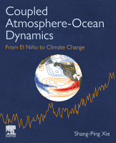
6/5 Student talks
6/7 Review for final
SIOC 235 Ocean-atmosphere interactions and climate
Textbook available online
Emphasis on phenomena & physical processes using illustrations.
Lectures available in podcasts
Updated slides to be posted on Canvas
Published
Feb 2023

Slide 2
Student presentations: Building on and extending class lectures (SP 2022)
12 min talk w/ 3 min Q&A (on which final exam draws)
written summary (1~2 pages).
5/25 (W) 8am-10:50am, Speiss 330. No class on 5/23 (M)
Kayleigh. Wyrtki, K., 1975: El Niño—The Dynamic Response of the Equatorial Pacific Ocean to Atmospheric Forcing. J. Phys. Oceanogr., 5, 572–584.
Adriana. Saravana, R. and P. Chang, 2000: Interaction between tropical Atlantic variability and El Niño - Southern Oscillation. J Climate, 13, 2177-2194.
Jack. Zhou, Z.-Q., S.-P. Xie, and R. Zhang, 2021: Historic Yangtze flooding of 2020 tied to extreme Indian Ocean conditions. PNAS, 118, e2022255118.
Anthony. Dai, A., 2013: The influence of the inter-decadal Pacific oscillation on US precipitation during 1923–2010. Climate Dynamics, 41, 633–646.
Euan. Williams, A. P., et al., Large contribution from anthropogenic warming to an emerging North American megadrought. Science 368, 314–318 (2020).
Nate. Wei, X., et al.: Large-scale conditions for the record-setting Southern California Marine Heatwave of August 2018. Geophys. Res. Lett., 48, e2020GL091803.
Holden. Cordeira, J.M., et al., 2019: A 142-year Climatology of Northern California Landslides and Atmospheric Rivers. Bull. Amer. Meteor. Soc., 100, 1499-1509.
Marissa. Hughes, M., and A. Hall, 2010: Local and synoptic mechanisms causing Southern California’s Santa Ana winds. Climate Dyn., 34, 847–857.
Veronica. Gershonuv et al. 2021 Hot and cold flavors of southern California’s Santa Ana winds: their causes, trends, and links with wildfire. Climate Dyn., 57, 2233–2248.

Slide 3
Student presentations
Each student is to make a 12-minute presentation (<10 ppt slides), followed by 3-minute questioning. A computer will be available. Please load your ppt file before the class starts. Write a summary (1-2 pages) that discusses in your own words the background, major findings, significance, and implications of the paper(s). Please include the full reference (authors, year, title, journal). The final exam will feature questions from student presentations.
The talk should target at your fellow students so please include necessary background to motivate your audience. Key points to cover: what is the paper about? What are the major phenomena/science questions it addresses? What methods does it use and what are the major results? What are the major contributions of the research? What do you feel most excited at, and why? Do not just present the results but also provide the context/story for why these results are interesting/new/important.
It is not feasible to present the whole paper in a 12-minute talk so you need to be selective, choosing the most important results and building a coherent story for your talk. Additional reading and synthesis with related papers help gain perspective. (One can find additional reading in the References section of the main paper or by searching on AMS/AGU journal sites. If you choose a short paper in Nature, Science or Geophys Res Lett, you might want to read one additional paper.)
Make sure that figures and text are big/clear enough for the audience to see. Use schematics as necessary.

Slide 4
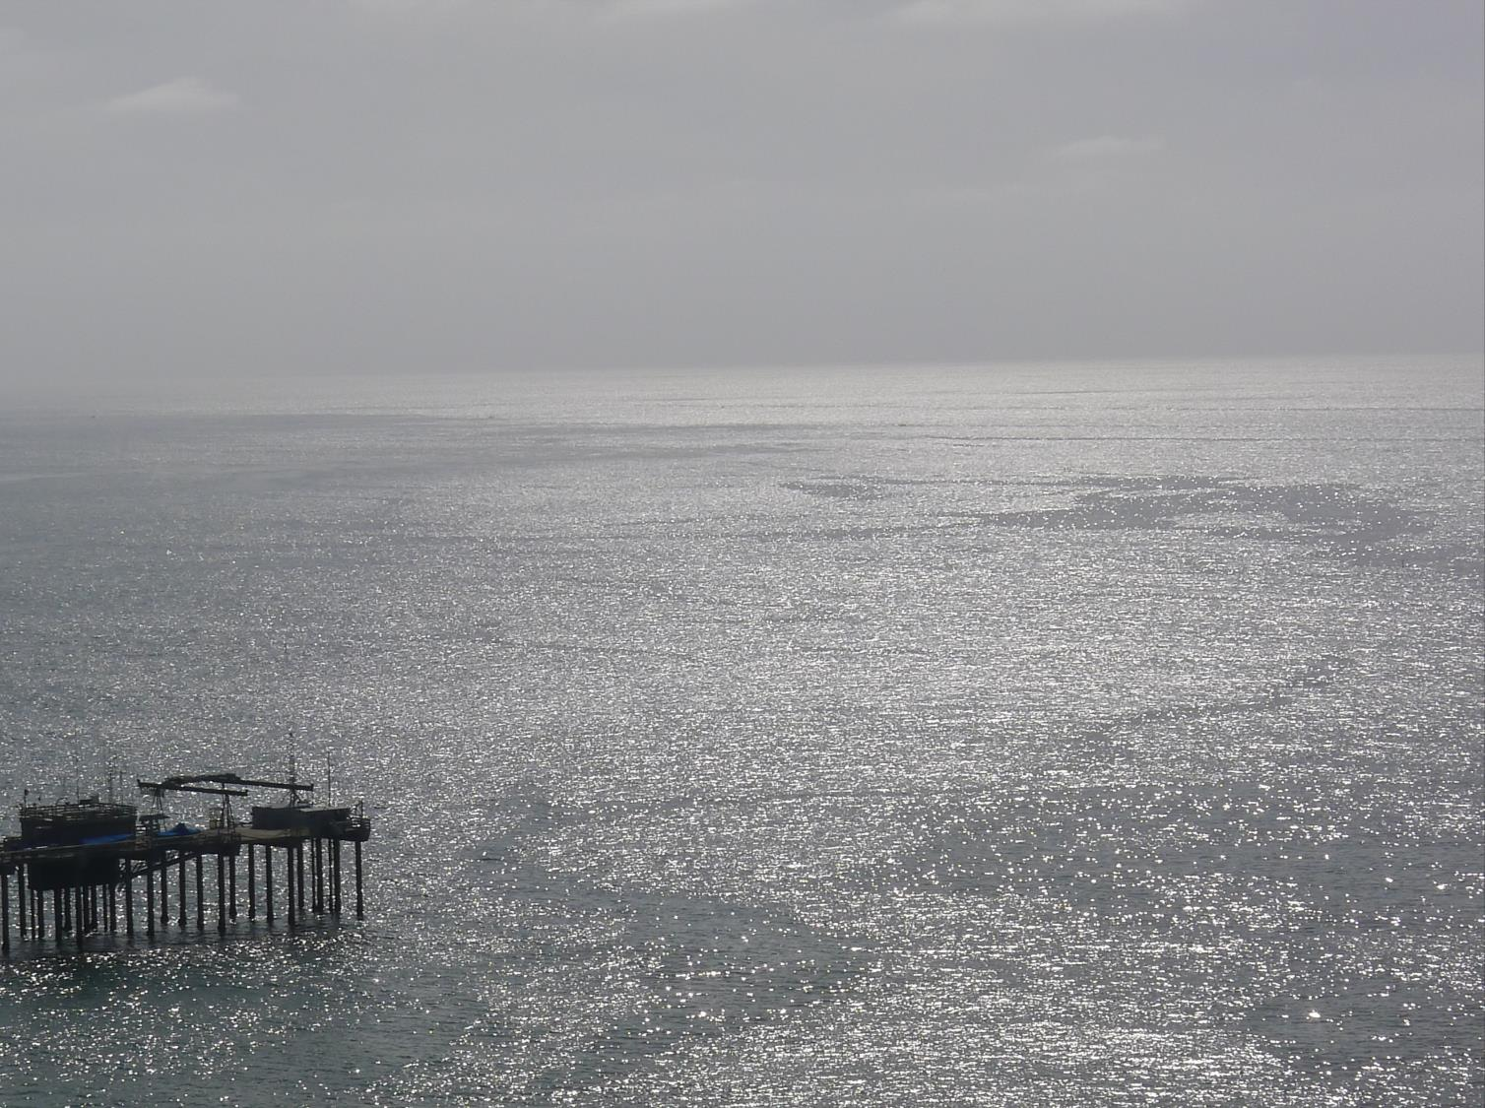
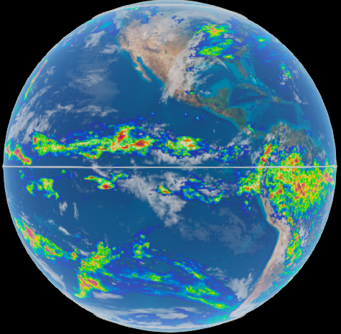
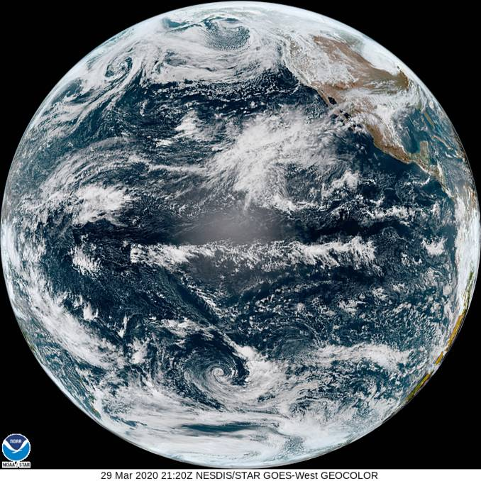
Ocean-Atmosphere Interaction and Climate
What determines recurrent patterns of climate variations?
Why are some climate events predictable, but some not?
How will climate change?
4/5/23
3/29/20
7-d precip
Vis
Notes:
1.1, 1.2, 2.1

Slide 5
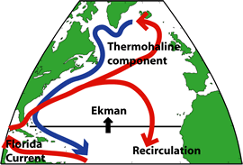
Ocean’s role in climate variability
Atmospheric mass = 10 m deep water
Atmospheric heat capacity = 4 m water
Ocean depth = 4,000 m
Ocean involved in seasonal cycle ~ 100 m
In additional to large heat content,
Ocean currents transport and redistribute the heat from one region to another.

Slide 6
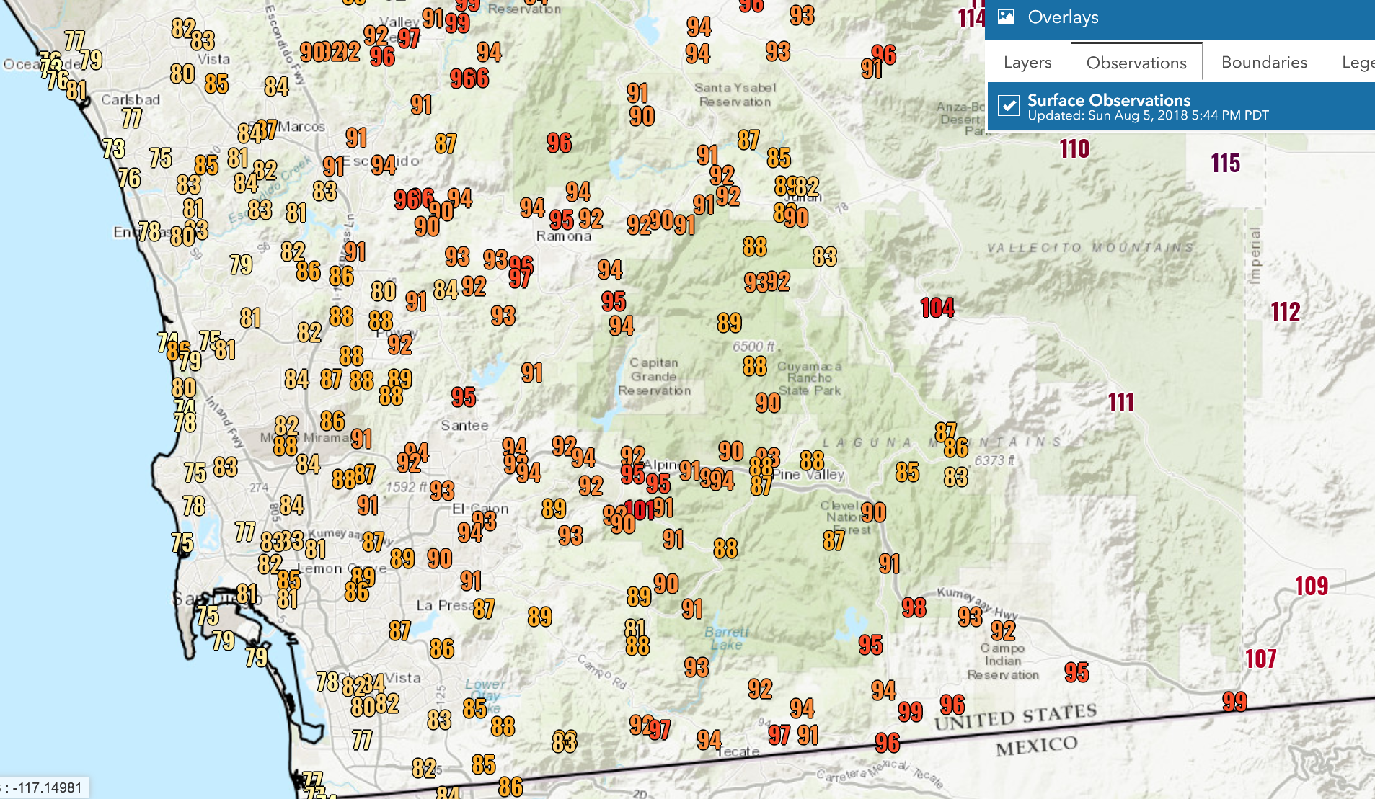
Ocean effect on temperature
8/5/2018, 4pm
Coastal
Inland
Mountain
Desert

Slide 7
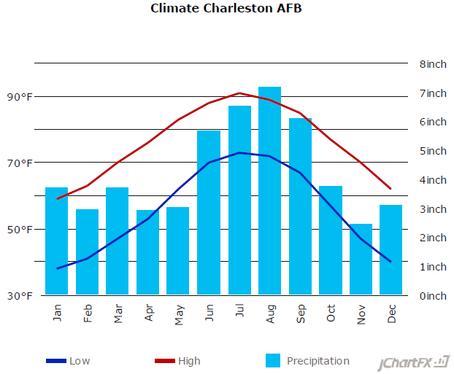
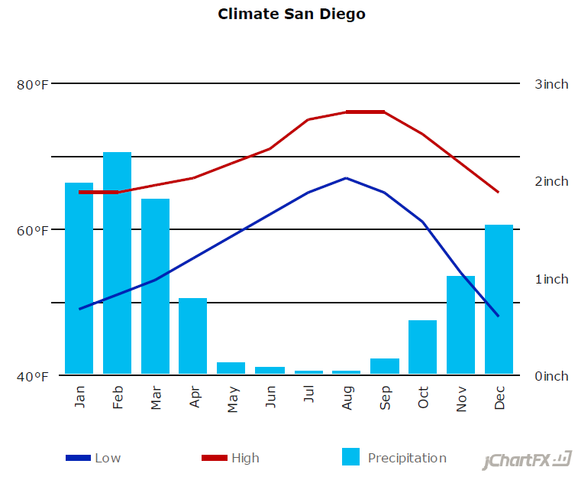
Ocean effects: contrast b/w West and East Coasts
San Diego: warm winter and cool summer. Why?
The westerlies bring warm marine air → mild winters.
Ocean conditioned by coastal upwelling in summer.
Charleston, SC, 32º47’
32º43’

Slide 8
Daily weather patterns propagate from west to east: regression of 300 mb v’ (daily anomaly). Chang et al. (1993, JAS)
Is the tropics important for weather forecast?
L
Monthly climate pattern w/ energy propagation from tropics along great circle: auto-correlation for 500 mb Z’ with 45N, 165W). Wallace & Gutzler (1981)
H
L

Slide 9
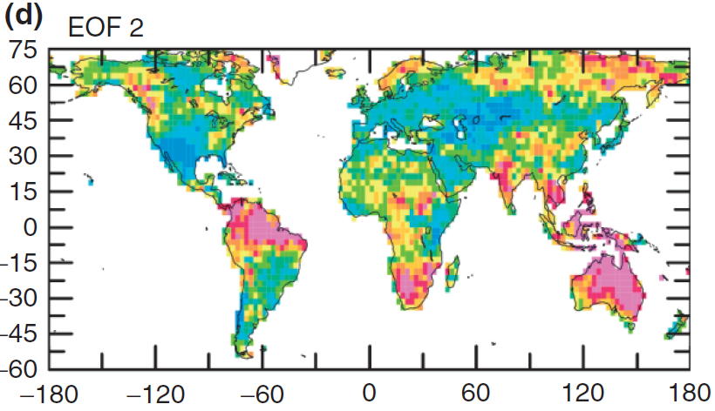
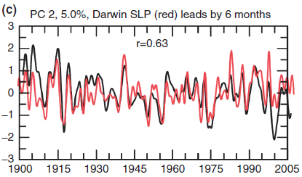
Why tropics?
Engine for global atmospheric circulation.
Tropical variability affects global climate.
Tight ocean-atmosphere coupling gives rise to predictability.
ENSO’s global influence on drought
La Nina
EOF2 of Palmer Drought Severity Index from 1900 to 2008. Red (blue) areas are anomalously wet (dry) for a positive value of PC. Dai (2011, WIREs Clim Change)
Notes:
Dai, A., 2011: Drought under global warming: A review. Wiley Interdisciplinary Reviews: Climate Change, 2, 45–65, DOI: 10.1002/wcc.81.

Slide 10
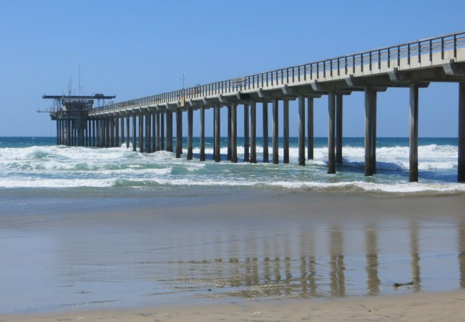
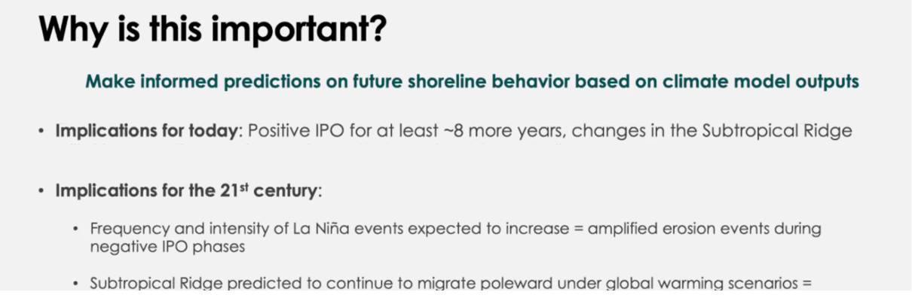
Coupled OA dynamics guiding data analytics
: statistical modes are not all predictable.
Which are predictable?
Correlate beach morphological variations with
El Nino/Southern Oscillation (ENSO),
Interdecadal Pacific Oscillation (IPO),
Annular Mode…
Is IPO predictable? Why?
Is the projection robust & reliable? Why?

Slide 11
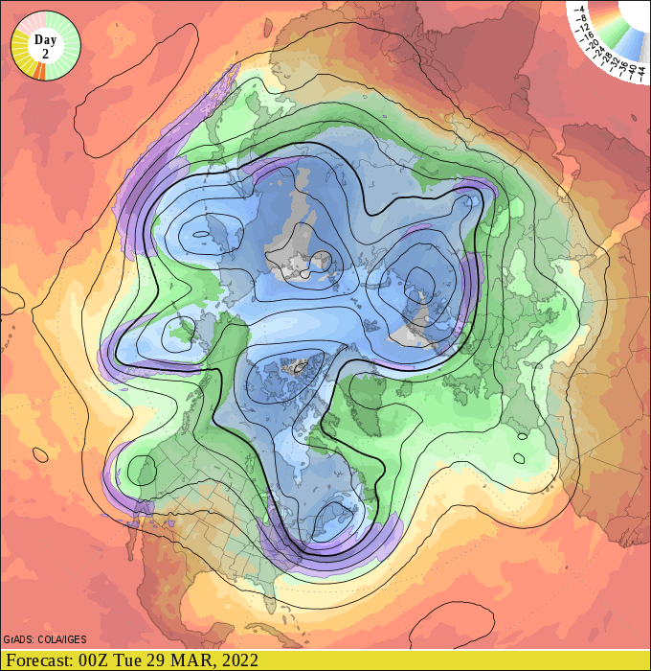
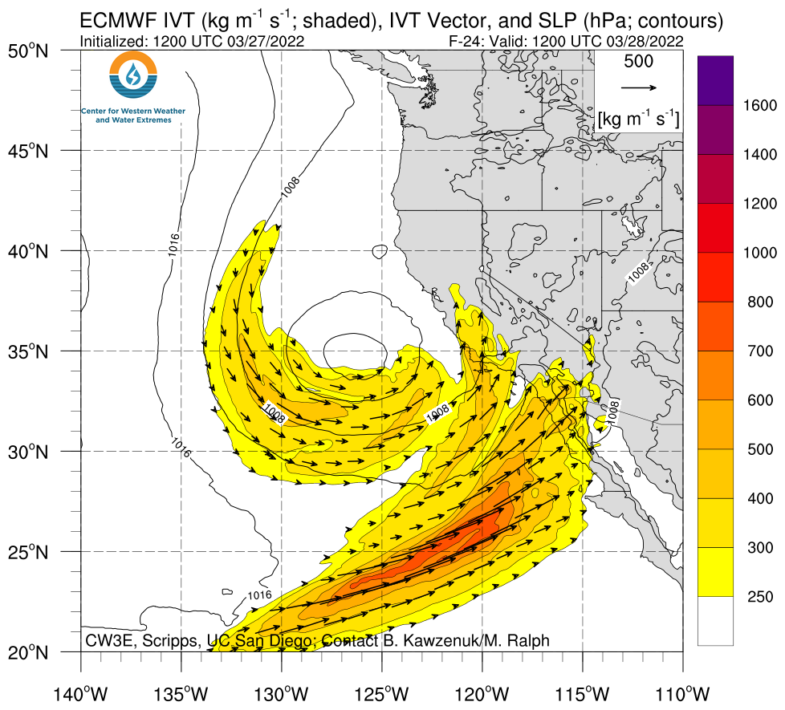
Weather Forecast: iterations of observation, physical understanding & modeling improve weather forecast (5-day forecasts are as good as 3-day ones in early 1980s).
Why has the forecast improved faster for the Southern than Northern Hemisphere?
Z & T at 500 hPa
ECMWF
____ NH
____ SH
Deep trough, atmospheric river & intense rainfall forecast for SoCal

Slide 12
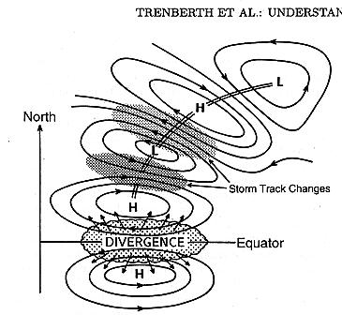
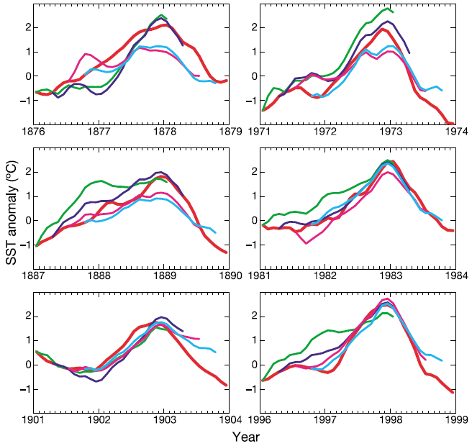
From Geographical to Dynamical
Climatology
Geography: Halley (1686), Koppen (~1900)
General circulation: Rossby, Charney, Sverdrup…; Gill (1982)…
Ocean-atmosphere interaction (ENSO): Bjerknes (1969)…
Climate modeling: Manabe (1974), Manabe & Bryan (1969)…CMIP
El Nino Prediction: A triumph of science
iterations of observations, physical understanding, and modeling.
El Nino predictions vs. obs. Chen et al. (2004, Nature).

Slide 13
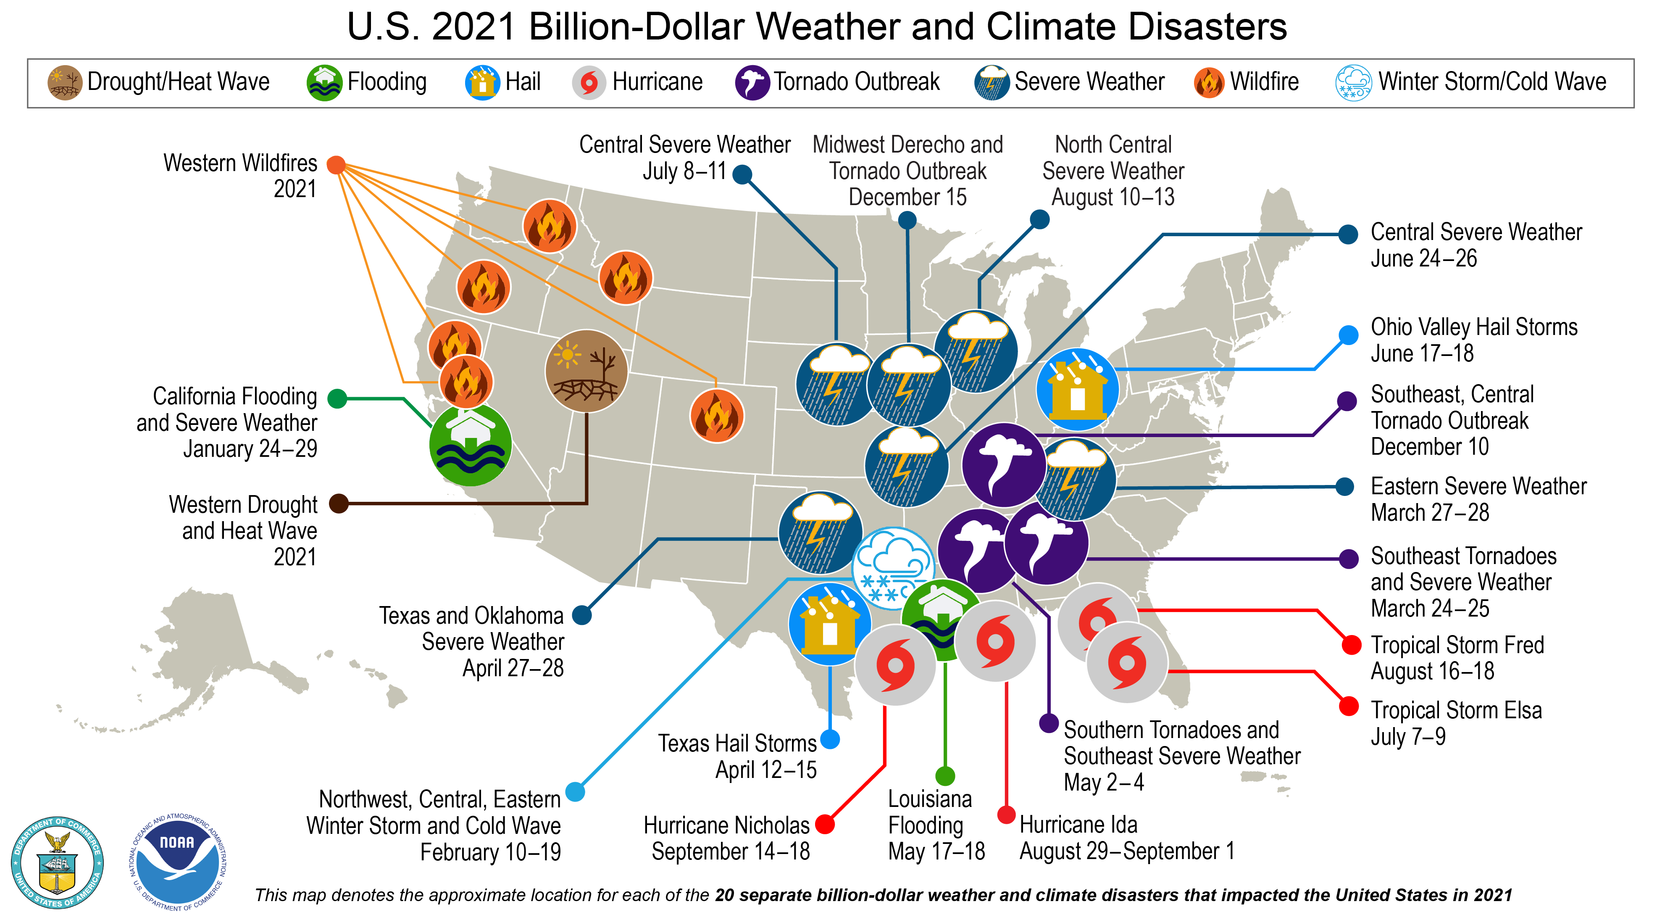
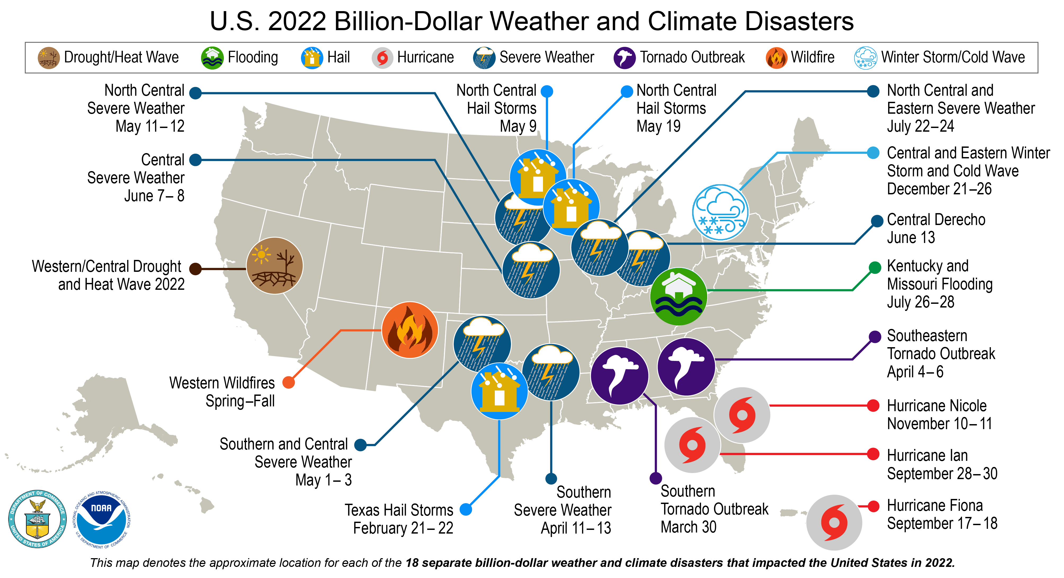
Climate in the news
Our class will enlighten how to read into some of these events.
Which recent climate disasters come to mind?
31 named tropical cyclones

Slide 14
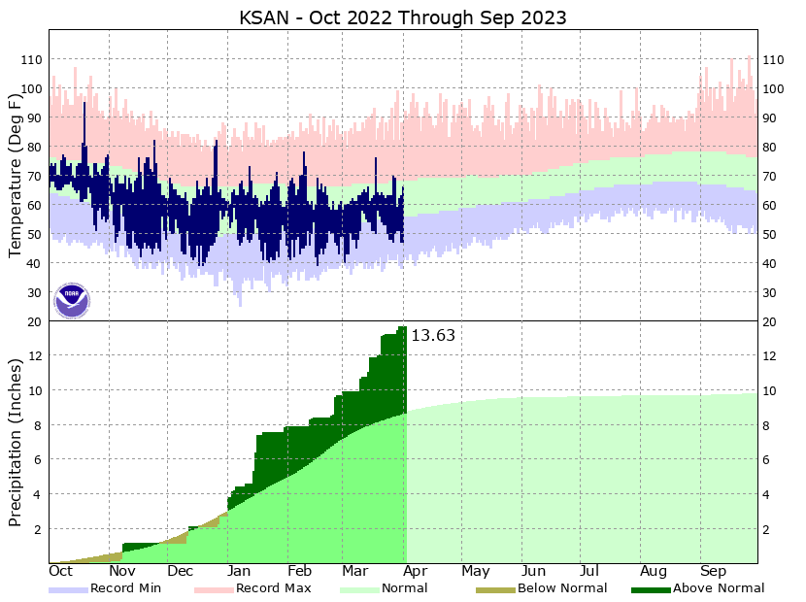
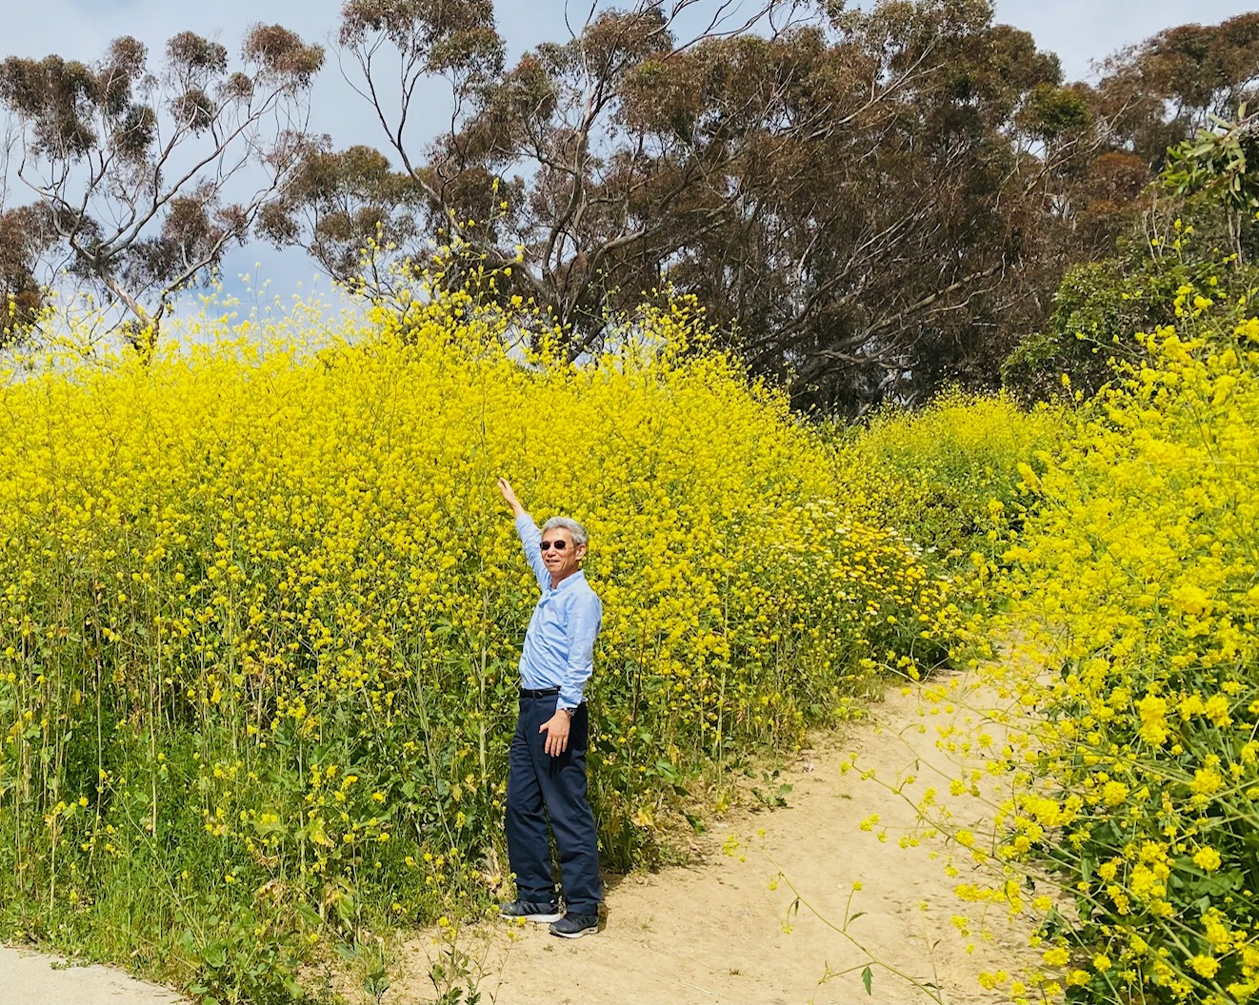
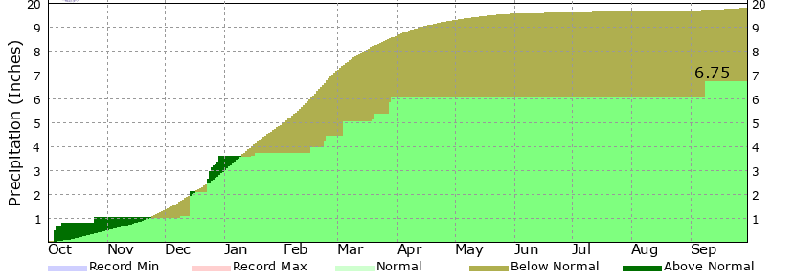
Super blooms at Scripps, San Diego (Apr 2023)
13
Accumulated rainfall SD airport
2022-23
13
climatology
10
10
2021-22 water year
Three years of La Nina: 2000/21-2022/23

Slide 15
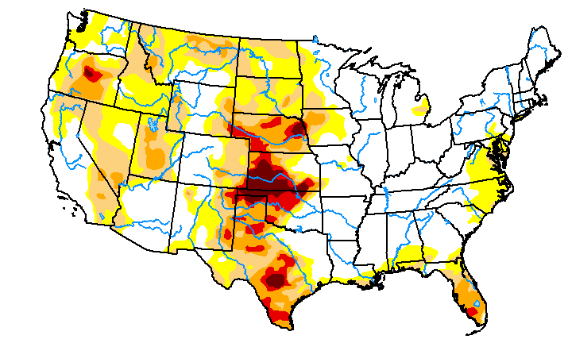
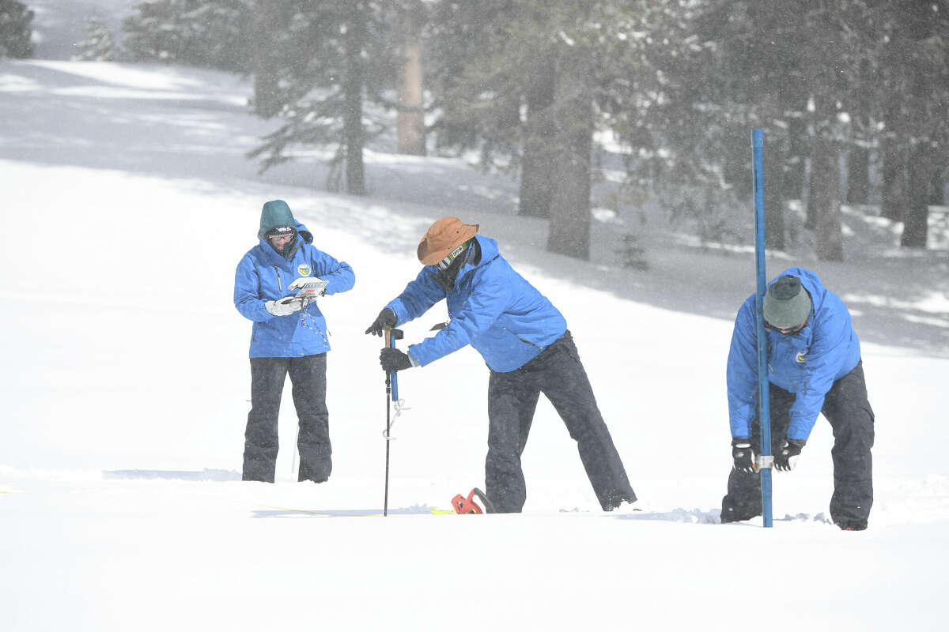
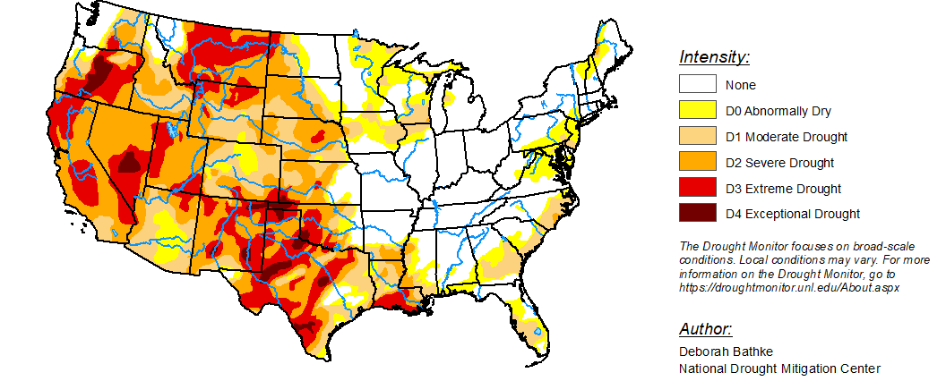
U.S. Drought Monitor
3/28/2023
Record Sierra snowpack (230%, 4/3/23)
U.S. Drought Monitor
3/29/2022

Slide 16
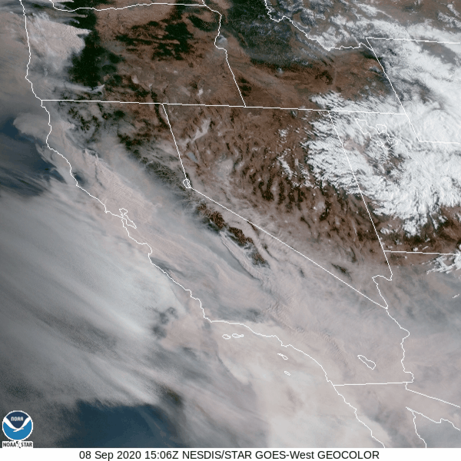
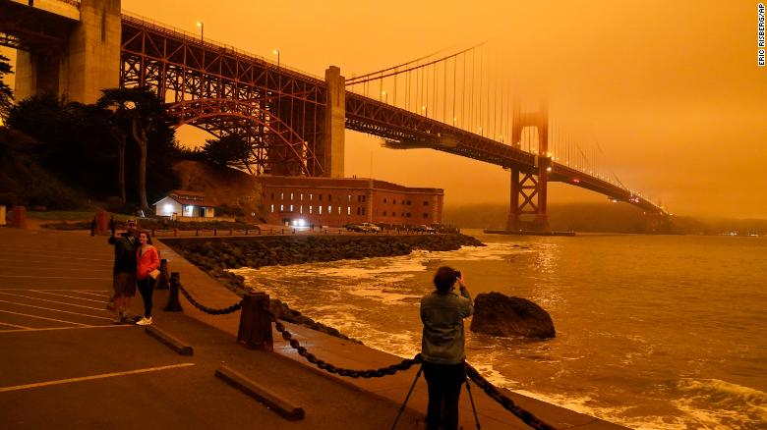
Climate change in action: Increased risk for wildfires
High temp & drier soil
Smaller, early-melting snowpack
Fall storms (Santa Ana)?
Winter storms & rainfall (fuel)?
Bay Area looks like Mars during the wildfires
https://www.cnn.com/2020/09/09/weather/california-orange-skies-wildfires-photos-trnd/index.html
Wildfire smokes
Notes:
apocalyptic

Slide 17
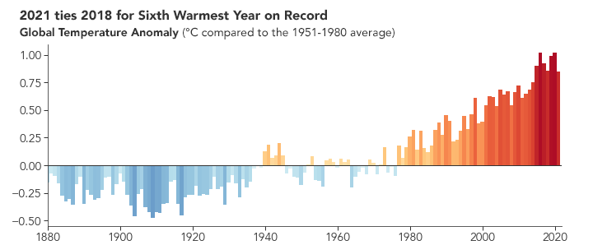
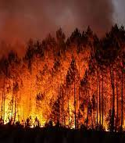
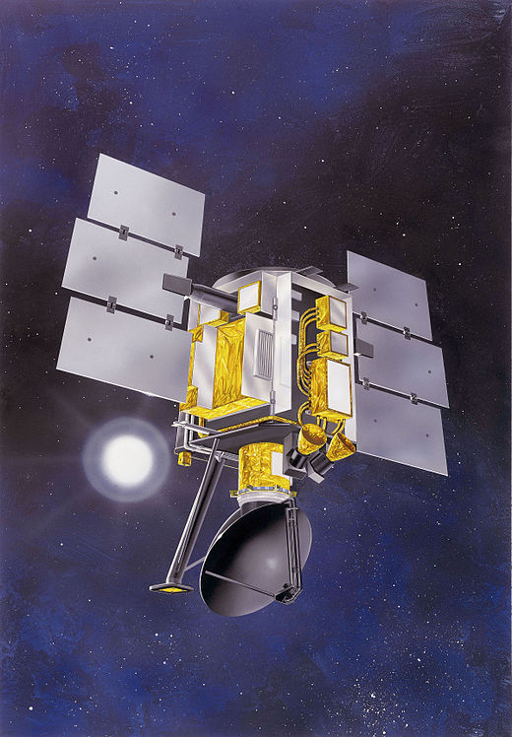
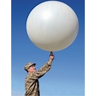
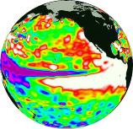

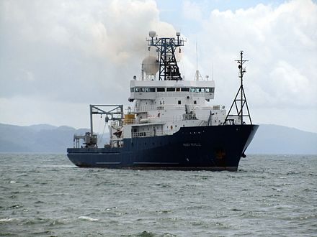
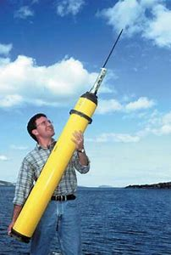
Instrumental observations of climate variability probe physical processes of paleoclimate and anthropogenic climate change.
Climate change
Ocean heat uptake, regional patterns, heatwaves
Global warming
Climate variability
El Nino, monsoon, drought, hurricanes, storm tracks
Climate Processes
Paleoclimate
Ice ages, green Sahara
ENSO
15ºC

Slide 18
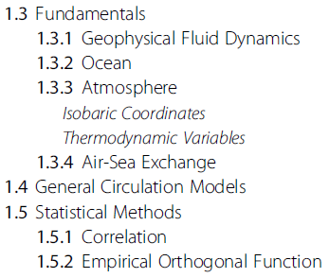
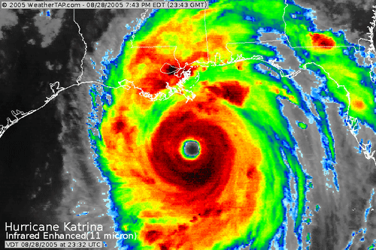
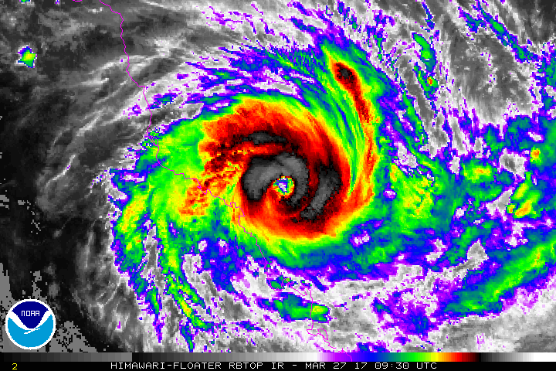
Tropical cyclone:
Counter-clockwise in NH
Clockwise in SH
20ºS
Tropical Cyclone Debbie Makes Landfall in Queensland, Australia at Category 4 Intensity

Slide 19
Class topics
1. Introduction & radiative imbalance
2. Zonal-mean circulation & energy transport
3. Convection and hydrological cycle
4. Equatorial waves & tropical atmospheric circulation
5. Madden-Julian Oscillation
6. Monsoons
7. Subtropical high and trade wind climate
8. Equatorial oceanography
9. Coupled feedback and tropical climate
10. El Nino/Southern Oscillation
11. ENSO cycle, predictability and teleconnections
12. Atlantic variability, large-scale control of tropical cyclones
13. Indian Ocean & monsoon variability
14. Extratropical variability
15. Extratropical modulations of tropical climate
16. Climate change
Atmos dynamics
Coupled dynamics

Slide 20
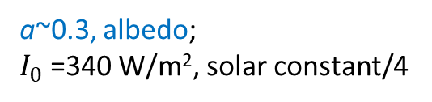


Radiative balance & greenhouse effect
A zero-dimensional model
I
for the glass sheet
Greenhouse effect
$σT_{s}^{4}$ $=I+σT_{1}^{4}$
on the ground
$$σT_{s}^{4}=2σT_{1}^{4}=2I=2(1−a)I_{0}$$
a~0.3, albedo;
$I_{0}$=340 W/m², solar constant/4
T₁= -19ºC = 252K, at which Earth emits IR.
Ts/T₁=2^{1/4} ~ 1.19 ← greenhouse effect; observed Ts~15ºC=288K.

Slide 21
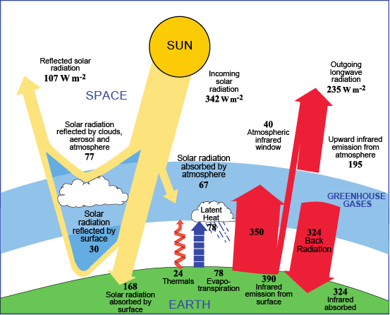
Energy balance, gray atmosphere, greenhouse effect
31
100
69
20
7
23
-50
Greenhouse effect
9
49
-7
-23
-114
95
Solar
Sensible
Latent
Infrared
Fig. 2.3. (left) Energy flow though the global climate system (Hartmann 2016). (right) Energy budget at the top of the atmosphere, for the atmosphere and at the ground surface. The fluxes are normalized by the downward solar radiation at TOA. Most of solar radiation absorption takes place at the Earth surface, and the atmosphere is mostly heated from beneath.
Ocean-atmosphere interaction determines how solar energy absorbed on ground is used to heat the atmosphere.
Notes:
Focus on heat balance of the ground, which receives 95 units infrared radiation from the atmosphere (greenhouse effect).

Slide 22
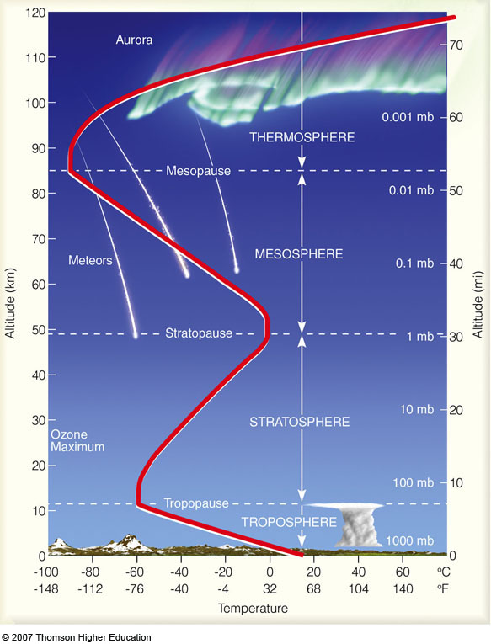


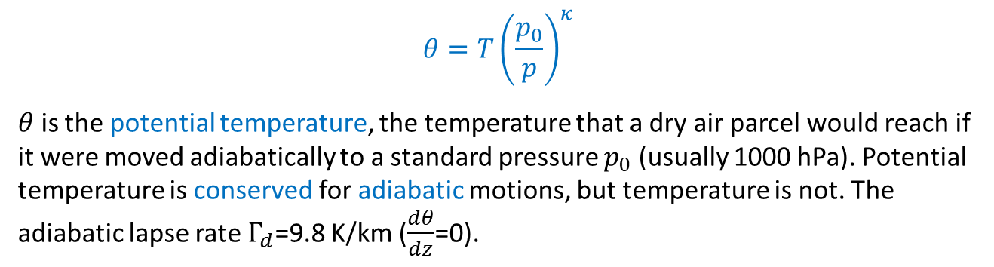

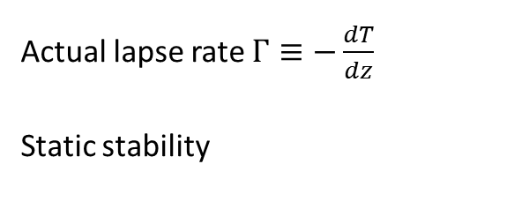

Review (SIOC 217A)
Thermodynamic variables of the compressible atmosphere
$$θ=T{\left(\frac{p_{0}}{p}\right)}^{κ}$$
$θ$ is the potential temperature, the temperature that a dry air parcel would reach if it were moved adiabatically to a standard pressure $p_{0}$ (usually 1000 hPa). Potential temperature is conserved for adiabatic motions, but temperature is not. The adiabatic lapse rate $Γ_{d}$=9.8 K/km ($\frac{dθ}{dz}$=0).
Vertical structure
Actual lapse rate $Γ≡−\frac{dT}{dz}$
Static stability
Stratosphere
$$\frac{g}{θ}\frac{dθ}{dz}=\frac{g}{T}\left(Γ_{d}−Γ\right)$$
Altitude (km)
$$Γ$$
$$Γ_{d}$$
In troposphere, ${Γ<Γ}_{d}$. Why?
Temperature

Slide 23
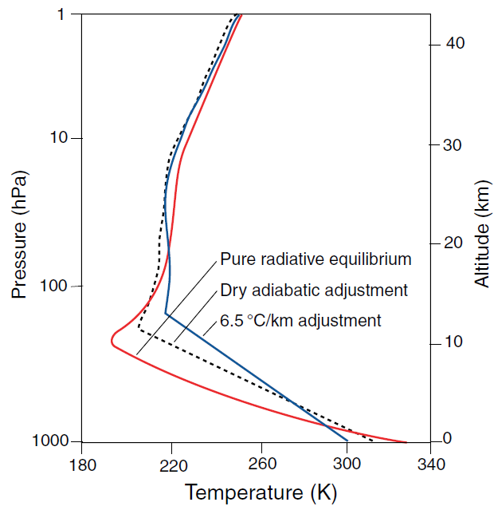
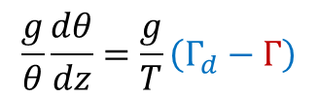

Radiative equilibrium
Radiative equilibrium is gravitationally unstable (${Γ>Γ}_{d}$).
Why?
Atmosphere is heated from below
nearly transparent to visible light,
infrared-absorbing water vapor trapped near surface.
9.8 K/km
Temp minimum: Tropopause
$$\frac{g}{θ}\frac{dθ}{dz}=\frac{g}{T}\left(Γ_{d}−Γ\right)$$
Static stability
Notes:
Compare the red and dashed curves near the surface. Explain lapse rate, adiabatic, potential temp

Slide 24
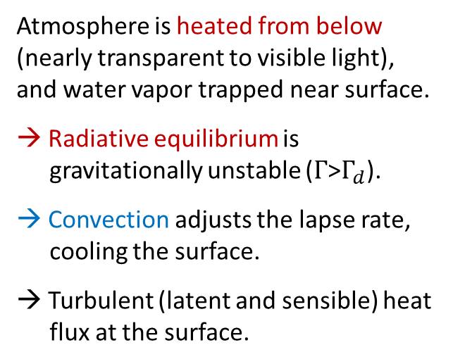
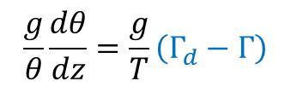
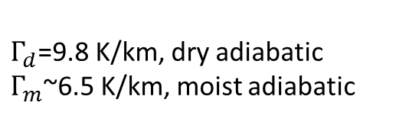
Radiative-convective equilibrium
Atmosphere is heated from below (nearly transparent to visible light), and water vapor trapped near surface.
→ Radiative equilibrium is gravitationally unstable ($Γ$>$Γ_{d}$).
→ Convection adjusts the lapse rate, cooling the surface.
→ Turbulent (latent and sensible) heat flux at the surface.
$$\frac{g}{θ}\frac{dθ}{dz}=\frac{g}{T}\left(Γ_{d}−Γ\right)$$
Static stability
$Γ_{d}$=9.8 K/km, dry adiabatic
$Γ_{m}$~6.5 K/km, moist adiabatic
Wallace & Hobbs (2006) based on Manabe & Strickler (1964)

