Slide 1
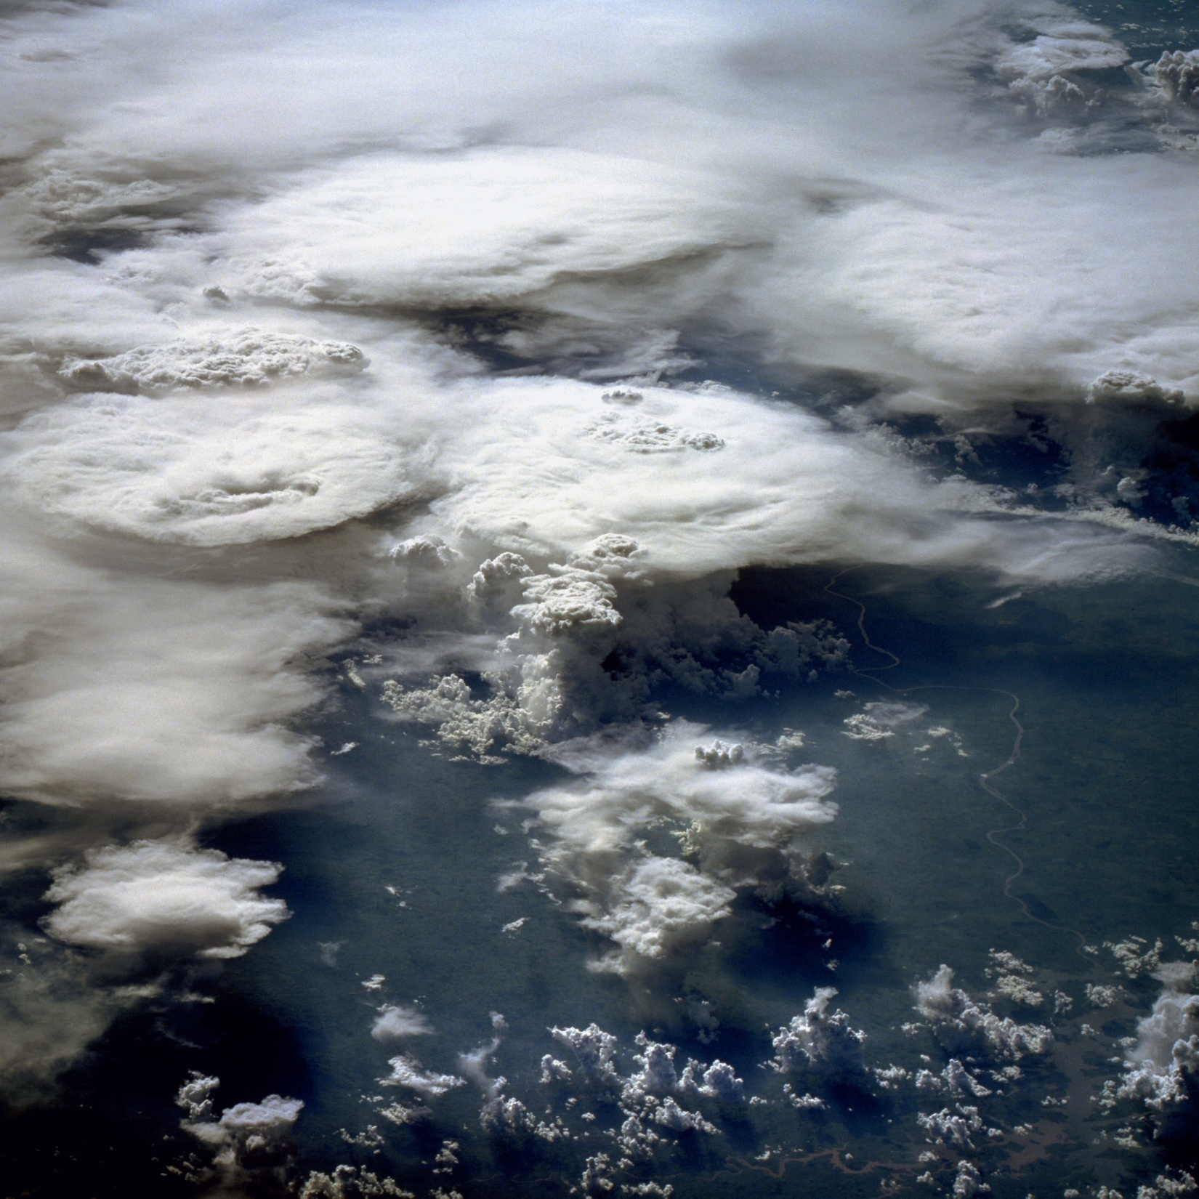
3. Tropical rain bands, and hydrological cycle
This image over Southern Brazil, taken from the space shuttle by an astronaut in February 1984, shows a mixture of cold and warm clouds. Warm clouds, consisting of individual cumuli clouds are found near the bottom of the image. The tops of these warm clouds are generally found below 3.1 miles (5 kilometers).
Cold clouds, with large anvils rising typically above 6.2 miles (10 km) dominate the top and left portions of the image. The feathery edge of the anvil indicates a cold rain process, called glaciation. These clouds are capable of producing very heavy rain and thunderstorms.
Near the center, about a third and half way from the bottom are cumulus congestus clouds, which can produce rain, and can rise to just above the freezing level near 3.1 miles (5 km), and are still considered warm clouds.
Notice the way warm clouds are also found underneath cold clouds, as indicated near the center of the picture.
--NASA
Small OLR
Large OLR
Cold and warm clouds seen from space
Notes:
3.1, 3.2, 3.3

Slide 2
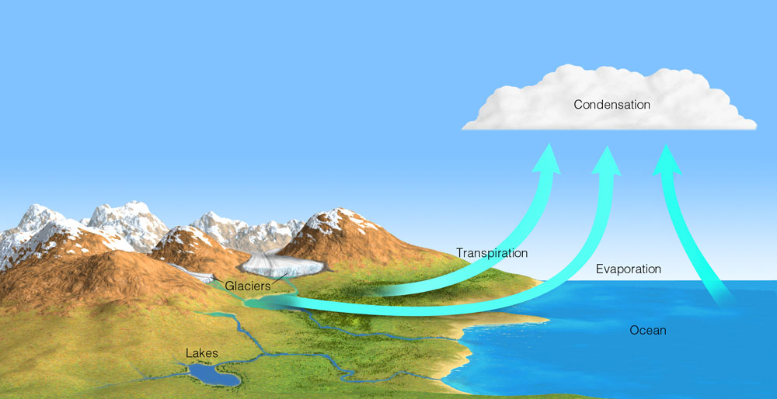
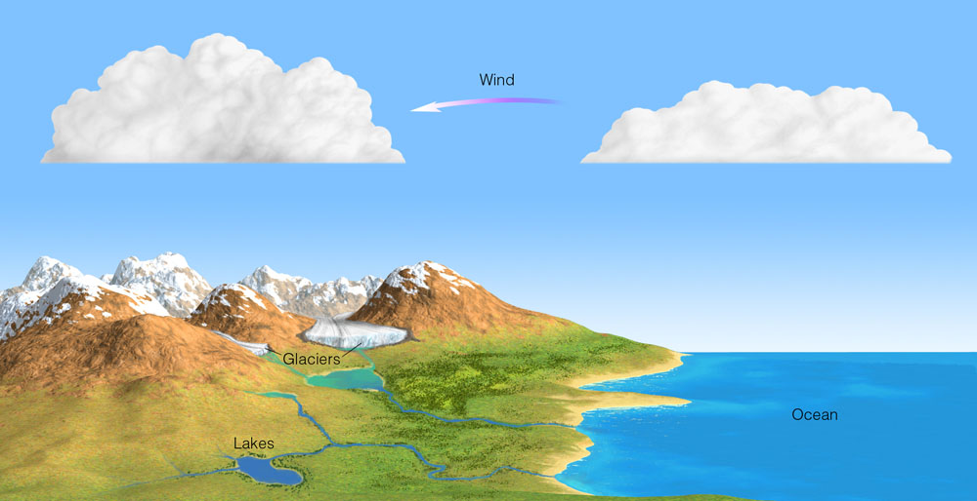
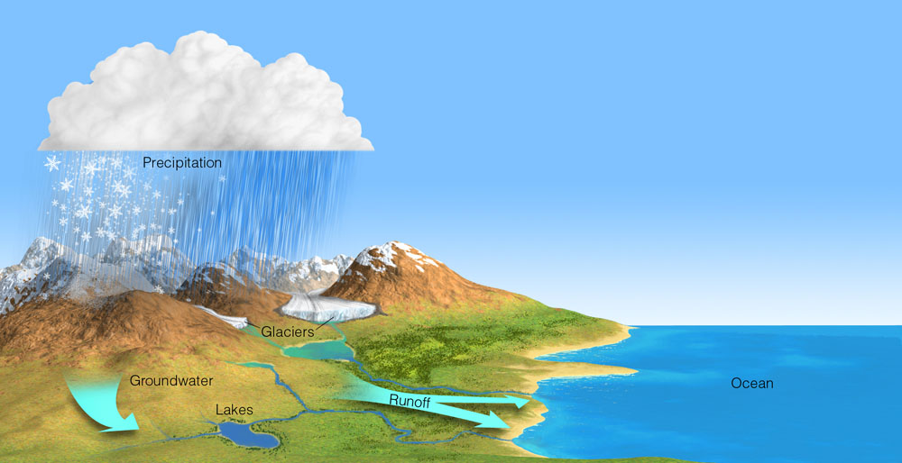
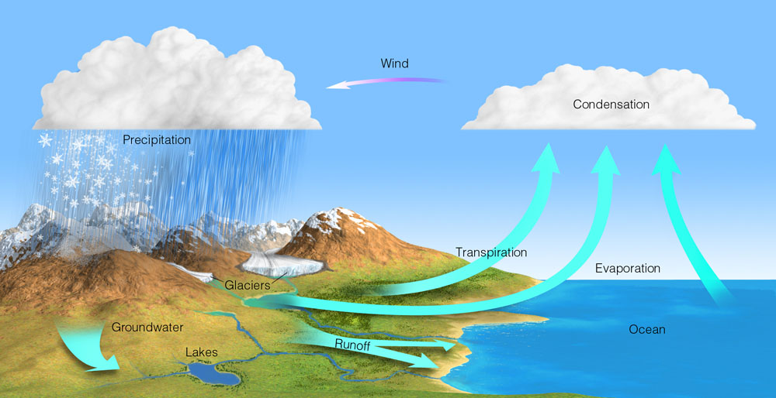
The Earth’s Hydrologic Cycle
Evaporation: 85% over ocean & 15% over land
Globally averaged, evaporation & precipitation are 1 m each year.
Notes:
Figure 4.1: The hydrologic cycle.

Slide 3
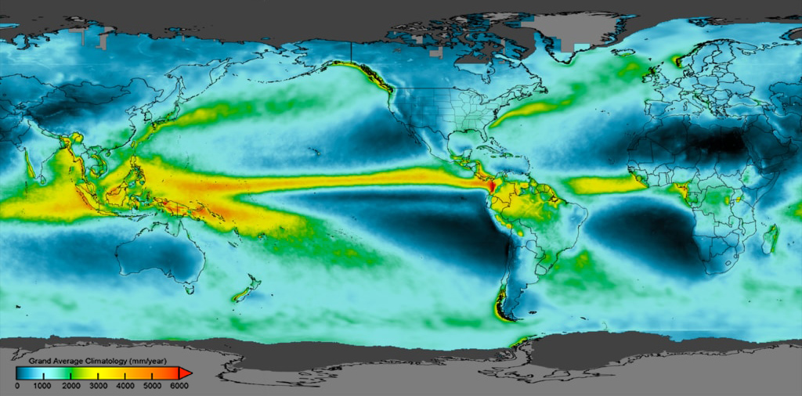
Rain bands are collocated with low-level convergence zones.
Storm track
Storm track
ITCZ
ITCZ
ITCZ
SPCZ
SACZ
Annual precip
ITCZ: Intertropical convergence zone
SPCZ: South Pacific convergence zone
SACZ: South Atlantic convergence zone
Latent heating drives atmospheric circulation
Notes:
https://gpm.nasa.gov/sites/default/files/2020-06/grand_average_climatology2_black_print.jpg

Slide 4
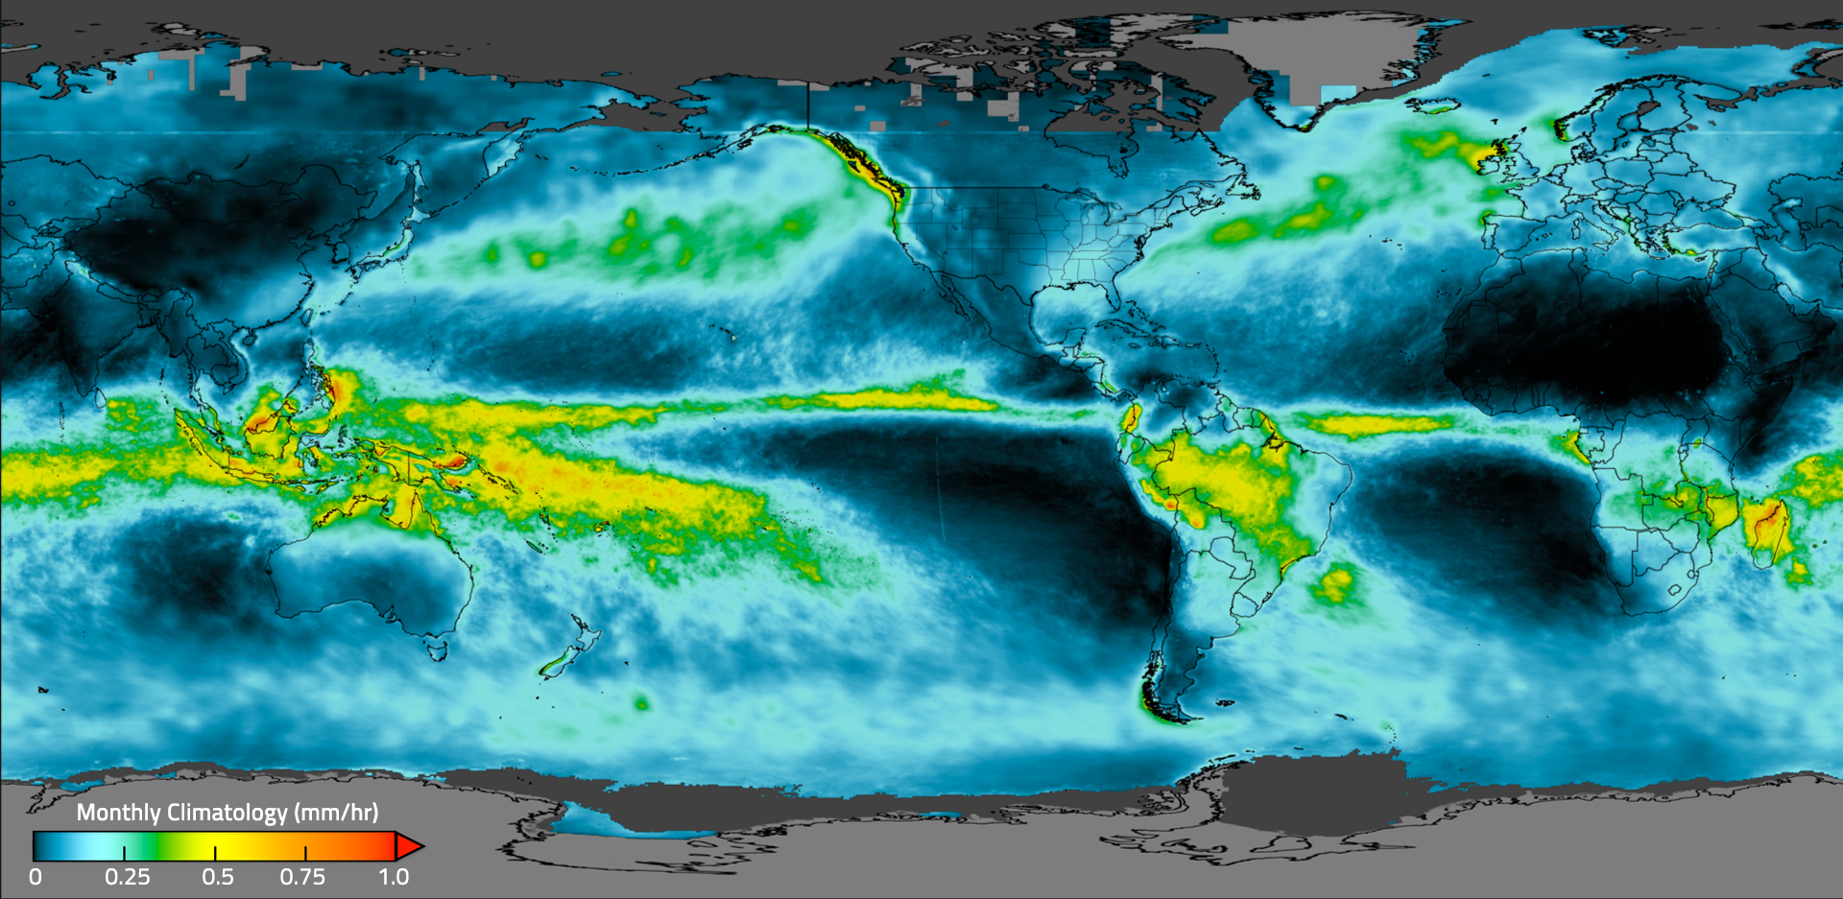
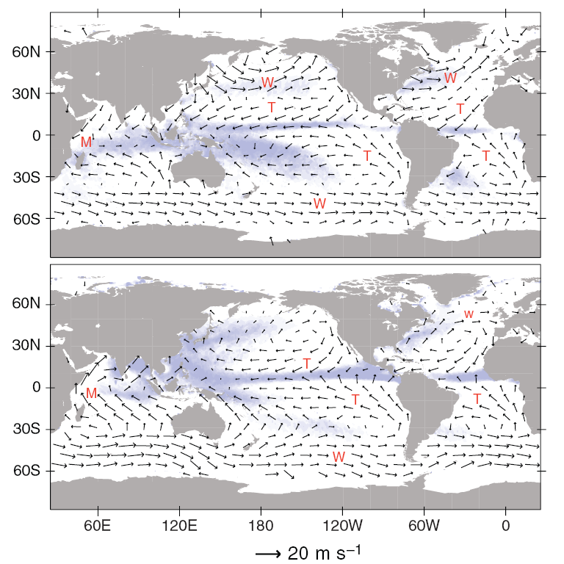
Rain bands are collocated with low-level convergence zones. Why?
ITCZ
SPCZ
Collocation of surface convergence and rainfall arises from water vapor budget and deep latent heating that drives atmospheric circulation.
SACZ
January
Fig. 3.3
DJF Sfc wind & precip (WH05)

Slide 5
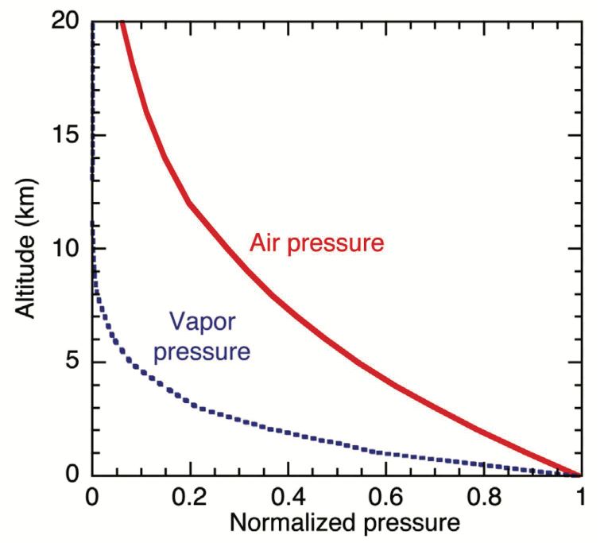
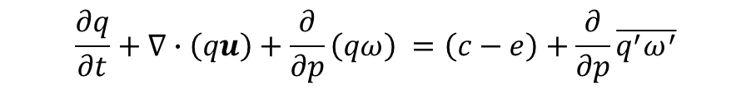

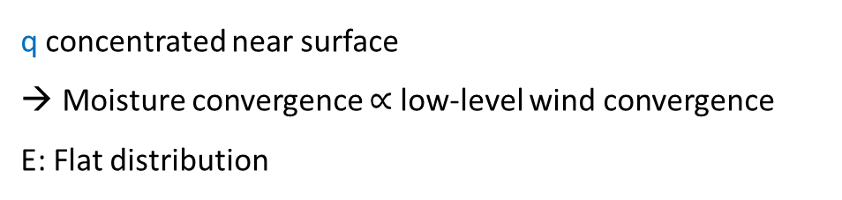




Water vapor budget
Condensation
turbulence
$$\frac{∂q}{∂t}+∇∙\left(qu\right)+\frac{∂}{∂p}\left(qω\right) =\left(c−e\right)+\frac{∂}{∂p}\overline{q^{′}ω^{′}}$$
$$q≡\frac{ρ_{v}}{ρ}=0.68\frac{e}{p}$$
$$\left\langle ∙\right\rangle ≡\int_{0}^{ps}{\left(∙\right)\frac{dp}{g}}$$
column-integrated, time-average
$$∇∙\left\langle qu\right\rangle =E−P$$
q concentrated near surface
Moisture convergence $∝$ low-level wind convergence
E: Flat distribution
Why is water vapor trapped near the surface?
Clausius-Clapeyron Eq.
$$e_{s}=e_{0}e^{α(T−T_{0})}$$
$α$=0.065 K⁻¹
Fig. 3.4
Notes:
Fig. 4

Slide 6
CMAP precip & SST (>27ºC)
Ann-mean
SST threshold for deep convection, currently at ~ 27ºC.
DJF, 23.5°S–23.5°N
Figs. 3.3, 3.6

Slide 7
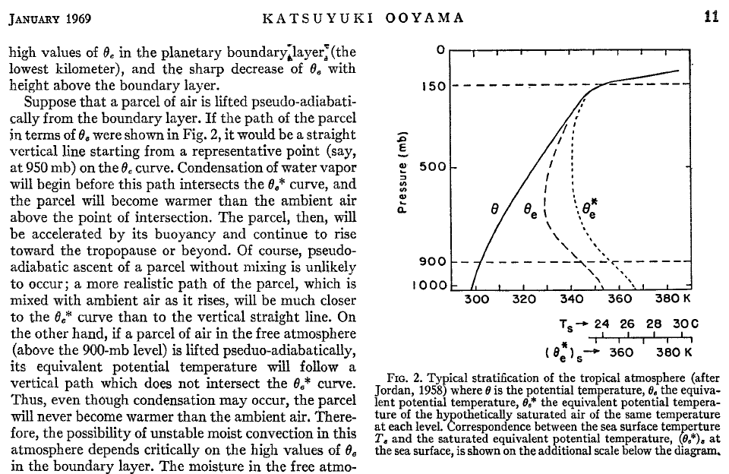

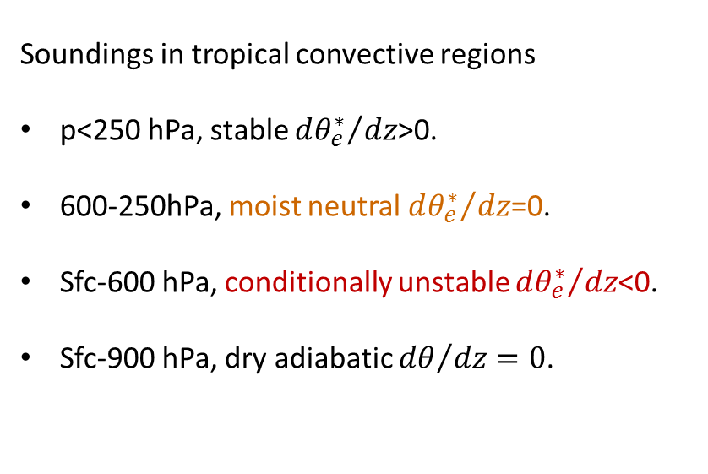
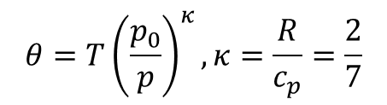
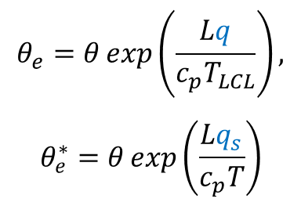
potential temperature
equivalent potential temperature
$$θ=T{\left(\frac{p_{0}}{p}\right)}^{κ}, κ=\frac{R}{c_{p}}=\frac{2}{7}$$
$$\left.θ_{e}=θ\exp\left(\frac{Lq}{c_{p}T_{LCL}}\right.\right),$$
$$θ_{e}^{∗}=θ\exp\left(\frac{Lq_{s}}{c_{p}T}\right)$$
c_{p}T d(lnθ) = ds
c_{p}T d(lnθ_{e}) = dm
Soundings in tropical convective regions
p<250 hPa, stable ${dθ_{e}^{∗}}/{dz}$>0.
600-250hPa, moist neutral ${dθ_{e}^{∗}}/{dz}$=0.
Sfc-600 hPa, conditionally unstable ${dθ_{e}^{∗}}/{dz}$<0.
Sfc-900 hPa, dry adiabatic ${dθ}/{dz}=0$.

Slide 8

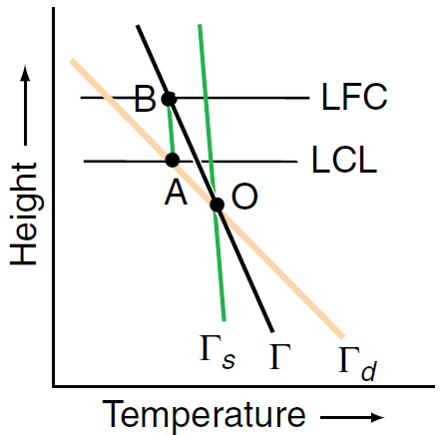


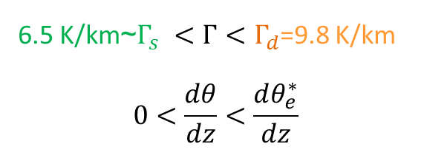
Conditional instability: parcel becomes unstable when lifted above LFC (B).
6.5 K/km~$Γ_{s} <Γ<Γ_{d}$=9.8 K/km
$$0<\frac{dθ}{dz}<\frac{dθ_{e}^{∗}}{dz}$$
$$T^{′}−T>0$$
A→B→, moist adiabatic; B: Level of free convection
O→A, dry adiabatic; A: Lifting condensation level
$$N^{2}=\frac{ g}{θ}\frac{dθ}{dz}=\frac{ g}{T}\left(Γ_{d}−Γ\right)$$

Slide 9

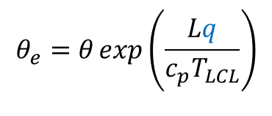

How does an SST decrease affect convection, e.g., height?
Reduced SST lowers cloud top height.
No moist convection for $θ_{e}$(z=0) < $θ_{e}^{∗}$(500 mb); threshold.
LNB: Level of neutral buoyancy
Rising plume
LFC: Level of free convection
LCL: Lifting condensation level
$$θ=T{\left(\frac{p_{0}}{p}\right)}^{κ}$$
$$\left.θ_{e}=θ\exp\left(\frac{Lq}{c_{p}T_{LCL}}\right.\right)$$
Fig. 3.5
Notes:
9
Fig. 7. The tropical atmosphere is stably stratified for dry convection but conditionally unstable for deep moist convection: d(theta)/dz > 0 but d(theta*_e)/dz < 0 in the lower troposphere. In upward motion, an air parcel initially at the surface will reduce its temperature, eventually causing condensation and cloud formation. At the lifting condensation level, the air parcel still has a temperature cooler than the surrounding. Continuing upward, condensational heating warms the parcel, and at the level of free convection (where τηετα−e*(p)= surface theta-e), its temperature equals the ambient. Further above, the air parcel has positive buoyancy for free convection. Thus, whether deep convection takes place depends on the moisture content in the surface layer. Mean relative humidity at the sea surface is around 80% so both sea surface temperature (SST) and surface wind convergence are important for convection.
Frequent convection in the tropics neutralized the conditional instability. In the mid-troposphere, temperature stratification is close to moist adiabatic, with d(theta*_e)/dz ~ 0.
For an air parcel rising at LFC with the environmental theta_e (blue line), its initial theta_e never exceeds the environmental theta*_e and thus cannot rise by its own.
For a lower SST, the environmental theta and theta_e both drop like the green curves. An air parcel initially at the surface can eventually become freely convective, but reaching a lower cloud top (LNB).

Slide 10
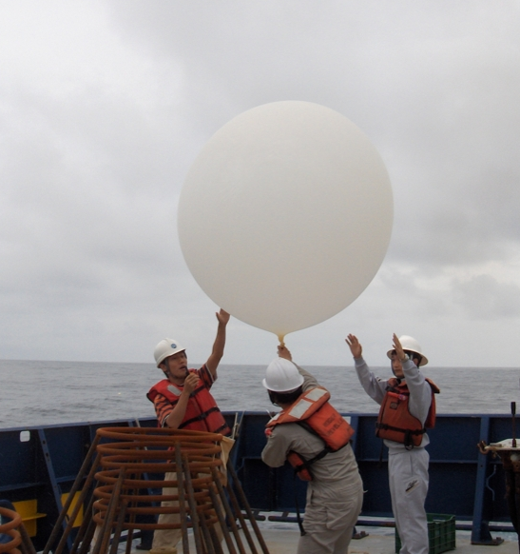



What happens in deep convection?
Diagnosis from atmospheric sounding network
$$∇∙u +\frac{∂ω}{∂p}=0$$
$$ω≡\frac{dp}{dt}$$
s
m
m*
Pressure
Soundings
Is it possible to compute $∇∙u$ from an array of soundings in midlatitudes?
4-time daily, April 15-July 22, 1956; Marshall Islands, 165E, 10N (Yanai et al. 1973)
Atmospheric moist energy: m=c_{p}T+gz+Lq ; dm=c_{p}T d(lnθ_{e})
Dry energy: s=c_{p}T+gz ; ds=c_{p}T d(lnθ)
Fig. 3.7
Notes:
Fig. 4

Slide 11
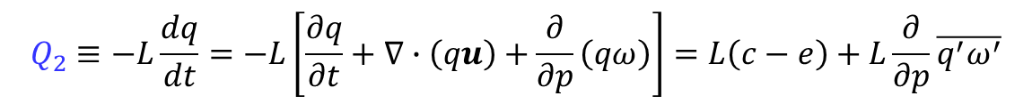
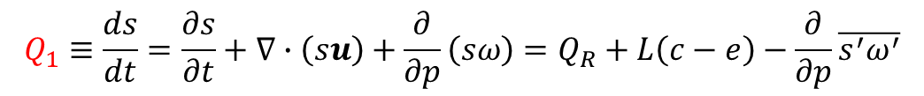
Estimate diabatic heating
Soundings
condensation
turbulence
radiation
Energy budget:
Apparent heat source
$$Q_{1}≡\frac{ds}{dt}=\frac{∂s}{∂t}+∇∙\left(su\right)+\frac{∂}{∂p}\left(sω\right)=Q_{R}+L\left(c−e\right)−\frac{∂}{∂p}\overline{s^{′}ω^{′}}$$
Water vapor budget:
Apparent moisture sink
$$Q_{2}≡−L\frac{dq}{dt}=−L\left[\frac{∂q}{∂t}+∇∙\left(qu\right)+\frac{∂}{∂p}\left(qω\right)\right]=L\left(c−e\right)+L\frac{∂}{∂p}\overline{q^{′}ω^{′}}$$
condensation
turbulence
Q1
Q2
4-time daily, April 15-July 22, 1956; Marshall Islands, 165E, 10N (Yanai et al. 1973)
Notes:
Fig. 4

Slide 12
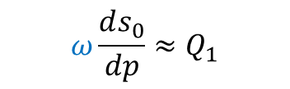

Nearly const in vertical
s
m
m*
$$ω\frac{ds_{0}}{dp}≈Q_{1}$$
→ ω & Q1 share a similar vertical profile.
$$ω≡\frac{dp}{dt}$$
Pressure

Slide 13
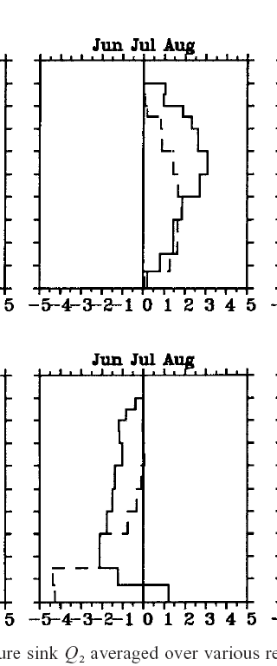

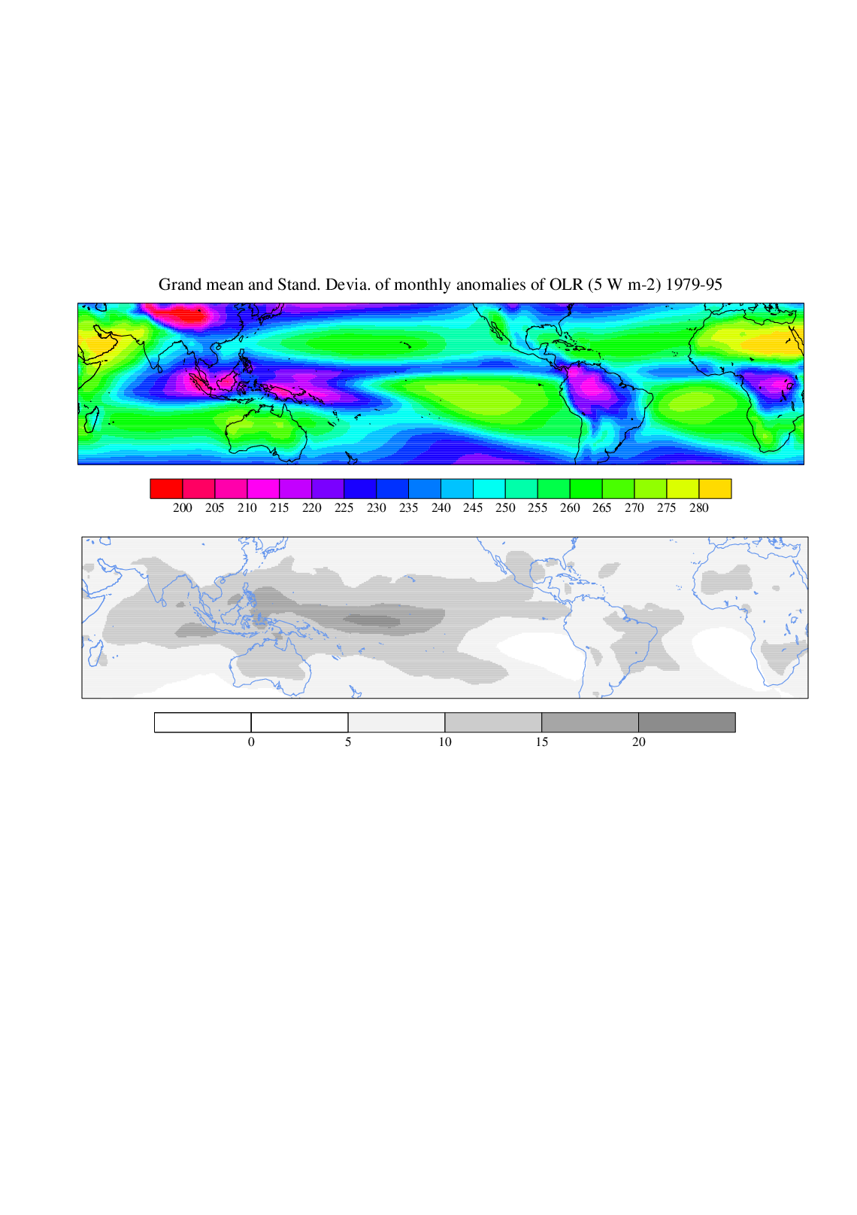
Estimate diabatic heating
NW Pac
In deep convective regions, diabatic heating peaks around 400-500 mb.
Q1
Q2
Pressure (mb)
OLR
SE Pac
In subsidence regions, radiative cooling and moistening of the boundary layer (Q2<0) by surface evaporation.
Q1
Q2
Fig. 3.8
Vertical profiles of heat source Q1 & moisture sink Q2. Yanai & Tomita (1998)
Notes:
NWP: Q1>Q2 ← latent heat of freezing + turbulent mixing of sensible heat

Slide 14
Baroclinic overturning circulation dominates tropics
Deep convective heating that peaks at mid-troposphere.
Radiative cooling in subsidence.
z
x
Notes:
The Hadley circulation is an important agent for energy transport in the tropics. Potential temperature is stably stratified, increasing upward. The Hadley circulation transports dry static energy (s=cpT+gz; cpT d(ln theta) = ds) poleward, with higher potential-temperature air flowing poleward. In the moist atmosphere, things are slightly different as humidity is trapped in the lower troposphere and decreases rapidly upward. The Hadley circulation transports the latent energy equatorward by the equatorward flow near the surface. The moist static energy is greater at the tropopause than at the surface, leading a net poleward transport of moist static energy. Because of the opposing effects in transporting temperature and humidity, the total energy transport by the Hadley circulation is much weaker than the transport in the midlatitudes, where eddies transport both temperature and moisture poleward. Because of this efficient eddy transport, the atmospheric energy transport features a pronounced peak in the midlatitudes.
Back, L. E, and C. S. Bretherton, 2006: Geographic variability in the export of moist static energy and vertical motion profiles in the Tropical Pacific. Geophys. Res. Lett., 33, L17810, doi:10.1029/2006GL026672.

Slide 15
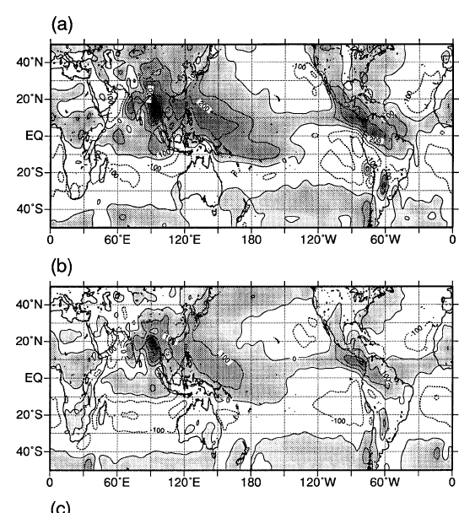

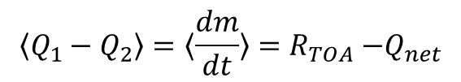


Estimate diabatic heating
Two sides of precipitation: Hydrological cycle (water balance) and condensational heating
Q1
column-integrated diabatic heating
$$〈Q_{1}〉=〈Q_{R}〉+LP+Q_{H}$$
Condens. heating
Sfc sensible heat
column-integrated moisture sink
Q2
$〈Q_{2}〉=L(P−E)$
Precip.
Sfc evap
Radiation~80 W/m²
Sfc flux ~0
$$〈Q_{1}−Q_{2}〉=〈\frac{dm}{dt}〉=R_{TOA}{−Q}_{net}$$
In convective regions, why $R_{TOA}$>0 & $Q_{net}$~0?
Vertically integrated (a) heat source Q1, and (b) moisture sink Q2 for JJA. (Yanai & Tomita 1998, JC)
Notes:
Vertically integrated Q1 = precip + radiation (TOA-sfc) + sfc sensible flux
Vertically integrated Q2 = precip – evaporation at the surface.

Slide 16
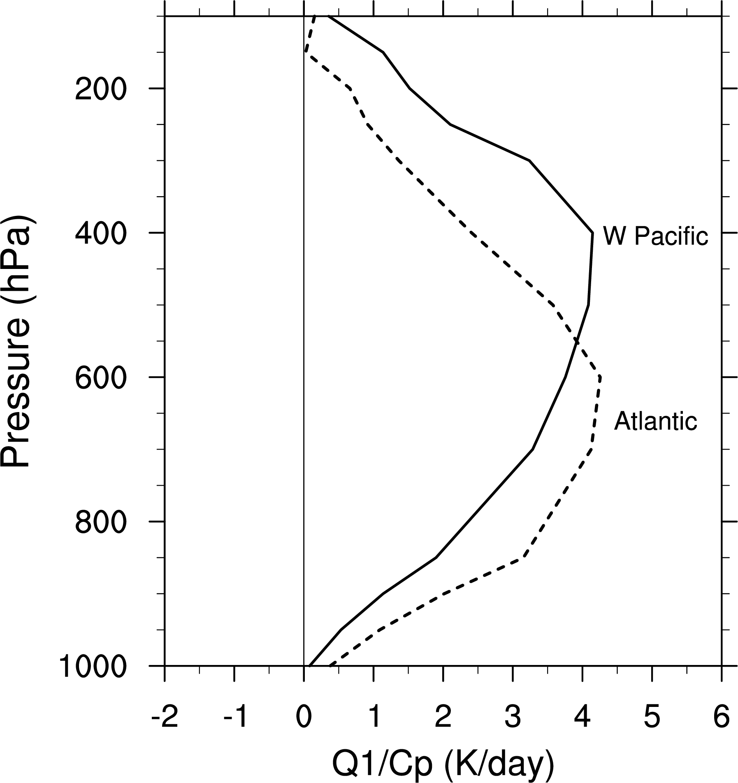
Heating profile dependency on underlying sea surface temperature (SST)
Fig. 3.9. Comparison of Q1/c_{p} profiles for June-August during 1981-2010 over the tropical western Pacific (145ºE, 5ºN) and Northeast Atlantic (40ºW, 6ºN, dashed). SST is 29.5 and 28ºC, respectivelyReplotted based on Lin and Johnson (1996, JAS).

Slide 17
Key words
Hydrological cycle and tropical rain bands
Importance of low-level wind convergence
SST control of deep convection, conditional instability
Heat and moisture budgets, Q1 & Q2 diagnostics
Condensational heating in deep convection
SST effects on the height of convection and heating profile
Convection
Circulation

