Slide 1


4. Equatorial waves and tropical circulation
Convection
Circulation
Notes:
3.4, 3.5, 3.6, 4.1.0; (H2004 11.4)
Throw a rock in a pond generates circular wave fronts. After a while, the water surface returns flat. Earth is rotating. What happens if we throw a rock on the equator.

Slide 2

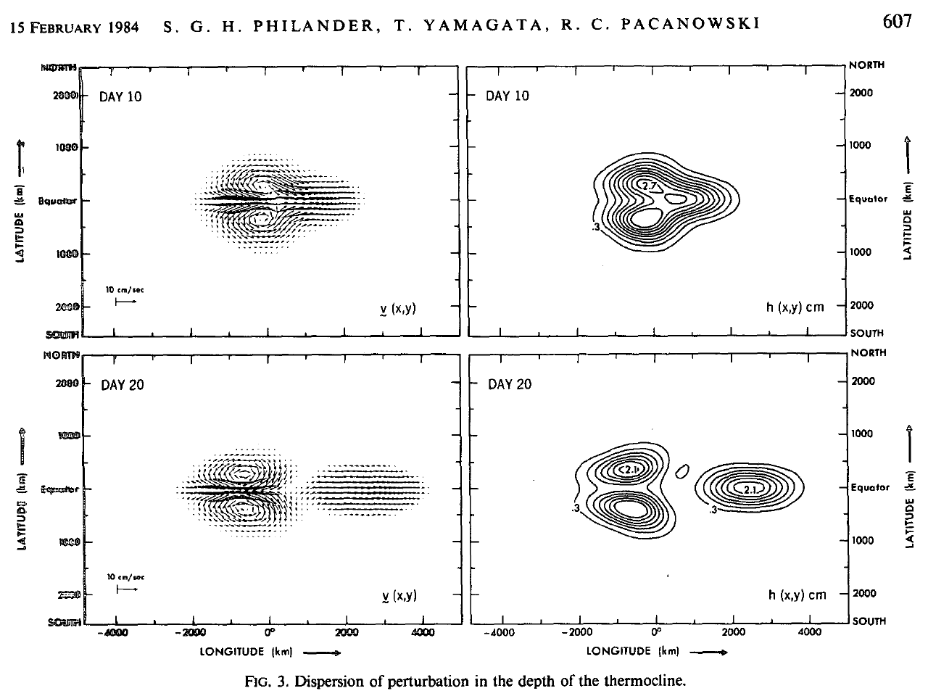
Dispersion of an initial thermocline displacement
JAS
←R
K→
←R
Fig. 3.10.
Notes:
Geostrophy in the meridional direction prevents equatorial perturbations from propagating poleward (geostrophic adjustment).

Slide 3
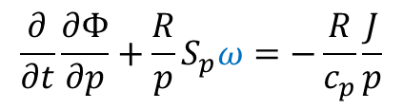

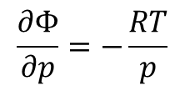
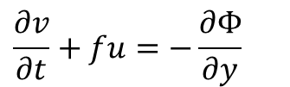


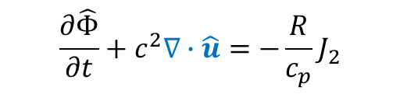
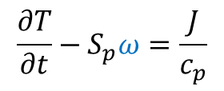

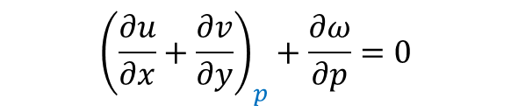
Governing equations in p coordinates for infinitesimal perturbations
$$\frac{∂u}{∂t}−fv=−\frac{∂Φ}{∂x}$$
p₁
$$\frac{∂v}{∂t}+fu=−\frac{∂Φ}{∂y}$$
Momentum
p₂
Q, T
p₃
$$\frac{∂Φ}{∂p}=−\frac{RT}{p}$$
u
$${\left(\frac{∂u}{∂x}+\frac{∂v}{∂y}\right)}_{p}+\frac{∂ω}{∂p}=0$$
Mass
$$\frac{∂T}{∂t}−S_{p}ω=\frac{J}{c_{p}}$$
$$\frac{∂}{∂t}\frac{∂Φ}{∂p}+\frac{R}{p}S_{p}ω=−\frac{R}{c_{p}}\frac{J}{p}$$
Energy
$$\frac{∂\hat{Φ}}{∂t}+c^{2}∇∙\hat{u}=−\frac{R}{c_{p}}J_{2}$$
Baroclinic mode
$$\hat{Φ}≡Φ_{3}−Φ_{1}$$
c² = (p₂/p_{s})^{k} R (θ₁-θ₃)/2
$$=\frac{θ_{1}−θ_{3}}{θ_{2}}\frac{gH_{s}}{2}$$
$H_{s}=RT_{2}/g$ scale height
Notes:
No motions at p2; tropospheric warming thickens p3-p1 layer → lower/increase geopotential at p3/p1
Discretize the hydrostatic and continuity equations.

Slide 4
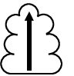
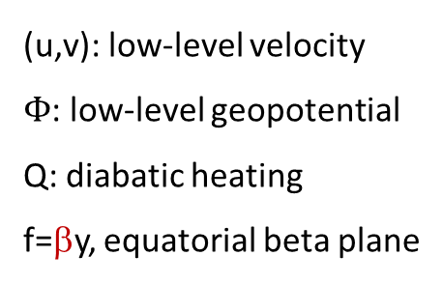

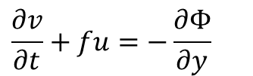

Two-level model: baroclinic mode
p₁
p₂
z
Q, T
p₃
u
x
$$\frac{∂u}{∂t}−fv=−\frac{∂Φ}{∂x}$$
(u,v): low-level velocity
$Φ$: low-level geopotential
Q: diabatic heating
f=βy, equatorial beta plane
$$\frac{∂v}{∂t}+fu=−\frac{∂Φ}{∂y}$$
Longwave approx.
$$\frac{∂Φ}{∂t}+c^{2}∇⋅u=−Q$$
c² = (p₂/p_{s})^{k} R (θ₁-θ₃)/2,
c ~50 m/s is the long gravity wave speed.
Fig. 3.11.
Notes:
Two-level model of Norman Philipps includes barotropic and baroclinic modes. Their coupling under a mean vertical shear gives rise to baroclinic instability.

Slide 5

Deformation radius
$$R=\frac{c}{f}$$
y
How does a sea level jump evolve in time (f=0 vs. f≠0)?

Slide 6
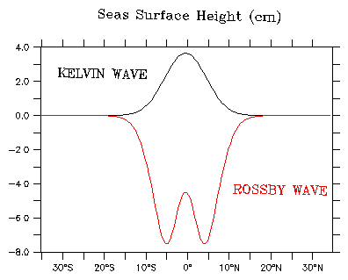

The eigen-value problem is
The solutions include
Kelvin wave (v=0), and
Rossby waves
Geostrophic in y,
$$fu=−\frac{∂Φ}{∂y}$$
Deformation radius R_{e} =(c/β)^{1/2}
is the parabolic cylinder function, H is Hermite polynomia, and (x, y) are coordinates non-dimensionized by the equatorial radius of deformation R_{e}=(c/β)^{1/2}.
Deformation radius
Φ pressure perturbations
y
y

Slide 7
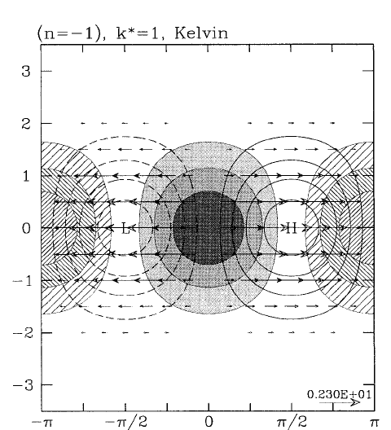
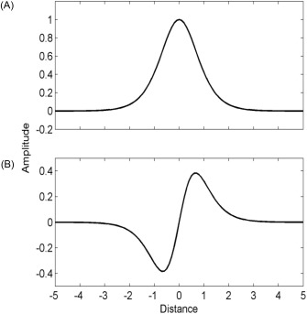




Kelvin wave
v=0, and symmetric about Eq.
Eastward propagation at c_{K}=c
Maximum and trapped on the equator: exp[-(y/R_{e})²/2], where R_{e}=(c/β)^{1/2} is the equatorial Rossby radius.
Mixture of gravity wave (x) and geostrophy (y-direction)
y (non-dimensionized)
x
Fig. 3.12b. Equatorially trapped Kelvin. Hatching is for convergence and shading for divergence. Unshaded contours are for geopotential. Wheeler et al. (2000, JAS)
c ~ 50 m/s is the gravity wave speed.
Deformation radius
c
Gravity wave in x
Geostrophic in y
$$fu=−\frac{∂Φ}{∂y}$$
>
>
x
Eq
y
$$\frac{∂u}{∂t}−fv=−\frac{∂Φ}{∂x}$$
$$βu=−\frac{∂^{2}Φ}{∂y^{2}}$$
on Eq.
$$exp\left[−\frac{1}{2}{\left(\frac{y}{R_{e}}\right)}^{2}\right]$$
Show is a solution.
Fig. 3.20.

Slide 8
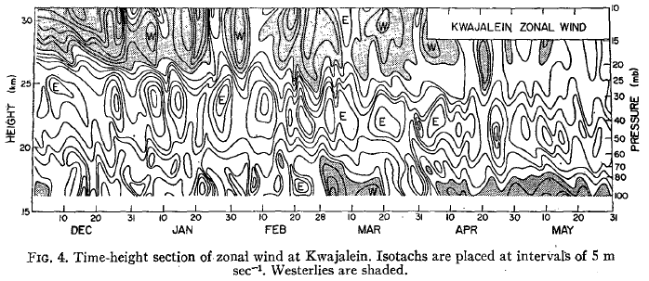
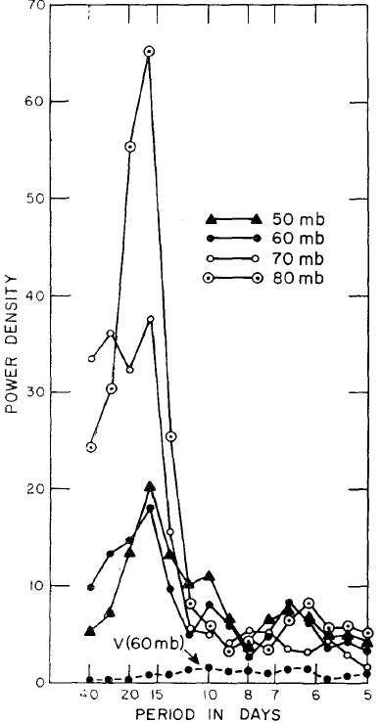
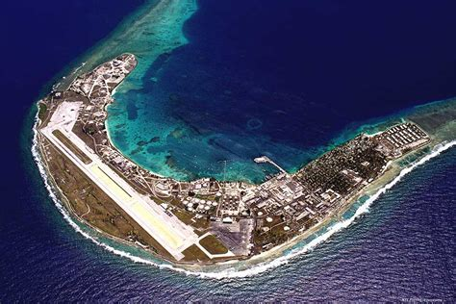
u
Kwajalein Island
8° 43′ N, 167° 44′ E
Discovery of equatorial Kelvin waves
in stratosphere (Wallace & Kousky 1968)
Fig. 3B1.1.

Slide 9
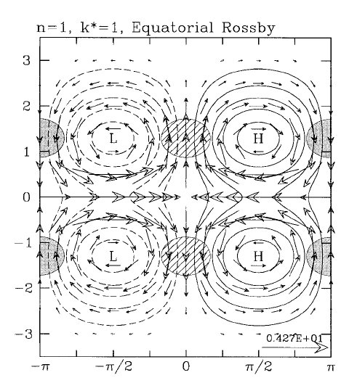



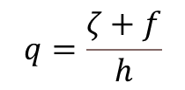
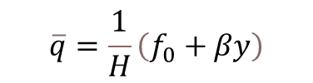

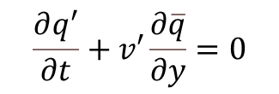
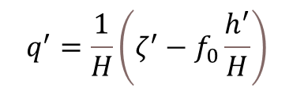
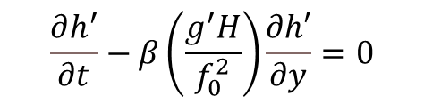
Long Rossby wave
Westward propagation at c_{R} = -c/(2n+1), n=1, 2, …
Symmetric (odd n) or anti-symmetric (even n) about Eq.
Maximum pressure perturbation off the equator
Nearly in geostrophy
$\frac{∂q′}{∂t}$>0
L
$\frac{∂q′}{∂t}$<0
H
$\frac{∂h^{′}}{∂t}$<0
$\frac{∂h^{′}}{∂t}$>0
$$q=\frac{ζ+f}{h}$$
Potential vorticity
Linearized conservation of q
$$\frac{∂h^{′}}{∂t}−β\left(\frac{g^{′}H}{f_{0}^{2}}\right)\frac{∂h′}{∂y}=0$$
$$\frac{∂q^{′}}{∂t}+v′\frac{∂\overline{q}}{∂y}=0$$
$$\overline{q}=\frac{1}{H}\left(f_{0}+βy\right)$$
Fig. 3.12a. Equatorially trapped Rossby wave. Hatching is for convergence and shading for divergence. Unshaded contours are for geopotential; negative contours dashed and the zero contour omitted. Wheeler et al. (2000, JAS)
longwave
$$q^{′}=\frac{1}{H}\left(ζ^{′}−f_{0}\frac{h^{′}}{H}\right)$$

Slide 10
Long Rossby wave
Westward propagation at c_{R} = -c/(2n+1), n=1, 2, …
Symmetric (odd n) or anti-symmetric (even n) about Eq.
Maximum pressure perturbation off the equator
Nearly in geostrophy
Equatorially trapped Rossby wave. Hatching is for convergence and shading for divergence. Unshaded contours are for geopotential; negative contours dashed and the zero contour omitted. Wheeler et al. (2000, JAS)
Fig. 3.12a.

Slide 11

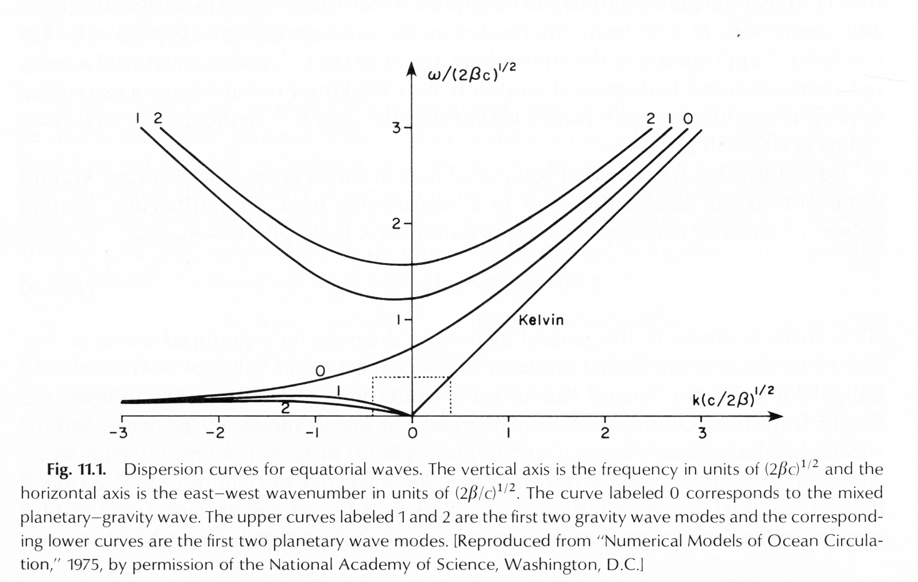
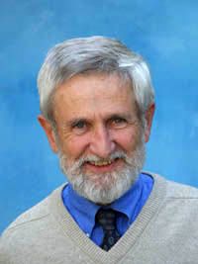
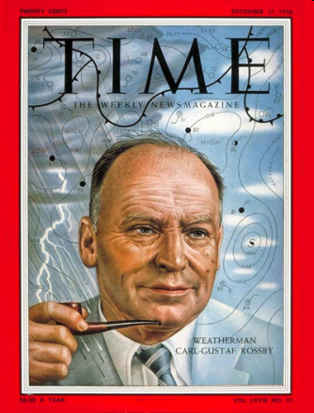

Equatorial waves (Matsuno 1966)
What happens where f=0?
T. Matsuno
Longwave approximation
$$fu=−\frac{∂Φ}{∂y}$$
Kelvin
n=1 Rossby mode
n=2
Yanai
M. Wallace
Phase speed: c_{p}=ω/k; group velocity: c_{g}=dω/dk
Fig. 3.13.

Slide 12
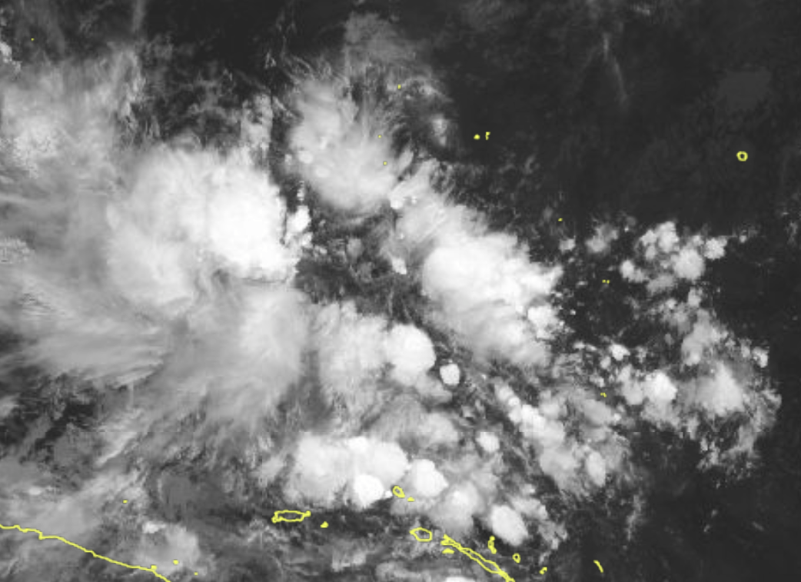


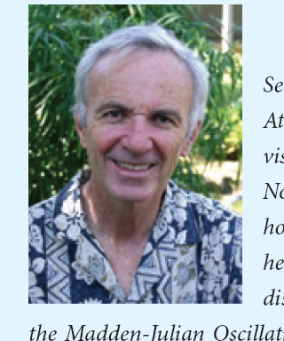

Convective variability follows Matsuno’s wave dispersion!
Convective waves (~15 m/s) slow down. Why?
$$c_{m}=c\sqrt{1−q^{∗}}$$
condensational heat
16 m/s
c_{m}~15 m/s
11 m/s
Wheeler & Kiladis 1999
Madden-Julian Oscillation: not a Matsuno solution
TBB spectrum in wavenumber-frequency space
Wheeler & KIladis (1999, JAS)
Madden & Julian 1972

Slide 13
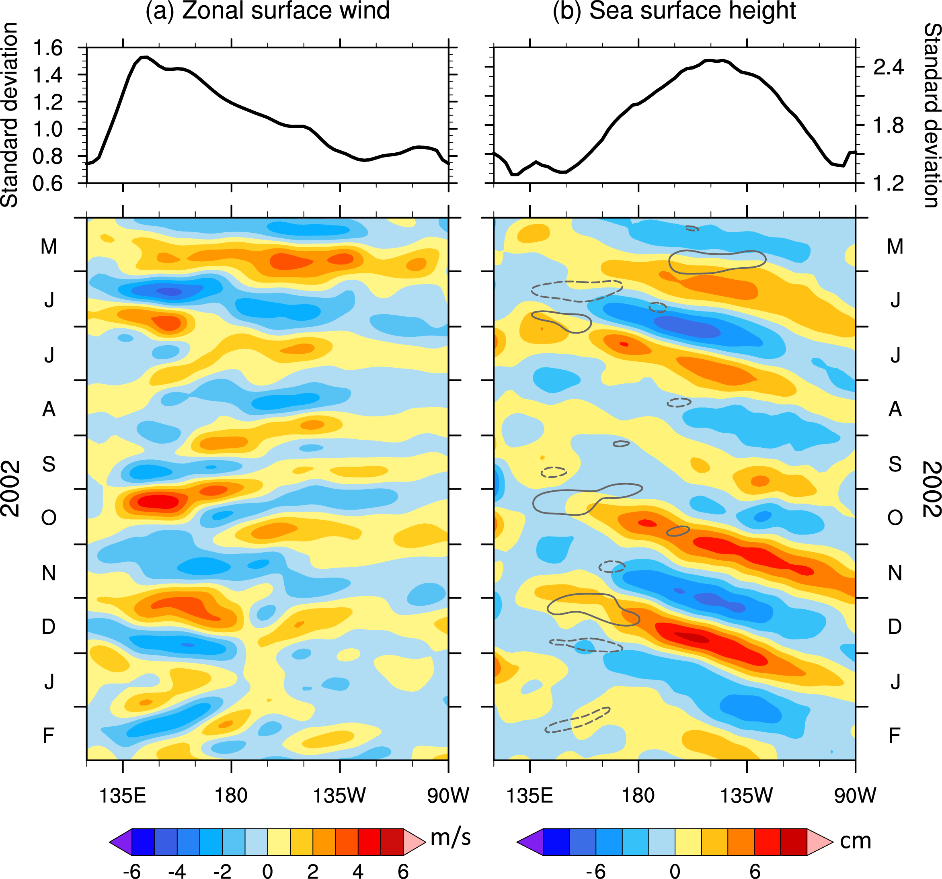
Prevalence of eastward moving disturbances on the equator:
Kelvin waves in the ocean (right)
t
Fig. 4.16. Longitude-time sections of 20–120-day band-pass-filtered (a) zonal surface wind (m/s) and (b) sea surface height (cm) anomalies at the equator across the Pacific. The upper panels show the standard deviations for 1997-2020. In (b), the u'=2.5 m/s contours are plotted in grey (negative dashed). Courtesy Y. Liang.
Notes:
Fig. 19

Slide 14
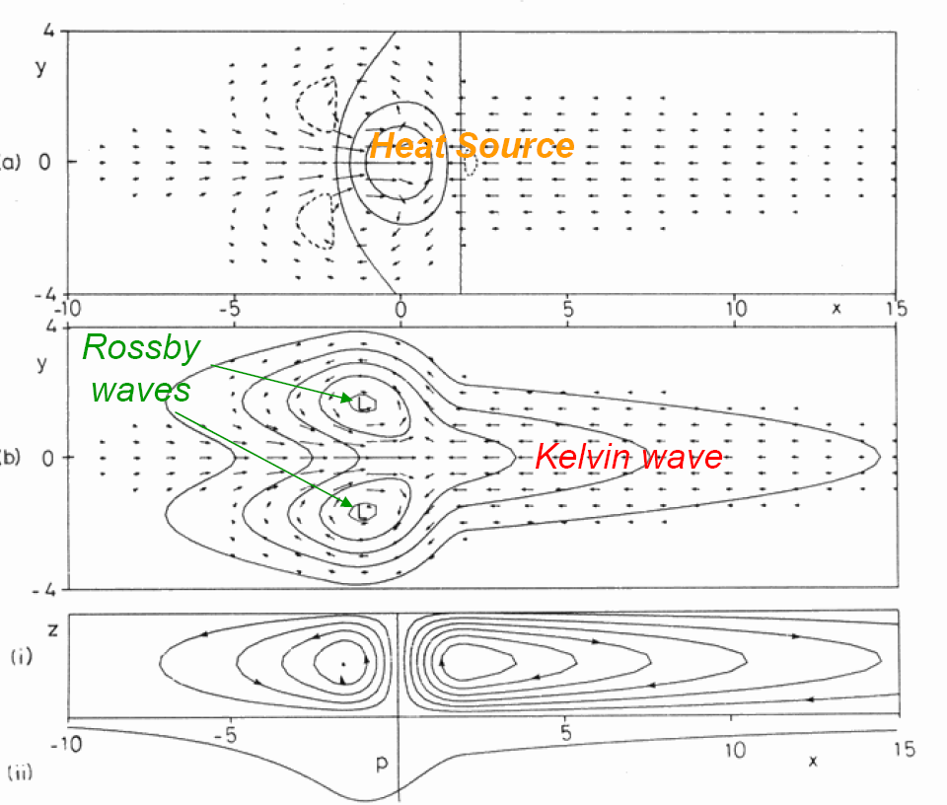
Thermal-induced circulation in the Gill model (friction-arrested waves)
y
ω, (u ,v)
x
y
p, (u ,v)
z
Stream function
x
Fig. 3.14.

Slide 15
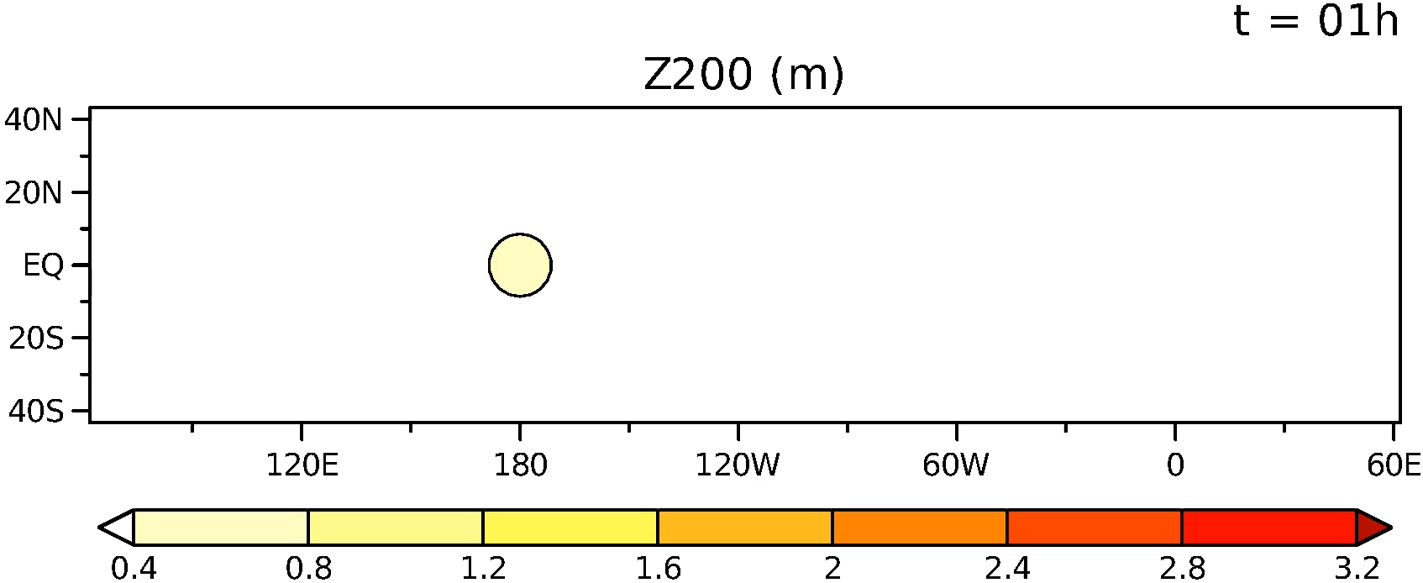
Rossby
Kelvin
Hovmoller diagram
Phase=k(x-ct)
c=dx/dt following a constant phase
Fig. 3.15.
Z₂₀₀ (m)
Transient adjust.:
From circular to K-R couplet
Ayumu Miyamoto

Slide 16
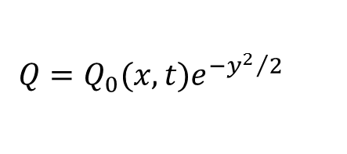
$$Q=Q_{0}(x,t)e^{−{y^{2}}/2}$$
Steady state response with damping ε
West of the forcing, q₂~exp(3εx)
East of the forcing, q₀~exp(-εx)
Rossby
Kelvin
z
x

Slide 17
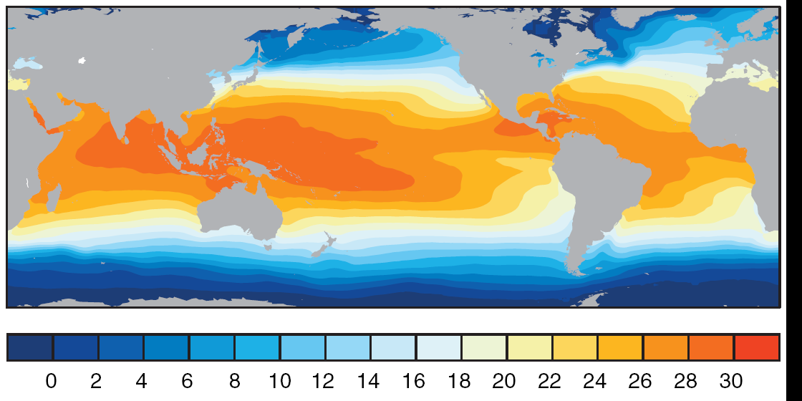
U
U
IWP warm pool
U
Cold tongue
U
U
Annual-mean sea surface temperature (C)
Precip & SST

Slide 18
Annual-mean
Convection-circulation interaction
On Eq., weak westerlies in the Indian and easterly trades in the Pacific, with convergence over the maritime continent.
Fig. 3.16.
Notes:
Effective beta small in upper troposphere (angular momentum conservation), with zeta < 0 b/w zonal mean westerlies in midlat and easterlies on Eq. → stationary Gill solution explains the westerly accelertation above Japan.
met610/xy.ann

Slide 19
The Walker Circulation (zonal-vertical): Rises in the Indonesia/western Pacific and sinks in the cool eastern Pacific on the equator, consistent with Gill’s solution. A mini-version is found over South America and the equatorial Atlantic.
Gill’s solution
On Eq., weak westerlies in the Indian and easterly trades in the Pacific, with convergence over the maritime continent.
Fig. 3.16.
Notes:
Effective beta small in upper troposphere (angular momentum conservation), with zeta < 0 b/w zonal mean westerlies in midlat and easterlies on Eq. → stationary Gill solution explains the westerly accelertation above Japan.
met610/xy.ann

Slide 20
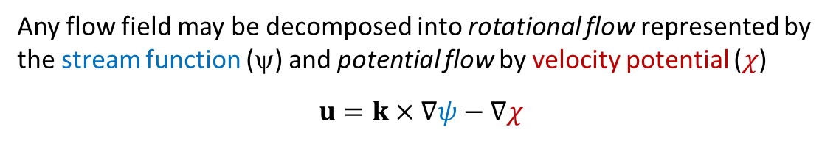



Any flow field may be decomposed into rotational flow represented by the stream function (ψ) and potential flow by velocity potential ($χ$)
$$u=k×∇ψ−∇χ$$
Solving Poisson Equations → stream function (ψ) and velocity potential ($χ$)
H
Geostrophic u_{g}
$$k⋅∇×u=∇^{2}ψ$$
ψ
H
Ageostrophic u_{a}
$$∇⋅u=−∇^{2}χ$$
$$χ$$
Fig. 3.17.

Slide 21
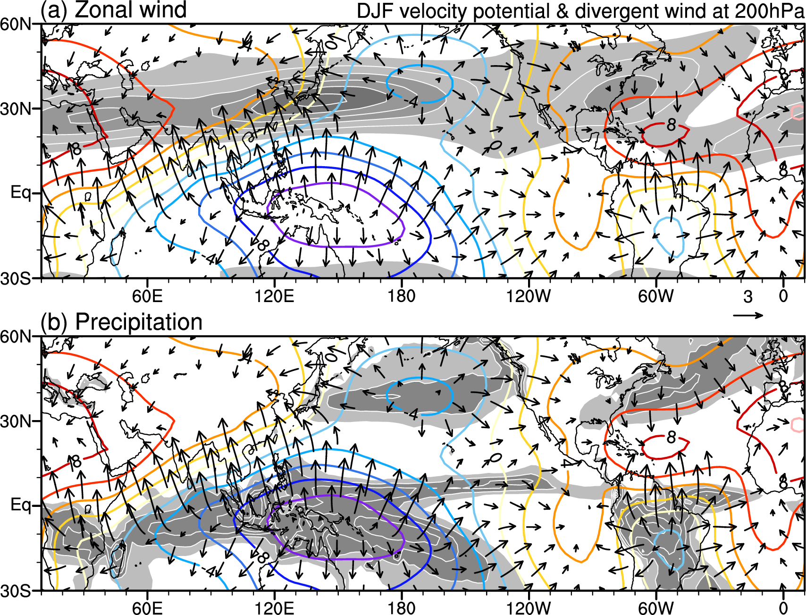

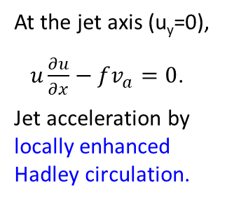
The winter subtropical jet core over Japan (u>70 m/s) is north of the convective center over the Indo-western Pacific warm pool.
Zonal wind=20, 40, 60 m/s)
At the jet axis (u_{y}=0),
$u\frac{∂u}{∂x}−fv_{a}=0$.
Jet acceleration by locally enhanced Hadley circulation.
D
C
C
D
200 hPa velocity potential, divergent flow & precip (DJF)
$u_{g}$ is non-divergent
Fig. 3.18.

Slide 22

Key words
Equatorial (Kelvin & Rossby) waves, equatorial waveguide
Weak horizontal gradients of free tropospheric temperature
Mechanism for SST threshold for convection
Balance b/w vertical temperature advection and diabatic heating
Response to isolated convective heating, east-west asymmetry
Walker circulation, warm water pool, and equatorial cold tongue
Divergence flow (velocity potential), streamfunction
Convection-circulation feedback
Circulation
Equatorial waves
Moisture convergence
$\left\langle q\right\rangle$
Convection
SST
Fig. 3.21.
Notes:
Equatorial waves were discovered in the stratosphere, and out of a theoretical curiosity. Wide applications are found in ocean, troposphere, and climate.

Slide 23
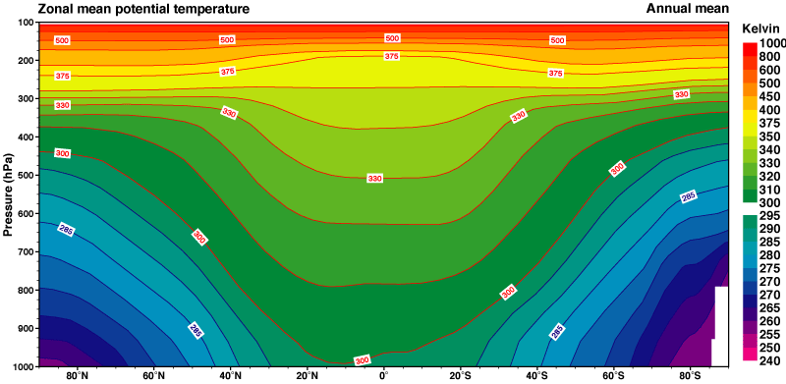
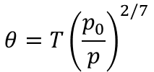


 | Mid-lat | Eq.
Rossby wave c_{R} (m/s) | β(c/f)² ~5 | c/3 ~ 17
Fast wave propagation within the eq. waveguide.
Temperature in free troposphere is nearly uniform in tropics (δT < 1K) (weak temperature gradient)
$$θ=T{\left(\frac{p_{0}}{p}\right)}^{2/7}$$
Zonal-mean potential temp
$$\frac{∂θ}{∂t}+u⋅∇θ+ω\frac{∂θ}{∂p}=(\frac{p_{s}}{p})^{κ}\frac{J}{c_{p}}$$
$$→ \frac{∂θ}{∂t}+ω\frac{∂θ_{0}}{∂p}=(\frac{p_{s}}{p})^{κ}\frac{J}{c_{p}}$$
T at 500 hPa, March
Notes:
Weak local maxima collocated with precip maxima.

Slide 24
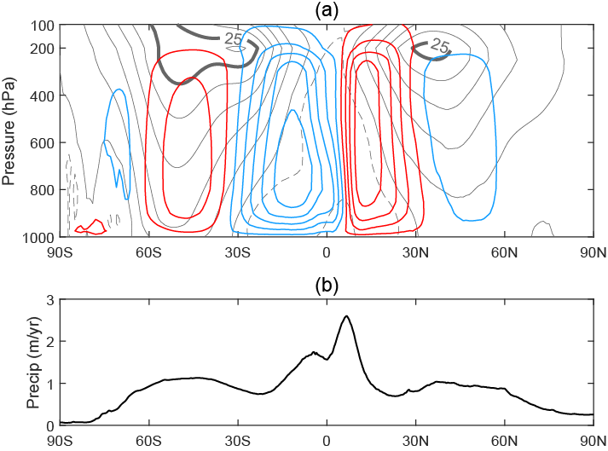
Weak temperature gradient (x, y) in tropics (20S-20N)
Zonal, annual mean streamfunction & zonal wind (u)

Slide 25
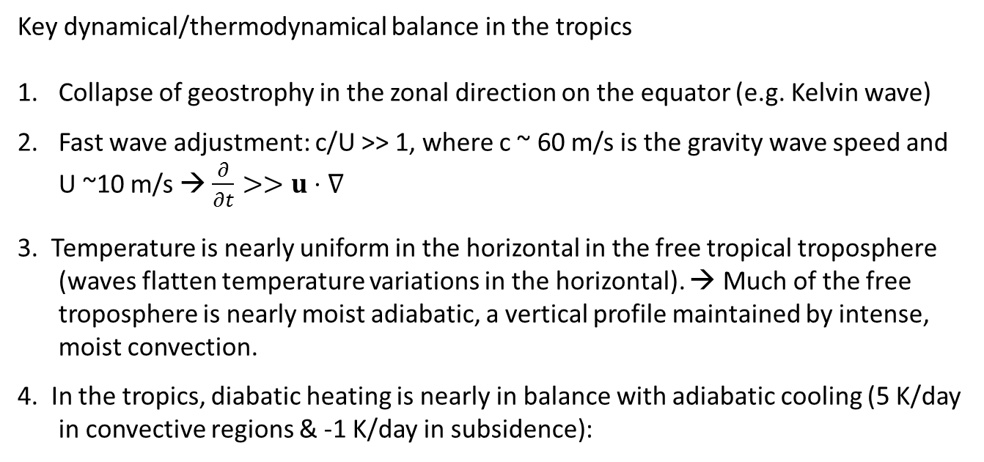
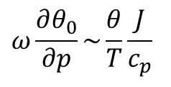
Key dynamical/thermodynamical balance in the tropics
Collapse of geostrophy in the zonal direction on the equator (e.g. Kelvin wave)
Fast wave adjustment: c/U >> 1, where c ~ 60 m/s is the gravity wave speed and U ~10 m/s → $\frac{∂}{∂t}>>u⋅∇$
3. Temperature is nearly uniform in the horizontal in the free tropical troposphere (waves flatten temperature variations in the horizontal). → Much of the free troposphere is nearly moist adiabatic, a vertical profile maintained by intense, moist convection.
4. In the tropics, diabatic heating is nearly in balance with adiabatic cooling (5 K/day in convective regions & -1 K/day in subsidence):
$$ω\frac{∂θ_{0}}{∂p}\sim \frac{θ}{T}\frac{J}{c_{p}}$$
Comparison with mid-latitudes
geostrophy → large temp. gradients.
c/U~1 → importance of horizontal advection.

Slide 26
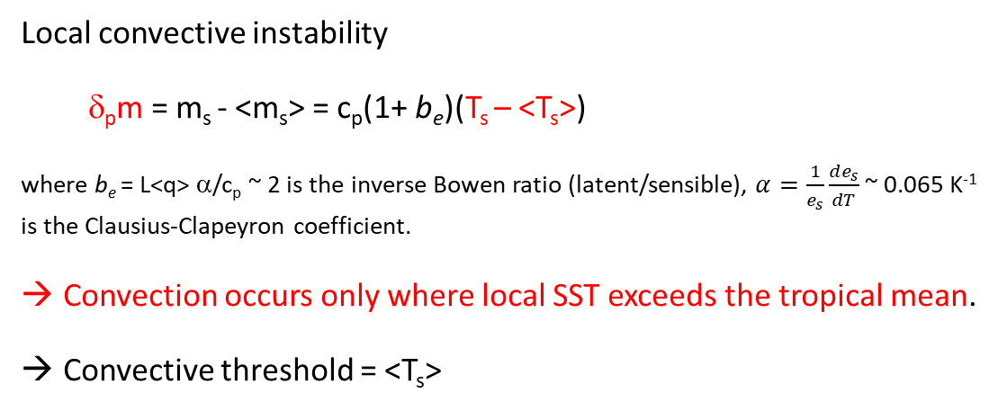
SST threshold for tropical convection
Convective instability defined as vertical difference in moist energy b/w surface and upper troposphere
δ_{p}m= m_{s}-m_{T}
m_{T}
With weak temperature gradient
m_{T}≈<m_{T}>=<m_{s}>
s
m
m*
Local convective instability
δ_{p}m = m_{s} - <m_{s}> = c_{p}(1+ b_{e})(T_{s} – <T_{s}>)
where b_{e} = L<q> α/c_{p} ~ 2 is the inverse Bowen ratio (latent/sensible), $α=\frac{1}{e_{s}}\frac{de_{s}}{dT}$ ~ 0.065 K⁻¹ is the Clausius-Clapeyron coefficient.
Convection occurs only where local SST exceeds the tropical mean.
Convective threshold = <T_{s}>
m_{s}
Notes:
Why not a continuum of convective depth and rainfall, P=a D(SST)?
This is not allowed because the troposphere is adjusted to convective neutrality. As a convective plume rises above LFC (850 mb), it is positively buoyant and must keep rising until reaching the level of neutral buoyancy near the tropopause.

