Slide 1
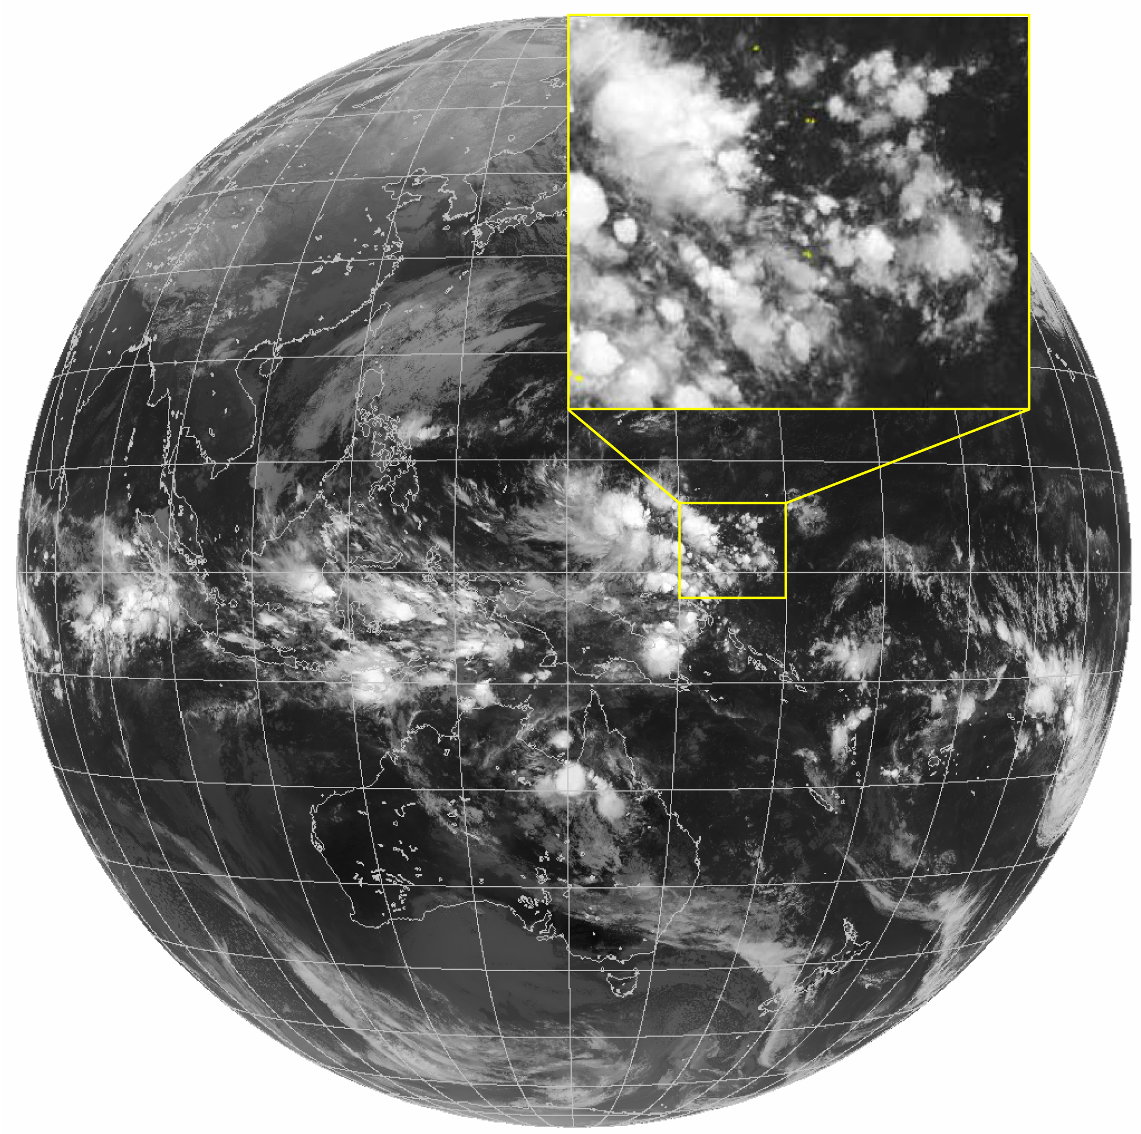
5. The Madden-Julian Oscillation:
Spontaneous mode of convection-circulation interaction
IR image
Active convect in Maritime Continent
Suppressed convect over C Pacific;
Hierarchy: MJO envelop/cloud clusters/Cb
Over Indo-WP warm pool:
Strong convection.
Large temporal variability (1-60 days).
Fig. 4.1 Hierarchy of tropical convective organizations captured by a satellite infrared image on 18 January 2022: embedded in a convective envelop over the western Pacific are meso-scale (100s km) cloud clusters (inset), each made up of by deep convective cumulonimbus clouds (~10 km).
Notes:
Last taught in 2021

Slide 2
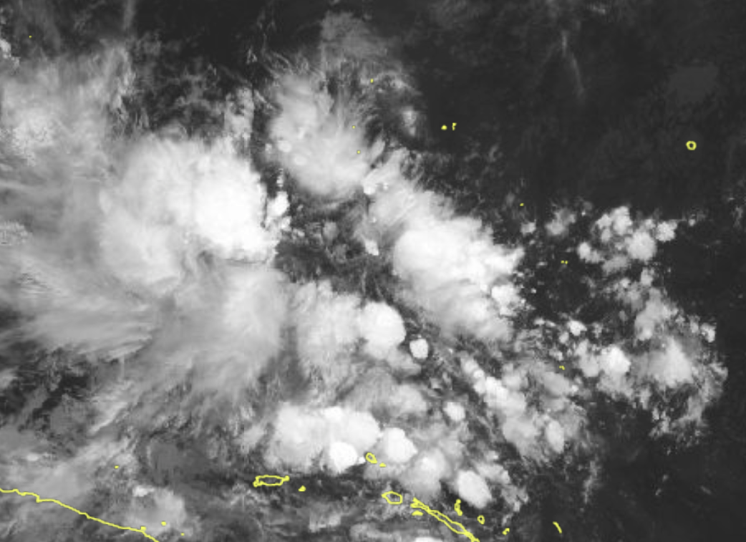



Convective variability follows Matsuno’s wave dispersion!
Convective waves (~15 m/s) slow down. Why?
$$c_{m}=c\sqrt{1−q^{∗}}$$
condensational heat
16 m/s
c_{m}~15 m/s
11 m/s
Madden-Julian Oscillation: not a Matsuno solution
TBB spectrum in wavenumber-frequency space
Wheeler & KIladis (1999, JAS)
Wheeler & Kiladis 1999

Slide 3
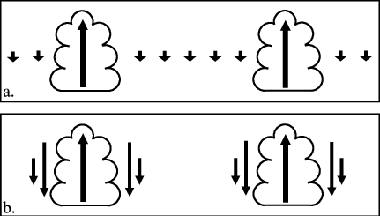





$$\frac{∂u}{∂t}−fv=−\frac{∂Φ}{∂x}$$
p₁
$$(\frac{∂v}{∂t}+)fu=−\frac{∂Φ}{∂y}$$
p₂
$$\frac{∂Φ}{∂t}+c^{2}∇⋅u=−Q$$
p₃
Dry model
c² = (p₂/p_{s})^{κ} R (θ₁-θ₃)/2 ~60 m/s is the dry, long gravity wave speed
How does latent heating affect the restoring force on a rising parcel?
Assume condensational heating is proportional to low-level wind convergence
where q is a non-dimensional parameter for low-level moisture content. Condensational heating reduces the effective restoring force, slowing the phase speed.
$${Q=−c}^{2}q∇∙u$$
$$c_{m}^{2}{=c}^{2}(1−q) =\text{(}\text{p}\text{2}\text{/}\text{ps}\text{)}κ \frac{R}{2}\text{(}θ\text{1}\text{−}θ\text{3}\text{)}\text{(}\text{1}\text{−}\text{q}\text{)}$$

Slide 4
Convectively coupled Kelvin wave
phase speed at c_{m}=15 m/s
v~0 despite N-displaced heating
Enhanced convection: dark or light shading?
Why are convective anomalies displaced N of equator?
T_{BB} variance
Notes:
Fig. 3. Maps of anomalous Tb (shading), geopotential height (contours), and wind (vectors)
associated with a 20 K perturbation in Kelvin wave Tb at the base point 7.5N, 172.5E, for (a) day 0 at
850 hPa, (b) day +2 at 850 hPa, and (c) day 0 at 200 hPa. The contour interval is 5 m in Figures 7a and 7b
and 10 m in Figure 7c, with negative contours dashed. Dark (light) shading is for negative (positive) Tb
perturbations of ±10 K and 3 K. Tb and wind vectors are locally significant at the 95% level, with the
largest vectors around 2 m s1.

Slide 5

Hierarchy of convective organizations
Slow-moving convective envelop in Indo-W Pacific
Circum-equatorial CC Kelvin waves
Westward propagating cloud clusters
5 m/s
MJO convective envelope radiates CC Kelvin waves at dateline.
15 m/s
IR brightness temperature (K)
Notes:
Fig. 4.3 Time-longitude section of CLAUS brightness temperature Tb, averaged from 2.5S to 7.5N from 1 April through 2 June 1987. Tb shading scale is shown at the bottom in K.

Slide 6
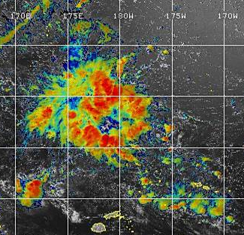
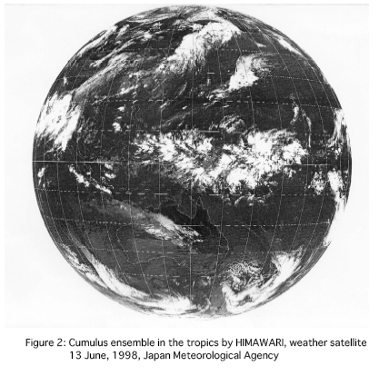
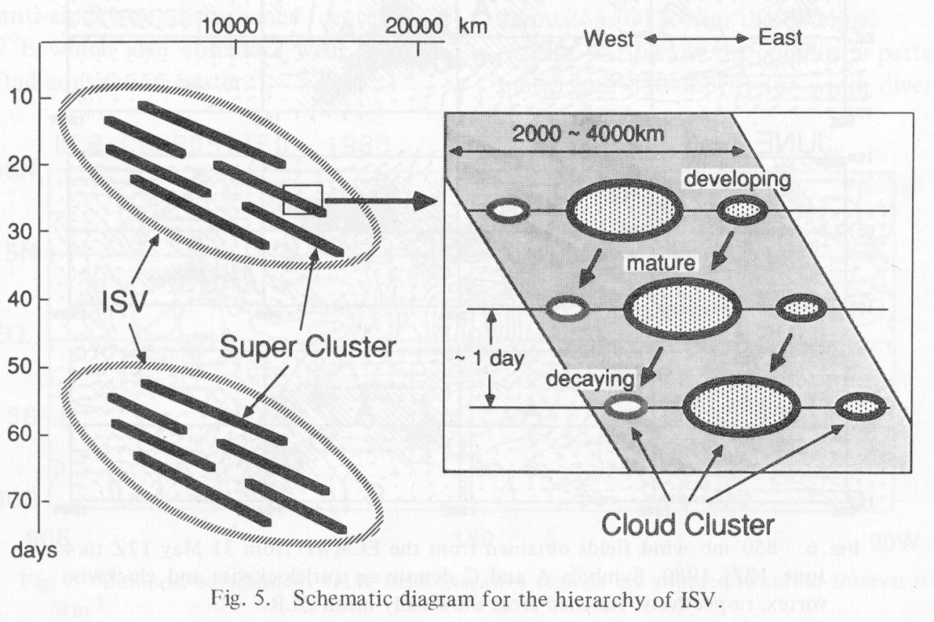
eq
5S
Convective envelop
Super cloud cluster
Cloud cluster
Nakazawa (1988, JMSJ)

Slide 7
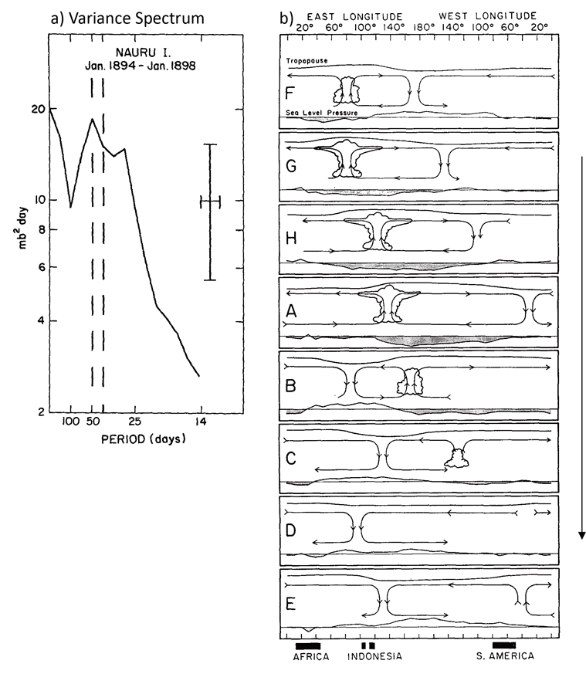
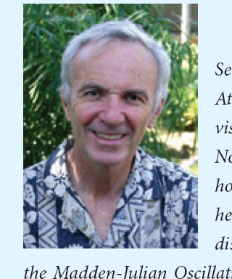
Time
Rol Madden
Fig. 4.6 (a) Variance spectrum of surface pressure at Nauru Island in the western equatorial Pacific. (b) Schematic of the 30-60 days oscillation. From Madden and Julian (1972).

Slide 8
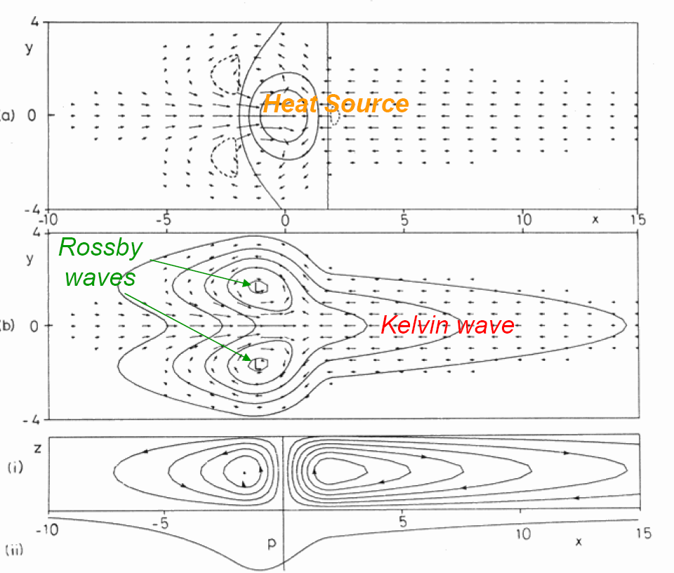
(u,v) & OLR w/ streamfunction (Kiladis et al. 2005, JAS)
Gill pattern (isolated heating)
Notes:
Fig. 6

Slide 9
Matsuno pattern (zonally periodic)
Gill pattern (zonally isolated)
Fig. 4.7. MJO anomalies when convection is active over the Maritime Continent (MJO phase 5). a Outgoing longwave radiation (OLR, shading), 150 hPa geopotential height (contours) and horizontal winds (arrows). b Precipitation (shaded) and 850 hPa geopotential height (contours) and horizontal winds. The contour interval is 2 m for (a) and 1 m for (b). From Adames and Maloney (2021).

Slide 10
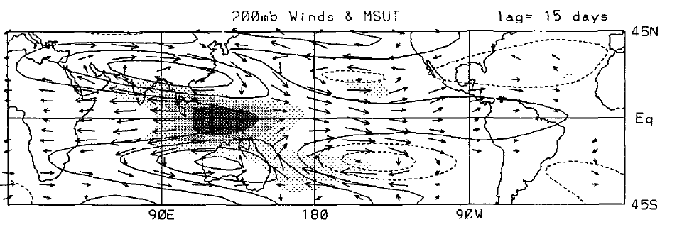
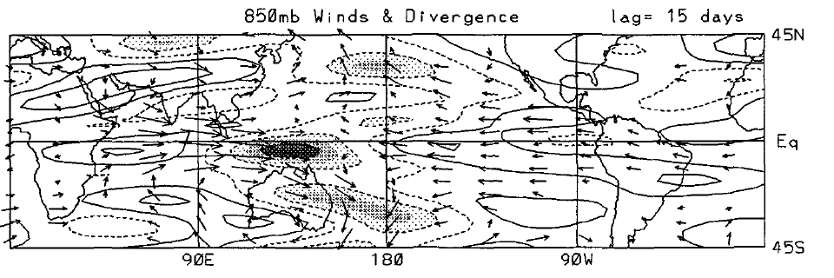
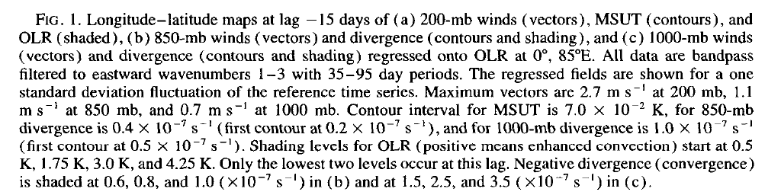
T (contours), OLR (shade)
MSUT (Microwave sounding unit channel-2 temperature)
Hendon & Salby (1994, JAS)

Slide 11
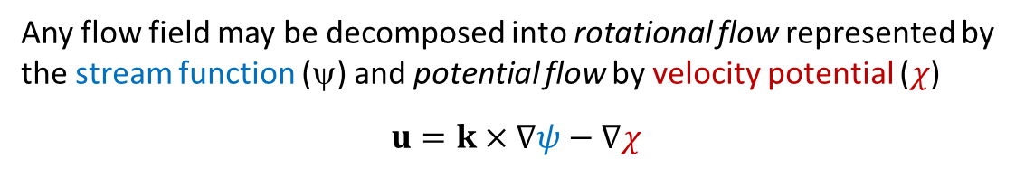



Any flow field may be decomposed into rotational flow represented by the stream function (ψ) and potential flow by velocity potential ($χ$)
$$u=k×∇ψ−∇χ$$
Solving Poisson Equations → stream function (ψ) and velocity potential ($χ$)
H
Geostrophic u_{g}
$$k⋅∇×u=∇^{2}ψ$$
ψ
L
Ageostrophic u_{a}
$$∇⋅u=−∇^{2}χ$$
$$χ$$

Slide 12
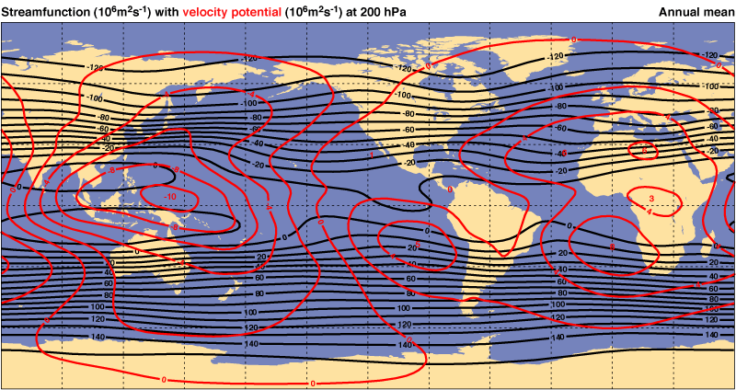
Hadley
Walker
Walker

Slide 13
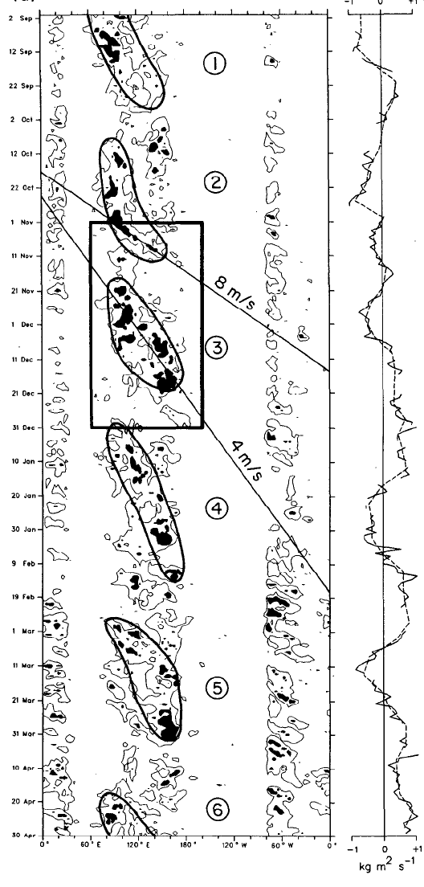
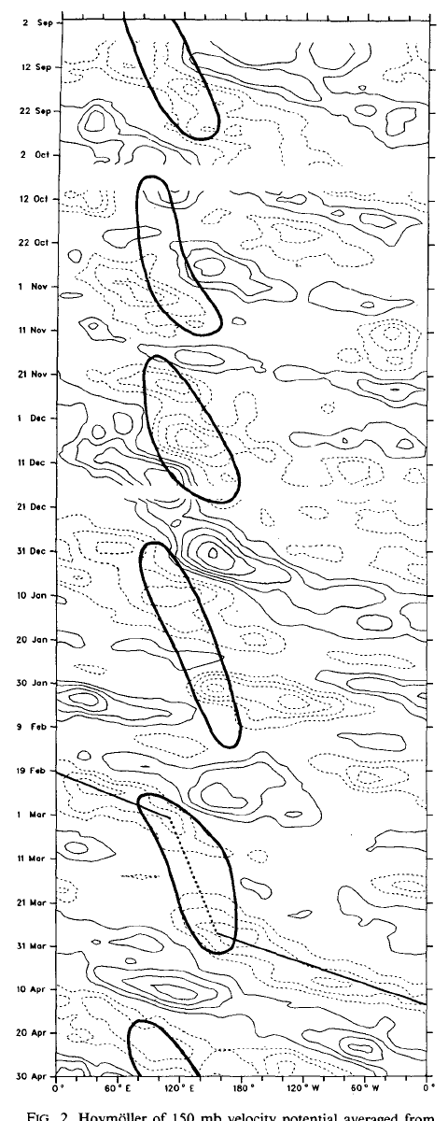
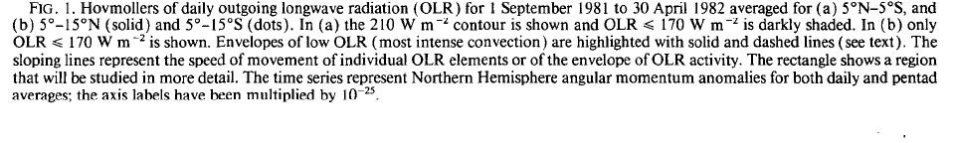
Why is propagation slow in the west than east Pacific?
Circulation decoupled from convection
Convective envelop
Slow
Fast phase propagation
Sept 81
Weickmann & Khalsa (1990, MWR)
15 m/s
April 82
OLR (5S-5N) < 210 W/m²
150 mb velocity potential (5S-5N)

Slide 14
MJO modulations of Kelvin waves, cloud clusters & diurnal convection
Hendon & Salby (1994, JAS)
Slow MJO convective envelope arrives at the edge of cold tongue
Breakdown of the Kelvin-Rossby couplet breaks down
Radiation of fast CC Kelvin waves
Notes:
Fig. 8

Slide 15
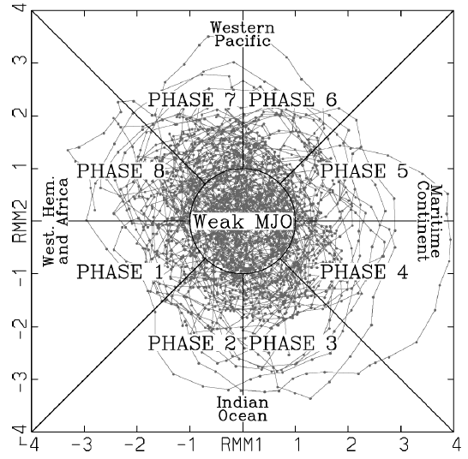
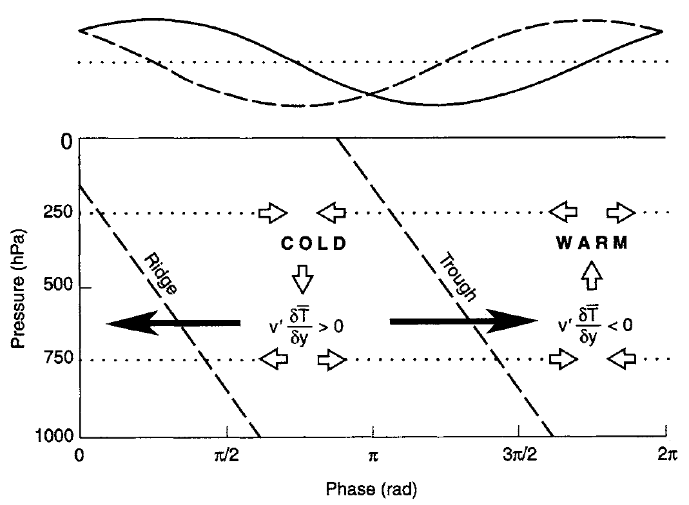
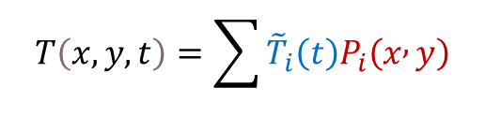


PC
EOF
MJO index
$$T\left(x,y,t\right)=\sum{{\tilde{T}}_{i}\left(t\right)P_{i}\left(x , y\right)}$$
x
>
$${EOF}_{1}$$
$${EOF}_{2}$$
EOF analysis of near-equatorially averaged zonal wind at 850 and 200-hPa, and OLR;
Two stationary EOFs represent east propagation: Real-time Multivariate MJO PCs 1 (RMM1) and 2 (RMM2);
Phase → location of enhanced convection
Counter-clockwise phase change → Robust eastward propagation
>
Two PCs to track zonal propagation
Wheeler, M.C., H.H. Hendon, 2004: An all-season real-time multivariate MJO index: Development of an index for monitoring and prediction. Mon. Wea. Rev., 132, 1917–1932.

Slide 16
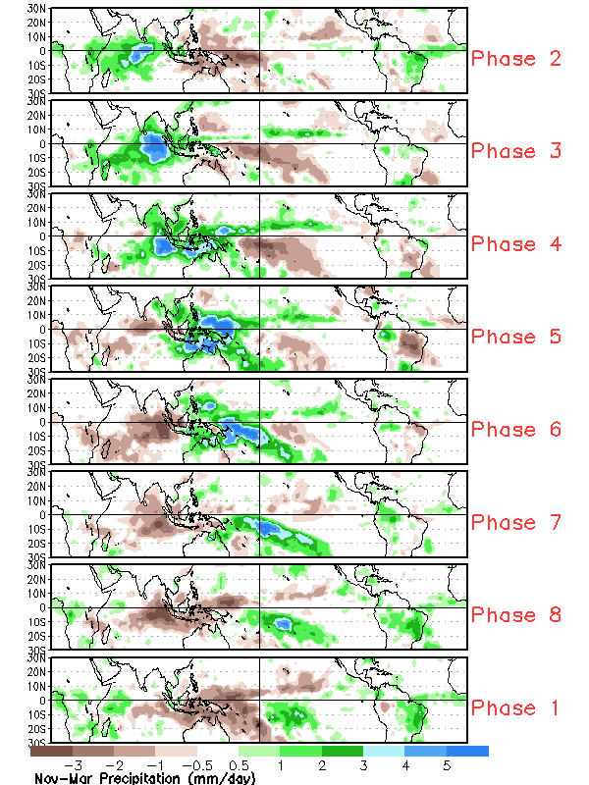
MJO index
>
>
Broad convective envelop moves slowly eastward.

Slide 17
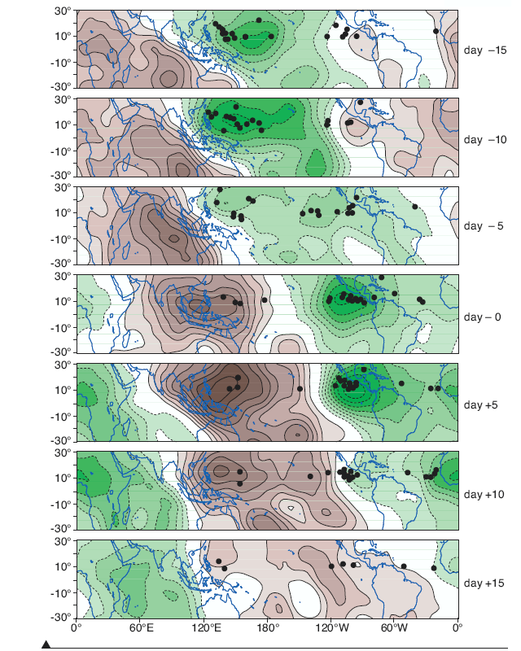
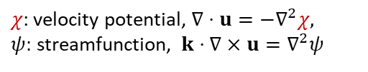

MJO
Coupled with convection, and not in Matsuno’s wave solutions.
30-60 days in period, wavenumber 1-2.
Slow eastward propagation at 5 m/s.
Baroclinic circulation much as in the Gill model, with easterlies to the east and westerlies to the west in low level.
Tropical convection is highly organized (in hierarchy).
Dominant mode of tropical convection but poorly simulated in GCMs.
$$u=k×∇ψ−∇χ$$
$χ$: velocity potential, $∇⋅u=−∇^{2}χ,$
$ψ:$ streamfunction, $k⋅∇×u=∇^{2}ψ$
200 hPa velocity potential anomalies (10⁶ m² s⁻¹) in MJO and tropical cyclogenesis (•). (Higgins, R. W., W. Shi, 2001, JC)
Notes:
Maloney and Hartmann 2000
Higgins, R. W., W. Shi, 2001: Intercomparison of the Principal Modes of Interannual and Intraseasonal Variability of the North American Monsoon System. J. Climate, 14, 403–417.

Slide 18
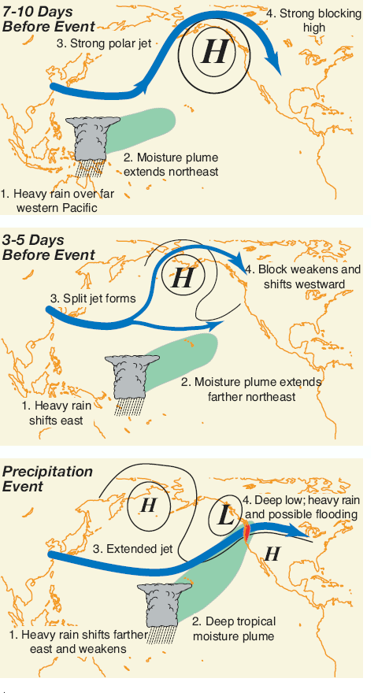
Atmospheric river
MJO effect on NA weather

Slide 19
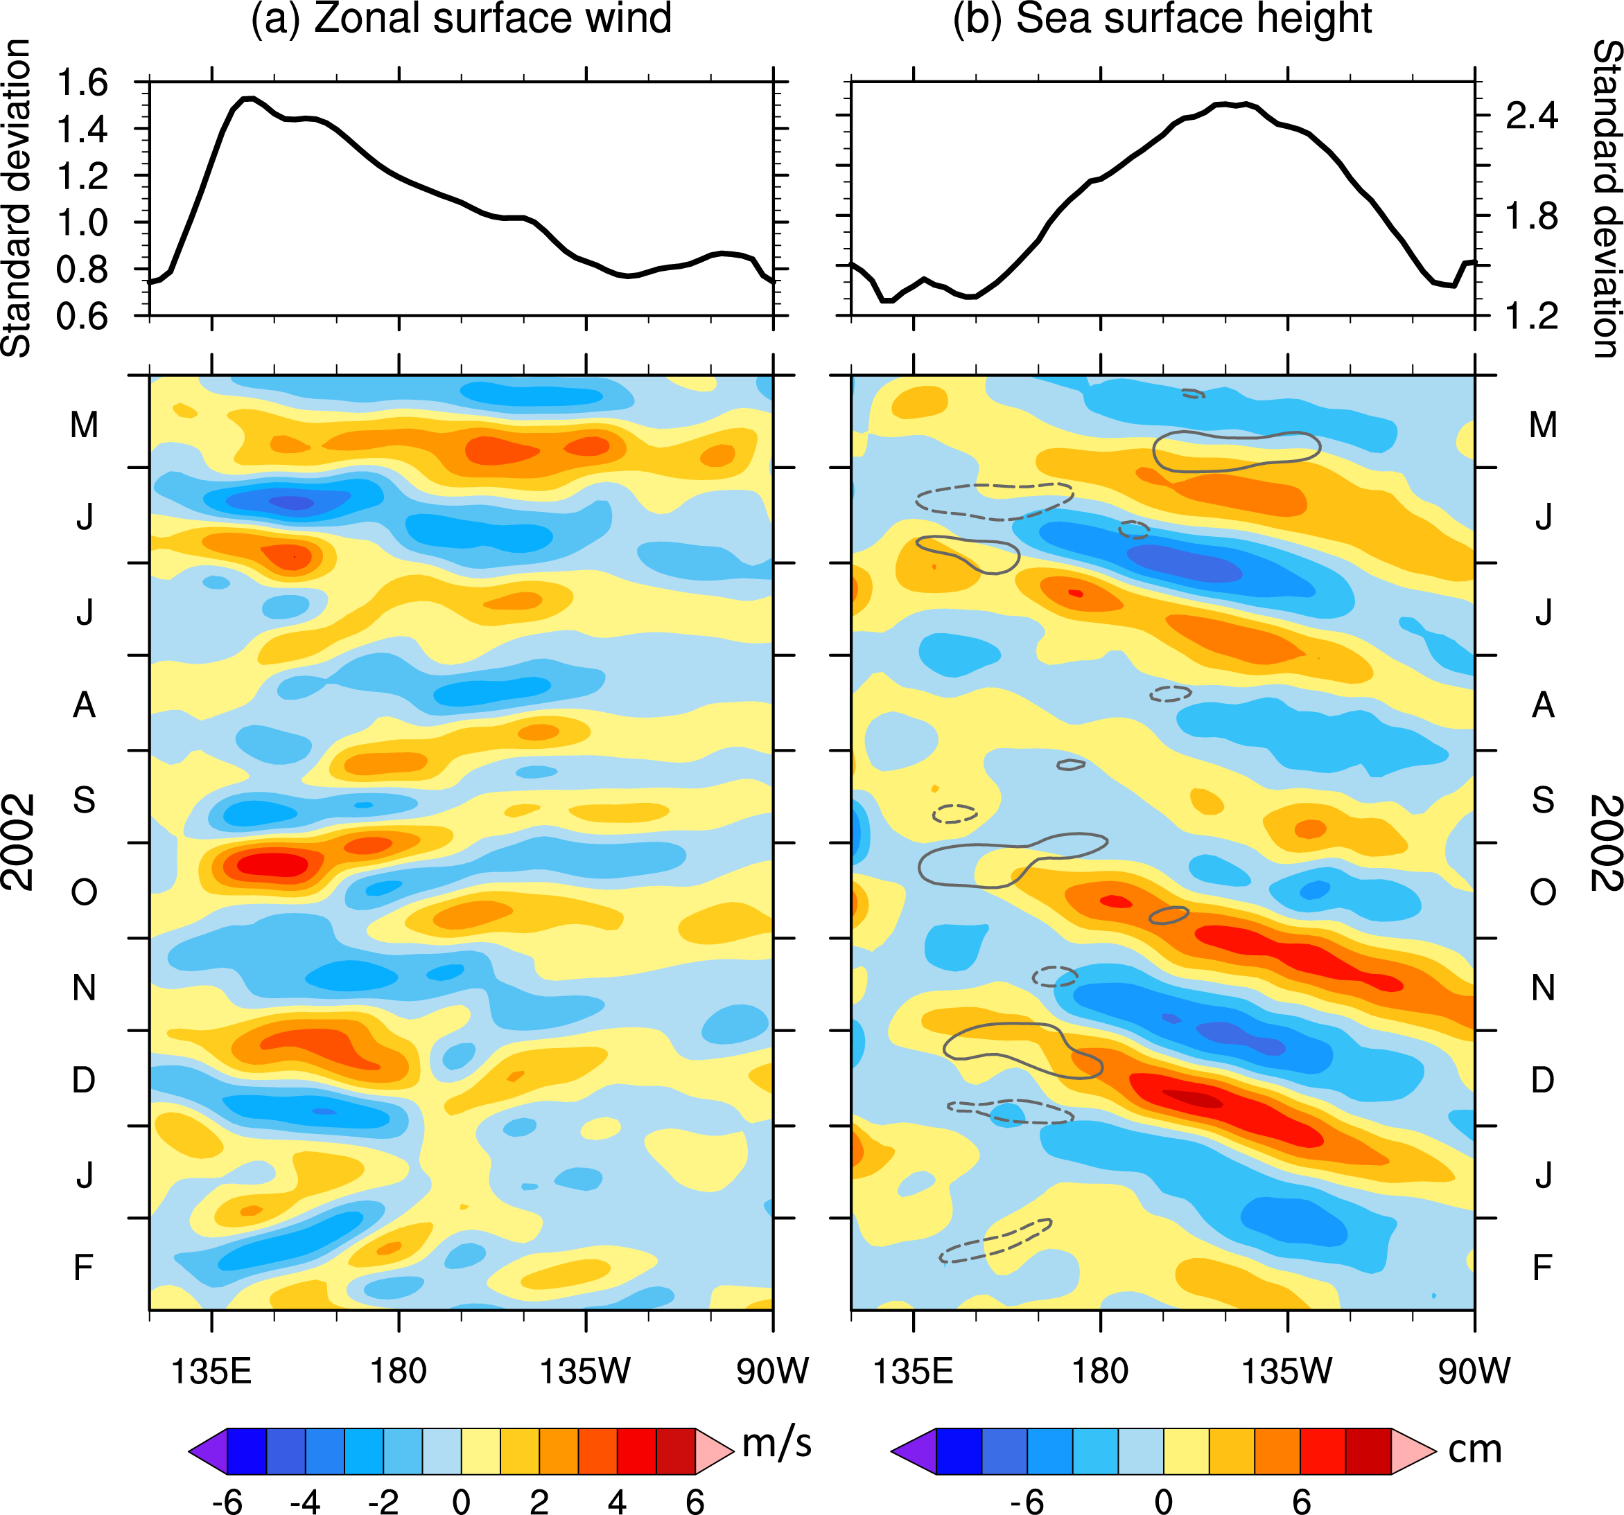
Prevalence of eastward moving disturbances on the equator:
Kelvin waves in the ocean (right)
t
Prefer low freq (~60 days) ← slow ocean response
Cross-Pacific transit time: 2~3 months
Estimate the phase speed of ocean Kelvin wave
Fig. 4.16. Longitude-time sections of 20–120-day band-pass-filtered (a) zonal surface wind (m/s) and (b) sea surface height (cm) anomalies at the equator across the Pacific. The upper panels show the standard deviations for 1997-2020. In (b), the u'=2.5 m/s contours are plotted in grey (negative dashed). Courtesy Y. Liang.

Slide 20
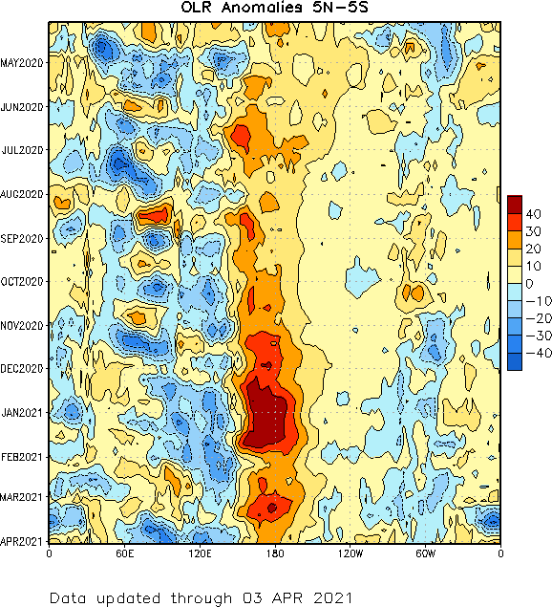
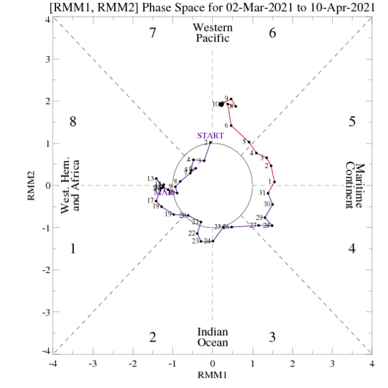
Current MJO condition?
15 m/s
5 m/s

Slide 21
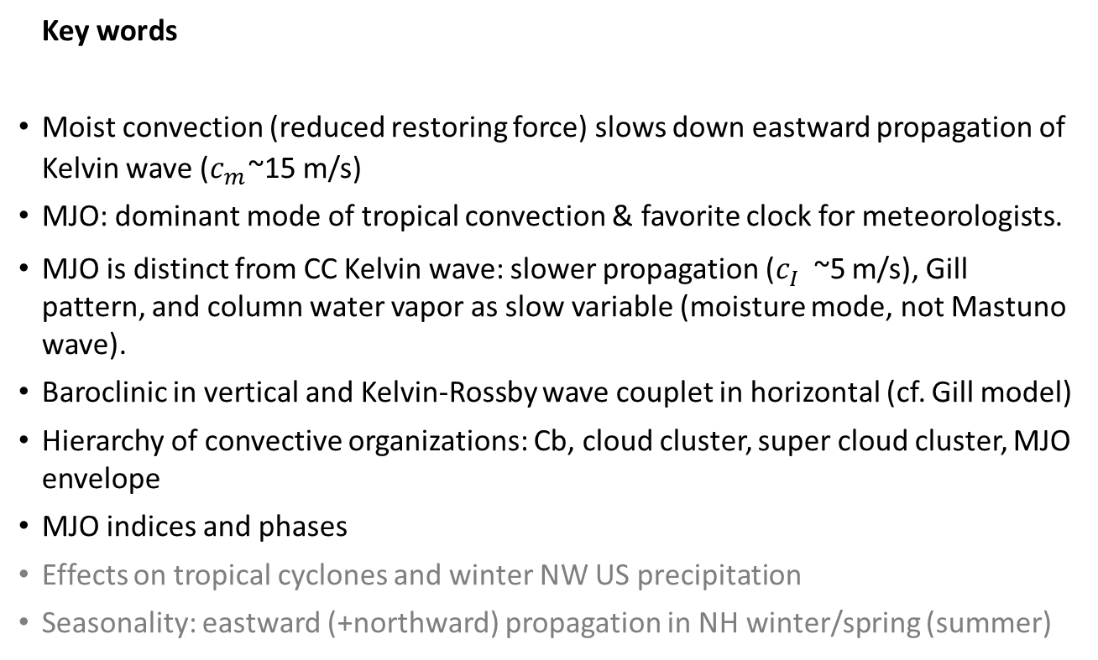
Key words
Moist convection (reduced restoring force) slows down eastward propagation of Kelvin wave ($c_{m}^{}$~15 m/s)
MJO: dominant mode of tropical convection & favorite clock for meteorologists.
MJO is distinct from CC Kelvin wave: slower propagation ($c_{I}^{}$~5 m/s), Gill pattern, and column water vapor as slow variable (moisture mode, not Mastuno wave).
Baroclinic in vertical and Kelvin-Rossby wave couplet in horizontal (cf. Gill model)
Hierarchy of convective organizations: Cb, cloud cluster, super cloud cluster, MJO envelope
MJO indices and phases
Effects on tropical cyclones and winter NW US precipitation
Seasonality: eastward (+northward) propagation in NH winter/spring (summer)

Slide 22
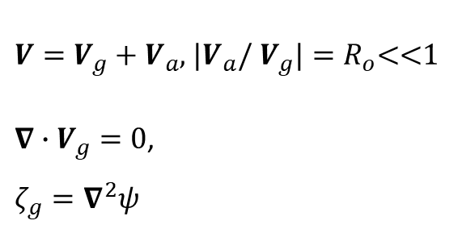

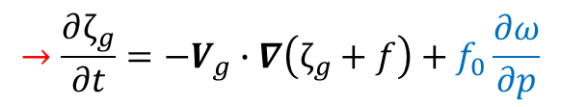

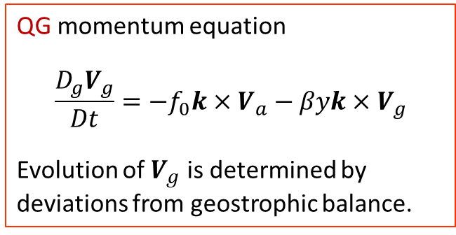
Extra. A theoretical discussion of why is MJO not a Matsuno solution?
Quasi-geostrophic theory
$V=V_{g}+V_{a}$, $|V_{a}$/ $V_{g}|=R_{o}$<<1
$∇∙V_{g}=0$,
${ζ_{g}=∇}^{2}ψ$
$$V_{g}≡k×∇ψ$$
Vorticity dynamics (Rossby waves, baroclinic instability)
QG momentum equation
$$\frac{D_{g}V_{g}}{Dt}=−f_{0}k×V_{a}−βyk×V_{g}$$
Evolution of $V_{g}$ is determined by deviations from geostrophic balance.
$$→\frac{∂ζ_{g}}{∂t}=−V_{g}∙∇\left(ζ_{g}+f\right)+f_{0}\frac{∂ω}{∂p}$$
$$\frac{D_{g}}{Dt} ≡\frac{∂}{∂t}+u_{g}\frac{∂}{∂x}+v_{g}\frac{∂}{∂y}$$

Slide 23


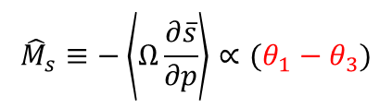
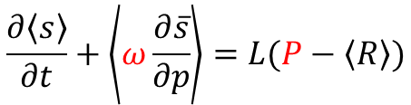
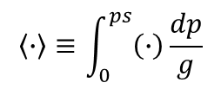


$$\left\langle ∙\right\rangle ≡\int_{0}^{ps}{\left(∙\right)\frac{dp}{g}}$$
Dry thermodynamic equation
$$〈Q_{1}〉$$
$ω=\tilde{ω}(x,y,t)Ω$(p)
c_{m}<< c → Quasi-steady
Vertical adv.
Latent heat
Radiation
$$\frac{∂\left\langle s\right\rangle }{∂t}+\left\langle ω\frac{∂\overline{s}}{∂p}\right\rangle =L(P−\left\langle R\right\rangle )$$
$${\hat{M}}_{s}≡−\left\langle Ω\frac{∂\overline{s}}{∂p}\right\rangle ∝(θ_{1}−θ_{3})$$
Dry stability
$$ds=c_{p}Tdlnθ$$
Dominant balance
Matsuno-Gill response to heat source/sink
3
1
y/Re
−1
−3
−60
0
60

Slide 24


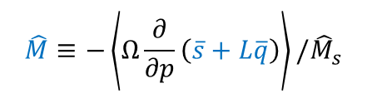


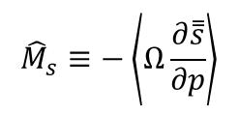
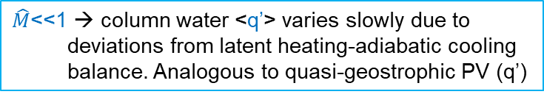
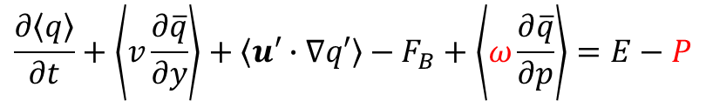

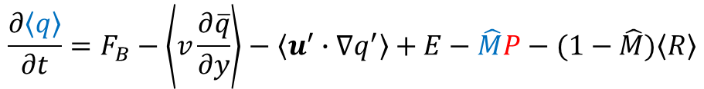
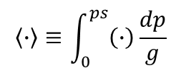


Moisture mode focuses on column-integrated moisture <q>, instead of temperature as in Matsuno’s theory.
$$\left\langle ∙\right\rangle ≡\int_{0}^{ps}{\left(∙\right)\frac{dp}{g}}$$
Angel Adames
$$〈Q_{1}〉$$
Dry stability
$$\frac{1}{L}×$$
$$\frac{∂\left\langle s\right\rangle }{∂t}+\left\langle ω\frac{∂\overline{s}}{∂p}\right\rangle =L(P−\left\langle R\right\rangle )$$
$${\hat{M}}_{s}≡−\left\langle Ω\frac{∂\overset{̿}{s}}{∂p}\right\rangle$$
Gross moist stability
$$\frac{∂\left\langle q\right\rangle }{∂t}+\left\langle v\frac{∂\overline{q}}{∂y}\right\rangle +\left\langle u′∙∇q′\right\rangle −F_{B}+\left\langle ω\frac{∂\overline{q}}{∂p}\right\rangle =E−P$$
$$\hat{M}≡−\left\langle Ω\frac{∂}{∂p}\left(\overline{s}+L\overline{q}\right)\right\rangle /{\hat{M}}_{s}$$
$$+)$$
Precip.
Eliminate $\tilde{ω}$
Eddy adv
Flux at PBL top
Meridional adv.
Vertical adv.
$$〈Q_{2}〉/L$$
$$\frac{∂\left\langle q\right\rangle }{∂t}=F_{B}−\left\langle v\frac{∂\overline{q}}{∂y}\right\rangle −\left\langle u^{′}∙∇q^{′}\right\rangle +E−\hat{M}P−(1−\hat{M})\left\langle R\right\rangle$$
$\hat{M}$<<1 → column water <q’> varies slowly due to deviations from latent heating-adiabatic cooling balance. Analogous to quasi-geostrophic PV (q’)
P = <q>/τ, <R> = - rLP, (u,v): Gill solution

Slide 25

Moisture mode focuses on column-integrated moisture <q>, instead of temperature as in Matsuno’s theory.
$$\left\langle ∙\right\rangle ≡\int_{0}^{ps}{\left(∙\right)\frac{dp}{g}}$$
Column water vapor budget w/o the balance b/w vertical transport & precip
$$\frac{∂\left\langle q\right\rangle }{∂t}=F_{B}−\left\langle \overline{u}∙∇q+u∙∇\overline{q}\right\rangle −\left\langle u^{′}∙∇q^{′}\right\rangle +E−α\left\langle q\right\rangle$$
(u,v): Gill solution
Flux at PBL top
Horizontal adv.
Eddy adv
Local stability

Slide 26
Frictional modulation of the Gill pattern
p, (u ,v)
Stream function

Slide 27

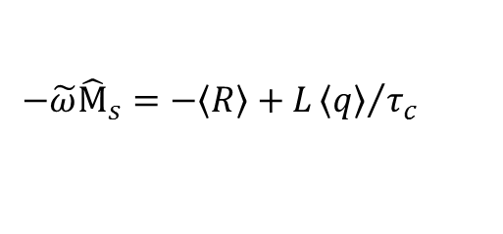
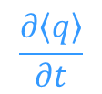
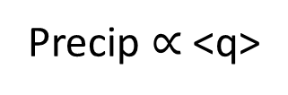

(u,v): Gill solution
V₈₅₀
$$\left\langle q\right\rangle$$
$$\frac{∂\left\langle q\right\rangle }{∂t}$$
$$\frac{∂\left\langle q\right\rangle }{∂t}$$
MSE, <q>
Beyond conv-cir FB
Partly predictive
Precip $∝$ <q>
Matsuno-Gill
Circulation
Vertical velocity can be diagnosed from
$$−\tilde{ω}{\hat{M}}_{s}=−〈R〉+L{〈q〉}/{τ_{c}}$$
Notes:
Fig. 13

Slide 28
q’ (shading), RH’ (contour)
Equatorial wave modes
Matsuno’s solutions (dry Kelvin, Rossby, Yanai) to coupled eqs of u, v, T; c=50-60 m/s.
Convectively coupled Matsuno waves: coupled eqs of u, v, T, q; c=15 m/s.
MJO: not a Matsuno T-wave, but a moisture (q) wave:
- u, v & T are quasi-steady
- Column water vapor path <q’> as the slow-varying variable due to deviation from the balance b/w vertical advection & P-E.
- c=5 m/s.
- Analogous to the deriation of quasi-geostrophic PV (q’).
(contour)
Adames & Wallace (2015, JAS)

Slide 29
Wind-moisture relation
Adames & Kim 2016, JAS
•
The wind anomalies are a balanced response to the heating: the Matsuno-Gill model.
•
Moisture in the mean decays exponentially with the square of the distance from the equator.
Matsuno-Gill response to heat source/sink
3
Horizontal structure of a wavenumber 2, linear moist wave. Q contoured, ɸ shaded.
1
y/Re
−1
−3
−44 −36 −28 −20 −12
−4 4
χϕ (m² s⁻²)
12 20 28 36 44
−60
0
60
7

Slide 30
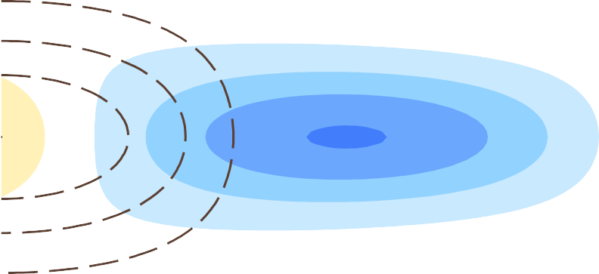
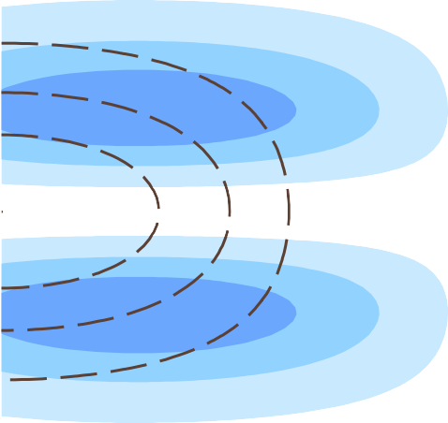
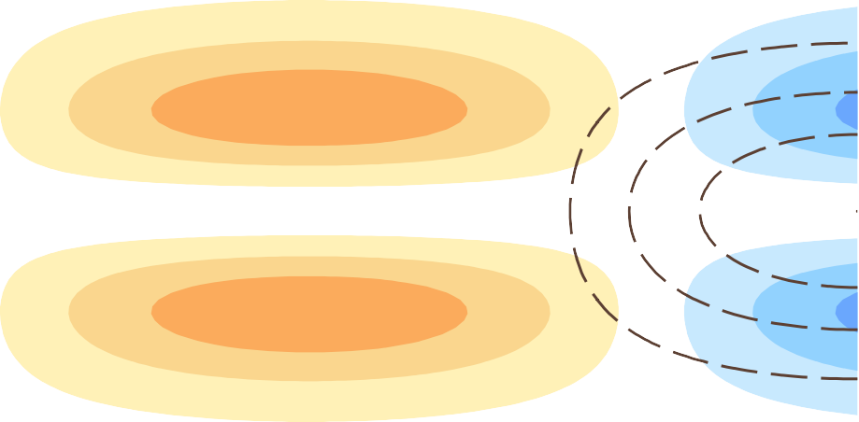
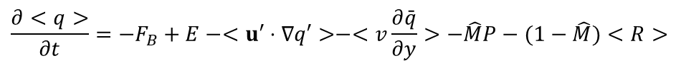
Propagation of the moist wave
Adames & Kim 2016, JAS
$$\frac{∂<q>}{∂t}=−F_{B}+E−<u′⋅∇q′>−<v\frac{∂\bar{q}}{∂y}>−\hat{M}P−(1−\hat{M})<R>$$
Au
3
Zonal
1
y/Re
−1
The winds in the Matsuno- Gill response lead to eastward propagation.
−3
cp
Bv
Meridional
3
1
y/Re
−1
Figure: Moistening (red shading) and drying (blue shading) induced by zonal (top) and meridional (bottom) wind-driven processes.
−3
−60
0
Longitude
60
8

Slide 31
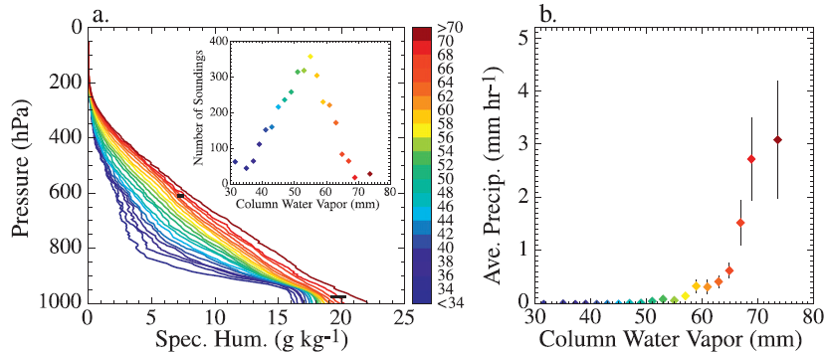
P = r <q>
Column vapor
Holloway and Neelin 2009, JAS

Slide 32
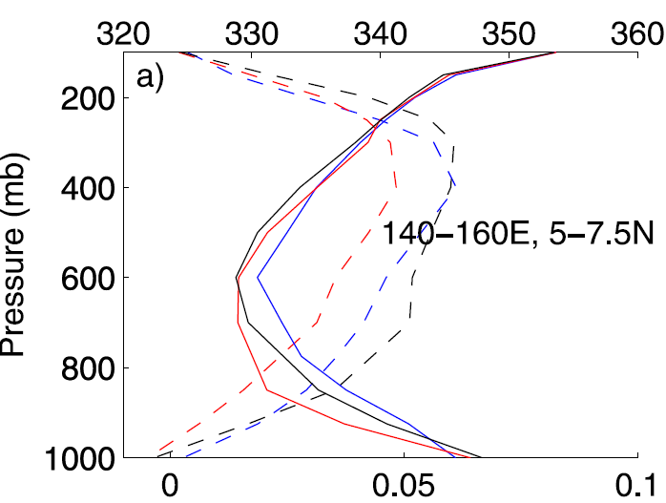
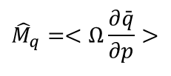




In parallel to derivation of quasi-geostrophy
$$⇒\frac{∂<q>}{∂t}=F_{B}−<v\frac{∂\bar{q}}{∂y}>−<u′⋅∇q′>−\hat{M}P−(1−\hat{M})<R>+E$$
P = <q>/τ
Convective
Parameterization
Vertical adv.
$$\hat{M}=\frac{{\hat{M}}_{s}−{\hat{M}}_{q}}{{\hat{M}}_{s}}=−<Ω\frac{∂}{∂p}(\bar{s}+L\bar{q})>/{\hat{M}}_{s}$$
$$ω=\tilde{ω}(x,y,t)⋅Ω(p)$$
Moist stability
<< 1
$${\hat{M}}_{s}=−<Ω\frac{∂\bar{s}}{∂p}>$$
$${\hat{M}}_{q}=<Ω\frac{∂\bar{q}}{∂p}>$$
Moisture
stratification
Dry stability
Ω
MSE
(u,v) follows the Gill solution for free-tropospheric response to MJO heating.
Moist static energy (MSE) in deep tropics is large in both lower and upper troposphere

Slide 33

Seasonality of MJO ← SST control of convective feedback
Winter: pronounced eastward propagation.
Summer: a northeastward propagation from the Bay of Bengal to Northwest Pacific; a secondary center of action in the NE Pacific off Central America.
Fig. 4.12 MJO standard deviation of Precipitation (mm/day, shaded) and mean SST (27, 28 and 29°C contours) for (a) Dec–Mar & (b) Jun–Sept of 1997-2020.

Slide 34

Hierarchy of convective organization
Super cloud clusters (a few 10³ km): eastward
Cloud clusters (a few 10² km): westward
Cumulonimbus clouds (~10 km): random
Westerly wind bursts often occur west of convective organizations. Why?
Nakazawa (1988, JMSJ)
Based on 3-hourly data

Slide 35


Summer MJO
850-hPa Velocity Potential & (u,v)
Precipitation (May-Sep)
Northward propagation in Indo-WP sector, in addition to eastward propagation;
Positive air-sea feedback in Indo-WP
Strong convective anomalies in the eastern Pacific warm pool;
Modulations of tropical cyclones;
Indian monsoon active-break cycle.
Phase 2
Phase 3
Phase 4
Phase 5
Phase 6
Phase 7
Phase 8
Phase 1
Notes:
http://www.cpc.ncep.noaa.gov/products/precip/CWlink/MJO/Composites/Tropical/precip.shtml

Slide 36

OLR
Twin cyclones at 90E & westerly wind burst
High wind recorded on R/V Revelle at 80E, Eq. during the DYNAMO field experiment

