Slide 1
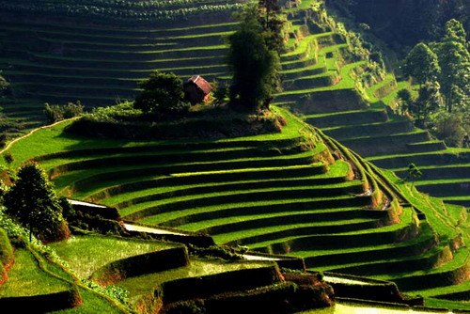
5. Monsoons of
Asia, Africa, and N America
Notes:
5.0, 5.1, 5.3,

Slide 2
Great Monsoons of Asia
Summer monsoon of Asia is dominated by southwest winds near surface.
Tibetan Plateau: an elevated heat source in summer and a wind block in winter.
Tectonic mountain building since 50 million years ago when the Indian Plate collided with the Eurasian Plate.
Monsoons aid sailing b/w China, India and Africa for millennium.
July
January
Land topography (km) & wind (m/s) at 925 hPa
Notes:
The seasonal cycle of temperature is the most predictable variation. In some parts of the world, distinct seasonal cycle is also found in wind and rainfall.

Slide 3
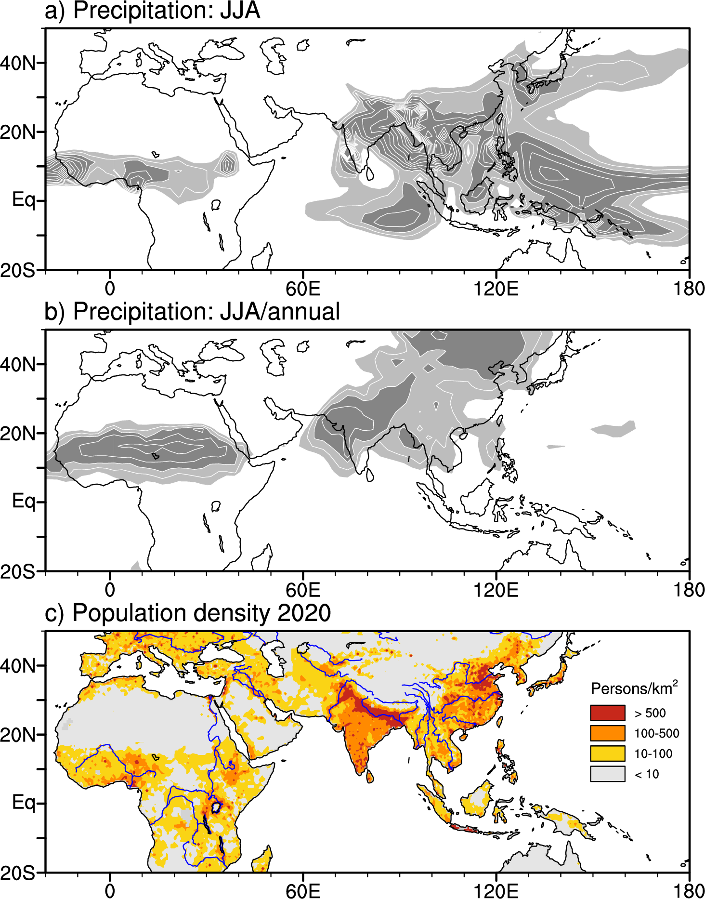
400, 600 mm
Summer rainy season
0.4, 0.6
Fig. 5.2.
Notes:
https://sedac.ciesin.columbia.edu/data/set/gpw-v4-population-density-rev11

Slide 4
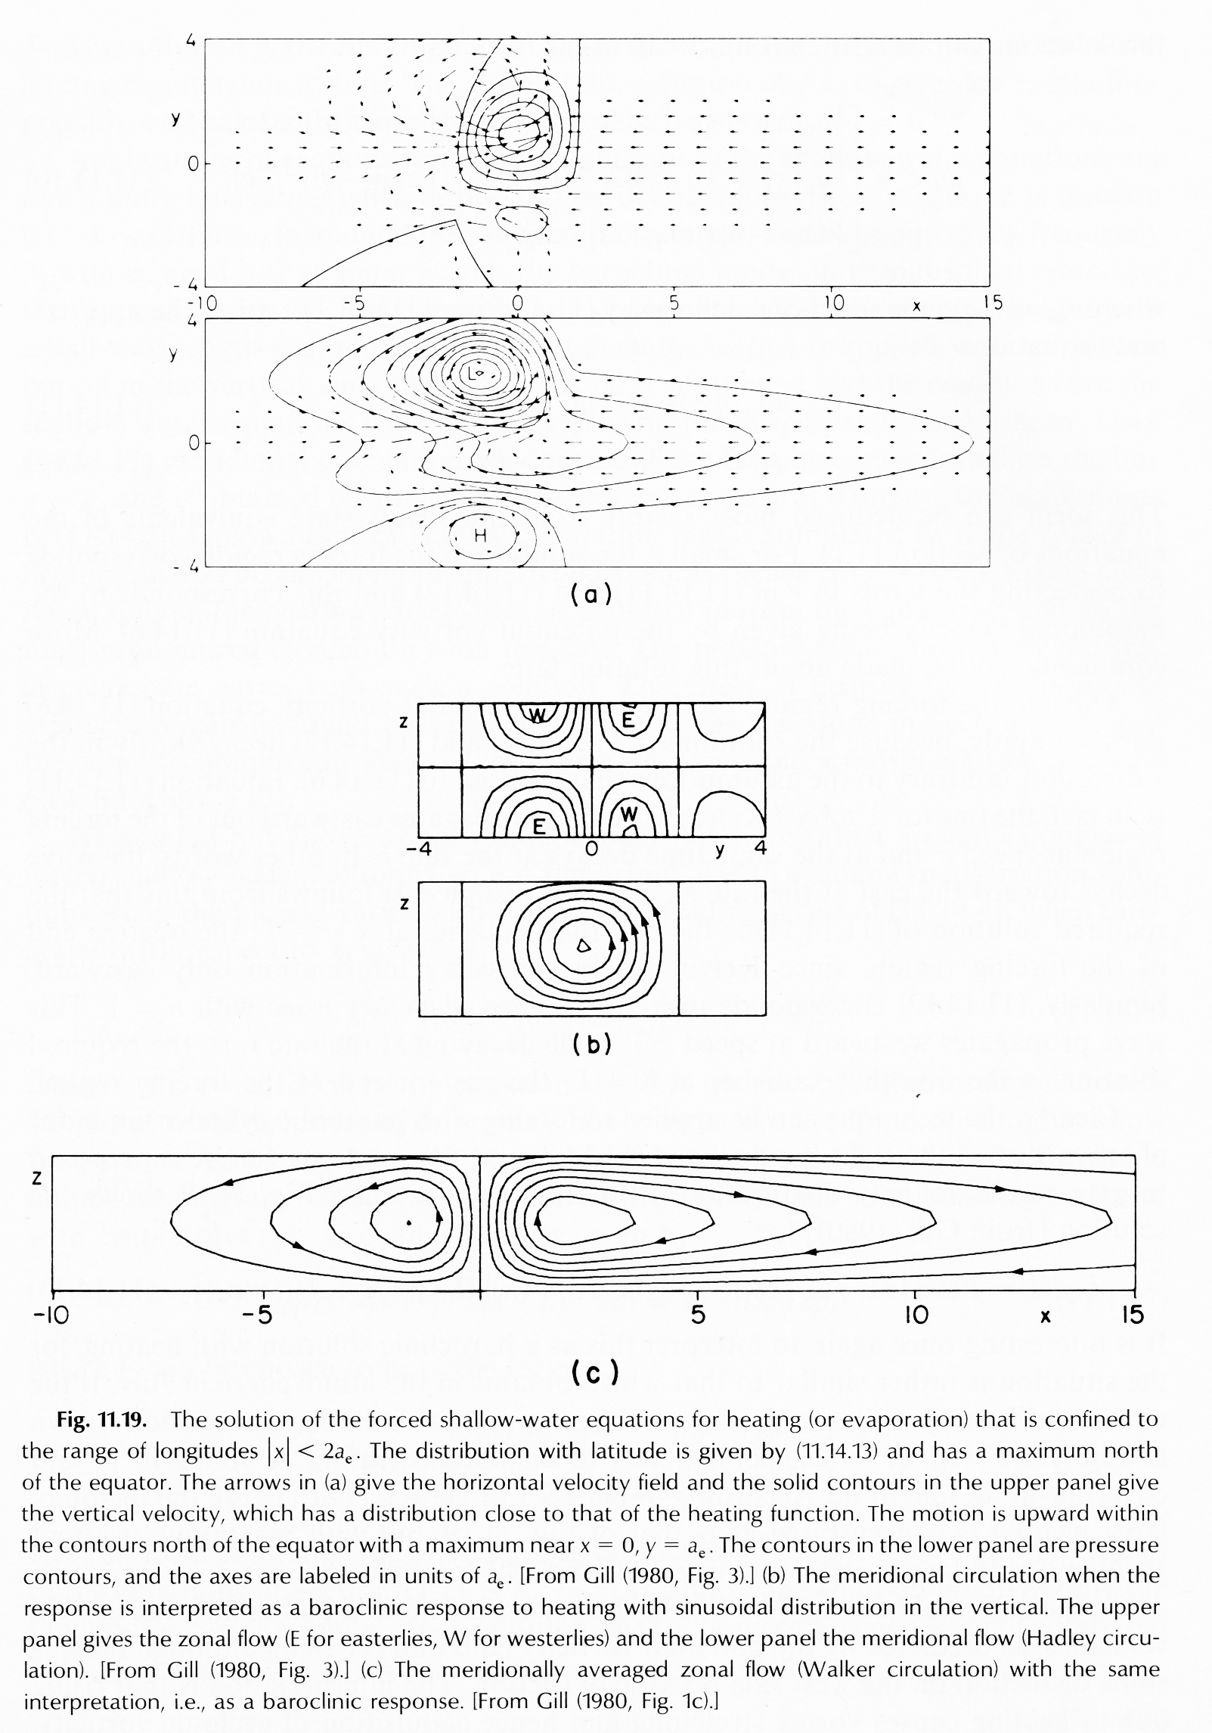
Boreal summer
descent
Response to the northward-displaced monsoon heating
Strong warm Rossby wave response w/ subsidence in summer hemisphere.
Cross-equatorial wind to the west (Rossby response)
Low-level southwesterlies, and easterly vertical shear north of Eq.
Fig. 5.3

Slide 5
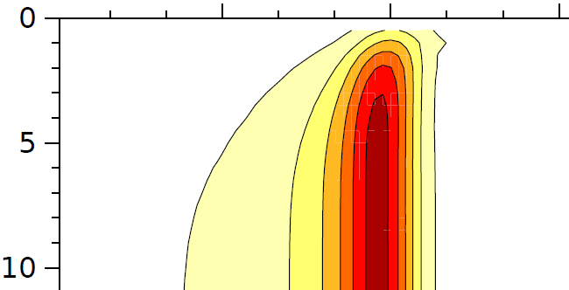
Z₂₀₀ @20N
Time (days)
Hovmoller diagram of geopotential height at 200 hPa in response to an isolated heating centered at 20N, 180E. Courtesy of A. Miyamoto.

Slide 6
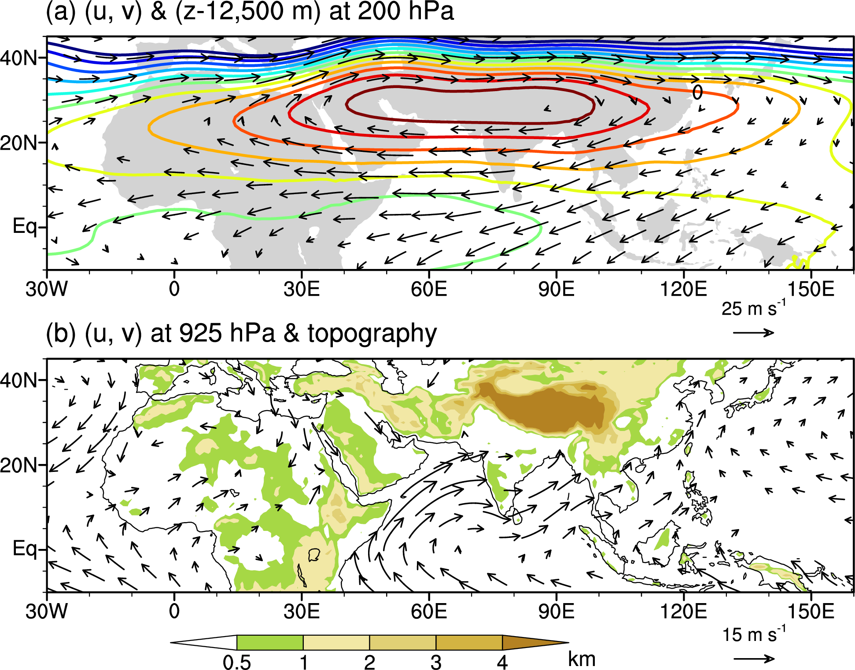
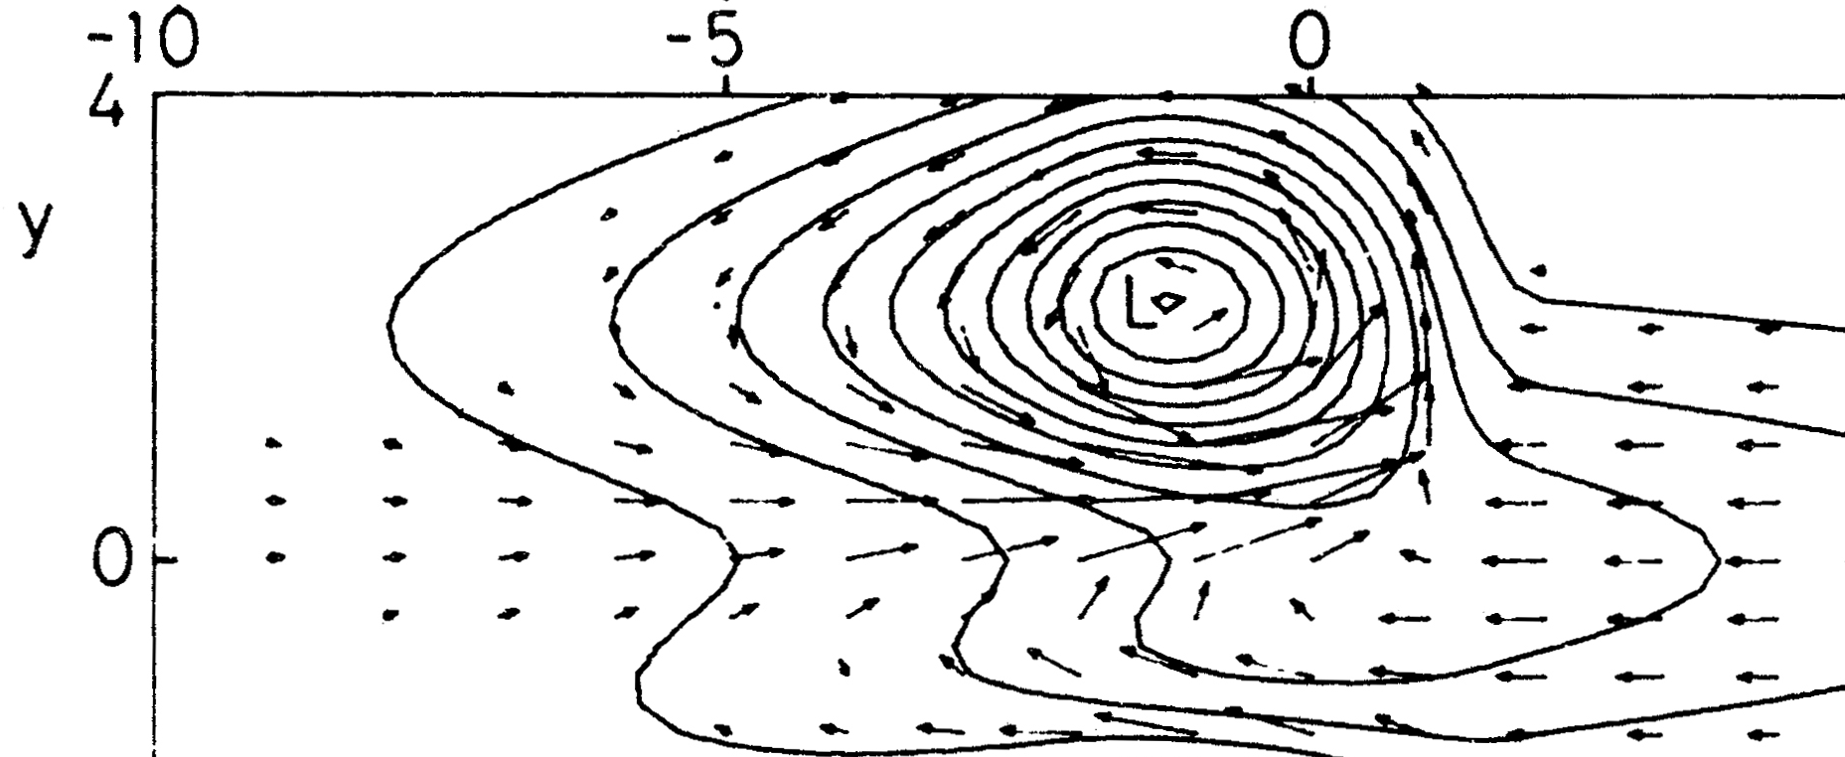
Summer monsoon (July)
In upper troposphere, the Asian high, with easterlies in the subtropics (extending west to Africa).
At low levels, strong southwesterlies over the Indian Ocean to the western Pacific;
Baroclinic circulation consistent with the Gill model in response to off-equatorial heating.
(u, v) & (z-12,500 m) at 200 mb
x
Gill’s solution @low level
Fig. 5.4
(u, v) 925 mb
Why are there no tropical cyclones over Indian Ocean during summer?

Slide 7

July wind & SST, topography (km)
Findlater jet: a summer wind jet steered by East African highlands with sustained speed of 13 m/s or greater.
Somali upwelling: forced by the SW wind jet with minimum SST~20ºC, 10ºC cooler than on the warm equator/Bay of Bengal
Socotra dragon tree
Socotra’s annual ritual of fetching supplies from mainland Yemen in prep for the jet onset.
Fig. 5

Slide 8
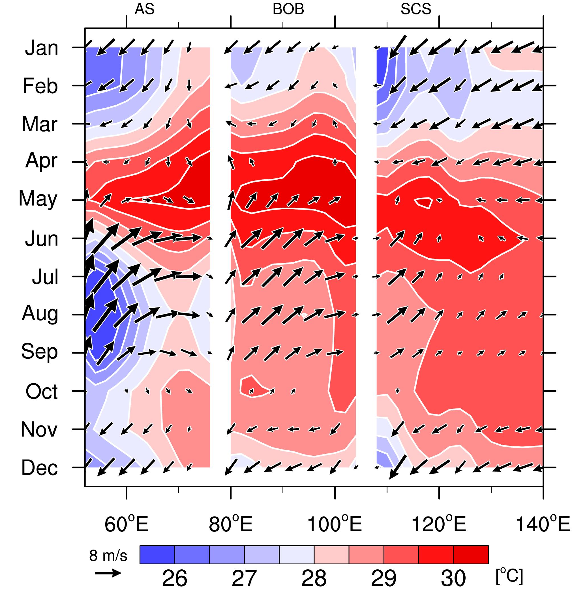
Arabian Sea
South China Sea
Bay of Bengal
SST peaks in inter-monsoon May.
Following SW monsoon onset,
─ cloud cover and wind speed increase;
─ SST cools → a negative ocean feedback?
SST (shades) and 10m winds at 11ºN
Fig. 5.13.

Slide 9
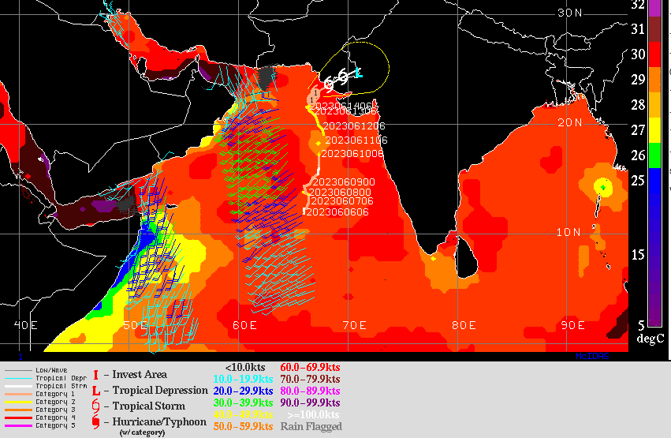
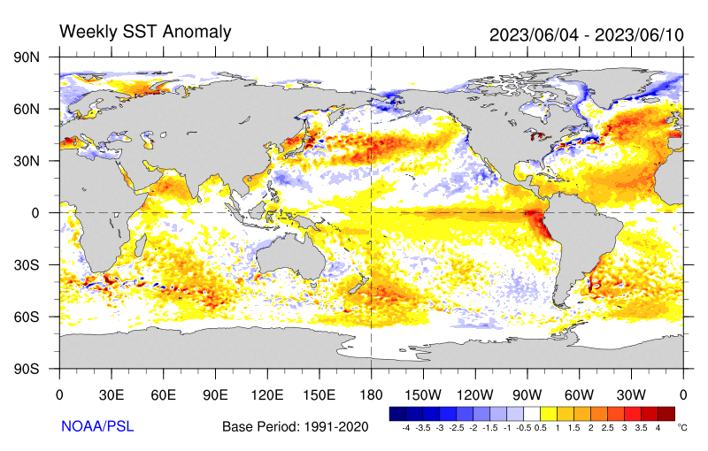
Cat 2 Cyclone Biparjoy on 6/14/2023
SSTA~2C in N Arabian Sea
ASCAT wind

Slide 10
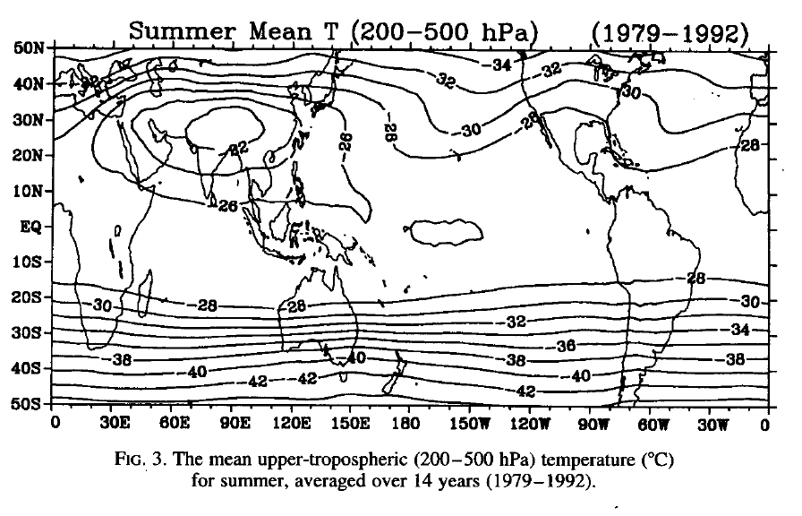
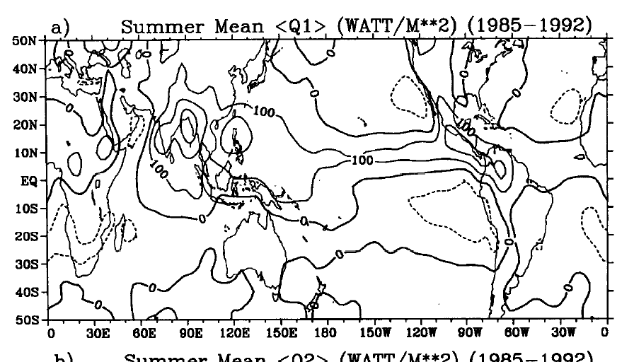
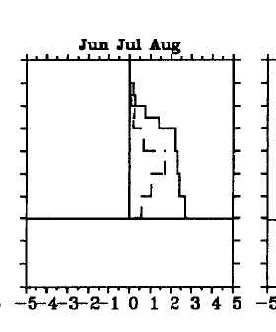

W
E
Reversed NS temperature gradient: effects of convective heating over India, Bay of Bengal, and NW Pacific
Q1
Pressure (mb)
Q2
Q1
Tibetan Plateau
Bay of Bengal
Li & Yanai (1996, JC)
Notes:
Emphasize temp max and northward displaced westerly jet → warm advection for Meiyu.
Why Q1> Q2? Sensible heating from the ground

Slide 11
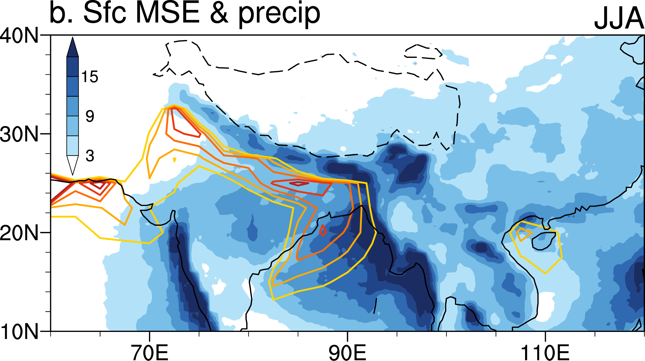
MSE/c_{p} (>350K) & rainfall
Orographic effect: elevated heating or barrier that protects high-MSE air south of the Himalayas from low-MSE air to the north
Moist static energy
m = c_{p}T+gz + Lq
Boos & Kuang 2010; Cane 2010, Nature
Notes:
Emphasize high latent energy that allows deep convection south of Himalayas.

Slide 12

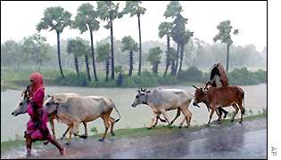
In April and May—day after day—temperatures burned above 45ºC, earth was parched, no cloud in sight, no water ran in river channels. When one or two cumulus clouds appeared in the sky, I would jump out and admire them. Some days later, Monsoon arrived. In no time, trees turned green, grass grew, temperature dropped to a pleasant level. Children ran around joyfully in the rain and farmers turned busy. Monsoon's drama has opened on the seasons’ revolving stage.
— From Monsoon by Takio Murakami in describing his observations in 1960 as a WMO research advisor in India (translation: SPX & GES)
Monsoon Onset
Notes:
WMOの指導員としてインド熱帯気象研究所へ行くことになった．同じ頃（昭和41年），アメリカから招待状が来ていた．今度，アメリカヘゆく時は，気象庁をやめる気でいた．

Slide 13
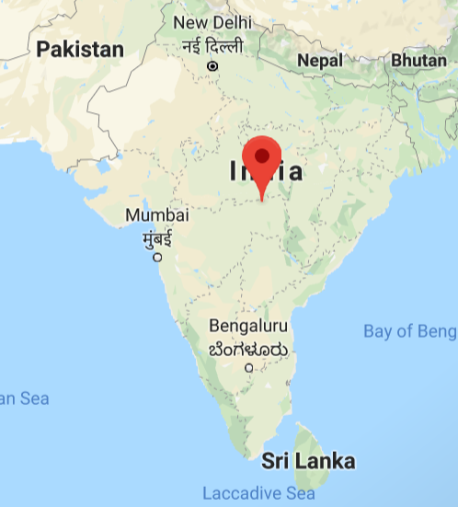
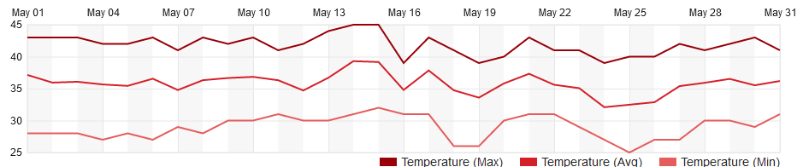
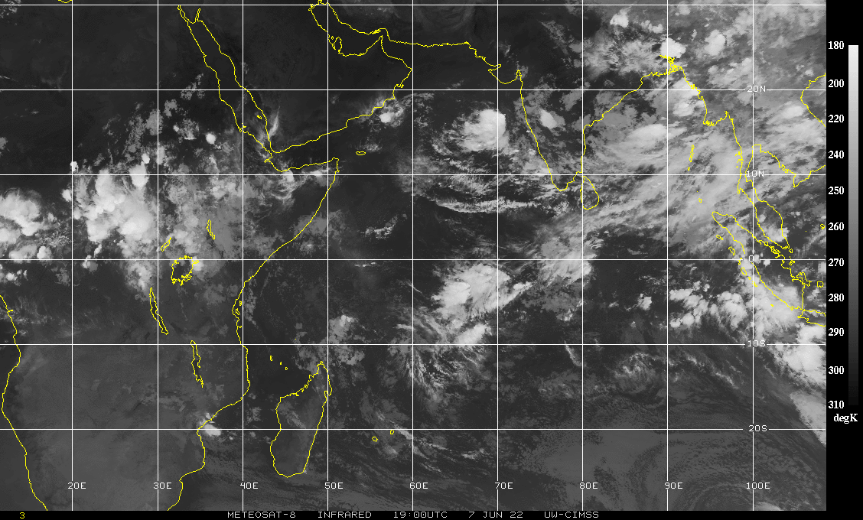
Pre-monsoon heatwave: Dry land surface heats up quickly because of small heat capacity and lack of evaporative cooling.
2022
Tmax (ºC)
Nagpur, India
IR, 6/7/2022
Post onset
Scattered convection over India
Suppressed convection over IO
Notes:
https://www.wunderground.com/forecast/in/nagpur

Slide 14
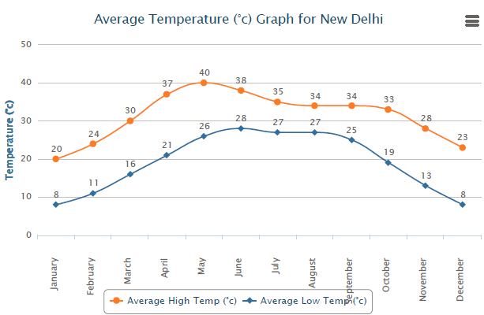
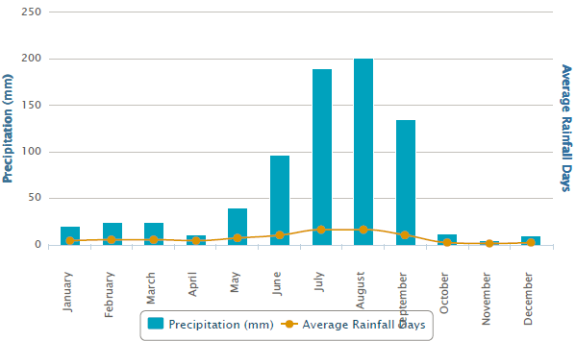
Moist static energy
m = c_{p}T+gz + Lq
T_{max} on 4/12/16 in New Delhi: 44ºC (110 F)

Slide 15
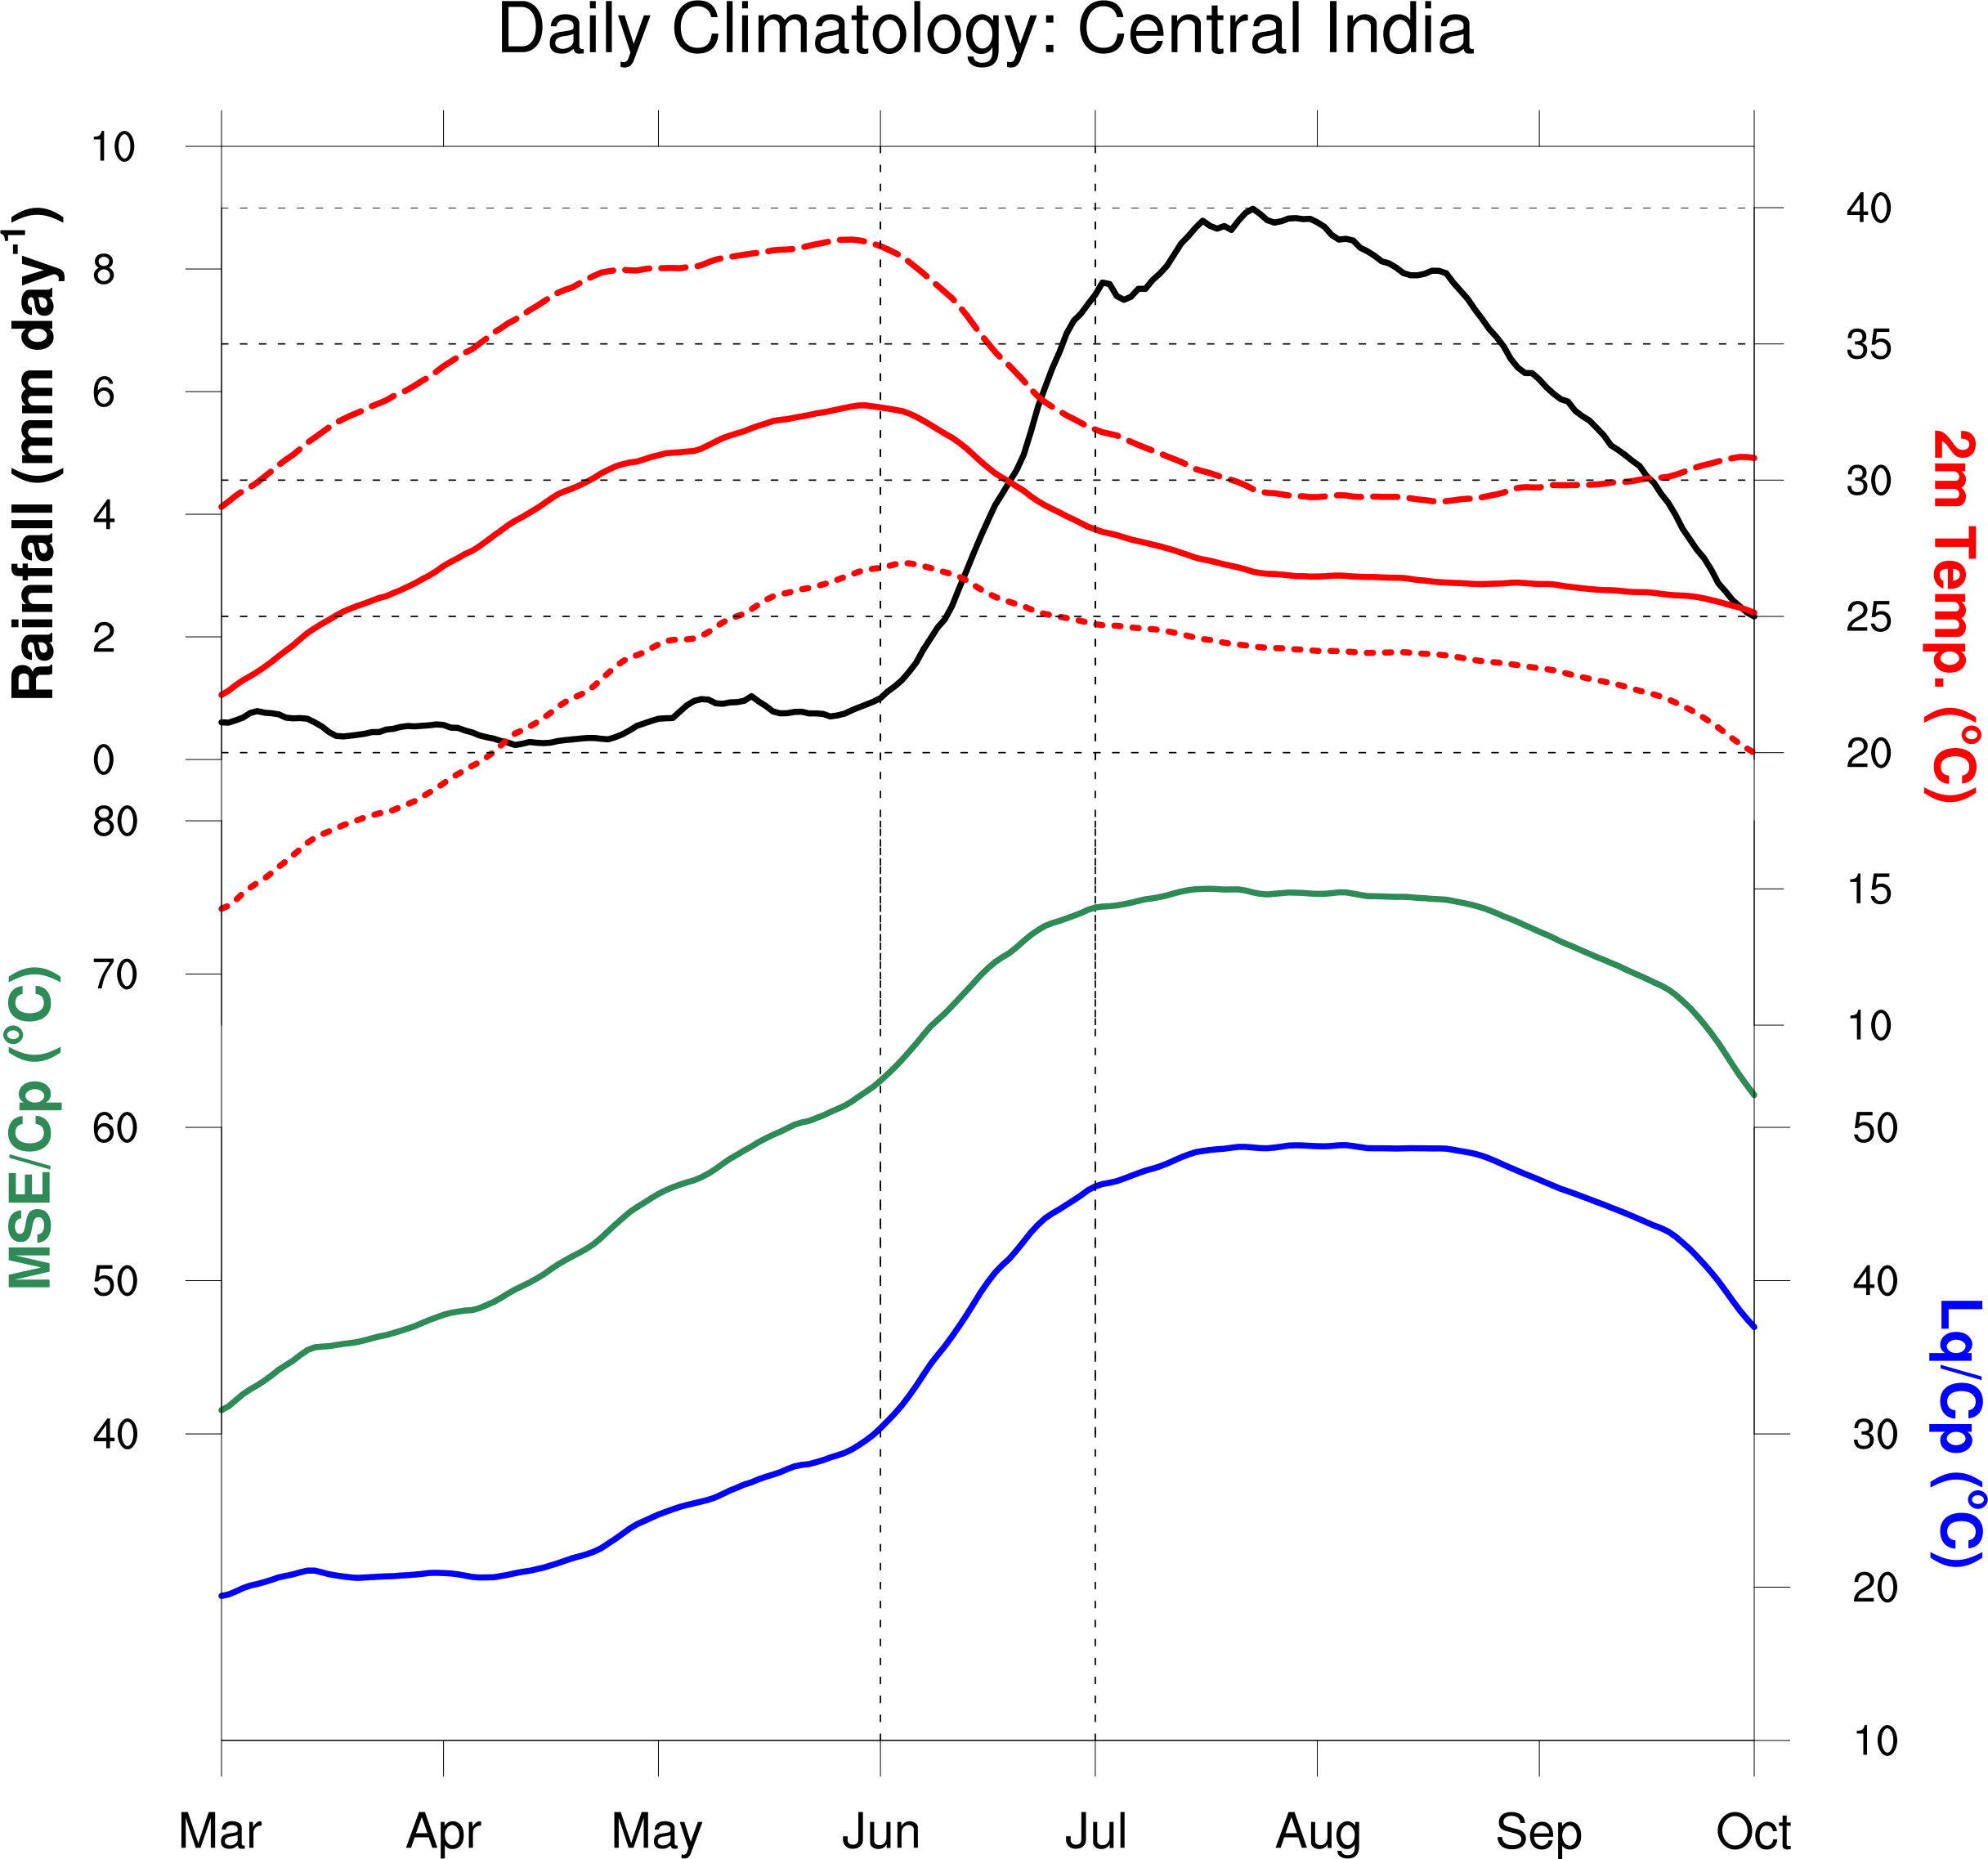
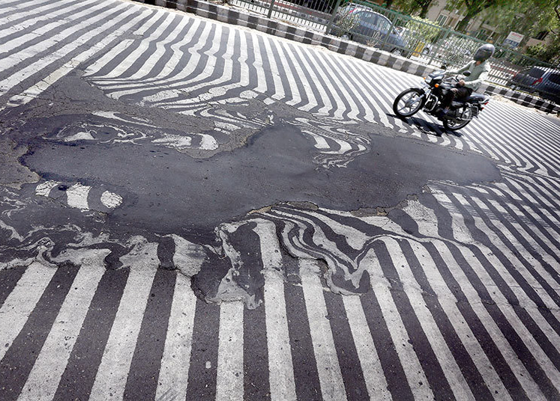
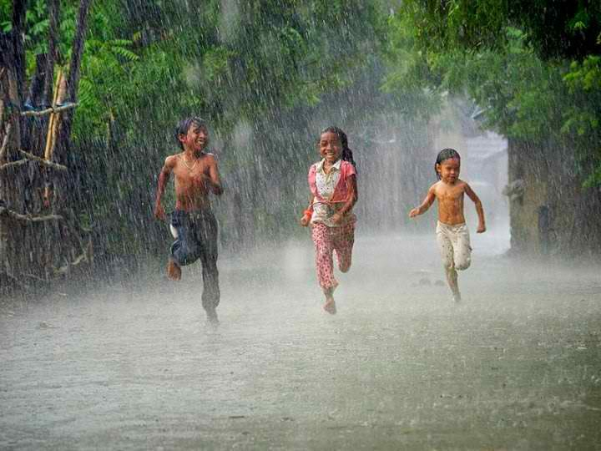
Precip
T
Moist static energy
m = c_{p}T+gz + Lq
Monsoon onset
What triggers the onset?
T+Lq/c_{p}
Monsoon convection driven by land-sea contrast in energy, not surface temp.
Lq/c_{p}
New Delhi, May 2015
Notes:
Emphasize high latent energy that allows deep convection.

Slide 16
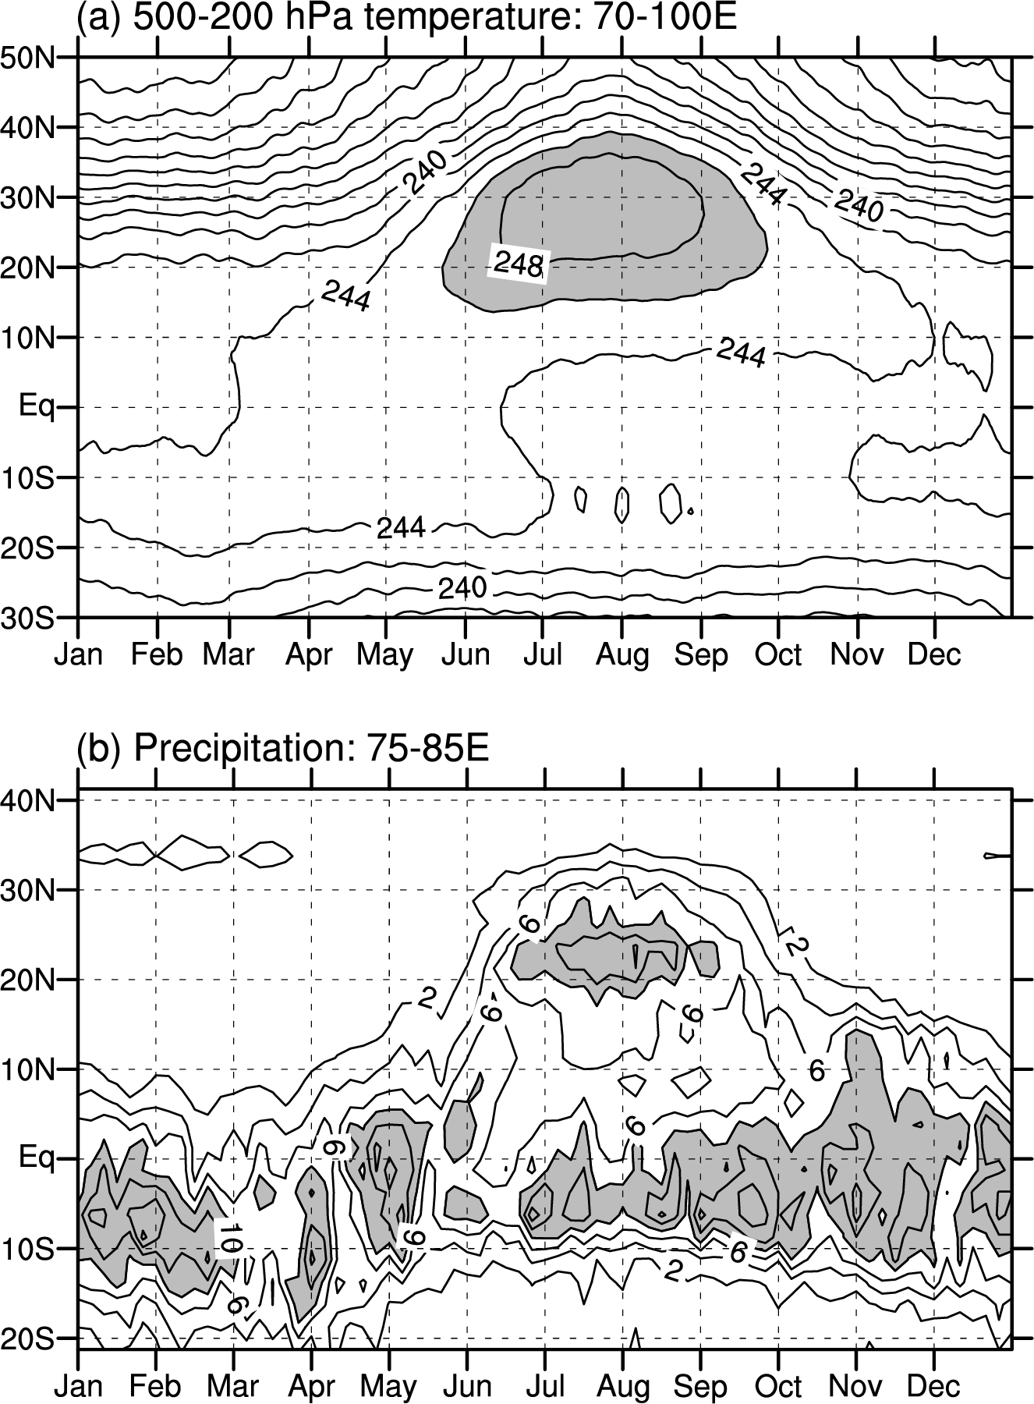
W
Tropospheric temp grad. begins reversing in May but major convection commences over India/BoB in June and lasts through August.
Westerly jet shifts from south to north of Tibet in summer.
Asymmetry between dry spring and wet fall equinoxes.
Monsoon onset 2 months after surface dT/dy reveres. Why?
X Moderate pre-monsoon Q1 despite high SAT.
Convective heating
W
E
x
C
Equinox
Solstice
Equinox
Dry
Wet
Fig. 5.11
Notes:
春分，夏至

Slide 17
Pre-monsoon
shallow overturning
south westerly jet
Summer monsoon
deep overturning
north westerly jet
u
Vapor transport
Fig. 5.10. Local Hadley cell (streamlines) and zonal wind velocity (m/s) in 78-90E in (a) April and (b) July.

Slide 18
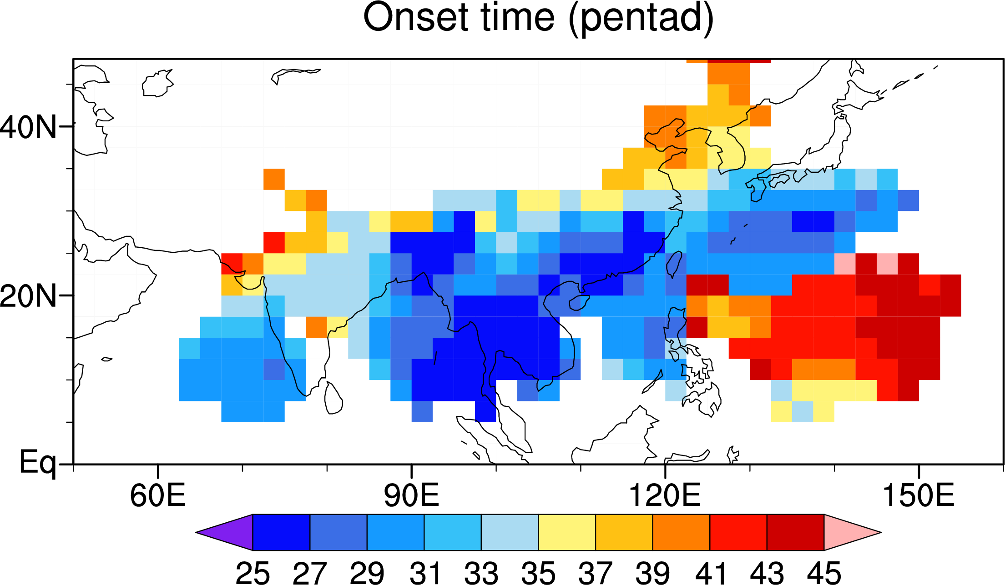
JJA precipitation
Meiyu-Baiu
Why is Sahara a desert while E Asia is blessed with monsoon rains?
Westerly jet
E Asia
S Asia
NW Pac
June
July
August
Sub-systems of Asian–Pacific monsoon
tropical: Indian and (oceanic) NW Pacific summer monsoon
subtropical: East Asian summer monsoon
Fig. 5.20.

Slide 19
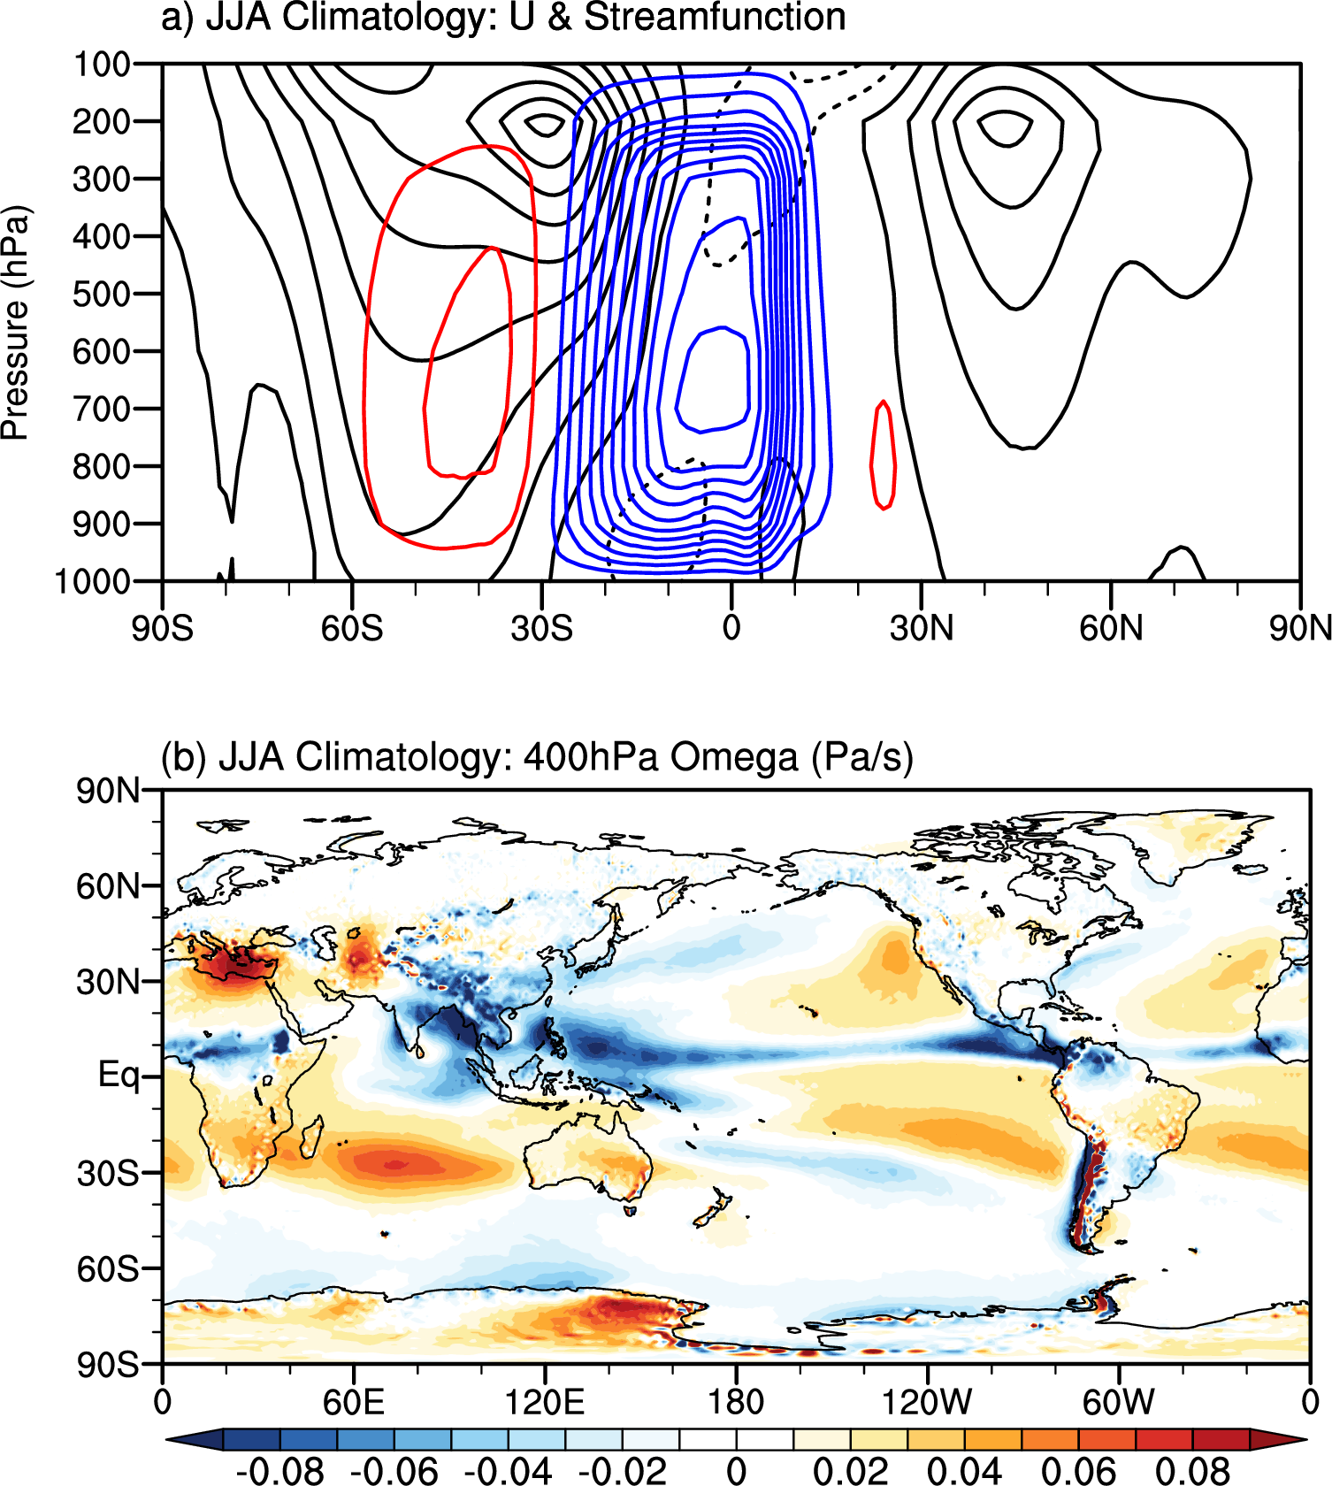
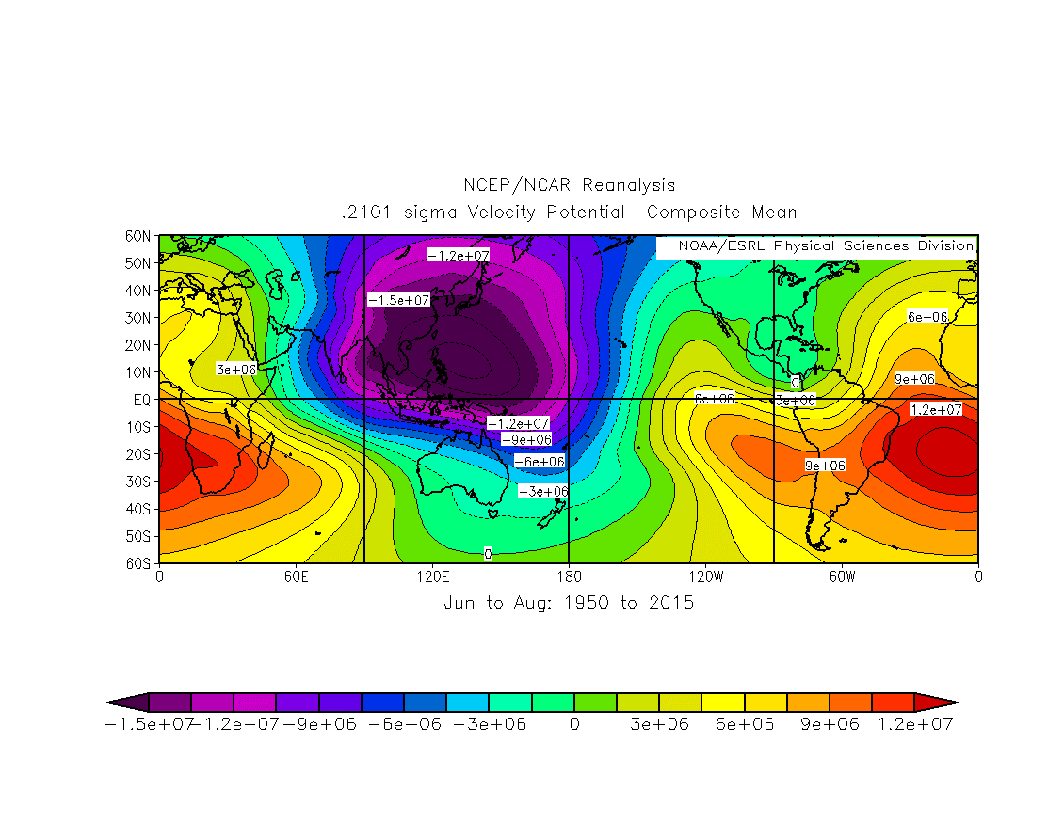
Summer Hadley subsidence is weak & zonal variations are large
Velocity potential
Fig. 5.21. Summer (JJA) climatology. (a) Zonally integrated meridional streamfunction (color contours, 2x10⁻¹⁰ kg/s intervals with zero omitted) and zonal-mean zonal wind (black contours, 5m/s intervals, easterly dashed). (b) vertical velocity at 400 hPa.

Slide 20
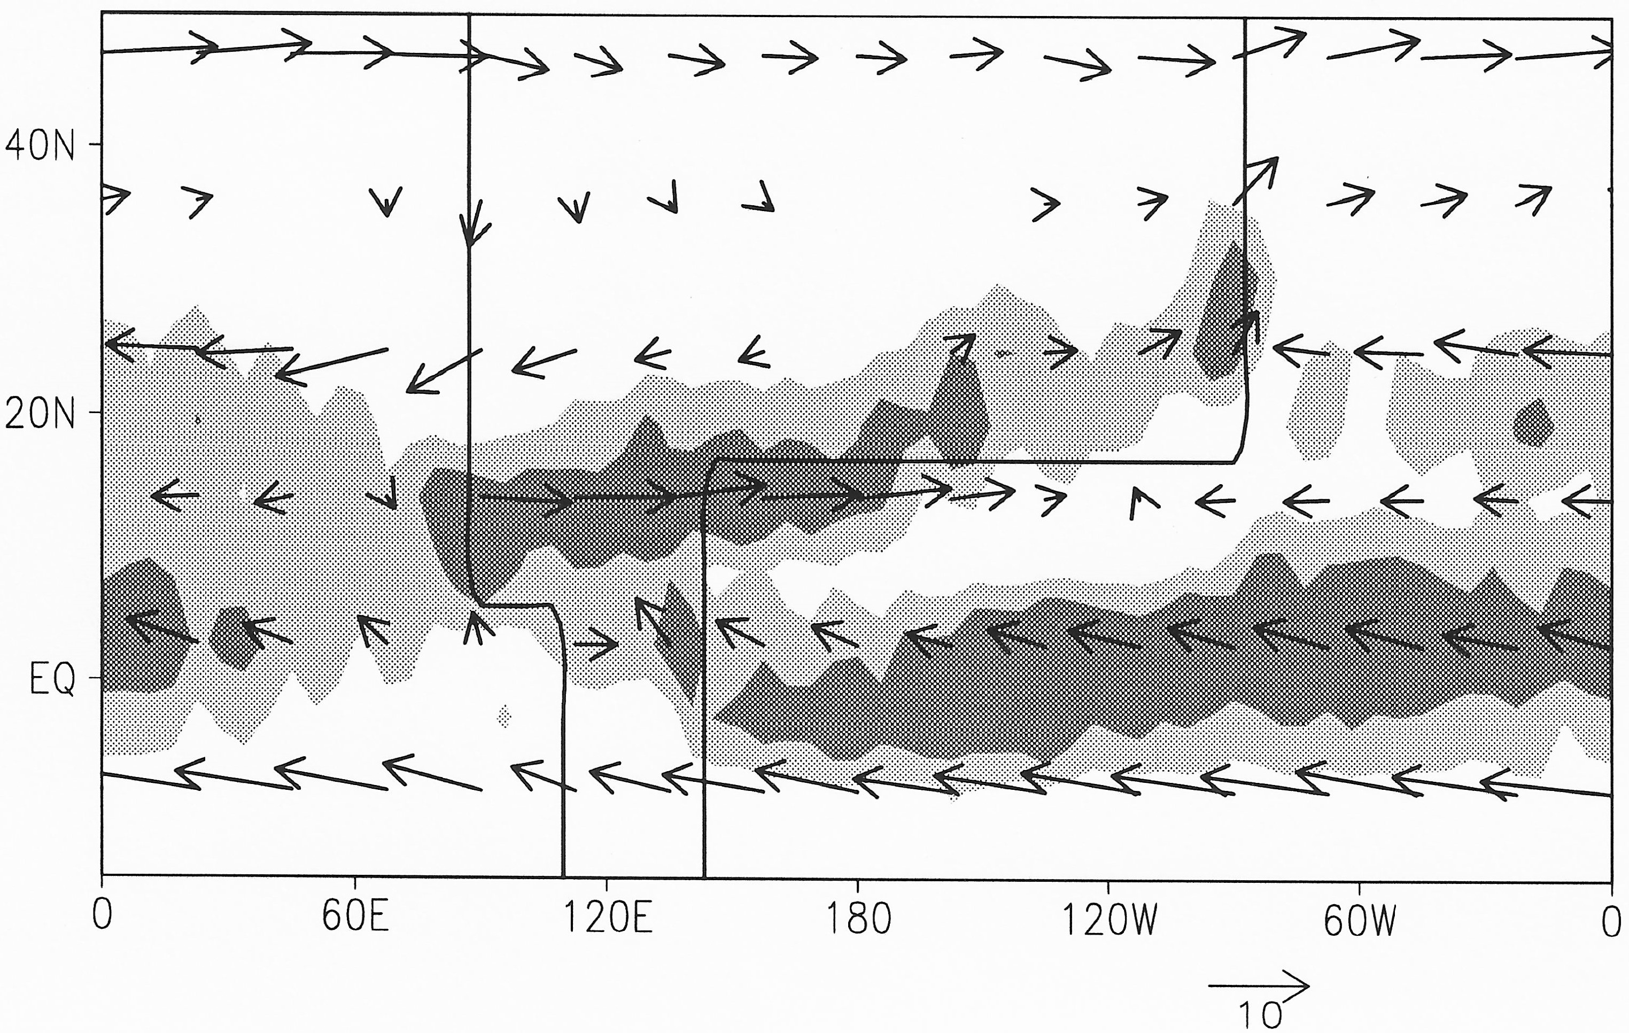
Cross-continental Connection: SE Asia & Africa
H
H
TB
Fig. 5.22. JJA precip & sfc winds in AGCM (flat land & zonally uniform SST)
x
West control on desert formation
Gill’s solution
Discuss thermodynamic balance in warm Rossby wave excited by SE Asian monsoon.
descent
Thermal high over the sea → northward/southward advection on east/west continent → wet east vs. dry west subtropical continent (Xie & Saiki 1999, JMSJ).
Adding Tibet forms a cyclonic circulation, strengthening east-west asymmetry.
Monsoon heating excites subsidence Rossby waves to the west: monsoon-desert mechanism (Rodwell & Hoskins 1996).

Slide 21
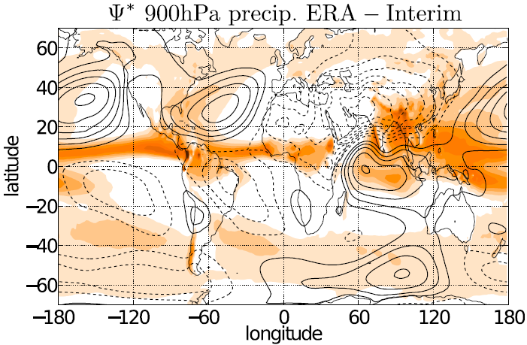
H
H
Comparison with obs
H
H
Fig. 5.22. (a) JJA rainfall (light/dark shading ≥ 3/6 mm/day) and 850 hPa wind in an atmospheric GCM experiment with an idealized Afro-Eurasian continent (Xie and Saiki 1999, JMSJ). (b) JJA precipitation (orange shading) and 900 hPa streamfunction (zonal mean removed) in observations. Shaw (2014, JAS)

Slide 22
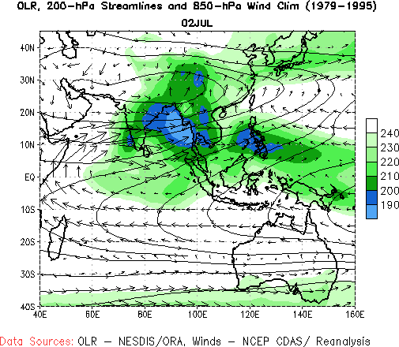
Monsoon Climatology

Slide 23
Key words
Winter NE monsoon, wind direction, maritime Silk Road
Summer SW monsoon, wind direction, rainfall over Asia
Findlater jet, Somali upwelling
Upper-level South Asian high, easterly wind shear over India, tropical cyclones
Monsoon onset, surface air temperature over India, soil moisture effect
East-west contrast between wet East Asia and dry Sahara on the Afro-Eurasian Continent
Orographic effects: the Tibetan Plateau, thermodynamics in subsidence Rossby wave, monsoon-desert mechanism, sub-systems of the Asian summer monsoon
Other narrow mountains, major convection centers of monsoon,
Asian monsoons are subject to strong intraseasonal variability
African monsoon: the Sahel, Sahara, African easterly jet, easterly waves
North American monsoon, gulf moisture surges, transition from Mediterranean to monsoon regime, mid-summer drought, orographic & diurnal effect
How does the summer monsoon differ from the diurnal sea breeze?
Notes:
When does SST off the Somali coast peak? Describe important processes for summer SST off the Somali coast.

Slide 24
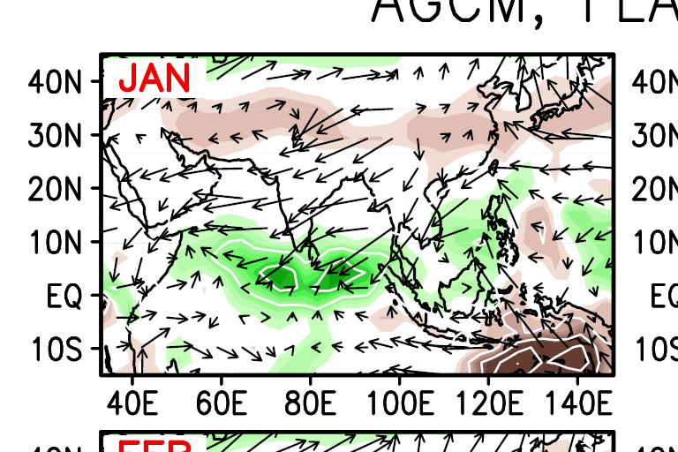
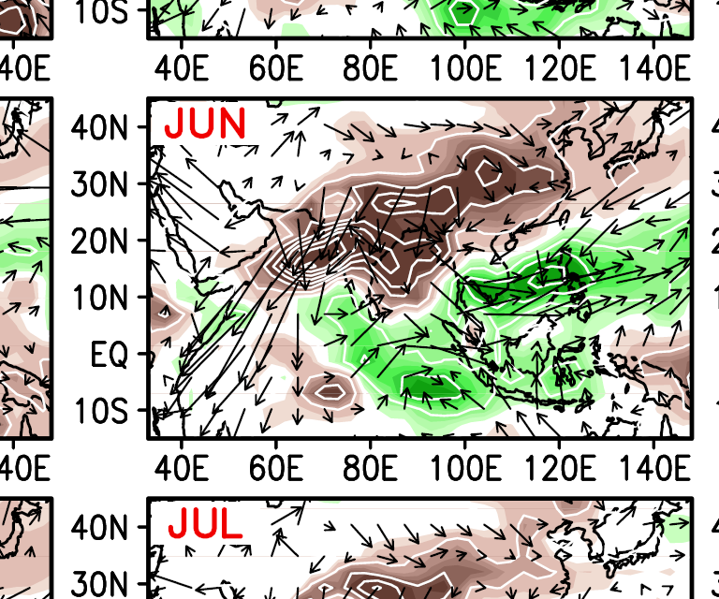
Role of the Tibetan Plateau
Its removal in models results in
Winter: intensified NE monsoon as cold/dry air surges onto the IO without the mountain blockage.
Summer: weakened SW wind in the Arabian Sea without the elevated surface heating; reduced precip over entire South and East Asia.
Monthly climatological difference b/w the AGCM experiments (FLAT minus CTRL run): precipitation (mm/day) and surface wind (m/s). Okajima 2006, PhD thesis.

Slide 25
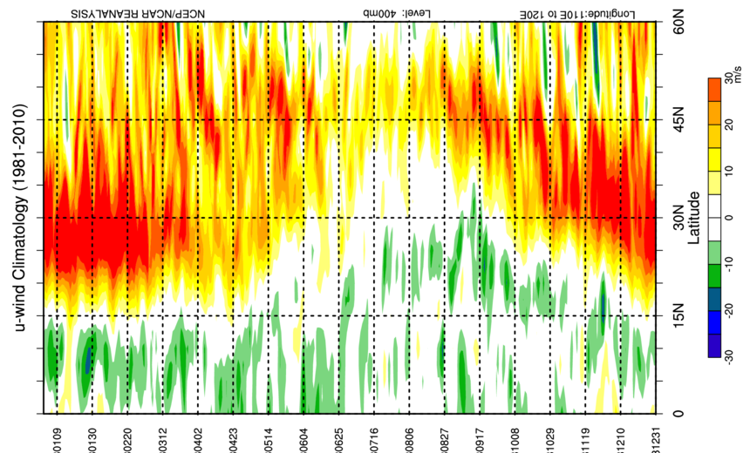

Slide 26
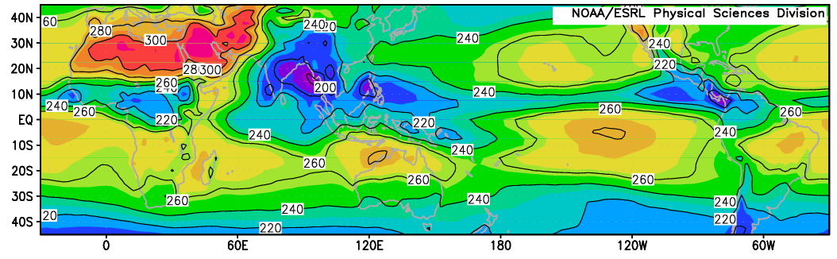
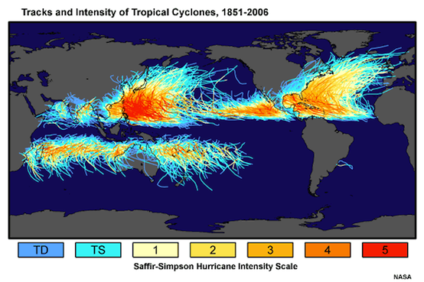
July OLR (W/m²)
At the height of the monsoon (JJA), the Bay of Bengal sees the tallest convection on Earth but there are no tropical cyclones. Why?

