Slide 1
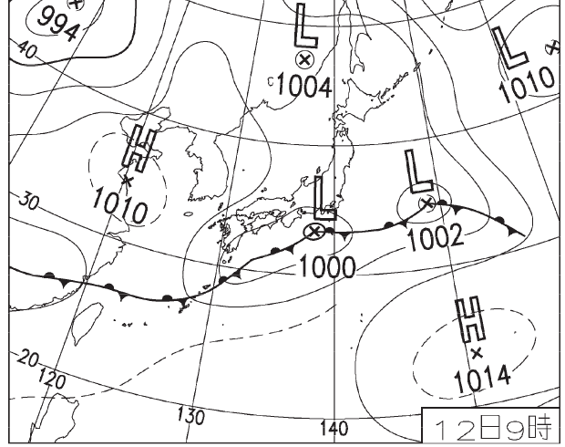
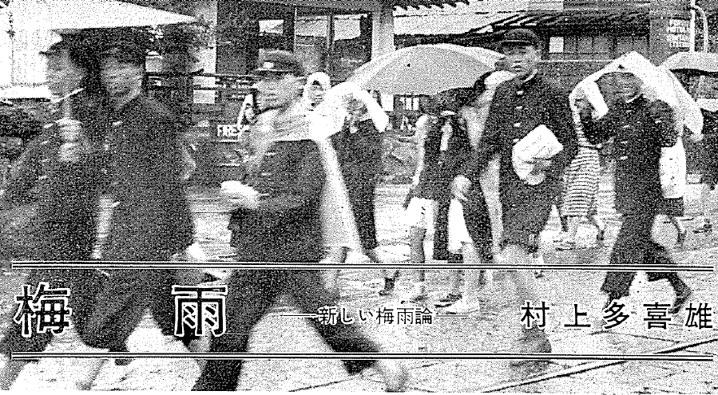
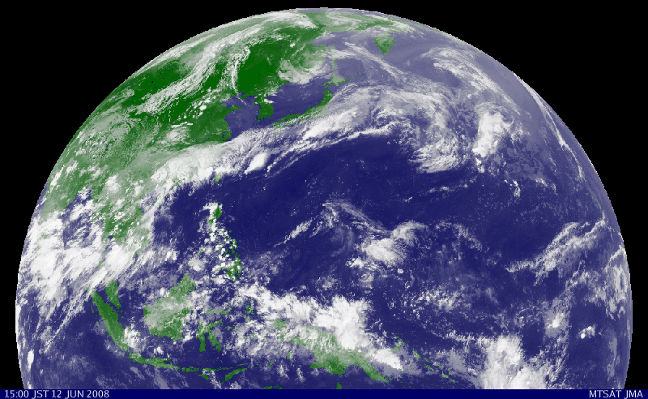
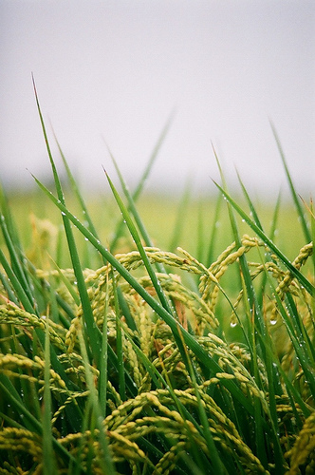
黄梅时节家家雨
青草池塘处处蛙
Meiyu-Baiu (梅雨)
Notes:
East Asian Monsoon

Slide 2
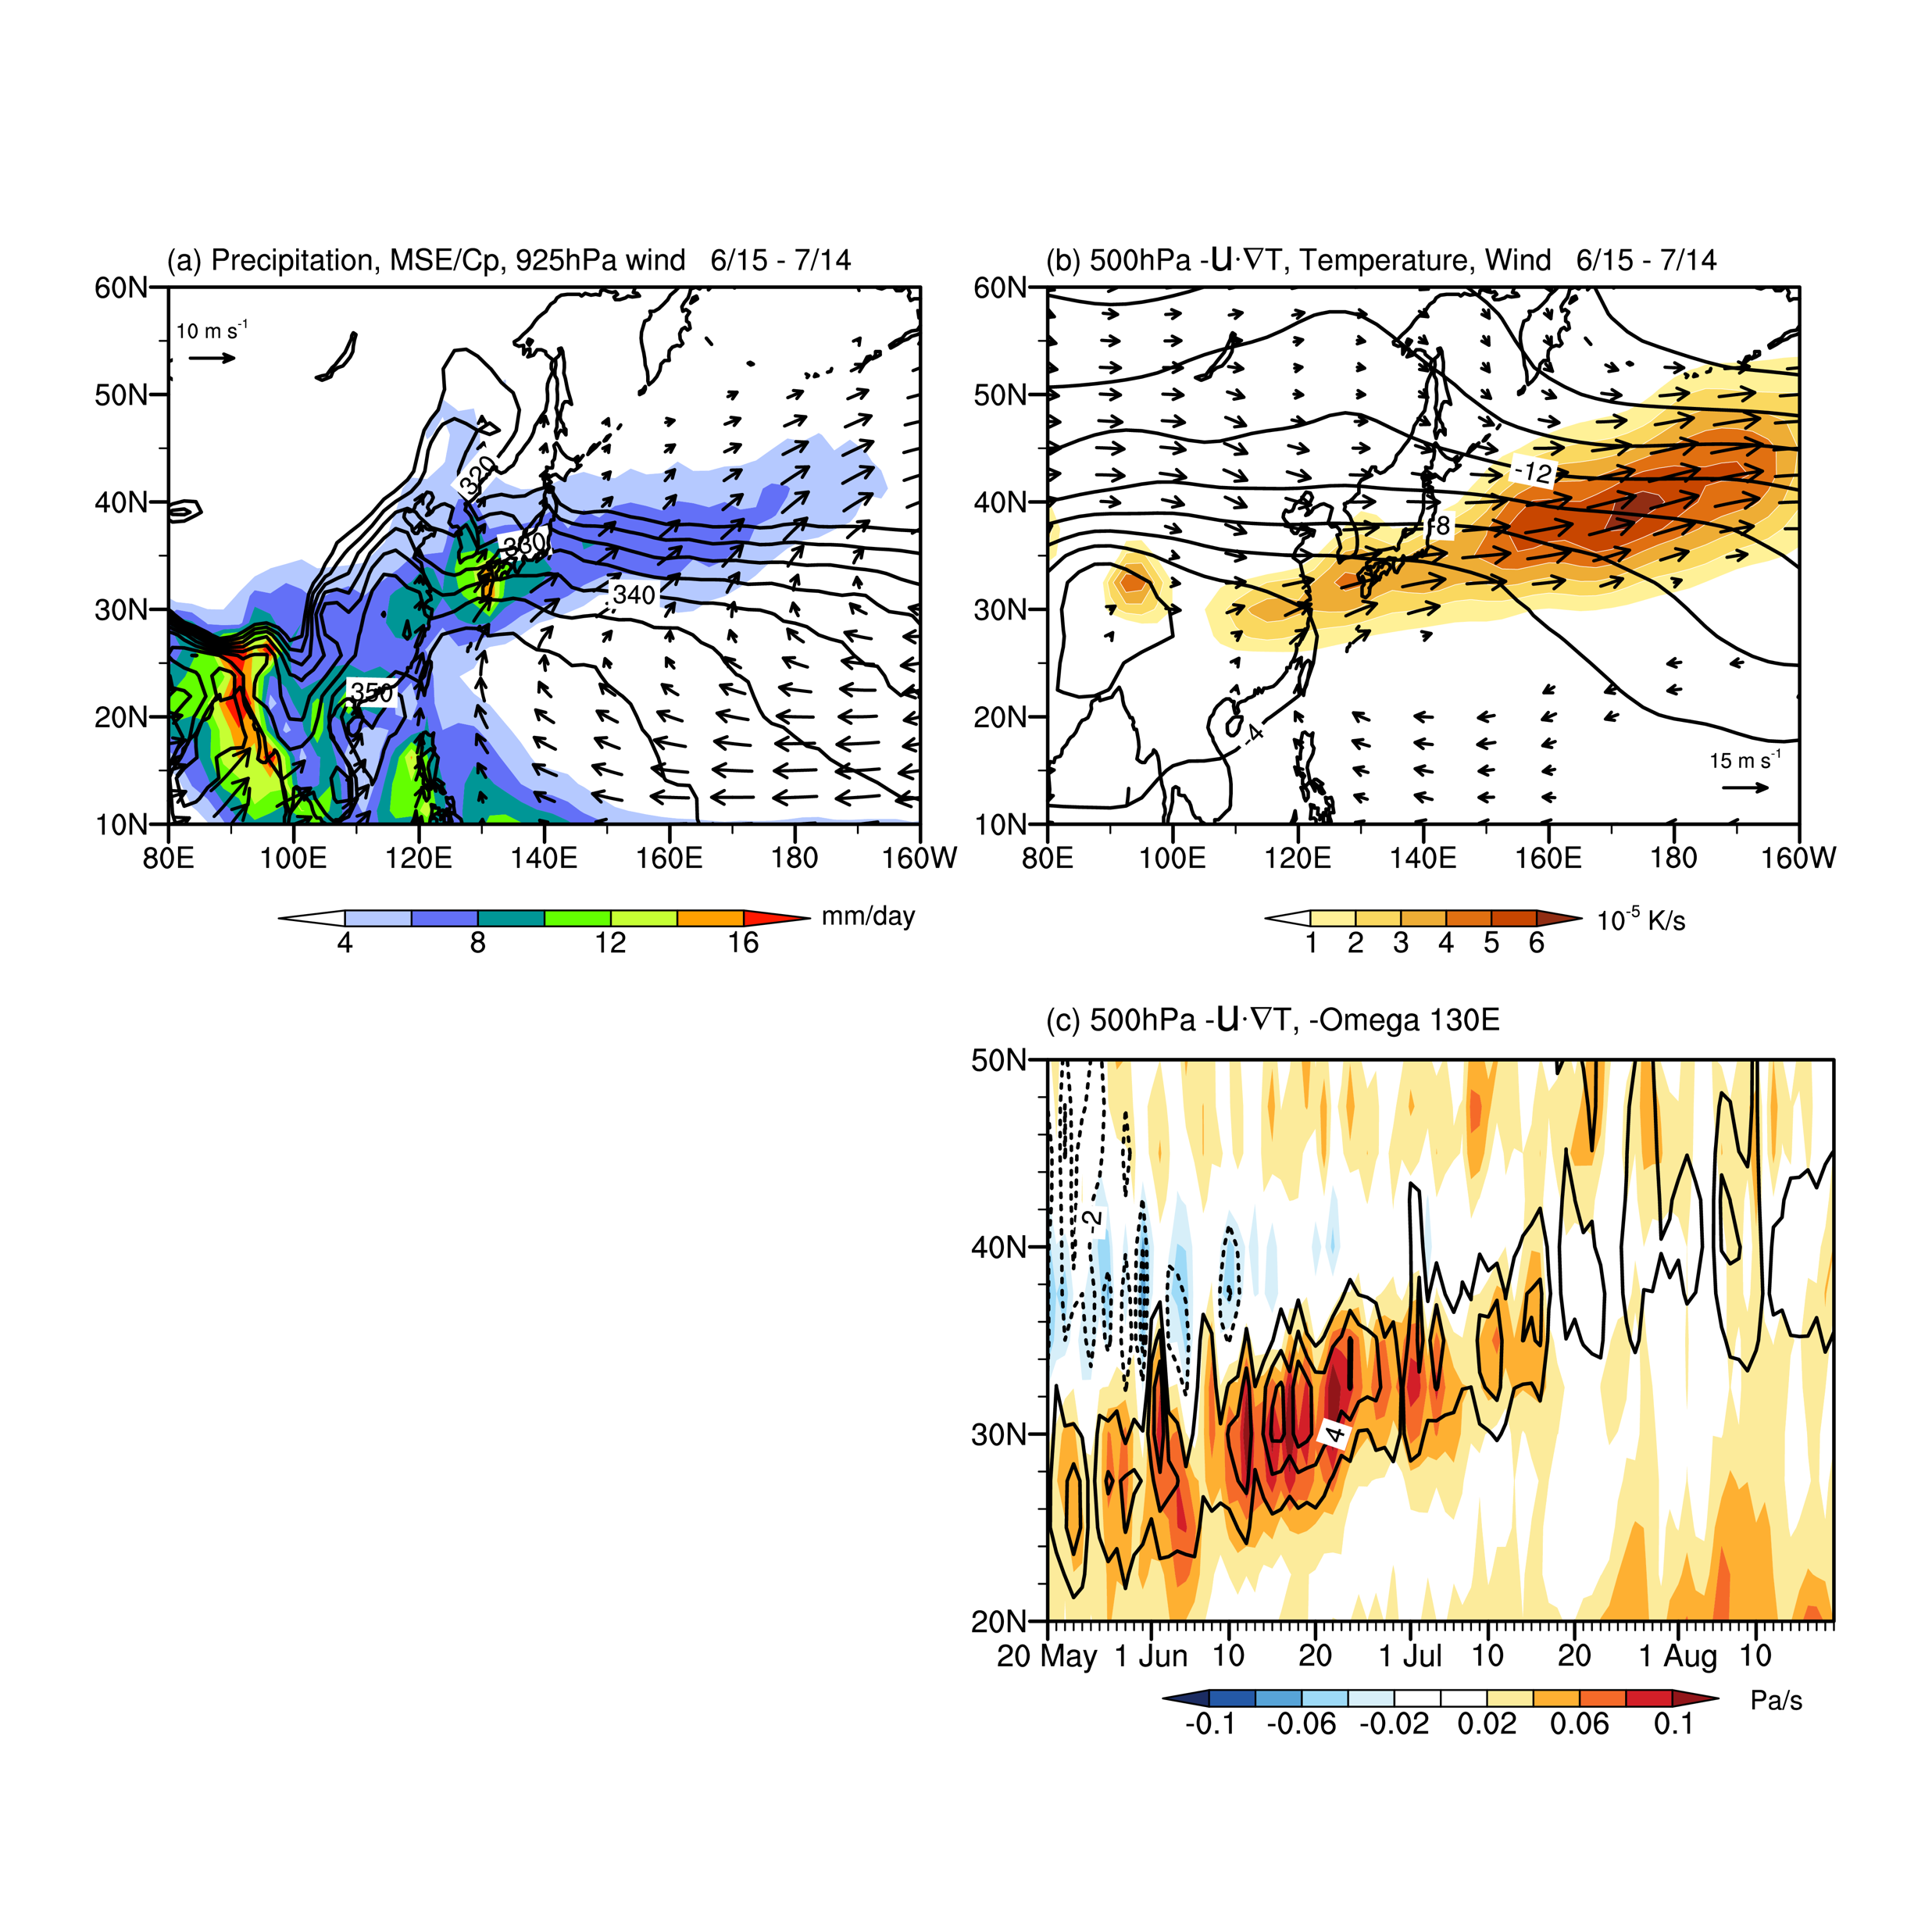


Induction of ascent by mid-tropospheric advection
At 500 hPa, circulation response to Meiyu-Baiu heating is weak.
Meiyu-Baiu rain band
Sampe & Xie (2010, JC)
Warm
Adiabatic
Induction
ascent
500 hPa warm advection
F B
Convection
Latent heating
Fig. 5.14
Notes:
Remind of temp max over Tibet and the westerly jet to the north → warm advection & adiabatic ascent

Slide 3
Schematic
500-hPa wind
L
H
L
40N
H
L
warm region
warm advection
H
20N
low-level flow
80E
120E
160E
Fig. 5.15

Slide 4
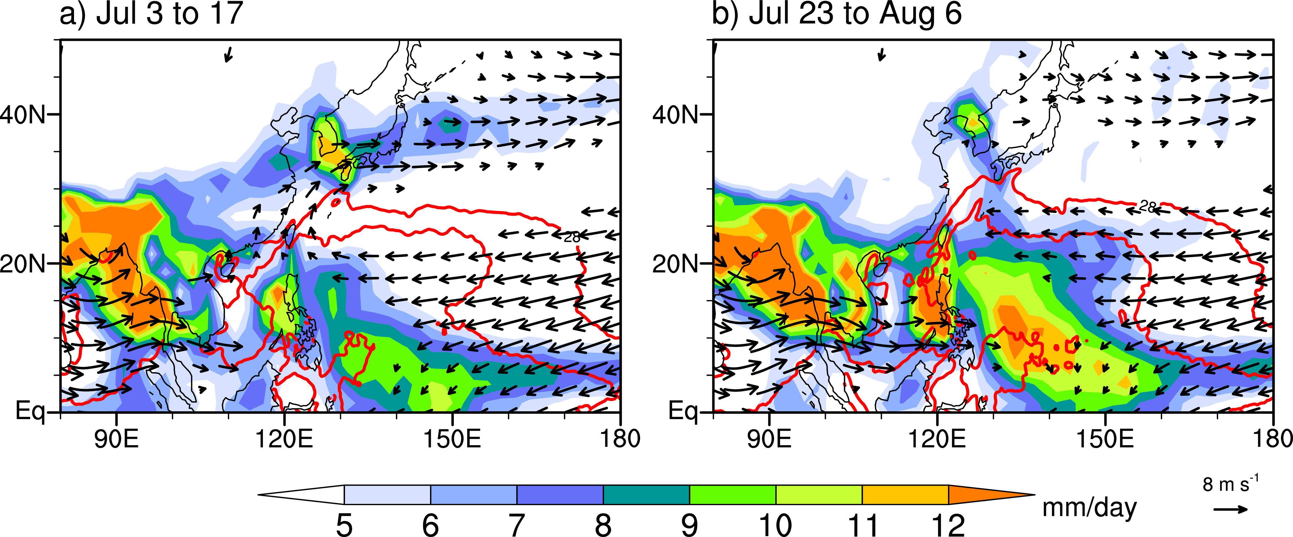
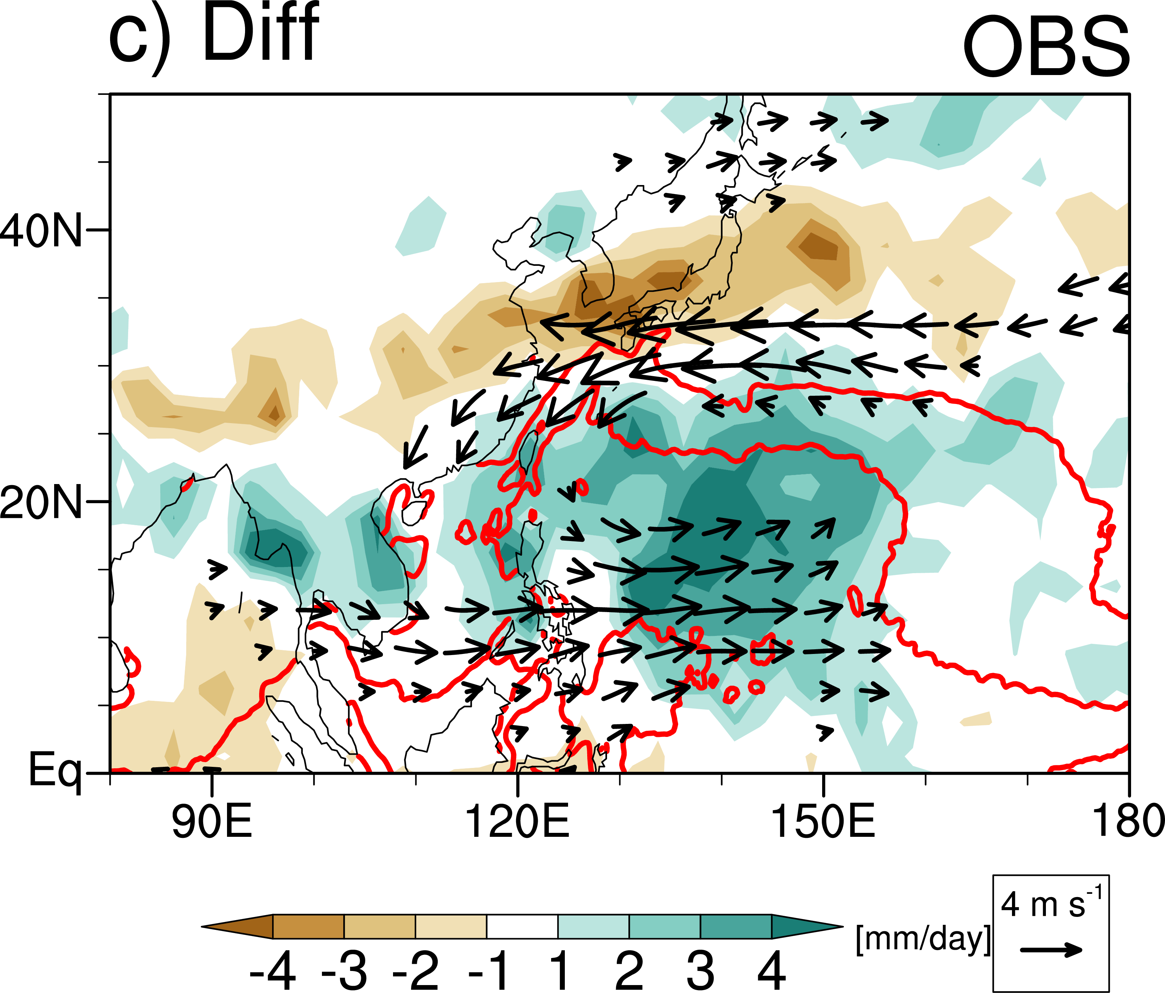
Abrupt convective Jump over the Northwest Pacific in mid-July
climatology: SST, Rainfall, 850hPa wind
(7/23-8/6) minus (7/3-17)
28
Convection jumps to fill the subtropical NW Pacific preconditioned with high SSTs>28C.
Linked to the Meiyu-Baiu withdrawal and eastward retreat of the WPSH, marking the final stage of ASM development.
Fig. 5.18. SST (28 and 29oC contours), precipitation (shading, mm/day) and 850 hPa wind (m/s) for (left) July 3-17, (middle) July 23-August 6, and (right) the difference. ZQ Zhou
Notes:
In mid-July, convection over the Northwest Pacific abruptly expands northeastward, forming a subtropical rainband. This abrupt rainfall variation has been first recognized by Hiroaki Ueda as the so-called ‘convective jump’. The abrupt transition is tightly linked with the withdrawal of the Meiyu-Baiu rainband and the eastward retreat of the western Pacific subtropical high, marking the final stage of Asian summer Monsoon development and . In this study, we will focus on the climatology over the convective jump region as indicated by the white square.

Slide 5


<q>
Entraining air parcels in dry ambient lose moist energy
SST
${\left\langle q\right\rangle }_{c}≈$ 40 mm
Fig. 3.6. Nonlinear relationship of monthly precipitation with (a) SST and (b) column-integrated water vapor over tropical oceans (23.5°S–23.5°N) during December–February based on the 1997–2018 climatology on a 2.5°x2.5° grid.
Notes:
Large <q> → reduced dry entrainment → protect high-m air for deep convection.

Slide 6
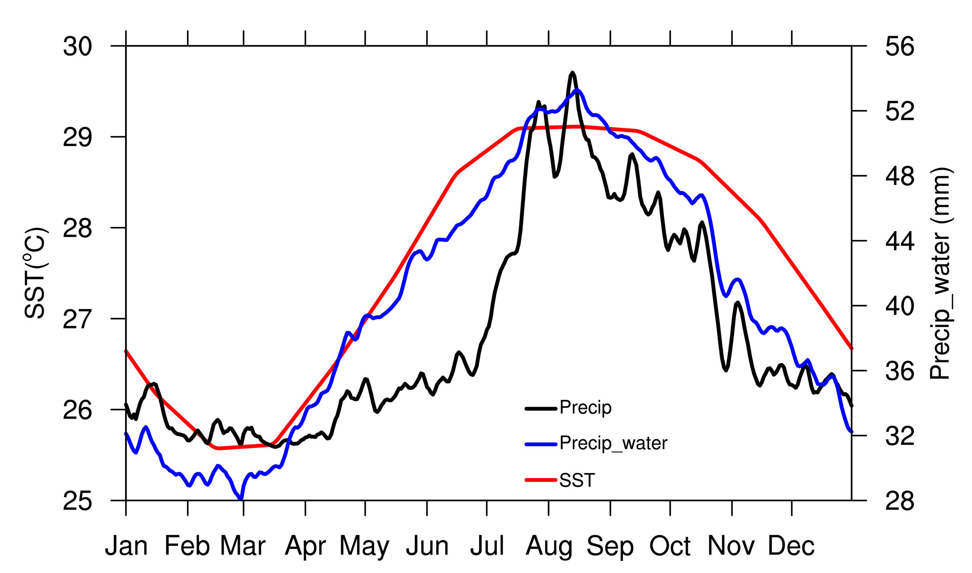

Fig. 5.19
δprecip & δwind_{850hPa}
(7/23-8/6) minus (7/3-17)
SST
<q>
precip
Ueda Jump
Ueda jump → Meiyu-Baiu termination
SST: necessary but not sufficient
Slow increase in column water vapor <q> is key to the Ueda jump.
Ueda et al. (1995, JMSJ)
Notes:
<q> better predictor for convection than SST.

Slide 7
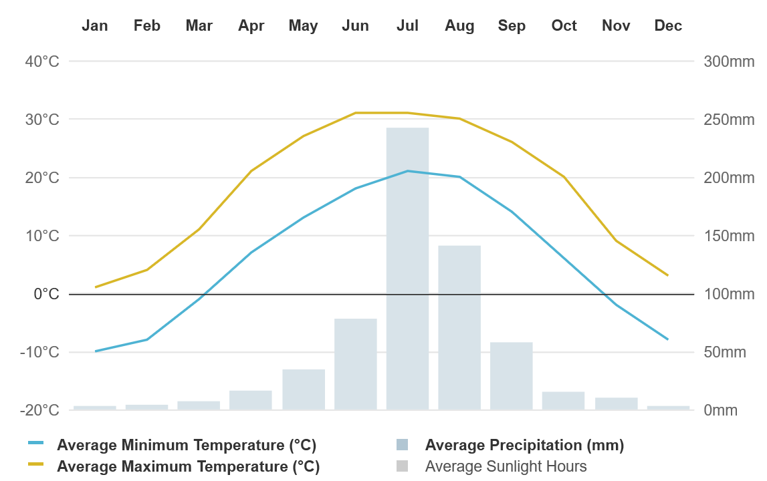
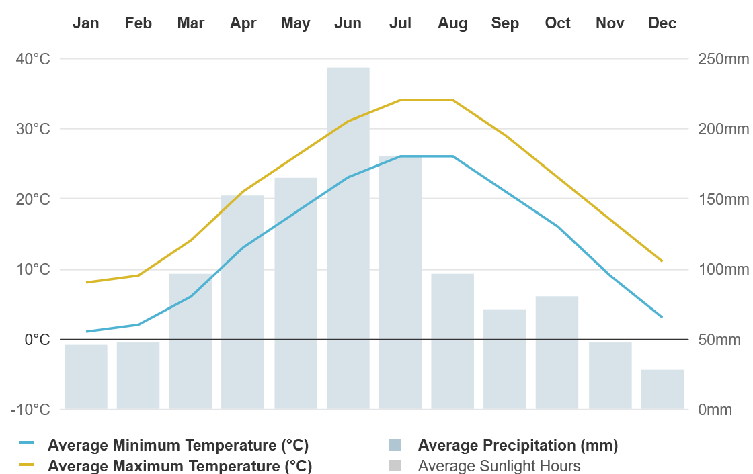
Onset of N China rainy season coincides with end of Meiyu
Recurrent anomalous anticyclone (AAC), aka PJ pattern
Beijing (40N)
北京
δprecip & δwind_{850hPa}
(7/23-8/6) minus (7/3-17)
Hangzhou (30N)
杭州
Notes:
Note that the cyclone around Ueda Jump and the easterly anomalies over East China Sea

Slide 8

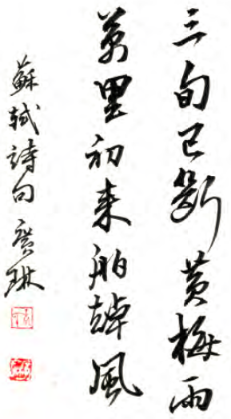
Circulation-convection coupling:
A poetic view
As Meiyu ceases in July, southeast breezes bring home sails from far seas. -- Shi Su (1037–1101)
Notes:
そしょく

Slide 9
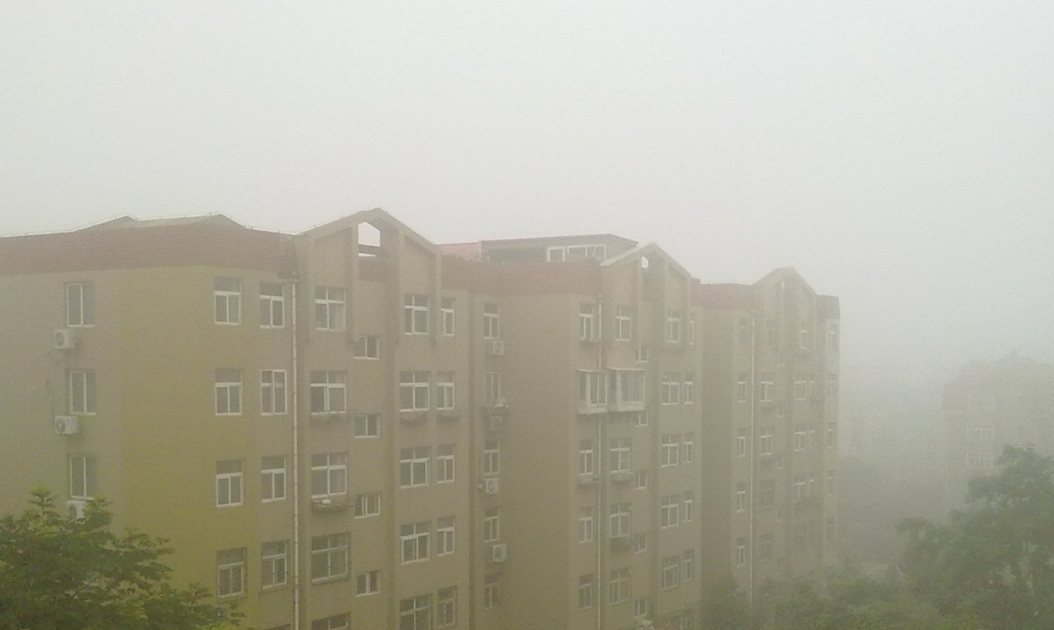
Sfc wind July & Aug
Abrupt fog retreat
Tropical convective jump → Termination of Yellow Sea fog season & Meiyu/Baiu
Notes:
Su Si’s easterly wind that sends merchant ships home up against the river flow.

Slide 10
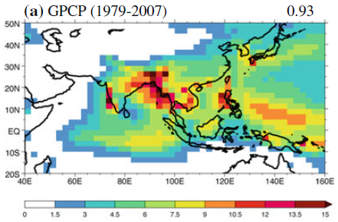
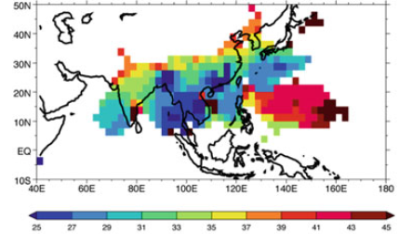
Asian Summer Monsoon System
Precip JJA
Onset time
EA
SA
NWP
Penta
June
July
August
Asian jet
Tibetan High
EA monsoon
Sahara desert
W Afr monsoon
SA monsoon
NWP jump
Surface low
Classification of sub-monsoon systems
modified based on Wang & LiHo (2002, JC)
figure from Sperber et al. (2013, CD)
Notes:
Sperber et al. 2013, Clim Dyn

Slide 11
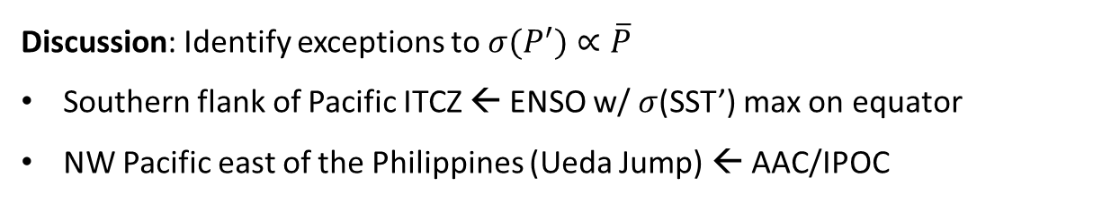
Discussion: Identify exceptions to $σ(P^{′})∝\overline{P}$
Southern flank of Pacific ITCZ ← ENSO w/ $σ$(SST’) max on equator
NW Pacific east of the Philippines (Ueda Jump) ← AAC/IPOC
Mean (contours) and interannual standard deviation (shading) of JJA precipitation (mm)
He and Li (2019, CD)
Notes:
He, C., Li, T. Does global warming amplify interannual climate variability?. Clim Dyn 52, 2667–2684 (2019).

Slide 12
Key words
Summer SW/winter NE monsoon over NIO-SCS (JJAS)
Upper-level Tibetan high, easterly wind shear → lack of tropical cyclones in JJA
Pre-monsoon heatwave in India, seasonal MSE increase → monsoon onset
Contrast between the wet East Asia and dry Sahara on the Afro-Eurasian Continent
Warm advection by the westerly jet anchors the Meiyu-Baiu rain band (June-mid July)
Termination of Meiyu-Baiu is tied to the convective onset in subtropical NW Pacific → wind shifts from southerly to easterly over E China/Yellow Seas →end of advective fog in Qingdao (late July).
Sub-systems of the Asian summer monsoon, distinctions & interactions
Ocean’s role
Max SST in May over NIO-SCS ← weak wind and large solar radiation
Somali upwelling, seasonal Somali current (> 1 m/s), in prep for transient ENSO in Pacific
Ocean is largely absent in seasonal monsoon but dictates interannual variability (with land largely absent)

Slide 13
Jul-Jan difference in temp & (u,v) at 850 hPa
Cyclonic over continent, and anticyclonic over ocean in mid-latitudes
Southwesterly/southeasterly in northern/southern tropics
In the tropics, large wind differences span from Africa to western Pacific.

Slide 14






Asian summer monsoon dynamics (longwave limit)
$$\left(\frac{∂}{∂t}+ε\right)\left(\frac{∂^{2}}{∂x^{2}}−2λ^{2}\right)ψ_{T}+β\frac{∂ψ_{T}}{∂x}=−2λ^{2}Q_{2}$$
$$εψ_{T}+c_{R}\frac{∂ψ_{T}}{∂x}=Q_{2}$$
$Q_{2}$: latent heating
$$c_{R}≡−\frac{β}{k^{2}+2λ^{2}}$$
Outside
In the forced region
$$ψ_{T}=ψ_{0}exp\left(\frac{x}{L_{R}}\right)$$
$$L_{R}=−\frac{c_{R}}{ε}$$
$$ψ_{T}=\int{\frac{Q_{2}}{c_{R}}}dx$$
Upper-level flow
y
x
$ψ_{1}$>0
Vertical cell
z
x
217B. 2-level model
Notes:
Adiabtic cooling/warming in forced/unforced region:

Slide 15
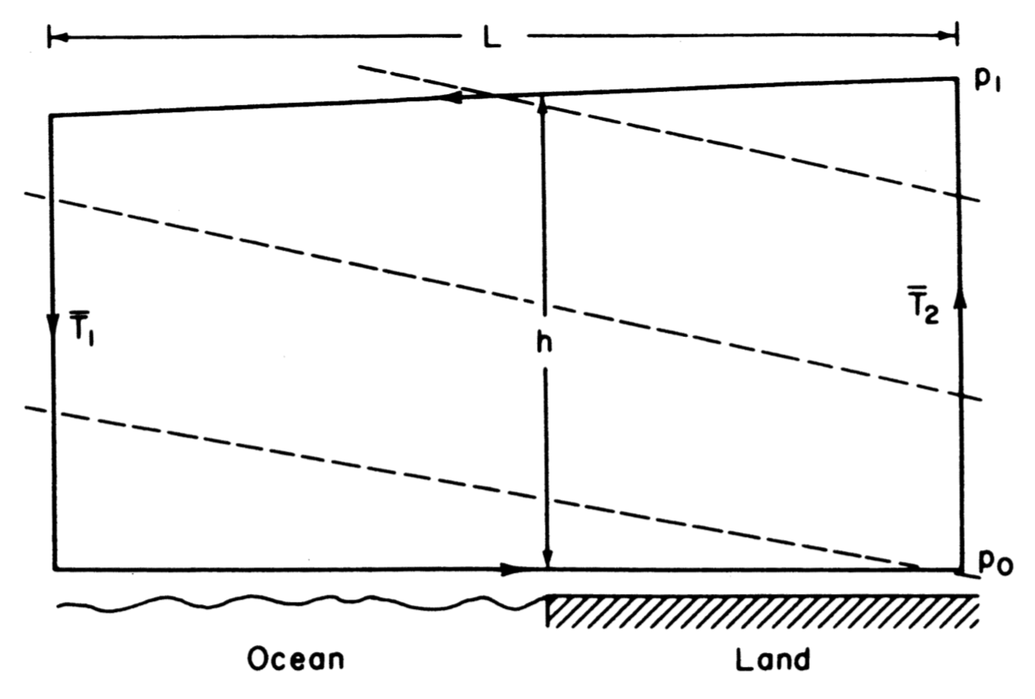
In a baroclinic fluid,
$$\frac{DC_{a}}{Dt}=\frac{D}{Dt}\oint{U_{a}∙dl}=−\oint{\frac{dp}{ρ}=−\oint{RTd\ln{p}}}$$
$$\frac{DC_{a}}{Dt}=R\ln\left(\frac{p_{0}}{p_{1}}\right)\left({\overline{T}}_{2}−{\overline{T}}_{1}\right)>0$$
Letting $\left\langle v\right\rangle$ be the mean horizontal velocity at the surface,
$$\frac{D\left\langle v\right\rangle }{Dt}≈\frac{R\ln\left({p_{0}}/{p_{1}}\right)}{2L}\left(\overline{T_{2}}−\overline{T_{1}}\right)$$
$$\left\langle v\right\rangle$$
Integral on p surface ~ UL
Integral in the vertical ~WH
Vertical/horizontal ~ $\frac{WH}{UL}={\left(\frac{H}{L}\right)}^{2}≪1$
L ~ 10 km, H ~ 1km
$$C_{a}≈2\left\langle v\right\rangle L$$
Diurnal sea breeze
$$\frac{∂\left\langle v\right\rangle }{∂t}+f\left\langle u\right\rangle ≈\frac{R\ln\left({p_{0}}/{p_{1}}\right)}{2L}\left(\overline{T_{2}}−\overline{T_{1}}\right)$$
Seasonal monsoon (thermal wind)
217B. Circulation

