Slide 1
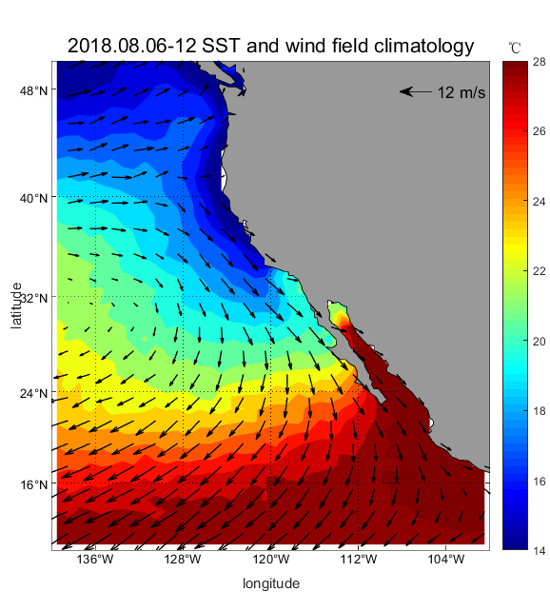
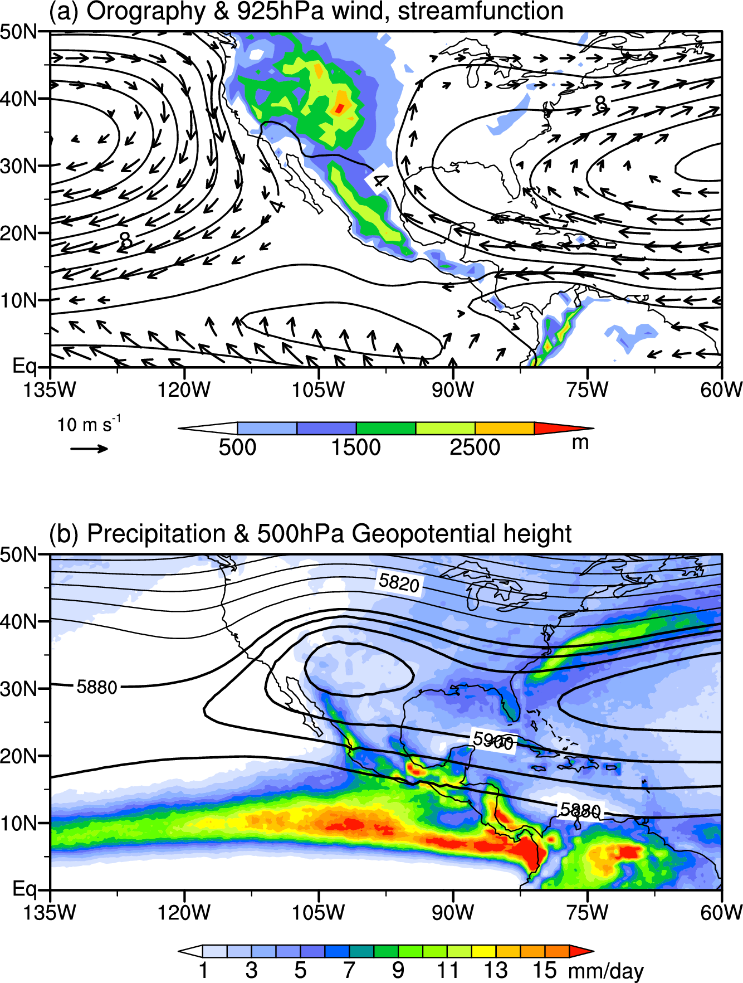
North American monsoon
NPSH
Upwelling
NASH
NPSH
July-August
N Pacific subtropical high (NPSH)
N Atlantic subtropical high (NASH)
H
ITCZ
Fig. 5.27.

Slide 2
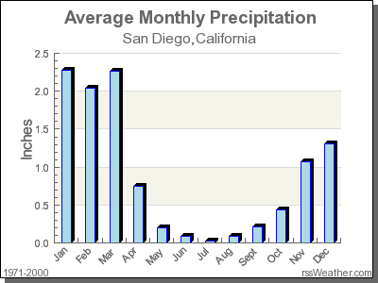
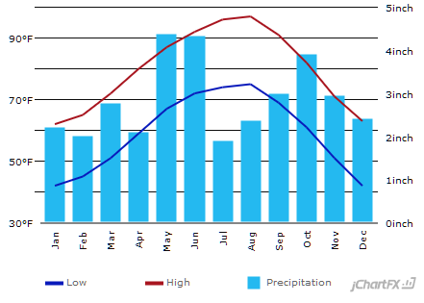
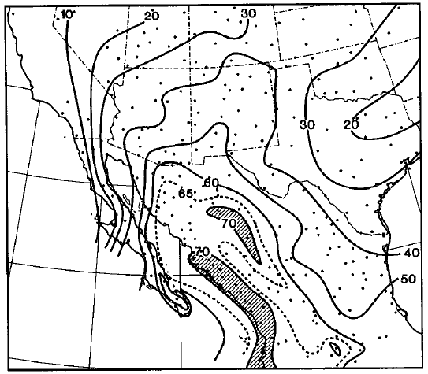
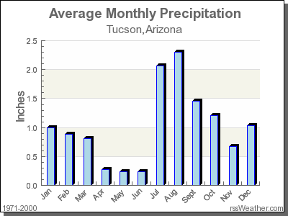
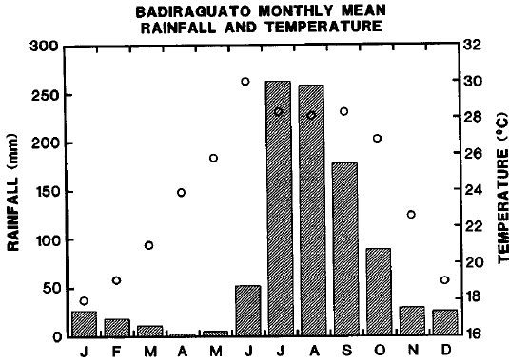
Austin, TX
Mid-summer drought
Mediterranean
Summer monsoon
JAS/Annual precip
Douglas et al. (1993, JC)
North American monsoon

Slide 3
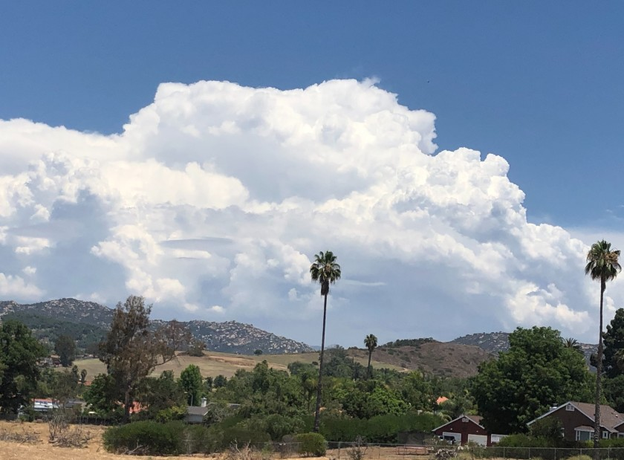
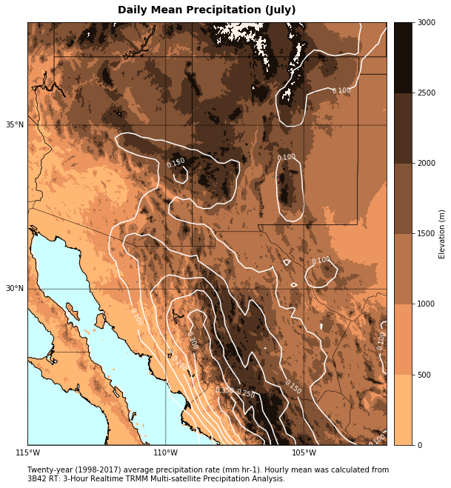
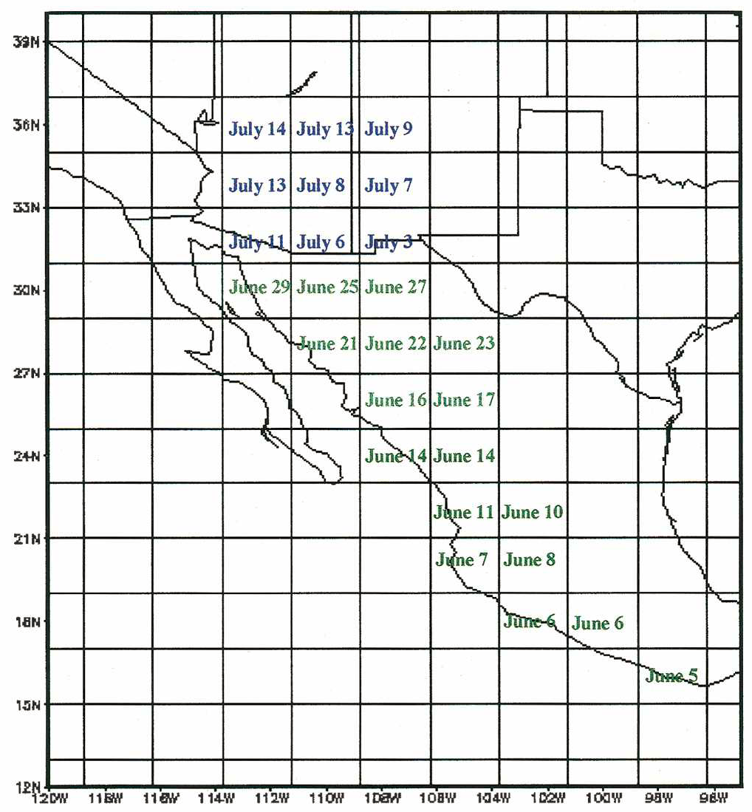
July rainfall & elevation
Storm in SD mountain
Large rainfall w/ lightning in afternoon-evening on the west slope of Sierra Madre Occidental (~2 km high)
Onset date for N American monsoon (Higgins et al. 1999, JC)
Notes:
400 miles from SD to Tucson

Slide 4
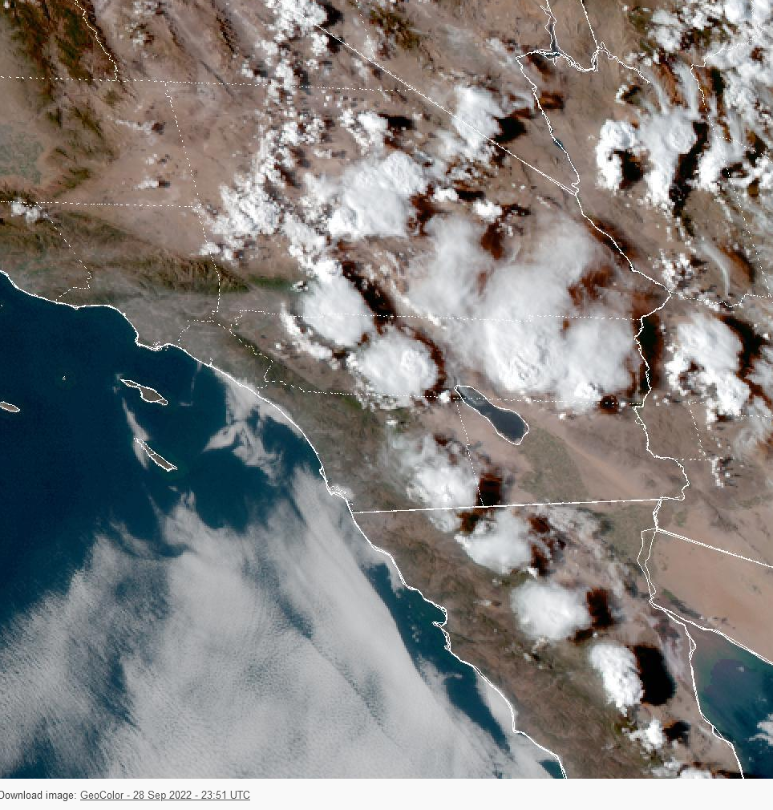
Summer ends on a high note
Webcam from SDSC rooftop looking toward the east: Thunderstorms along mountain range
https://hpwren.ucsd.edu/cameras/archive/sdsc-e-mobo-c/large/20220928/MP4/Q5.mp4

Slide 5
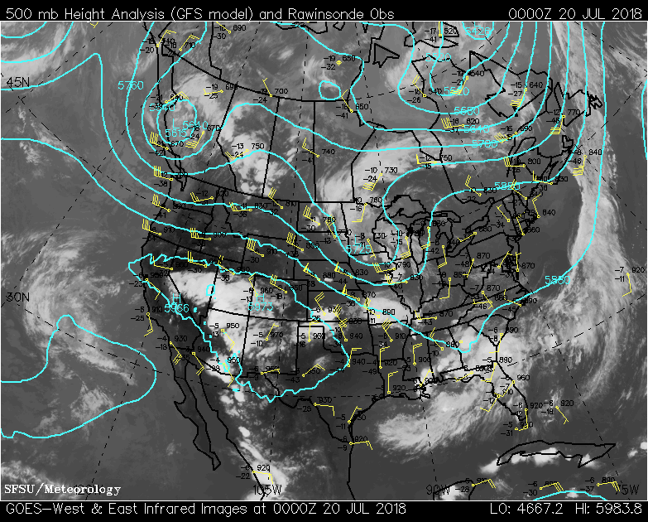
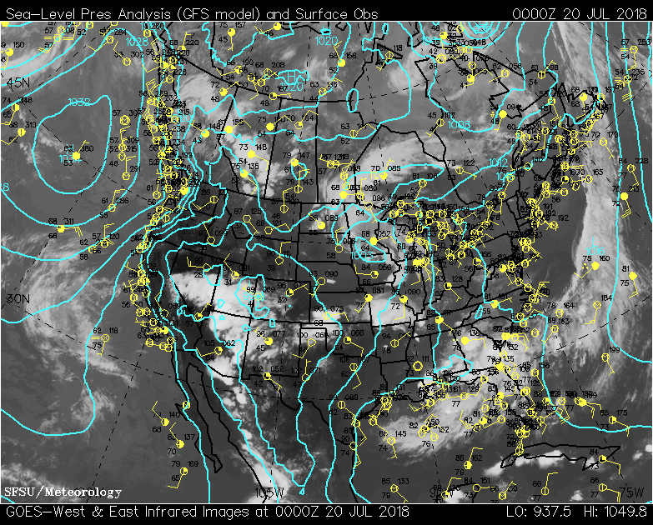
H
Deep convection in AZ, NM (NV, UT) and along Sierra Madre Occidental
Monsoon high at 500 hPa
Monsoon low at low levels
L

Slide 6
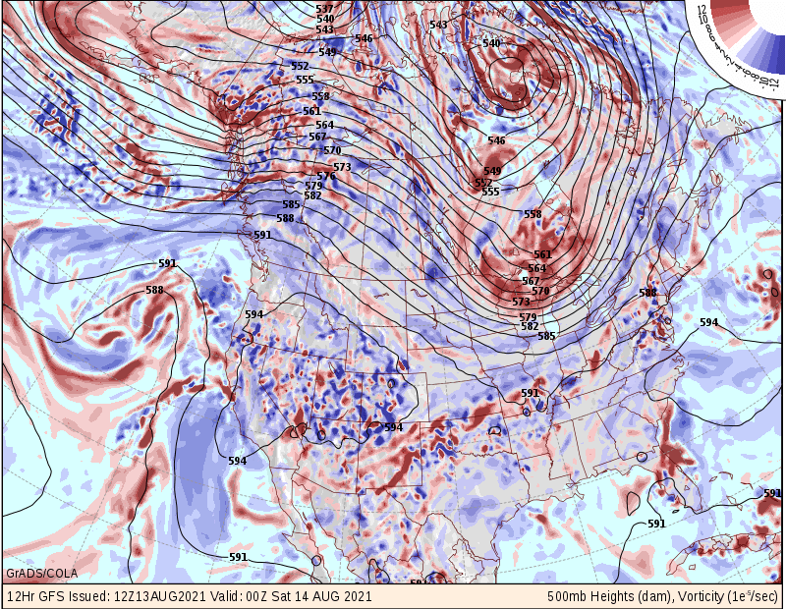
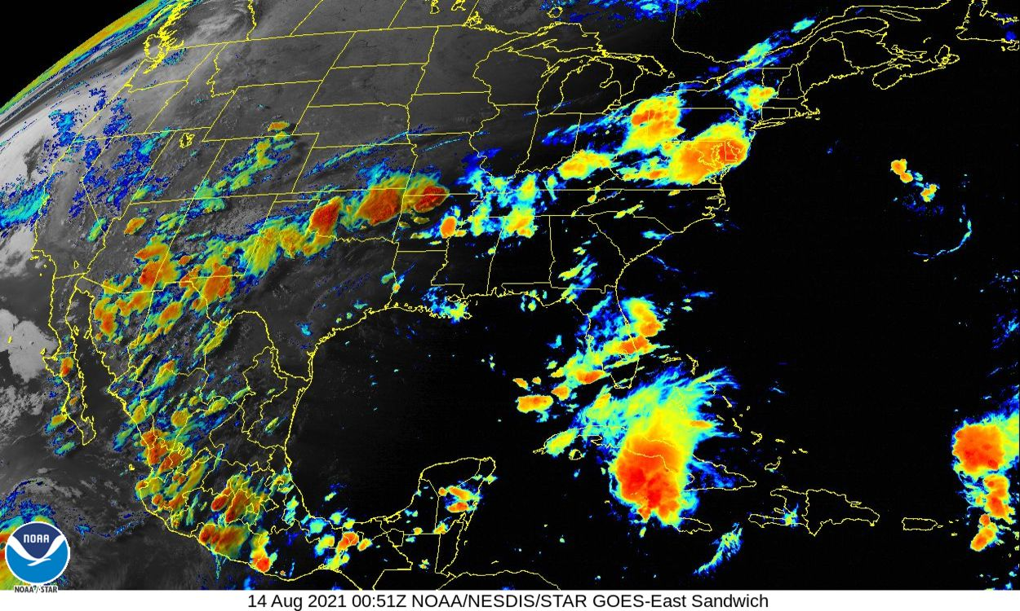

Slide 7
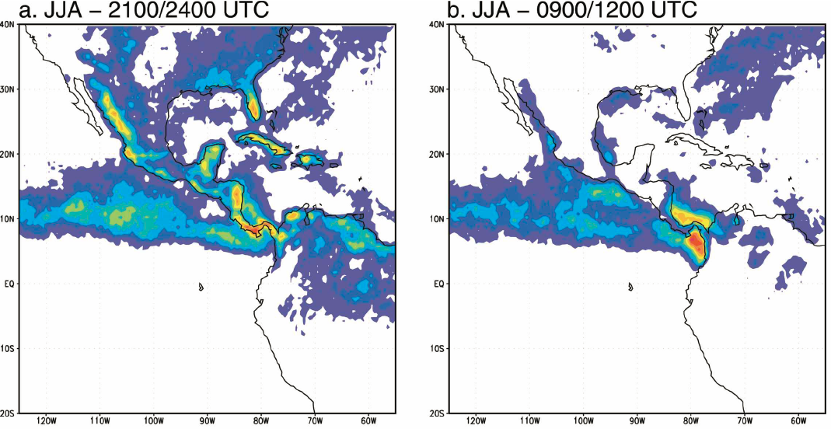
Strong diurnal cycle
2–5pm PDT
2–5am PDT
Frequency of cold cloud tops (temperature T_{BB} < 235 K)
Late afternoon-evening (2100–2400 UTC) & early morning (0900–1200 UTC).
Vena et al. (2006, JC)

