Slide 1
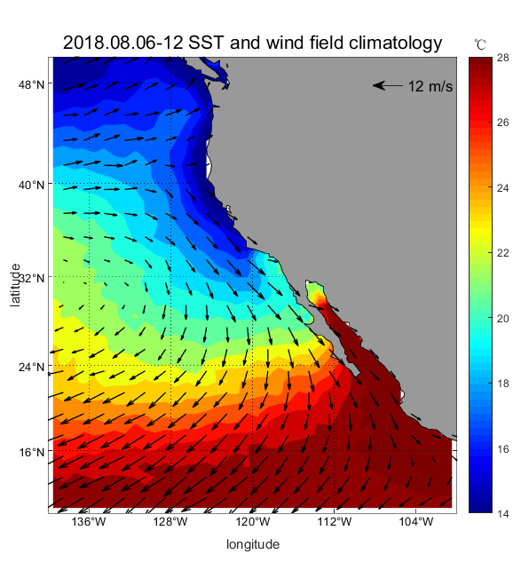
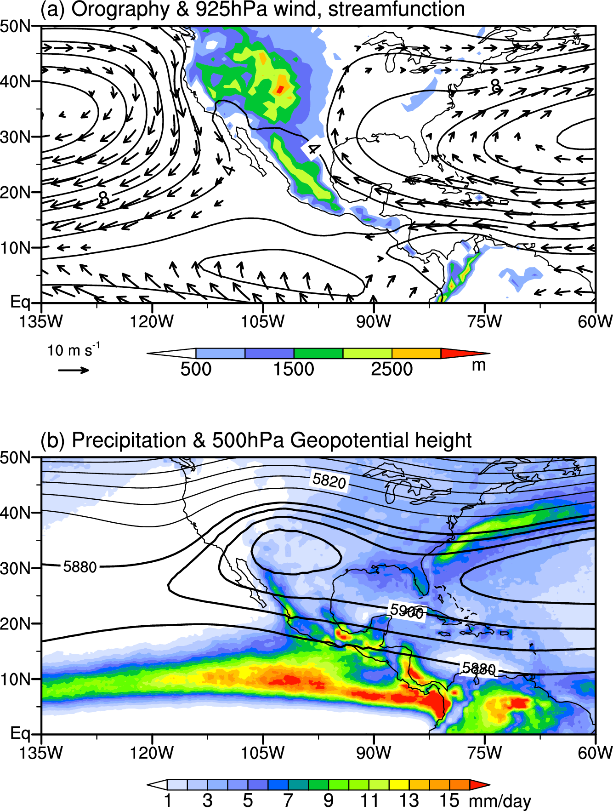
7. California climate
North American monsoon
NPSH
Upwelling
NASH
NPSH
July-August
N Pacific subtropical high (NPSH)
N Atlantic subtropical high (NASH)
H
ITCZ
Fig. 5.27.
Notes:
More on NA monsoon in Lect-05B-NAmerican-Monsoon.pptx

Slide 2
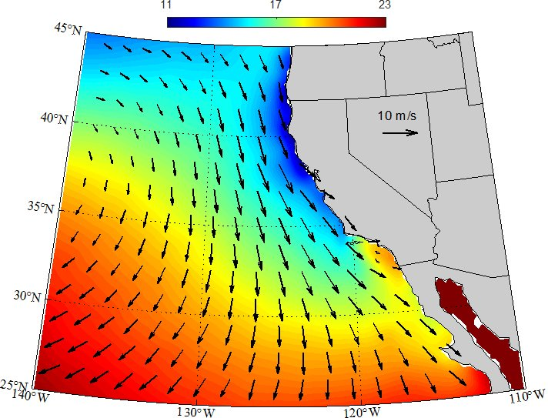
California coastal upwelling
Mean SST and wind in JJA
Transverse ranges
L
Why is SST much warmer at San Diego (18ºC) than Santa Barbara (15ºC)?
SST, wind & SSH (green contours) JJA
Figs. 6.15a, 6.16
Notes:
CMEMS (AVISO) absolute dynamic topography (ADT), CI=2cm, land elevation, CI=500 m
California coastal upwelling, contrast b/w San Diego and Santa Barbara, Southern California countercurrent

Slide 3
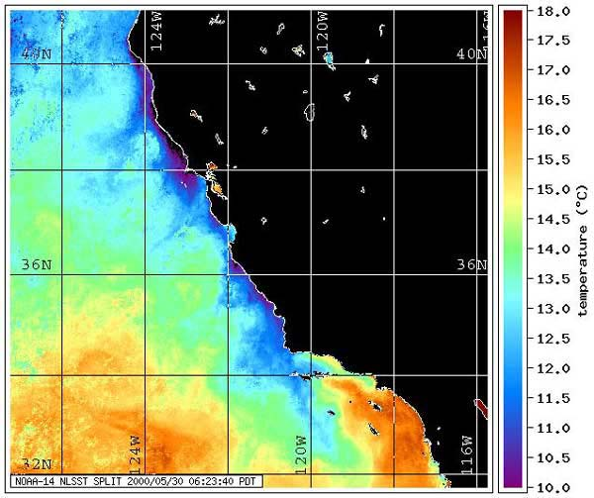

Upwelling nurtures life.
http://oceanexplorer.noaa.gov/explorations/02quest/background/upwelling/upwelling.html

Slide 4
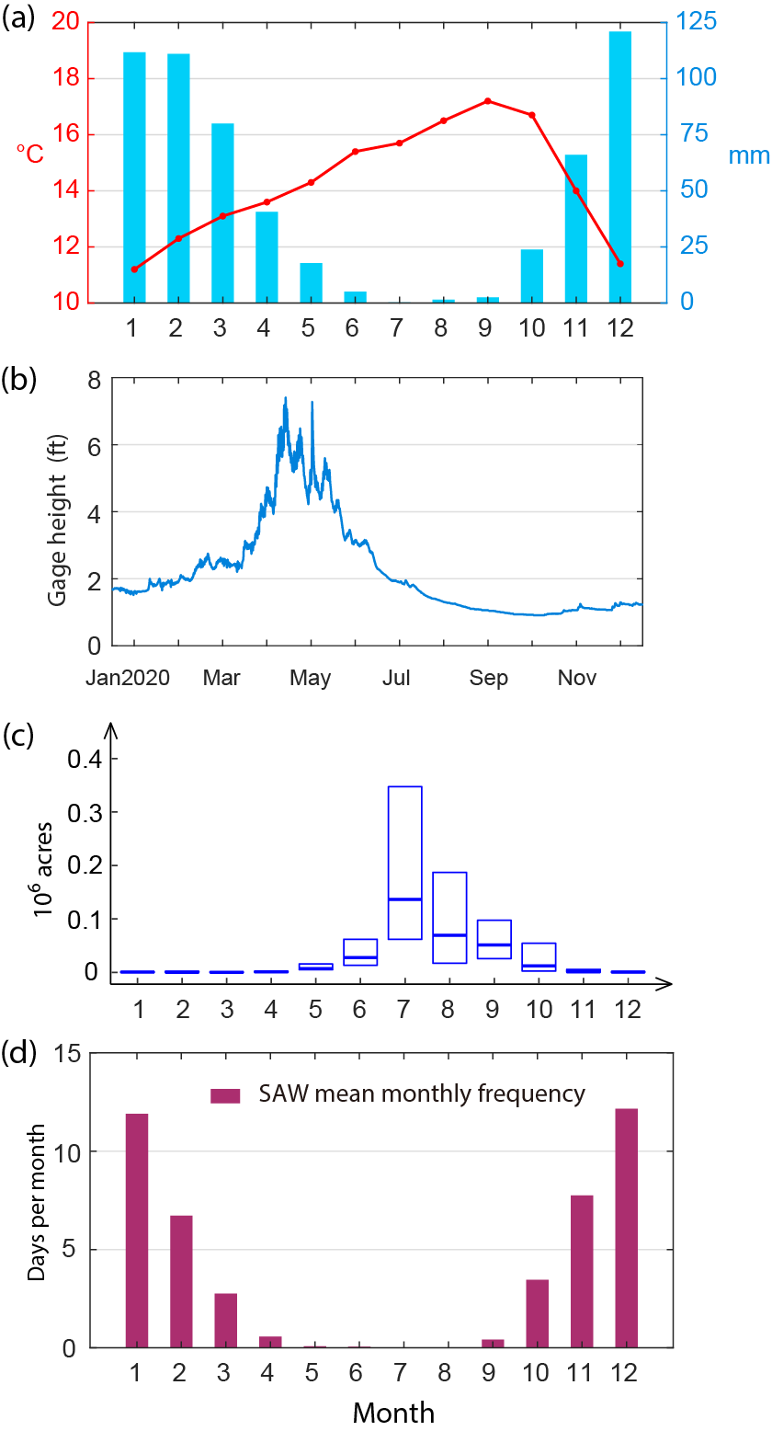
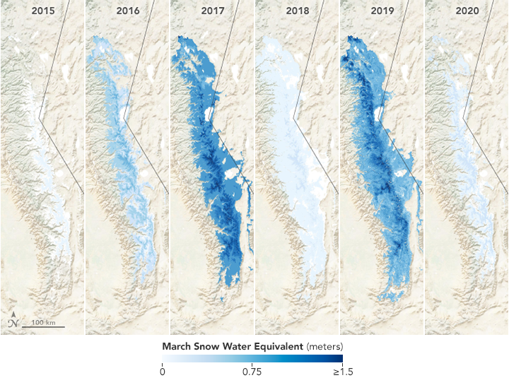
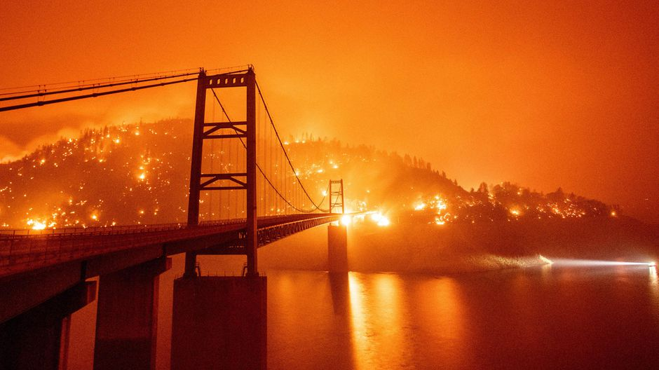
San Francisco
Interannual variability
T
0.88 | 0.67 | 1.5 | 2.0 | 0.26 | 4.3
10⁶ Acres Burned
Precip
Merced River flow
Burned area CA
Santa Ana wind
Fig. 6.19.
Notes:
(b) https://waterdata.usgs.gov/monitoring-location/11266500/#parameterCode=00065&period=P30D

Slide 5
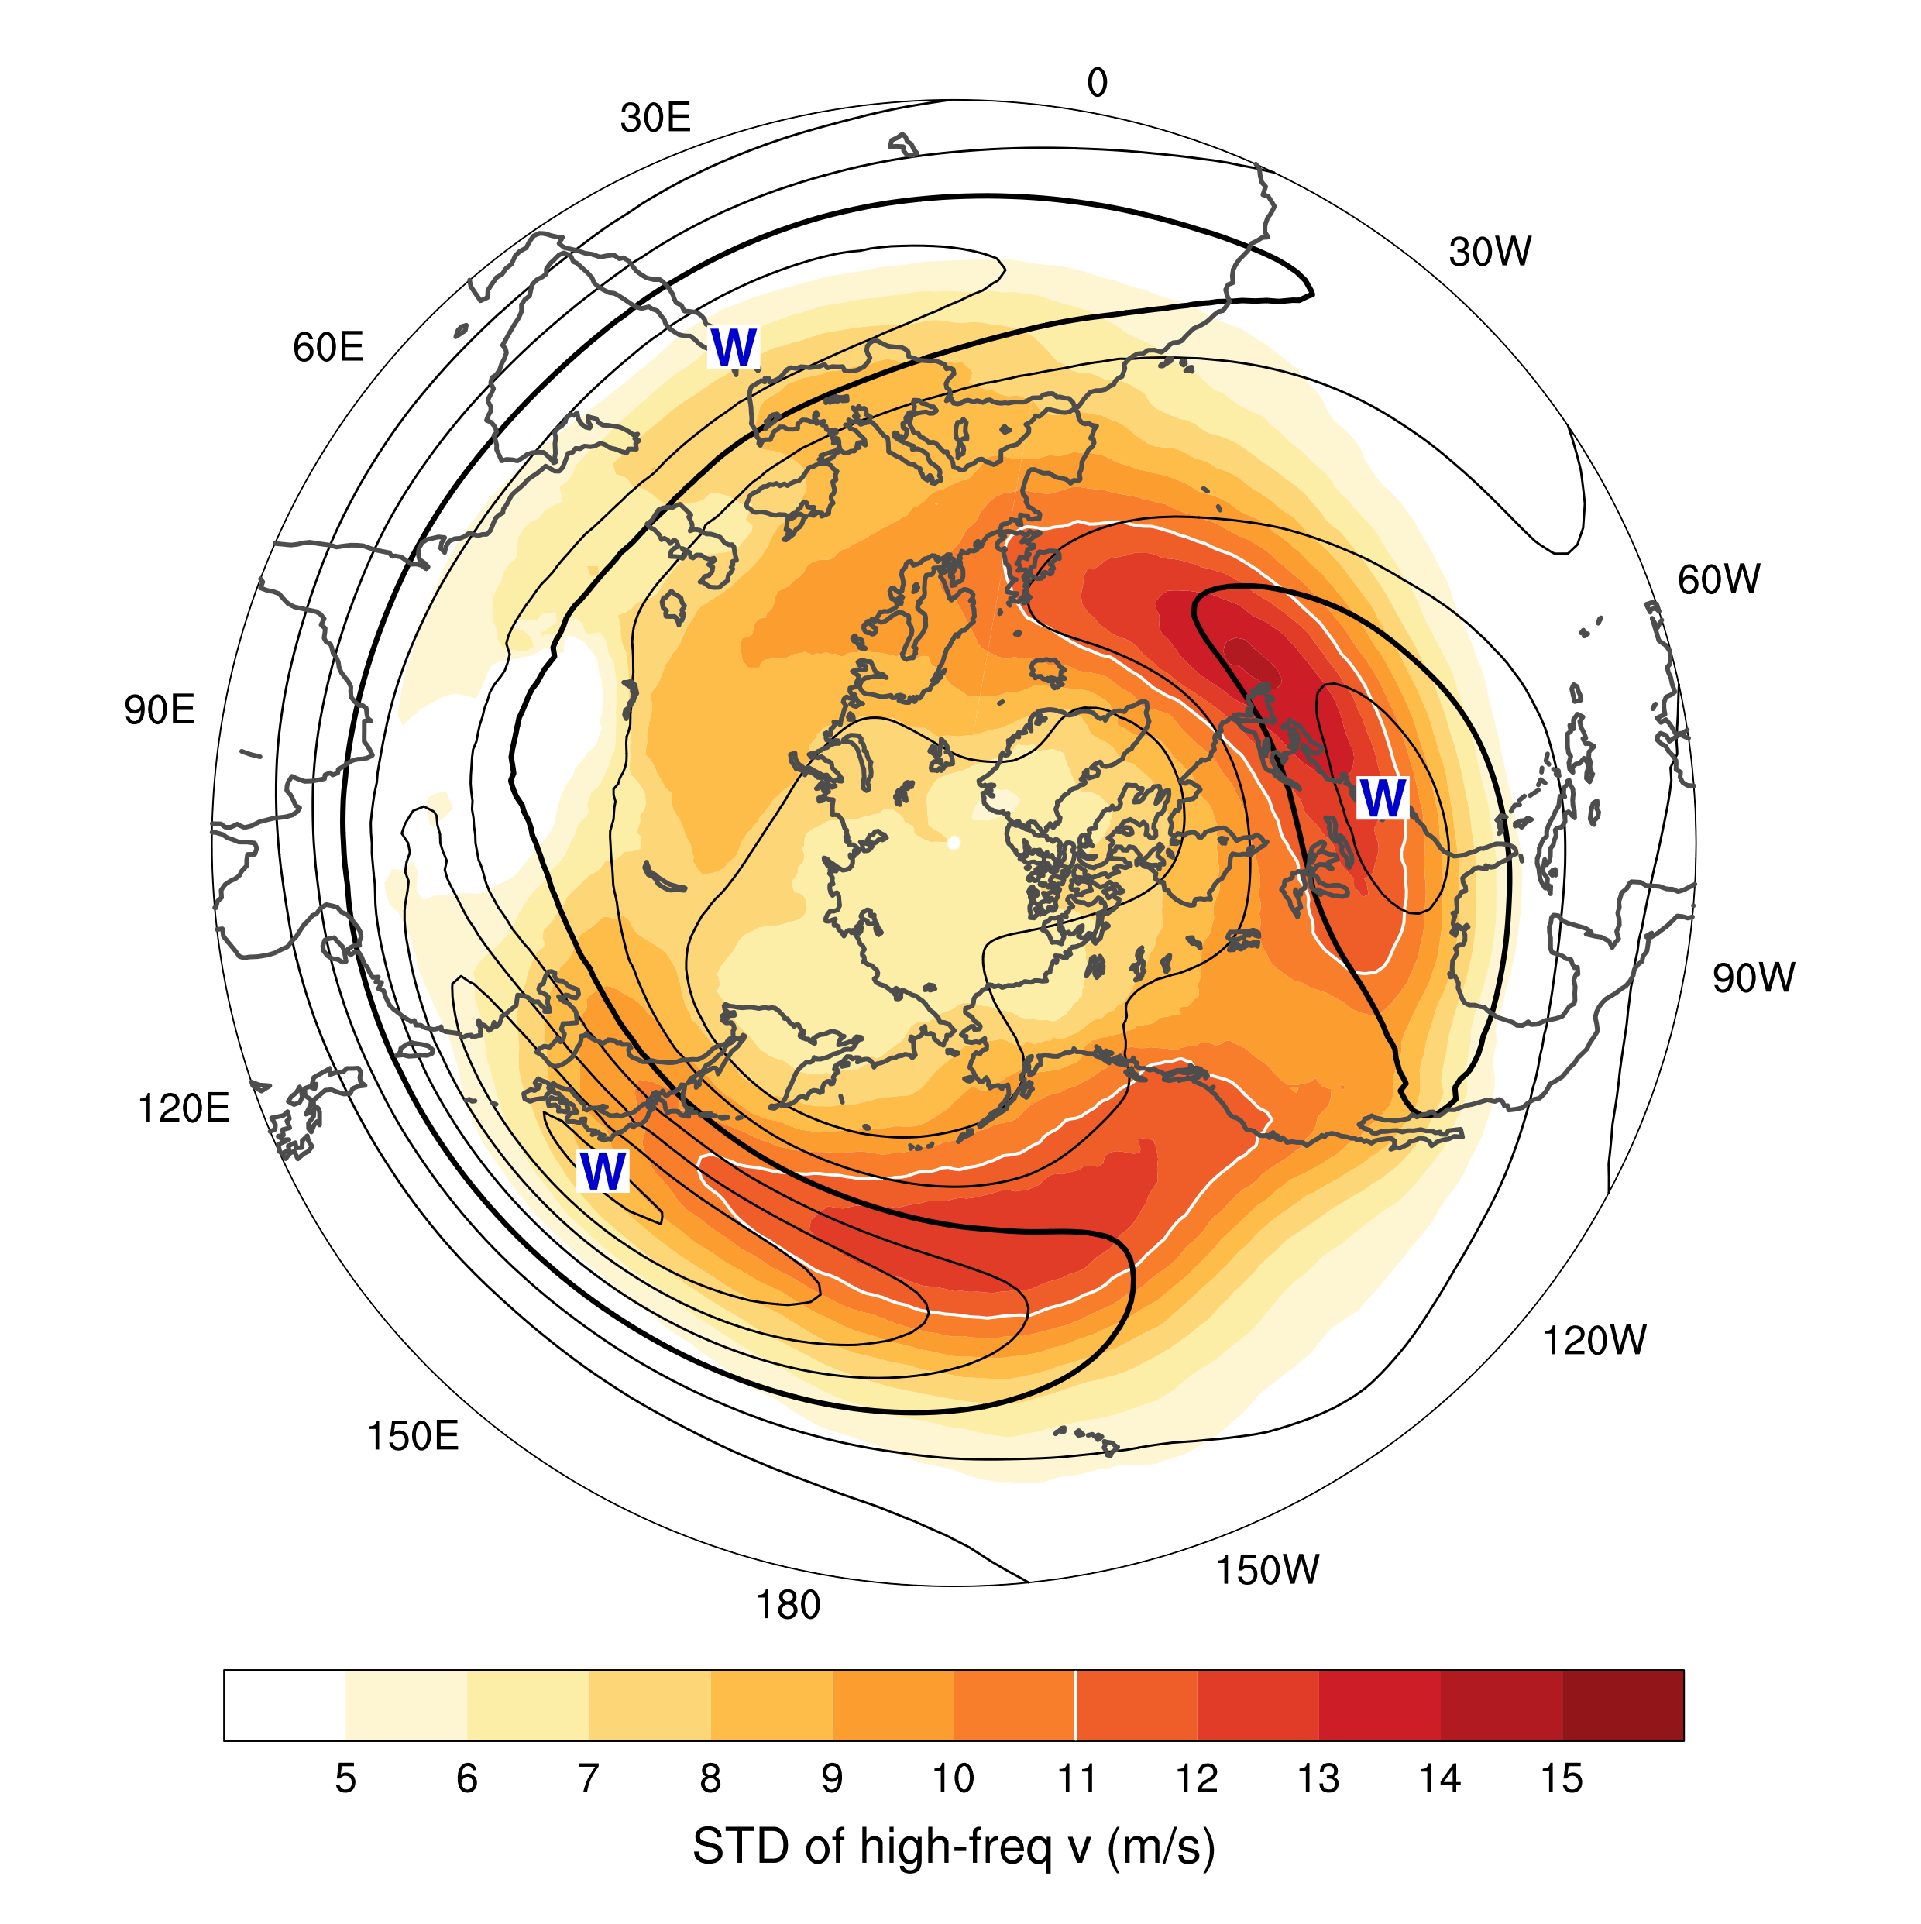
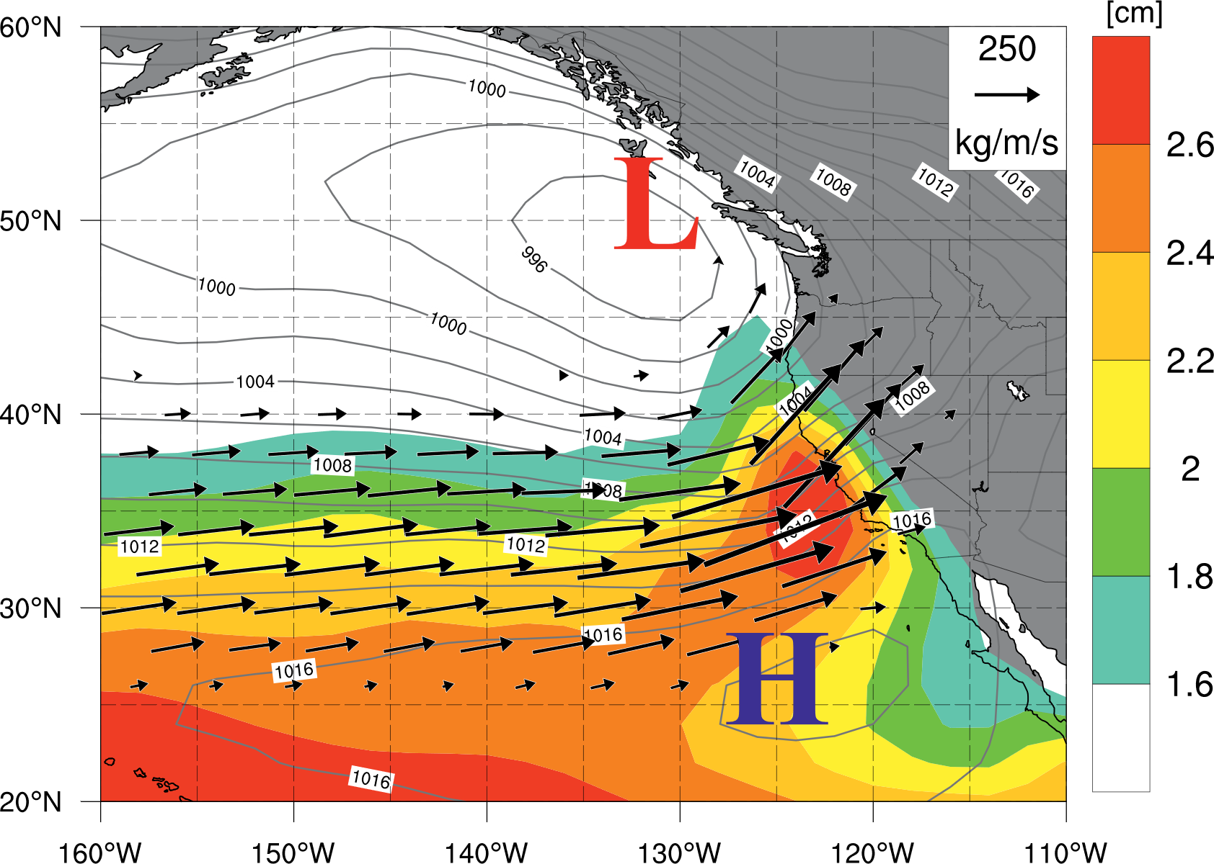
Mid-latitude storm tracks→ winter rainy season
Fig. 6.17. DJF mean flow (u) and storminess at 250 hPa. Standard deviation of 8-day high-pass variability of meridional wind velocity (shading), along with the zonal wind velocity (black contours, interval of 10 m s⁻¹, 30 m s⁻¹ thickened). Based on ERA5 for 1980-2019.
Fig. 6.18. Atmospheric river composites on days of San Francisco Bay Area landslide onset: SLP (line contours, hPa), column-integrated water vapor (color shading, cm), and column-integrated vapor transport vectors (>150 kg/m/s). From Cordeira et al. (2019).

Slide 6
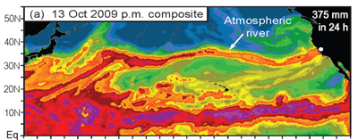

Ralph et al. (2011, MWR)
Atmospheric Rivers
are narrow bands that account for 95% of meridional moisture transport at 35N.
cause major flooding when they make land-fall and stall (orographic lifting).
account for 30-50% of annual precipitation in west coast states.
Identify ARs from column-integrated water vapor (IWV; satellite) and integrated vapor transport (IVT).
Moist neutrality
LLJ
Ralph et al. (2005, MWR)
Notes:
Ralph, F. M., P. J. Neiman, G. N. Kiladis, K. Weickmann, and D. W. Reynolds, 2011: A Multiscale Observational Case Study of a Pacific Atmospheric River Exhibiting Tropical––Extratropical Connections and a Mesoscale Frontal Wave. Mon. Wea. Rev., 139, 1169–1189, https://doi.org/10.1175/2010MWR3596.1.

Slide 7
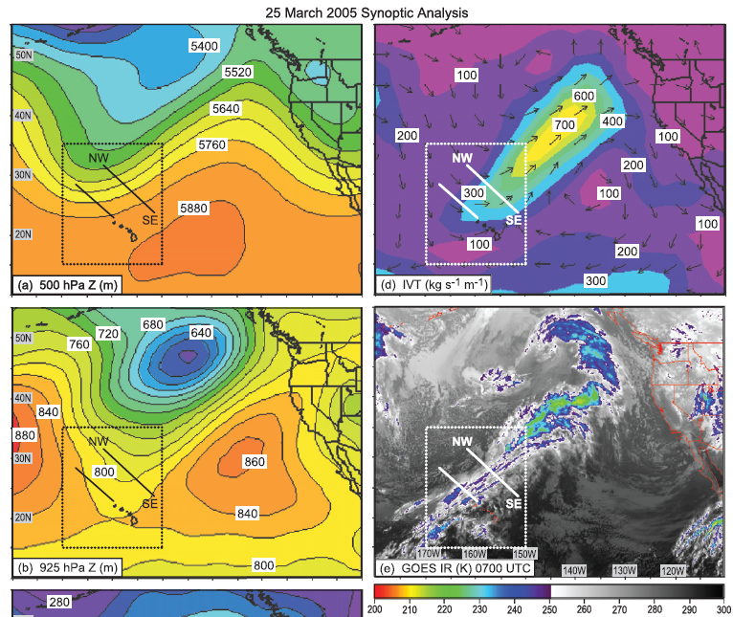
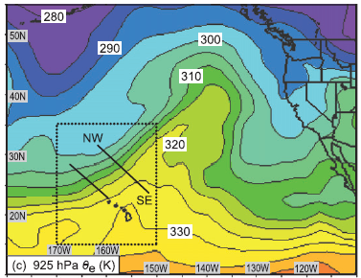
Notes:
Ralph, F. M., P. J. Neiman, G. N. Kiladis, K. Weickmann, and D. W. Reynolds, 2011: A Multiscale Observational Case Study of a Pacific Atmospheric River Exhibiting Tropical––Extratropical Connections and a Mesoscale Frontal Wave. Mon. Wea. Rev., 139, 1169–1189, https://doi.org/10.1175/2010MWR3596.1.

Slide 8
Key words
Trade wind inversion, the boundary between warm tropospheric air (as warm as on the equator) and cold ocean
Transition from solid stratus, through broken stratocumulus, scattered cumulus into deep cumulonimbus;
Bulk cloud cover variations with cloud type, SST effect
Turbulence: cold advection by the trades & cloud top longwave radiative cooling
Coupled vs. decoupled marine boundary layer, conditional instability and shallow cumulus convection
Cloud radiative effect of bright low cloud vs. deep convective cloud, important for planetary albedo
Prevalence of low cloud in eastern subtropical ocean basins (low SSTs & strong subsidence)
Two types of cloud-SST feedback: low vs. convective cloud

Slide 9
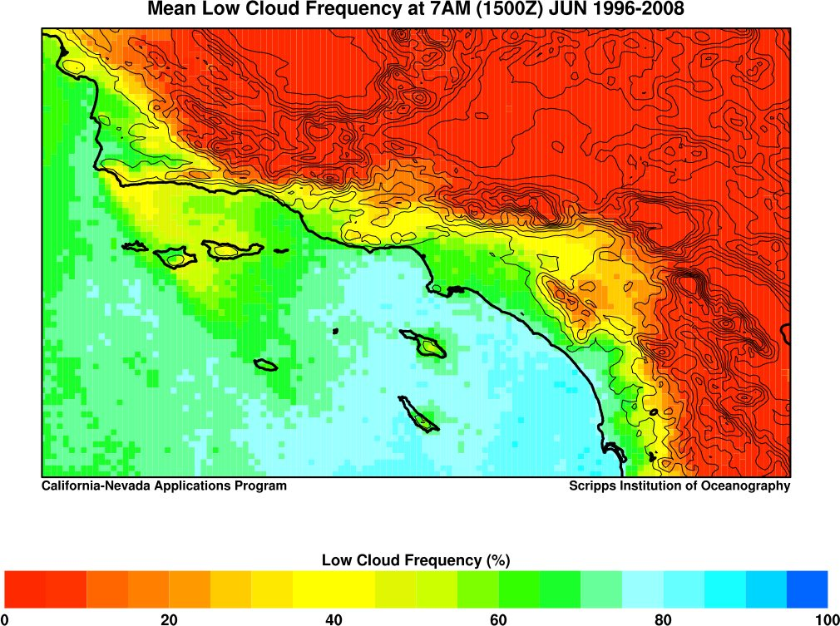
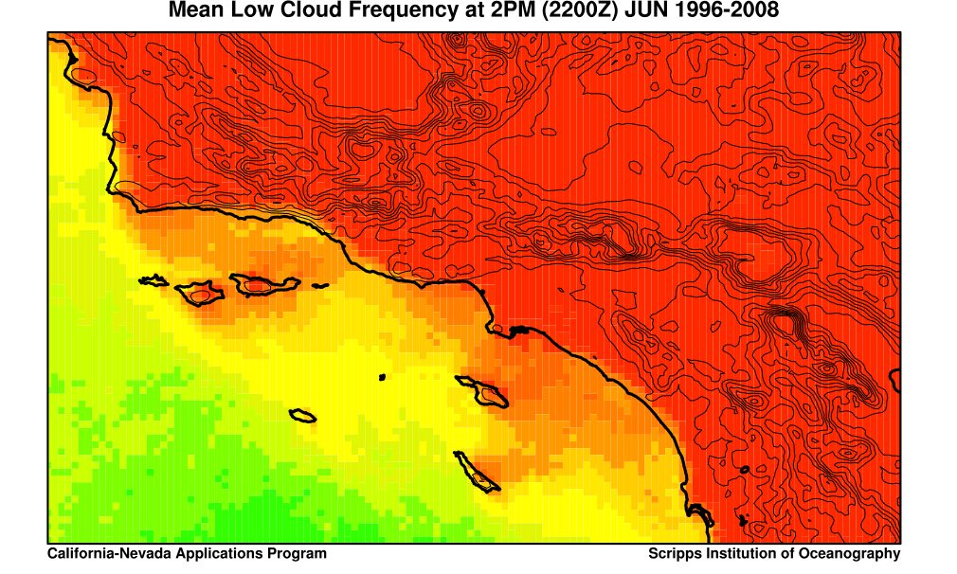
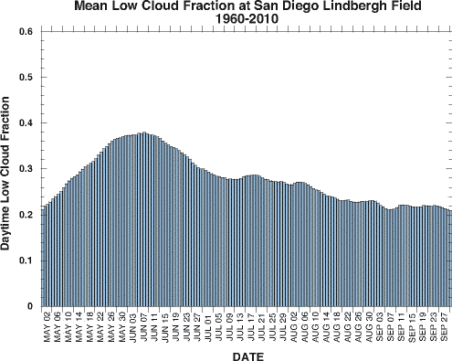
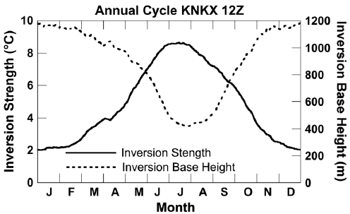
May Gray / June Gloom
May
Jun
Jul
Aug
Sep
Sam Iacobellis website: meteora.ucsd.edu/~iacob/marinelayer.html
Notes:
http://meteora.ucsd.edu/~iacob/marinelayer.html

Slide 10
COADS SST, cloud & (u,v)
Jan
Marine layer in May-July
Stronger alongshore wind than winter → Catalina eddy?
A considerable onshore component (land heating?) → moist advection (vs. winter offshore dry advection)
Enhanced cold advection across the “warm” coastal water.
Strong inversion west of warm continent.
Upwelling
Jul

