Slide 1
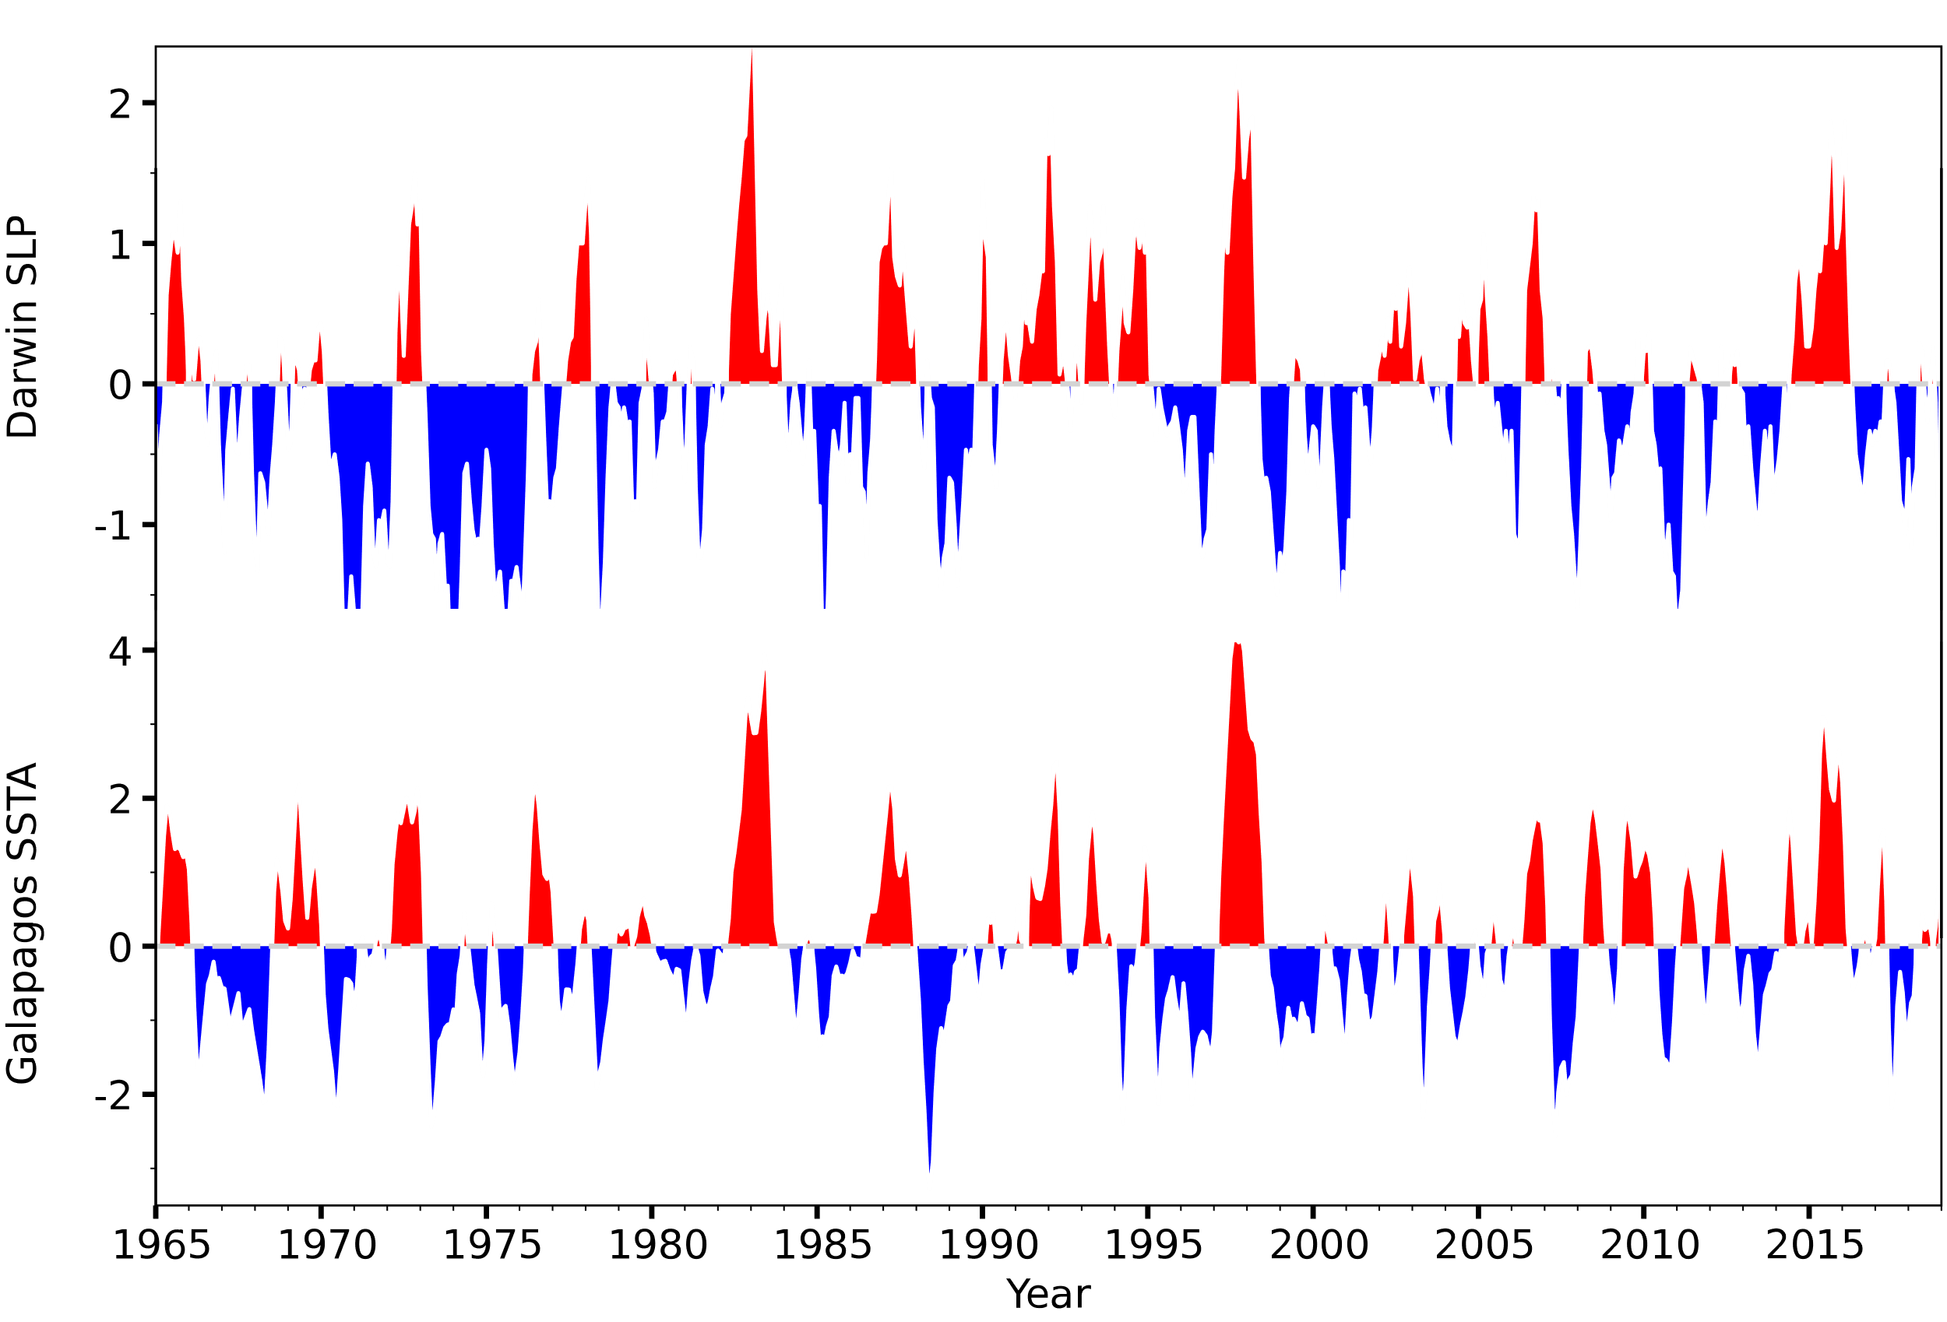
10. El Nino and the Southern Oscillation (ENSO)
Darwin SLP
E Pacific SST
Fig. 9.1. Monthly times series of in-situ observed atmospheric surface pressure anomalies (hPa) at Darwin, Australia and SST anomalies (ºC) at the Galapagos. The cross-correlation is 0.83.
Notes:
9.1, 9.2, 9.3, 9.4.1, 9.4.3

Slide 2
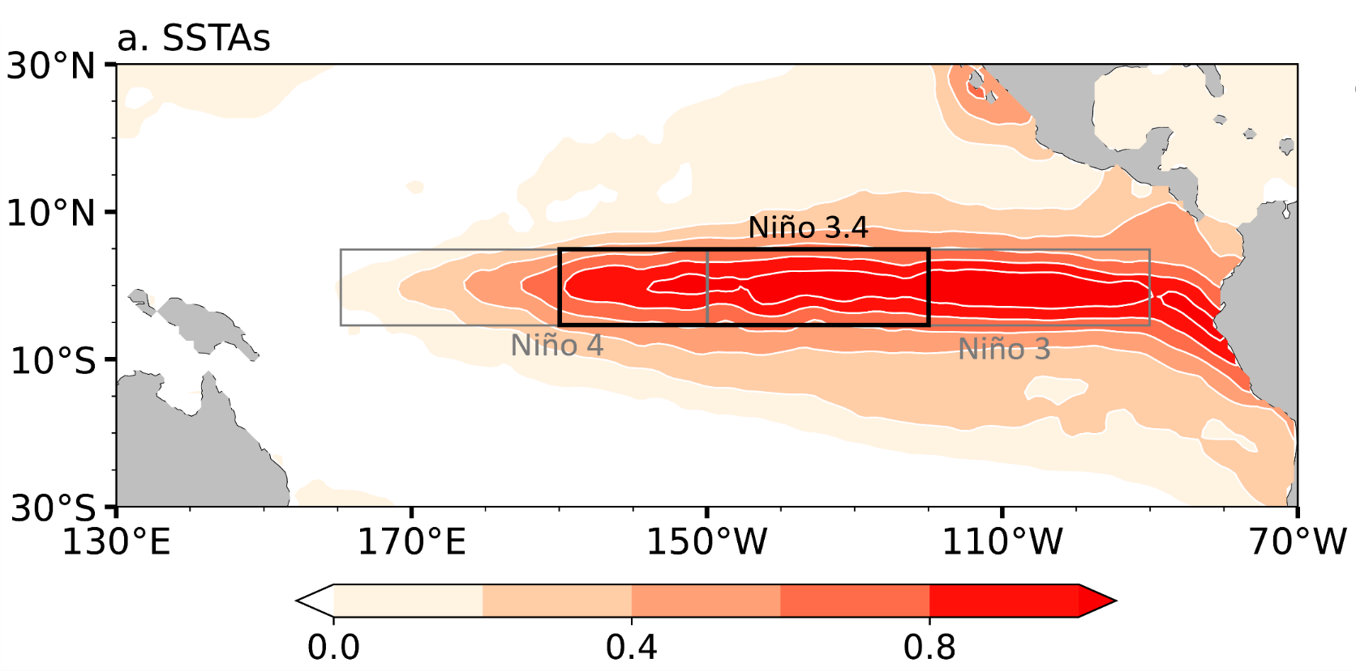
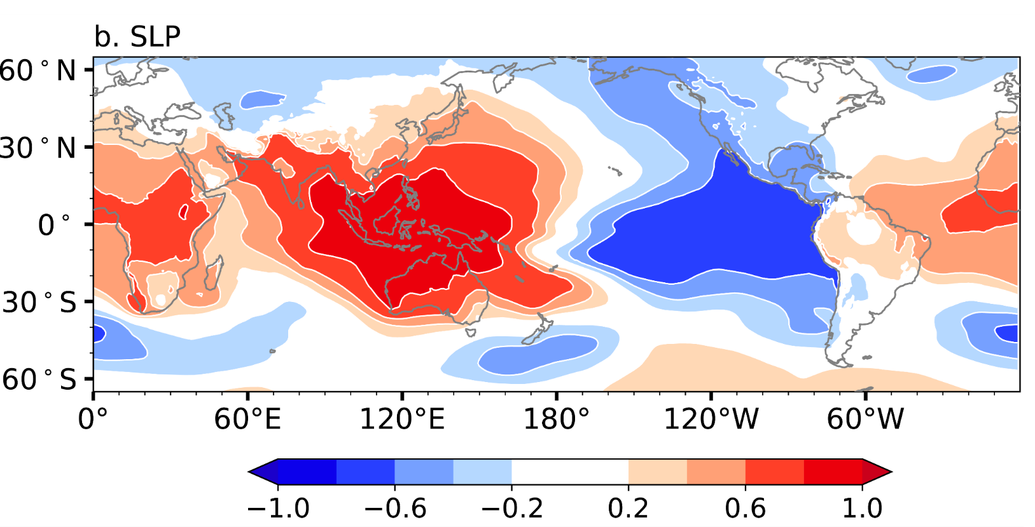
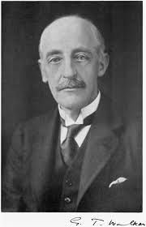
El Nino: abnormal warming in the central to eastern equatorial Pacific Ocean (including the Peruvian coast).
Southern Oscillation: seesaw in sea level pressure between the western (Darwin, Australia) and central (Tahiti) Pacific.
G. Walker
D
Fig. 9.2. (a) SST regression onto Galapagos SST variability with Niño regions marked. (b) Sea level pressure (SLP) correlation with Darwin SLP variability.

Slide 3
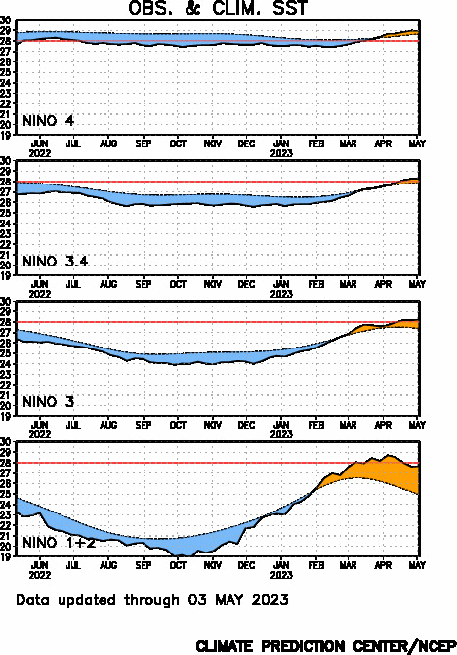
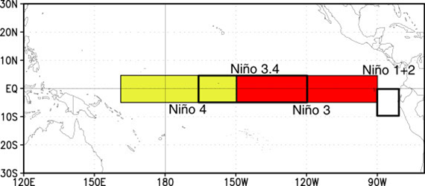
Tracking ENSO:
Niño SST Departures (ºC)

Slide 4
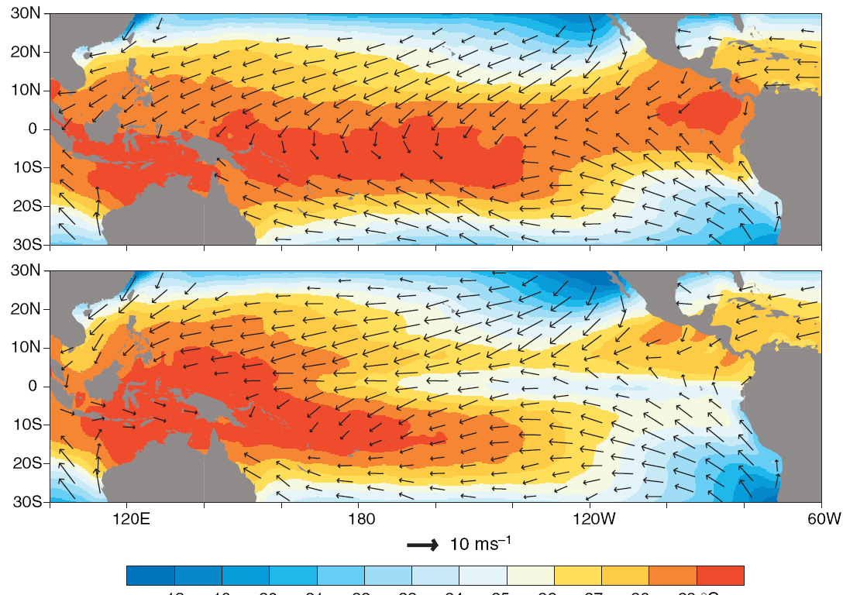

Nov 97-Apr 98
Nov 98-Apr 99
SST and surface winds during November-April of 1997-98, and 1998-99.
Fig. 9.4

Slide 5
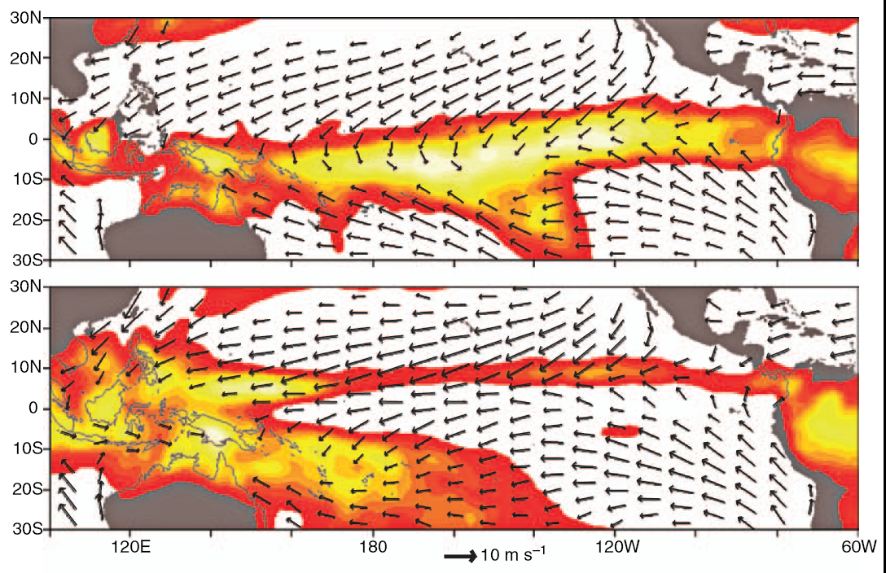

Nov 97-Apr 98
Nov 98-Apr 99
Precipitation and surface winds during November-April of 1997-98, and 1998-99.
Fig. 9.4

Slide 6
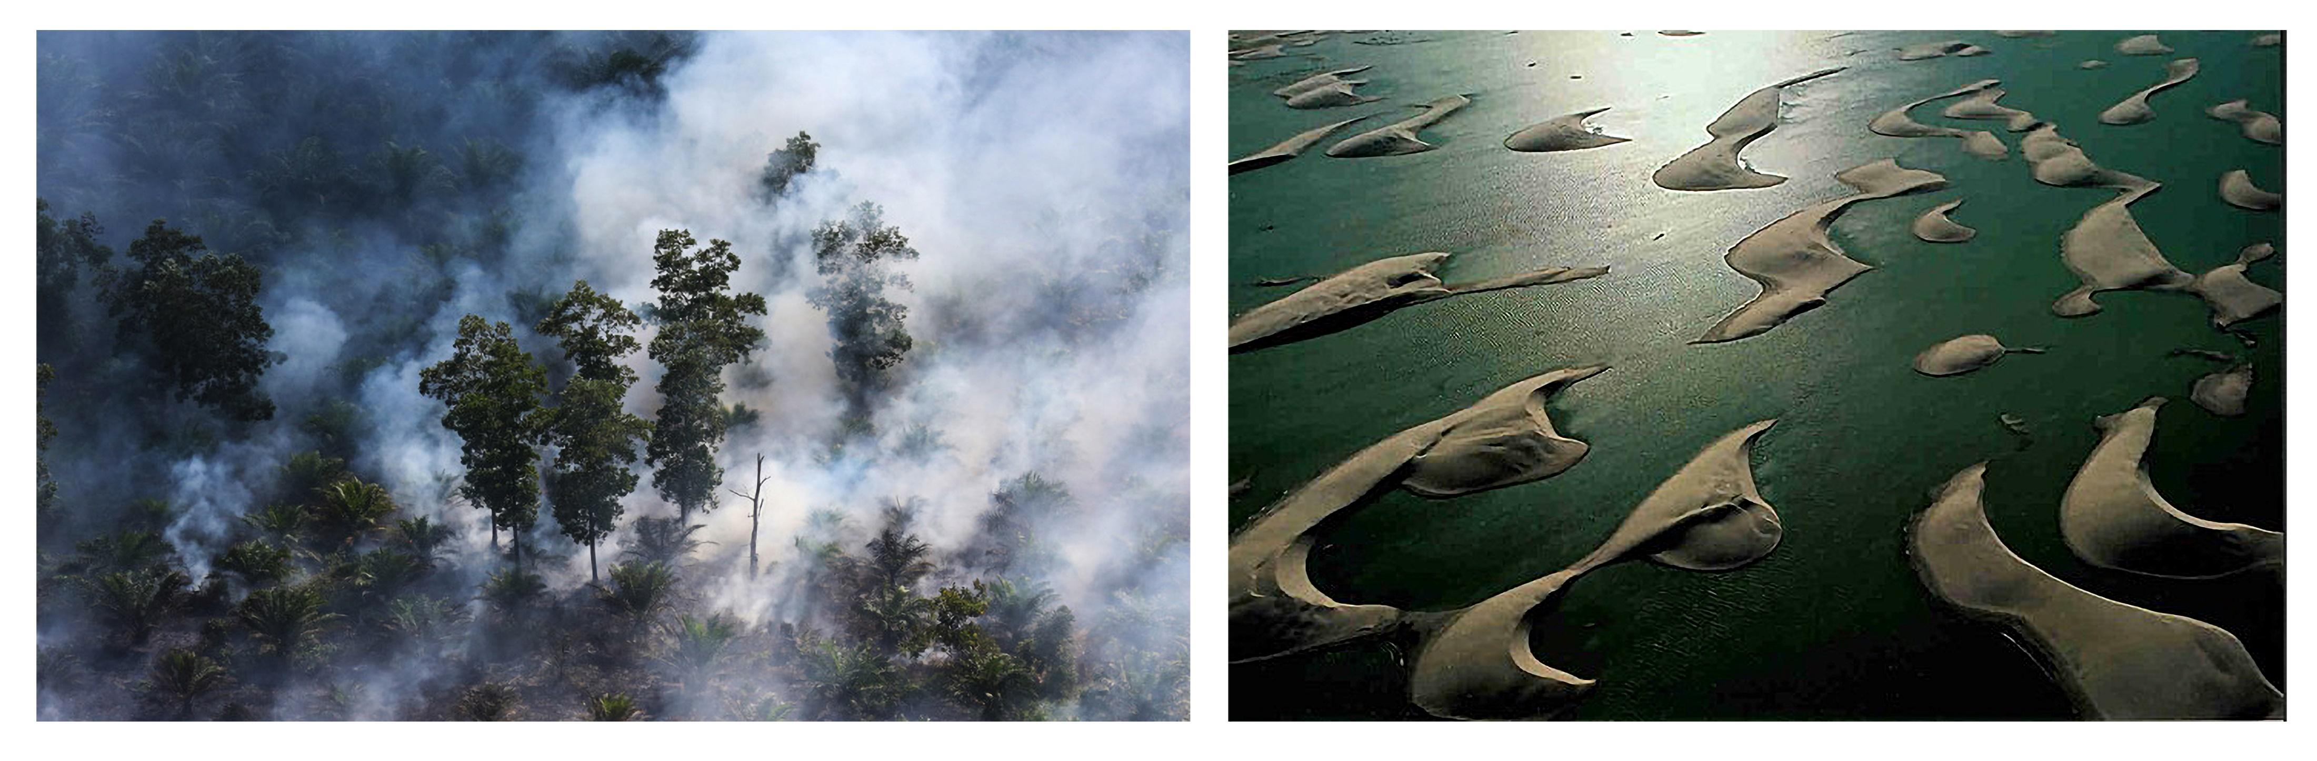
Indonesia
El Nino effects
Peru
Fig. 9.3. (left) Smoke from wildfire in Indonesia 2015. (right) A lake that emerged in Peruvian desert following the 1997-98 El Nino.
Lake of the Dunes
Like a 90-mile long mirage, an El Nino-fed lake ten feet deep spread across Peru’s Sechura Desert, usually one of the dries places on Earth. Over the centuries native people have given the periodic lake temporary names. This time Lake La Nina prevailed.
National Geographic, March 1999
Notes:
Fig. 5
Wiki: Reappeared in 2008. La Laguna de La Niña returned with an unusual dimension in March 2017 (https://www.youtube.com/watch?v=1DJURCKVHog).

Slide 7
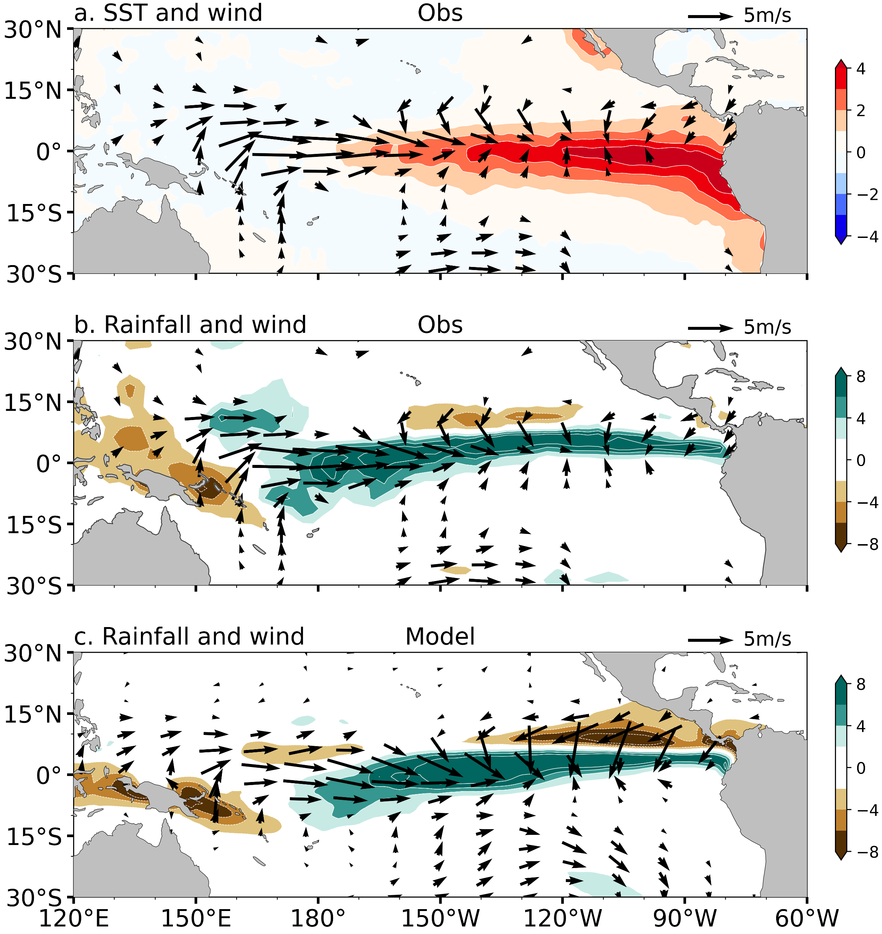
El Nino: An anomaly view
Why is SST warming largest in east while wind anomalies largest near Dateline?
August-October 1997
Relaxed trades
E-shifted convection

Slide 8

K. Wyrtki
Why is SST warming largest in east while wind anomalies largest near Dateline?
SIO 1961-64
Downwelling K wave
Eq
E shift of convection & westerly wind anomalies

Slide 9
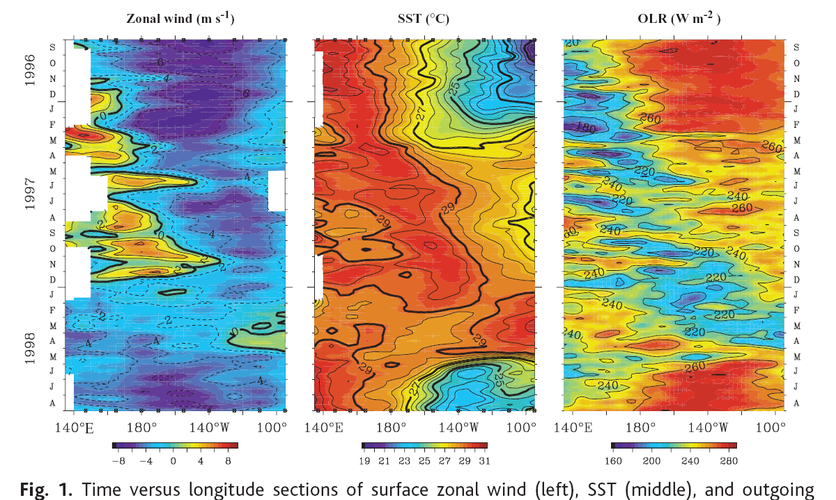
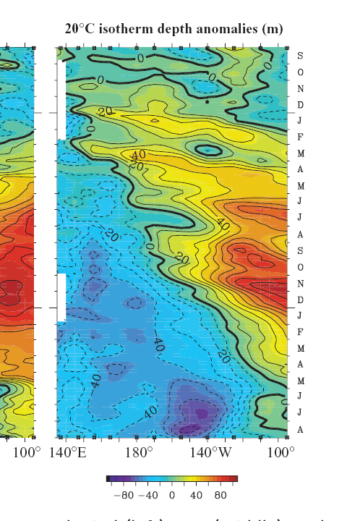
Time-longitude sections of surface zonal wind (left), SST (middle), and outgoing longwave radiation (OLR) (right). Analyses are based on averages for 2N–2S for TAO, and 2.5N–2.5S for OLR. McPhaden (1999, Science)
Dec 1997: El Nino peak, convective center displaced to central Pacific; the thermocline deepening in the east overshoots, followed by a rapid shoaling and decay of westerly anomalies (Dec 1997 onwards).
May 1998: Rapid easterly acceleration, rapid transition to La Nina (SST cooling and westward displacement of atmospheric convection.
Fig. 9.7

Slide 10
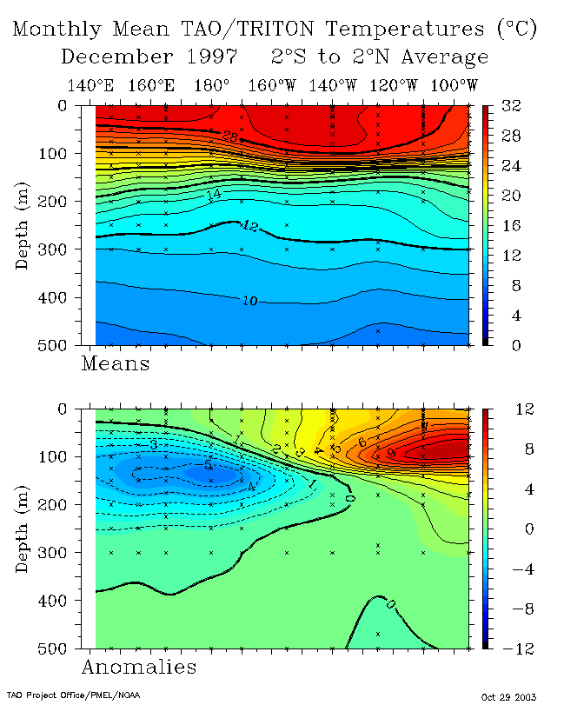
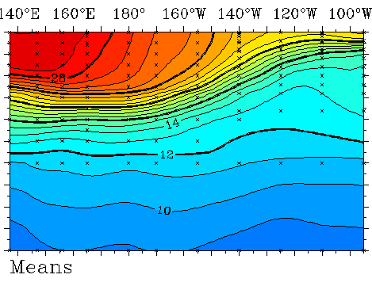

Thermocline feedback on SST in E Pacific
What flattens the thermocline tilt?
Temperature at Equator
Dec 1997
Dec 1998
Wind anomalies
$$\frac{∂T_{s}}{∂t}=\frac{Q}{ρC_{p}H_{m}}−\left[u_{m}⋅∇T_{s}+w_{m}\frac{T_{s}−T_{e}\left(h\right)}{H_{m}}\right]$$
Deepened thermocline in the east: remote response to westerlies ~ dateline
thermocline feedback
Pump warmer water into mixed layer
Temperature anomalies
El Nino: SST warming in the east
Why is thermocline feedback on SST limited to the east?
Fig. 9.6

Slide 11


Advective feedback on SST in Central Pacific
$$\frac{∂T_{s}}{∂t}=\frac{Q}{ρC_{p}H_{m}}−\left[u_{m}⋅∇T_{s}+w_{m}\frac{T_{s}−T_{e}\left(h\right)}{H_{m}}\right]$$
Eastward anomalous surface currents and the zonal advection
Wat drives SST increase in central Pacific?
Temperature at Equator
Wind anomalies
$$u_{m}^{′}$$
Temperature anomalies
Fig. 9.6

Slide 12
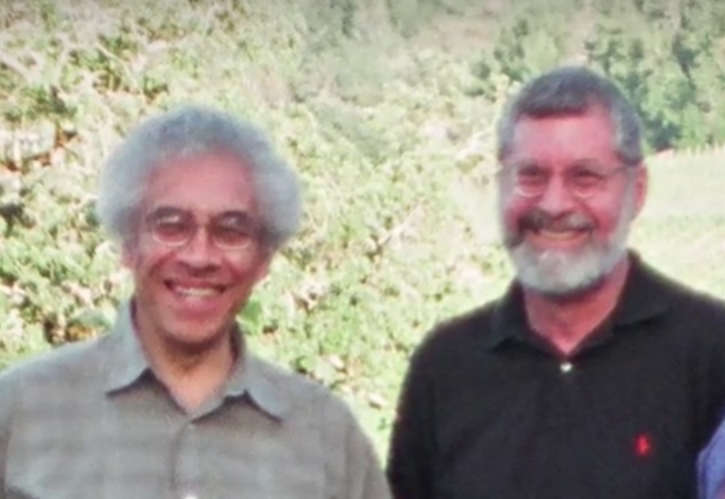
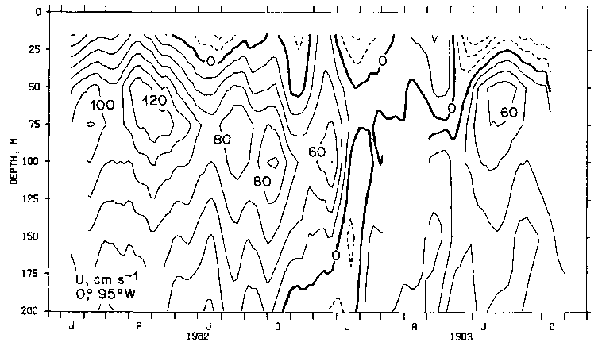
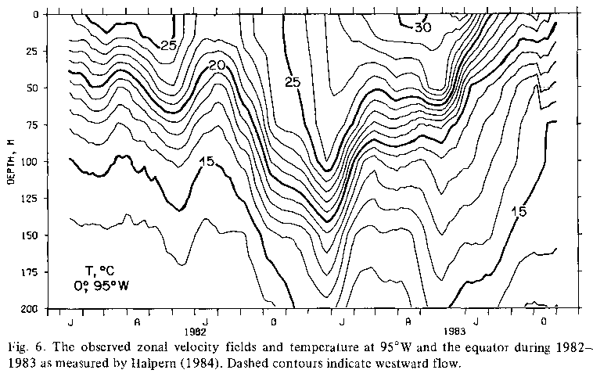
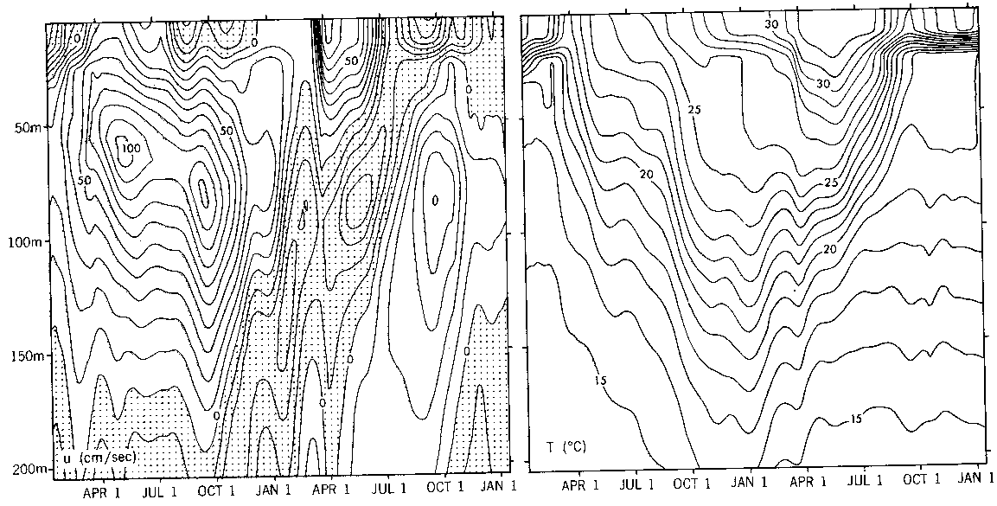
Obs. from moored buoy at 95ºW, the first in Eq. Pacific
Thermocline deepened by ~100m;
Strong surface warming of ~5ºC;
Vanishing Eq. Undercurrent ← flattened thermocline.
Philander Halpern
W
100
Depth (m)
200
1982
1983
Wind-forced ocean GCM simulates El Nino (Philander and Seigel, 1985)
W
Depth (m)
Fig. 9.8
Notes:
Philander, S.G.H., and A.D. Seigel, 1985: Simulation of El Ni�o of 1982-1983. Coupled Ocean-Atmosphere Models, J. Nihoul, Ed., Elsevier, 517-541.

Slide 13
August-October 1997
El Nino→ Southern Oscillation
SST-forced atmospheric GCMs successful simulate the Southern Oscillation, and the westerly wind anomalies in the central Eq. Pacific.
Fig. 9.5
Notes:
ESRL-CAM5： https://psl.noaa.gov/repository/entry/show?entryid=e4a9390e-638b-4f48-a6f0-799ee2cbc894

Slide 14
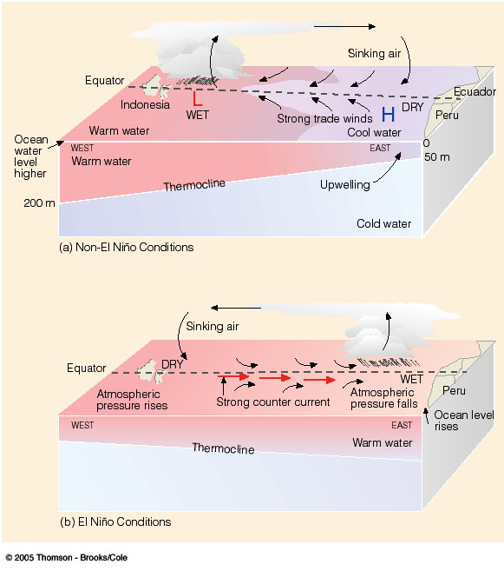
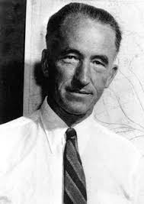
Positive Feedback between ocean & atmosphere
Bjerknes (1969)
Warming in the east
Eastward shift of deep convection & reduced air pressure in the east
Reduced easterly trades
Reduced upwelling & deepened thermocline
El Nino is a coupled ocean-atmosphere phenomenon.
Notes:
FIGURE 7.27 In diagram (a), under ordinary conditions higher pressure over the southeastern Pacific and lower pressure near Indonesia produce easterly trade winds along the equator. These winds promote upwelling and cooler ocean water in the eastern Pacific, while warmer water prevails in the western Pacific. The trades are part of a circulation that typically finds rising air and heavy rain over the western Pacific and sinking air and generally dry weather over the eastern Pacific. When the trades are exceptionally strong, water along the equator in the eastern Pacific becomes quite cool. This cool event is called La Niña. During El Niño conditions—diagram (b)—atmospheric pressure decreases over the eastern Pacific and rises over the western Pacific. This change in pressure causes the trades to weaken or reverse direction. This situation enhances the countercurrent that carries warm water from the west over a vast region of the eastern tropical Pacific. The thermocline, which separates the warm water of the upper ocean from the cold water below, changes as the ocean conditions change from non-El Niño to El Niño.

Slide 15
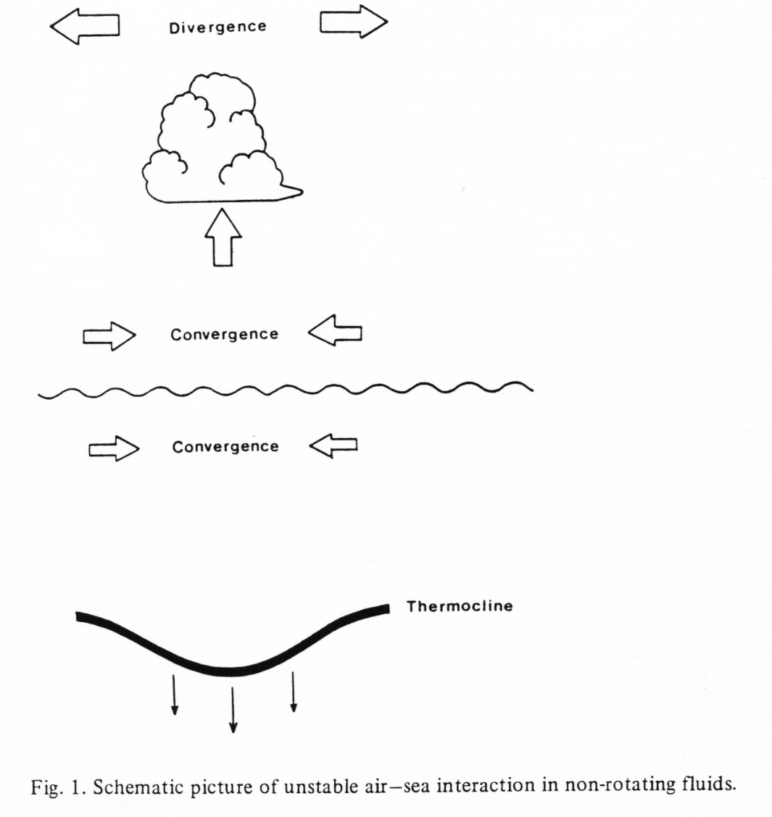
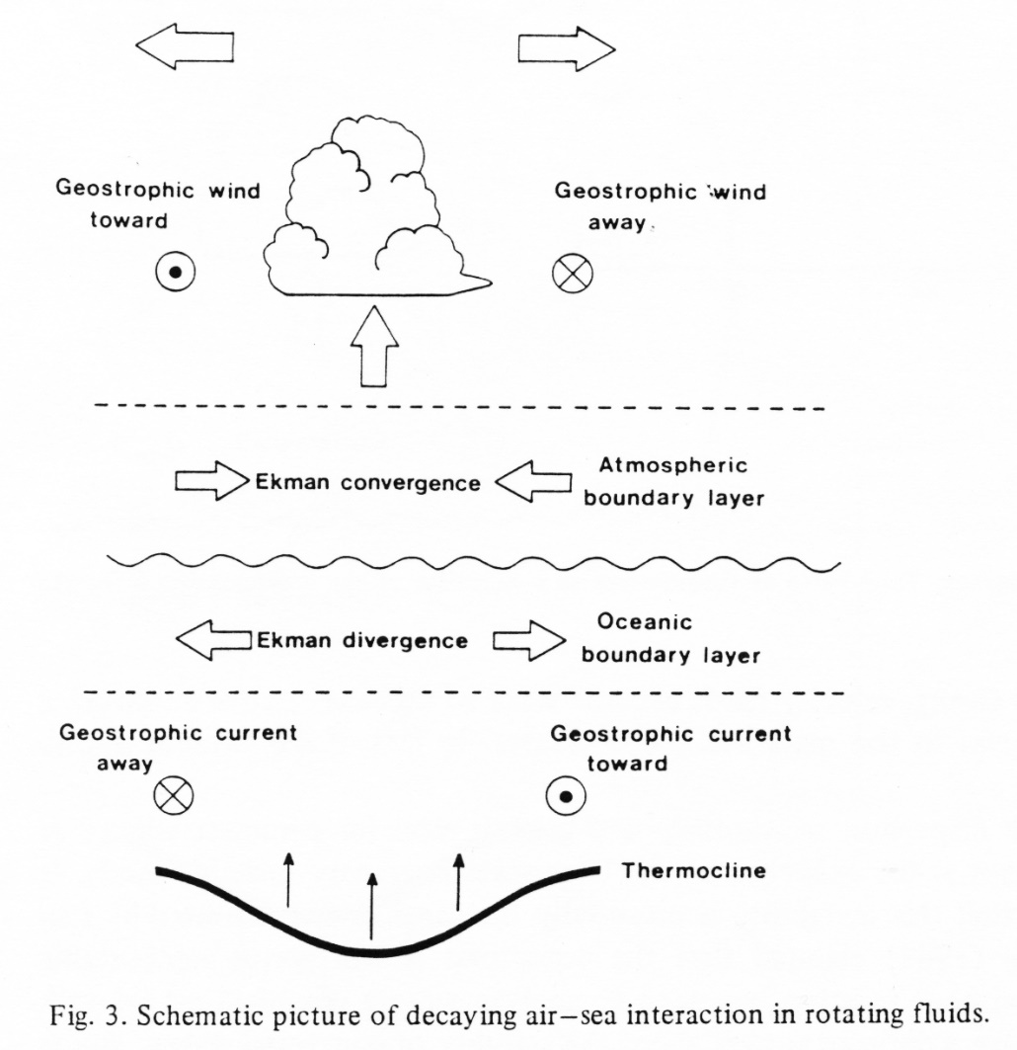
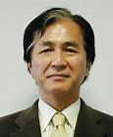
Air-sea interaction of the Bjerknes type
Unstable on the equator
Stable off the equator
f=0
f>0
→ Why El Nino is observed only on the equator.
Yamagata (1985)
Fig. 9.9

Slide 16

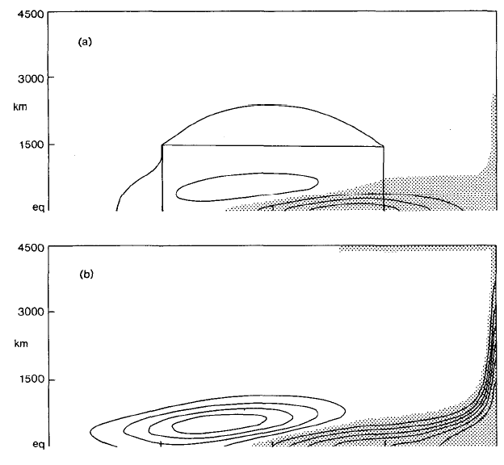
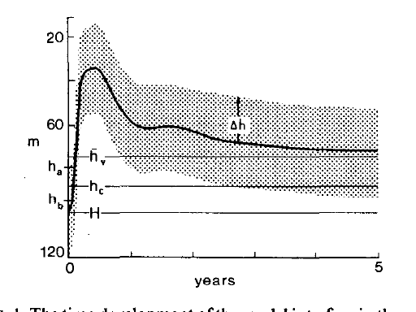
Why oscillates b/w El Nino & La Nina?
Slow ocean wave adjustment to wind change
T=3 mon
h<0 shaded
SIO PhD 1977
Downwelling Rossby
Upwelling Kelvin
McCreary & Anderson (1984, MWR)
τ(x,y)
Arrival of downwelling Kelvin wave reflected from western boundary
Kelvin wave shoals the thermocline in the east in response to a remote easterly wind forcing, despite no change in local wind.

Slide 17

Upwelling Rossby waves hidden in the deep thermocline w/o atmospheric feedback, seeding the later decay of El Nino and transition to La Nina
W
Developing
Downwelling Kelvin wave to be amplified by the Bjerknes feedback
Turn around
Reflected upwelling Kelvin wave to terminate El Nino
Fig. 9.10

Slide 18
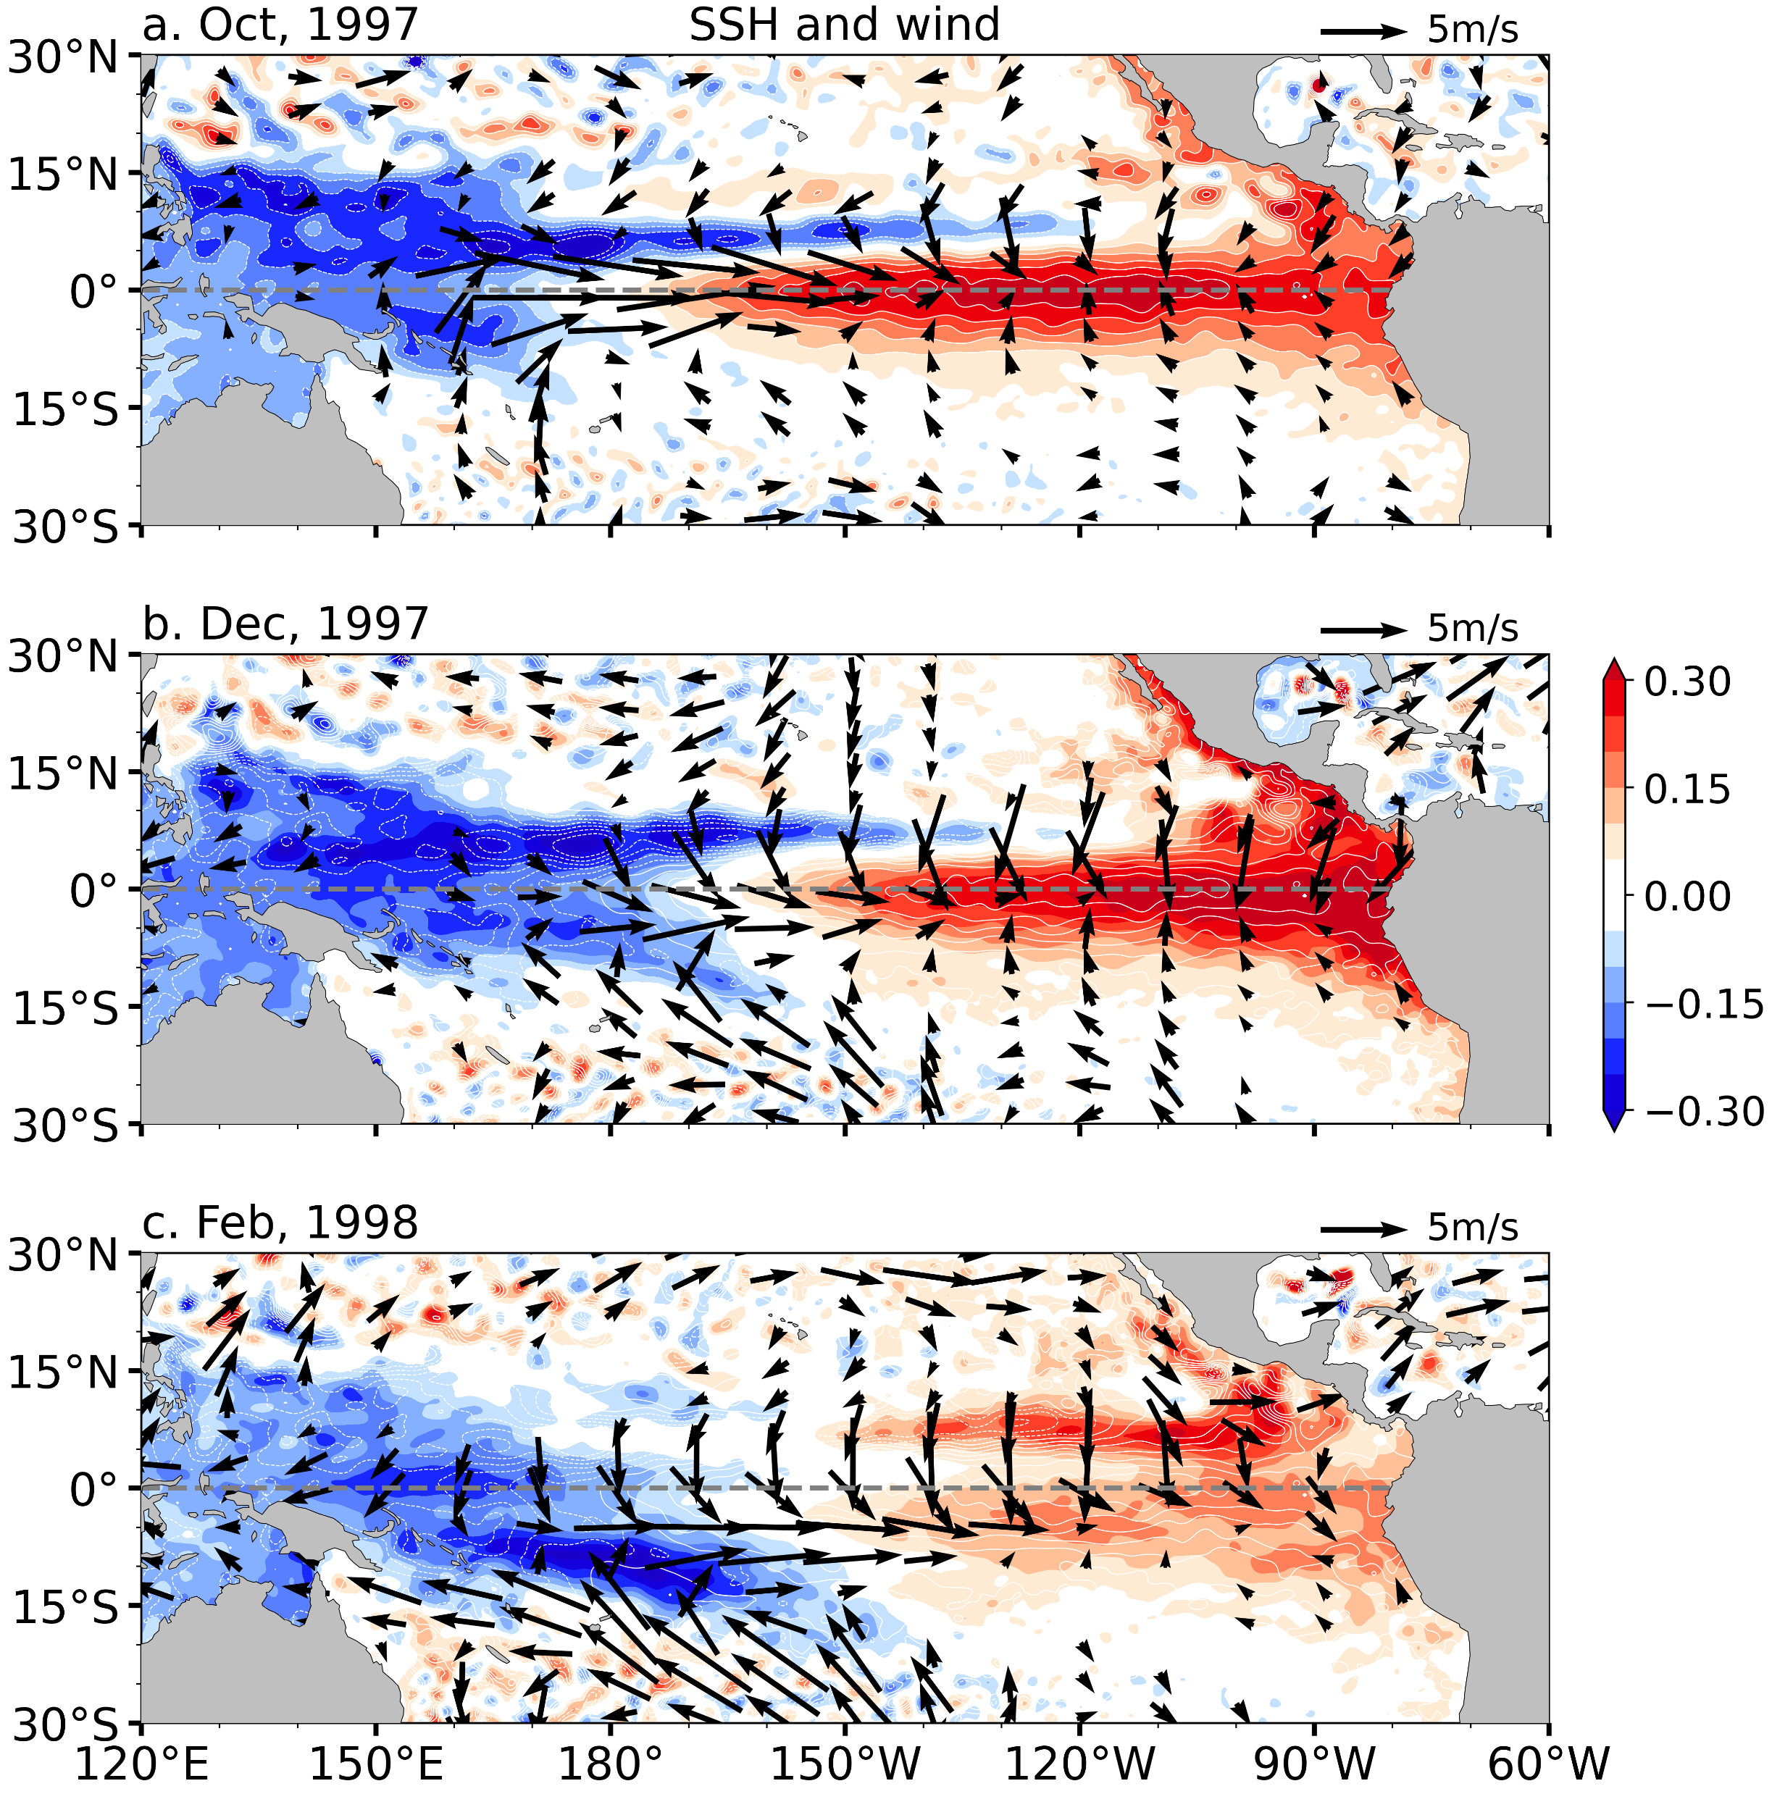
Satellite altimeters observe ocean heat redistribution
(thick warm water layer in red)
Westerly wind anomalies deepen the thermocline in the eastern eq Pacific while lifting the thermocline in the western Pacific off the equator.
The thermocline depth returns to normal in the eastern eq Pacific while the westerly wind anomalies in Nino4 displace south of the equator.
Fig. 9.12.

Slide 19

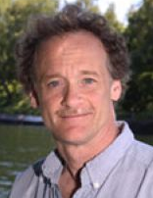
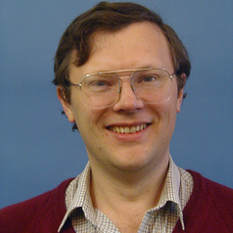



W
Downwelling Kelvin wave to be amplified by Bjerknes feedback
In the eastern equatorial Pacific
Atmospheric model: τ_{x}=βT
$$\frac{∂T}{∂t}=Kh−εT$$
$$=−bT\left(t−τ\right)+cT$$
$$T=\tilde{T}e^{−i\left(σ_{R}+iσ_{I}\right)t}$$
τ ~ 180 days: the time for Rossby/reflected Kelvin waves to arrive in E Pacific.
Battisti & Hirst (1989 JAS)
Notes:
Tau=0, infinity

Slide 20
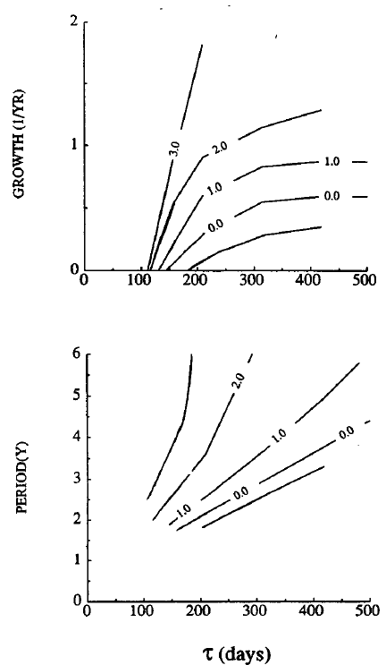

Delayed action oscillator
(Battisti & Hirst 1989, JAS)
c=2
Period increases with τ;
Growth rate increases with τ;
For c=2.2 yr⁻¹, the minimum τ for instability is 120 days, equivalent to a basin size of 13000km for Kelvin wave phase speed of 2.9m/s. Smaller basins?
Coupled instability increases with the zonal extent of the basin: Pacific vs. Atlantic and Indian Ocean.
τ (days)
c=2
Fig. 9.11. (a) Growth rate (yr⁻¹) and (b) period (yr) of the delayed oscillator solution as a function of time lag τ. Each curve is for a different value of c (yr⁻¹). From Battisti and Hirst (1989).
Notes:
1989 Battisti, D.S. and A.C. Hirst: Interannual Variability in the Tropical Atmosphere-Ocean System: Influences of the Basic State, Ocean Geometry and Nonlinearity. J. Atmos. Sci., 46, 1687-1712.

Slide 21
Key words
El Nino and Southern Oscillation are a coupled ocean-atmosphere phenomenon
Ocean: SST warming, retreating cold tongue, deepened thermocline, phase-locking
Atmosphere: eastward shift of convection, SLP seesaw between Darwin and Tahiti, westerly anomalies near the Dateline
Bjerknes feedback, coupled instability, effect of Earth rotation
Role of ocean Kelvin wave, zonal displacement between maximum zonal wind anomalies and peak SST warming on the equator, coastal Kelvin wave observed at tide gauges,
Thermocline feedback confined to eastern Eq. Pacific ← shallow mean thermocline & persisting southeast trades
Oscillation b/w El Nino and La Nina, delayed negative feedback due to slow ocean wave propagation, preference for large basin

Slide 22
DJF(1) correlation with NDJ Nino3.4 SST (79-05)
SST
SLP & sfc wind
Temp (850-250 mb) & precip

