Slide 1
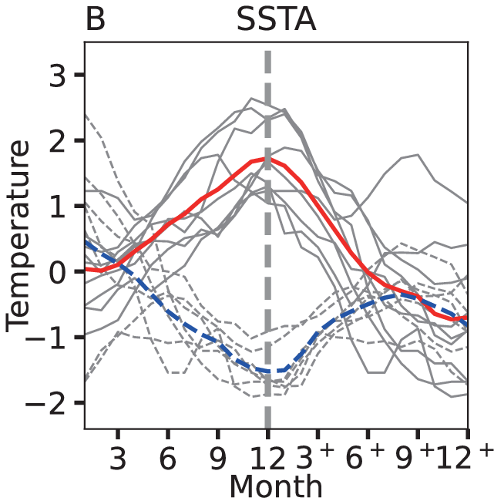
Global SST
11. ENSO: Seasonality, diversity, teleconnection, and predictability
Nino3.4 SSTA peaks in Dec
10 5 3 2 yrs
Seasonal phase locking
Deser et al. (2010)
Notes:
9.4.1, 9.4.3, 9.5, 9.6.1, 9.6.3-4, 9.7
Fig. 19 Deser et al. 2010, Annual Reviews…
(a) Leading empirical orthogonal function (EOF) of detrended monthly sea surface temperature (SST)
anomalies over the global oceans based on the HadISST data set during 1900–2008. This mode, which
accounts for 19% of the variance, depicts the El Ni˜ no-Southern Oscillation phenomenon. (b) Monthly SST
anomaly time series in the Ni˜ no-3.4 region (5◦N–5◦S, 170◦–120◦W: outlined by the rectangle on the EOF
pattern). (c) Power spectrum of the Ni˜ no-3.4 SST anomaly time series based on 1950–2008 (solid curve) and
1900–2008 (dashed curve). (d ) Monthly standard deviation of the Ni˜ no-3.4 SST anomaly time series.

Slide 2
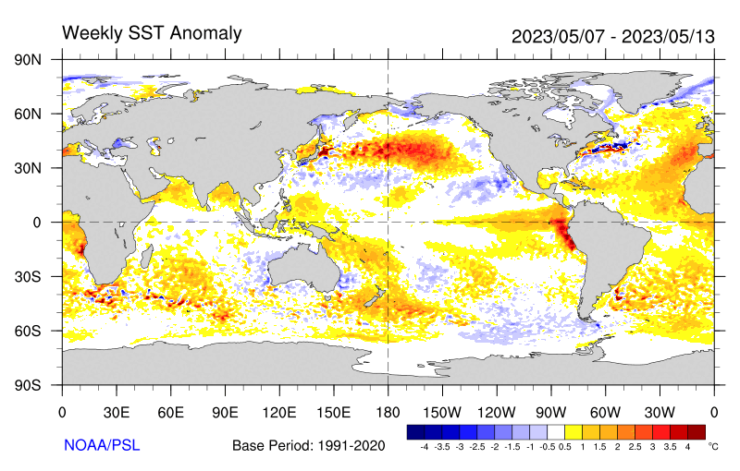
Current ENSO condition
Developing El Nino.
Warmest global-mean SST
Notes:
https://psl.noaa.gov/map/clim/sst.anom.anim.year.html

Slide 3
Key words
El Nino and Southern Oscillation are a coupled ocean-atmosphere phenomenon
Ocean: SST warming, retreating cold tongue, deepened thermocline, phase-locking
Atmosphere: eastward shift of convection, SLP seesaw between Darwin and Tahiti, westerly anomalies near the Dateline
Bjerknes feedback, coupled instability, effect of Earth rotation
Role of ocean Kelvin wave, zonal displacement between maximum zonal wind anomalies and peak SST warming on the equator, coastal Kelvin wave observed at tide gauges,
Thermocline feedback confined to eastern Eq. Pacific ← shallow mean thermocline & persisting southeast trades
Oscillation b/w El Nino and La Nina, delayed negative feedback due to slow ocean wave propagation, preference for large basin

Slide 4
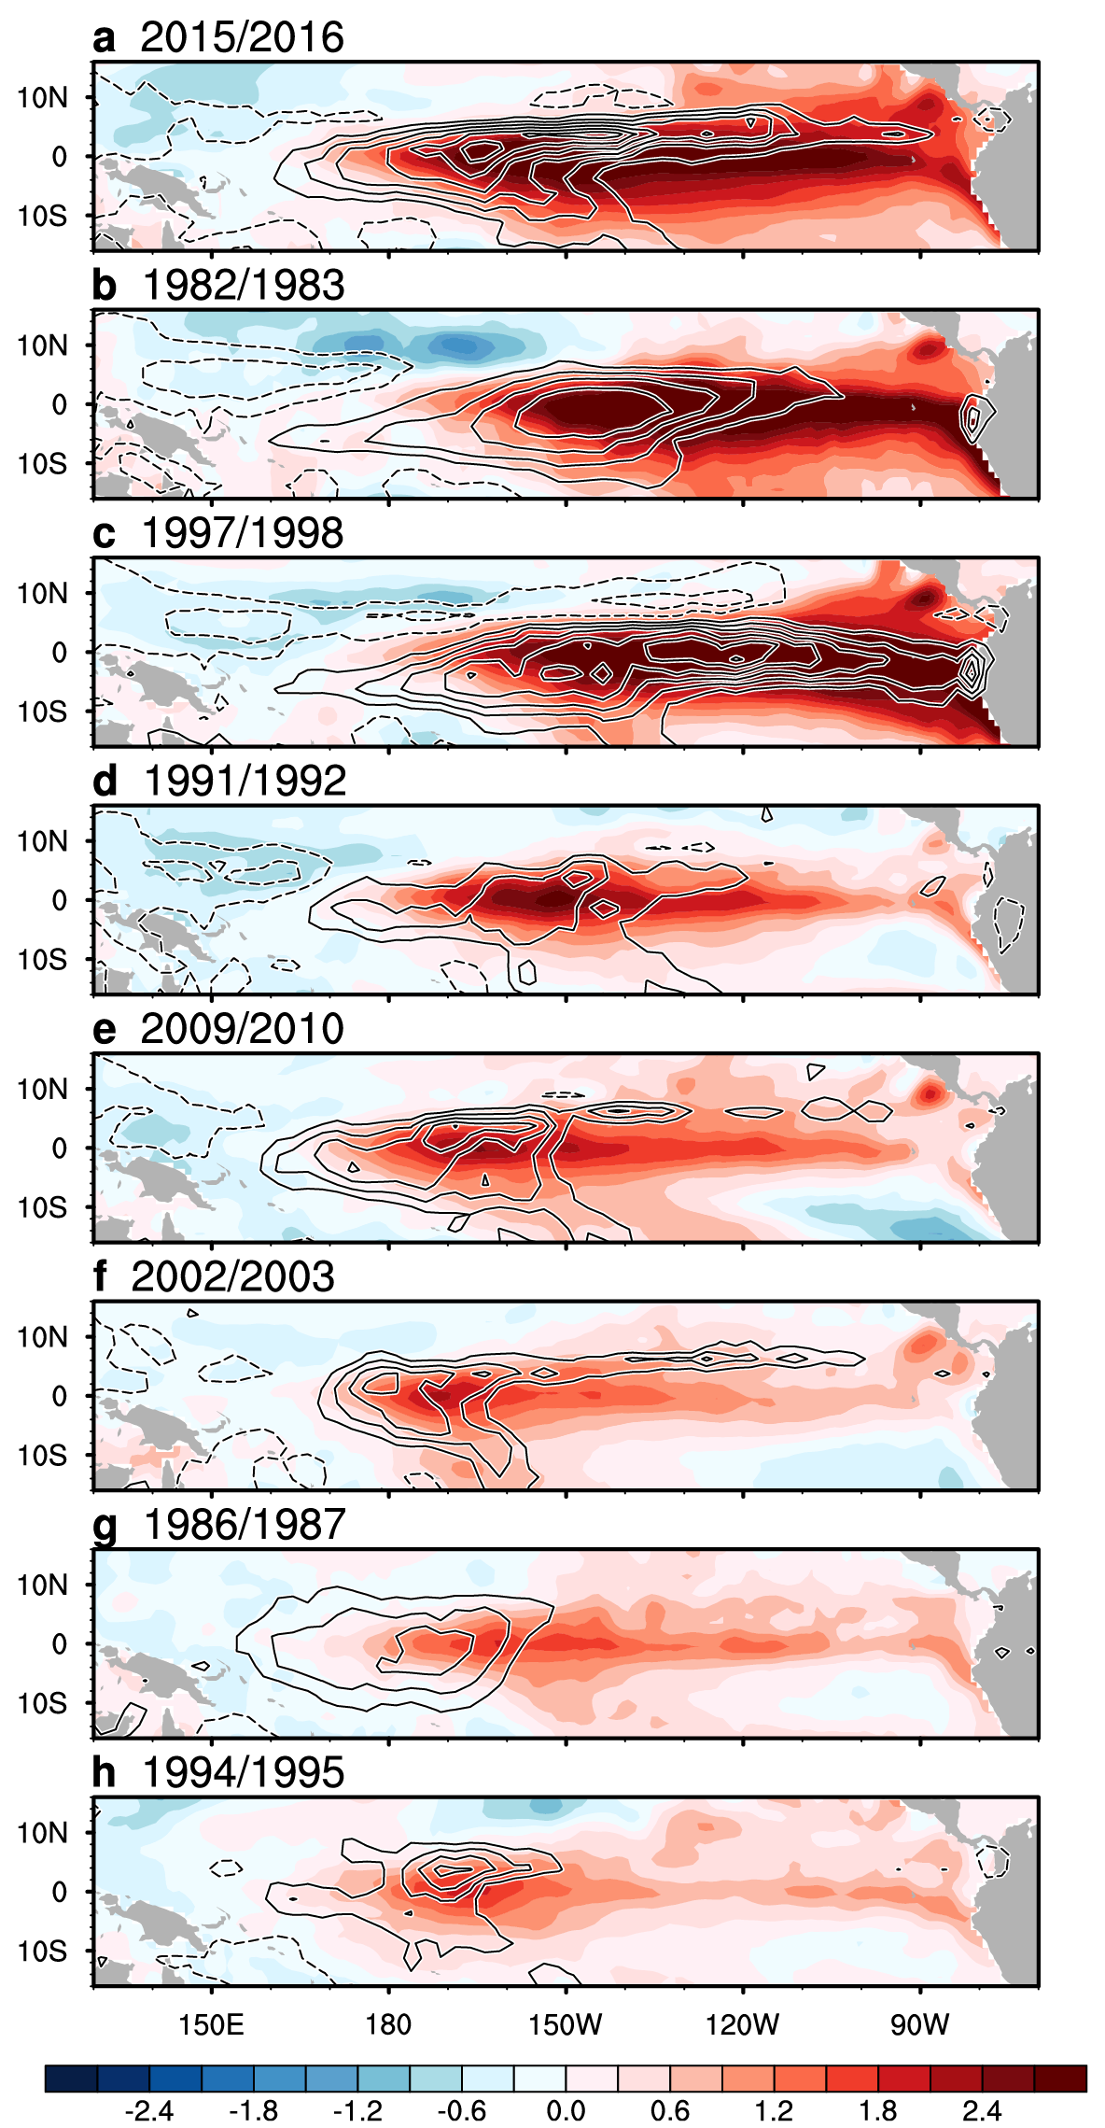
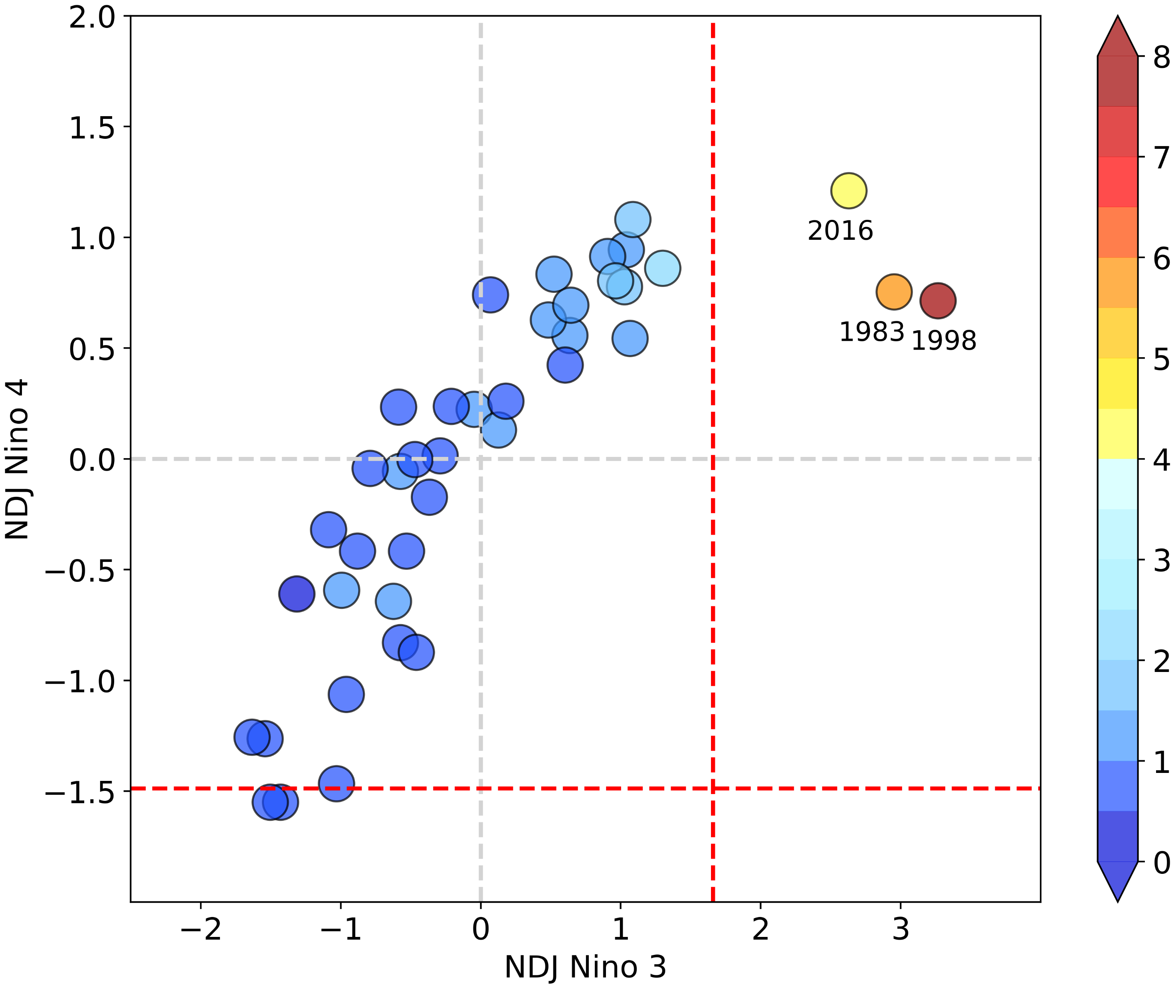
ENSO diversity
CP vs. EP, or
Moderate ENSO vs. Extreme El Nino
Extreme Nino
Moderate ENSO
SST>T_{convt}
Nino3 precip
DJF SST (shading) & rainfall anomalies ranked by Niño-3.4 SST since 1982. Okumura (2019, Current Clim Change Rep)
Figs. 9.16, 9.17

Slide 5
Westerly wind anomalies displaced south of Eq. from Nov on, following mean convection.
How does this change affect the equatorial thermocline in the east?
El Nino composites of wind anomalies at 180º during 1953-77. Harrison (1987 MWR)

Slide 6
ENSO Cycle: thermocline depth
Slow thermocline depth adjustment provides predictability (ocean initial condition)
Tilt mode in phase w/ El Nino
Recharge mode out of phase
28%
21%
r_{max}=0.77 w/ PC2 leading by 9 mon
Fig. 9.15.
Meinen and McPhaden (2000, JC)
Notes:
Meinen, C.S. and M.J. McPhaden, 2000: Observations of Warm Water Volume Changes in the Equatorial Pacific and Their Relationship to El Niño and La Niña. J. Climate, 13, 3551–3559, https://doi.org/10.1175/1520-0442(2000)013<3551:OOWWVC>2.0.CO;2

Slide 7
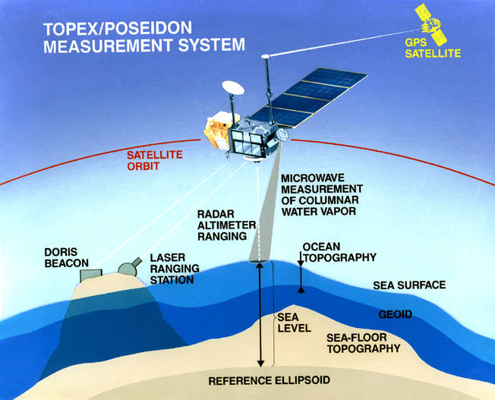
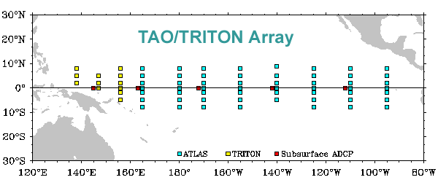
ENSO Cycle
Swings between El Niño and La Nina.
Basin-scale ocean waves are the switch.
ENSO observing system: moored array, Argo floats & satellites
Significant skill in predicting El Niño six months ahead.
Observing System

Slide 8

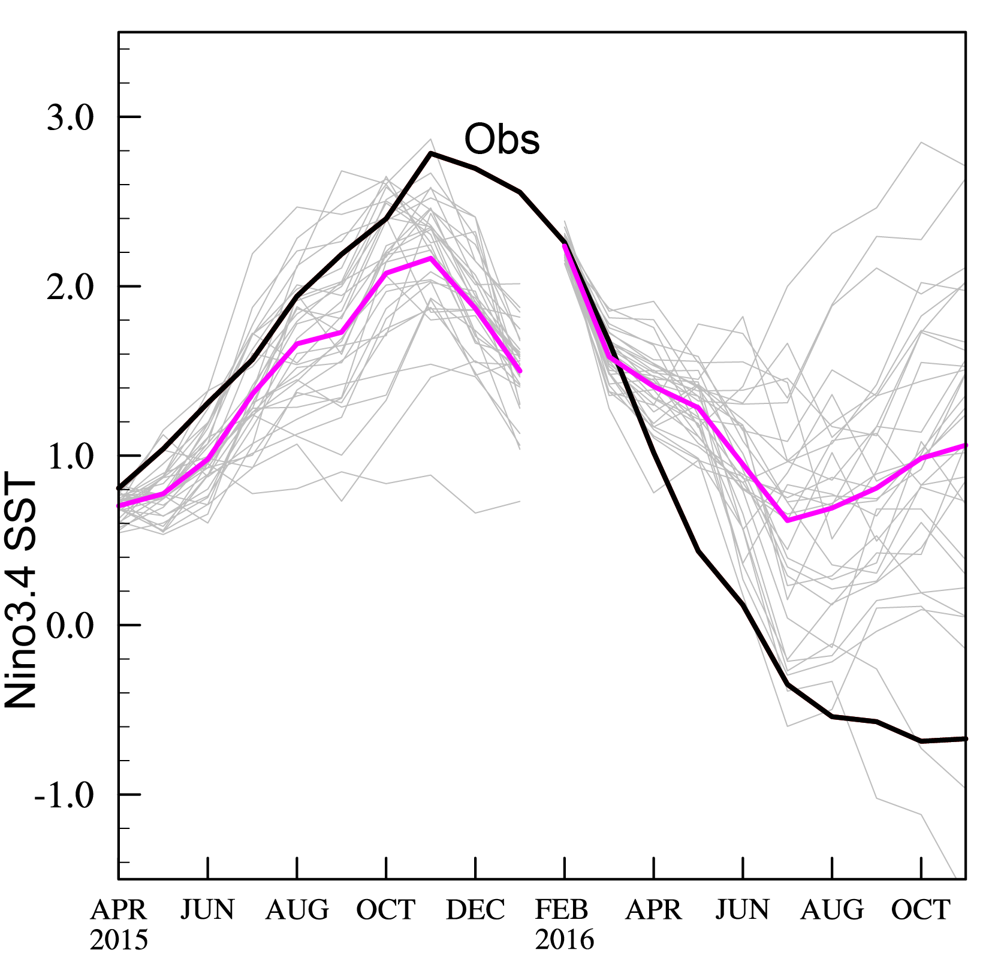
El Nino Prediction: A triumph of science
Iterations of physical understanding, coupled models, and observing system
Weather forecast: initialize atmosphere (lead< 2 weeks)
Seasonal forecast: initialize ocean; predict monthly-seasonal mean statistics, not individual storms (lead ~ 2-3 seasons)
Ensemble spread indicates uncertainties of the forecast.
Ensemble forecast
Ensemble forecast with perturbed initial conditions to sample uncertainty.
What variables are most important initial conditions for ENSO prediction?
Fig. 9.26.
Notes:
Thermocline depth, SST (PMM)

Slide 9
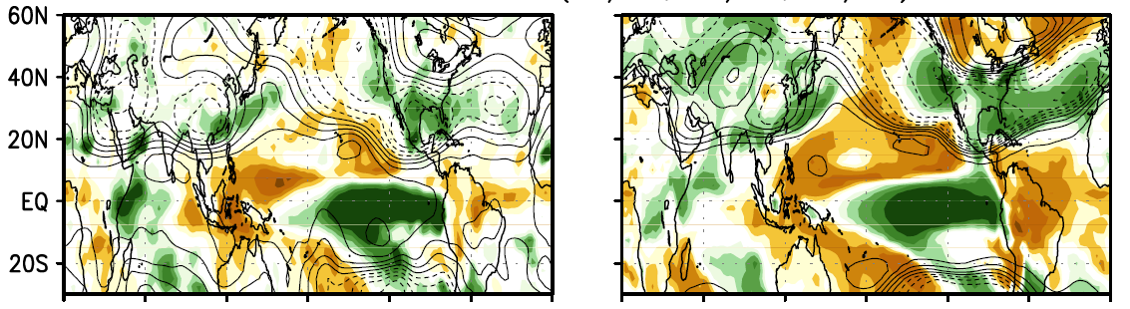
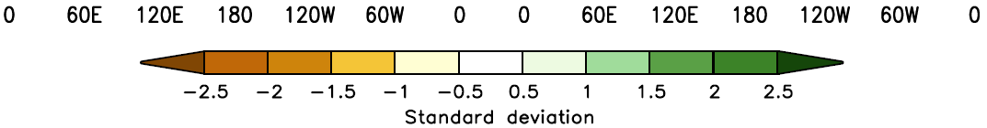
Obs
MME forecast
Precip (shaded) & Z500
Wang et al. (2009, Clim. Dyn.)
Agreement is good in the tropics.
Predicted extratropical anomalies:
- deepened Aleutian low;
- wet California/TexMex;
- wet southern China
Fig. 9.27.
Notes:
Wang, B., J.-Y. Lee and co-authors: Advance and Prospect of Seasonal Prediction: Assessment of the APCC/CliPAS 14-model ensemble retroperspective seasonal prediction (1980-2004). Climate Dyn., 33, 93-117. DOI: 10.1007/s00382-008-0460-0.

Slide 10
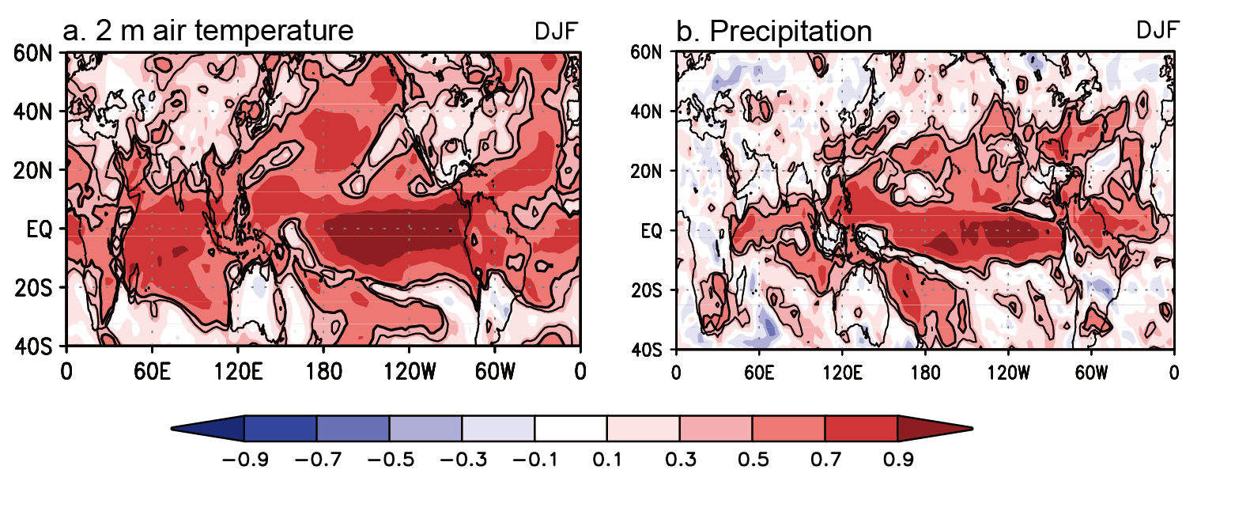
14-model ensemble-mean skill for 1981-2004
Corr. with obs
Why is sfc air temp more predictable over ocean than on land?
Skills are high in tropical oceans but low on land and in extratropics.
Fig. 9.28.

Slide 11
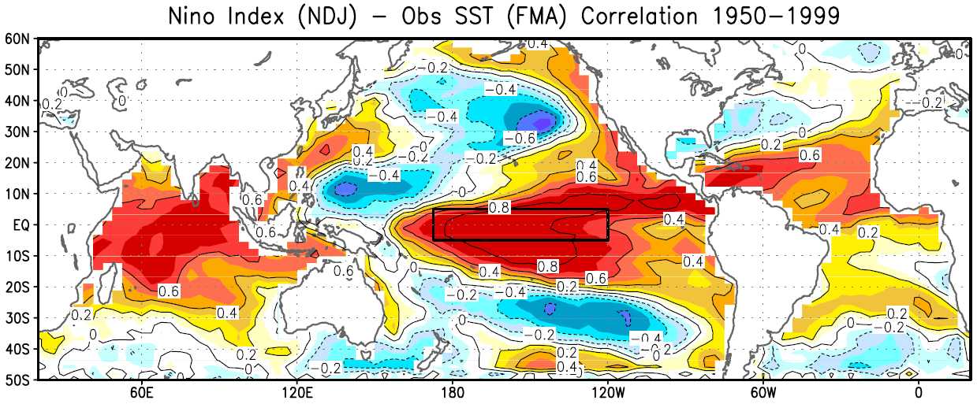
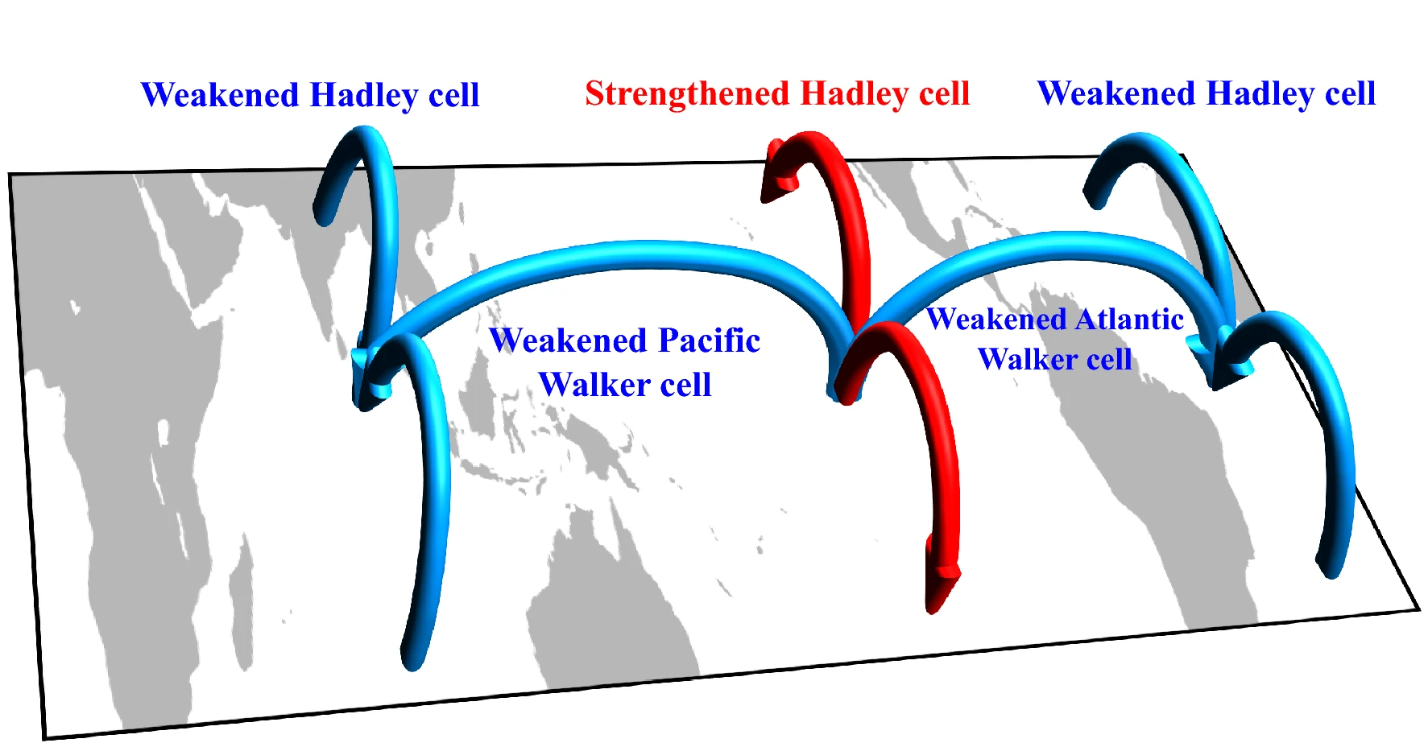
Alexander et al. (2002, JC)
Schematic diagram of the changed Walker and Hadley circulations associated with an El Niño event. When an El Niño occurs, both the Pacific and Atlantic Walker circulations are weakened. Additionally, the regional Hadley circulation is strengthened over the eastern Pacific but weakened over the Atlantic and Indo-western Pacific. C. Wang et al. (2019, CD)
Notes:
Wang, C. Three-ocean interactions and climate variability: a review and perspective. Clim Dyn 53, 5119–5136 (2019). https://doi.org/10.1007/s00382-019-04930-x

Slide 12
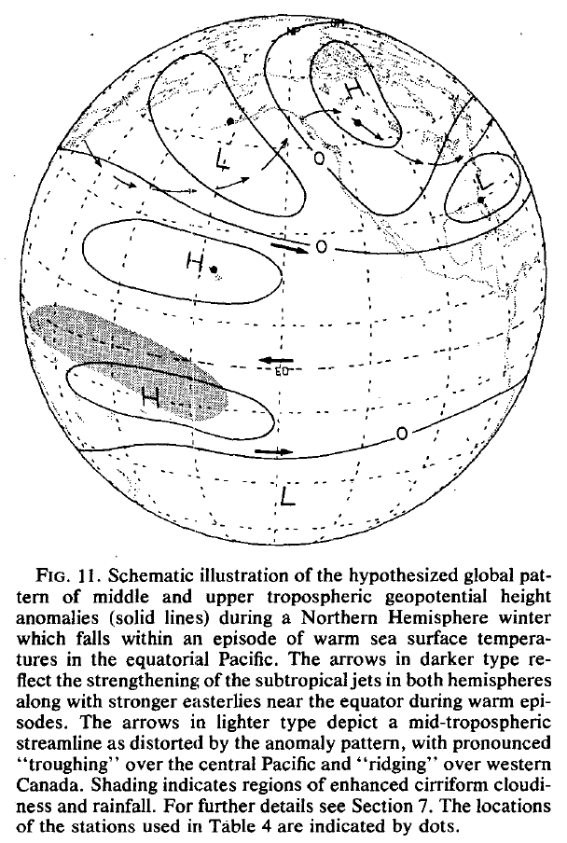
Schematic diagram of the changed Walker and Hadley circulations associated with an El Niño event. When an El Niño occurs, both the Pacific and Atlantic Walker circulations are weakened. Additionally, the regional Hadley circulation is strengthened over the eastern Pacific but weakened over the Atlantic and Indo-western Pacific. C. Wang et al. (2019, CD)
Notes:
Wang, C. Three-ocean interactions and climate variability: a review and perspective. Clim Dyn 53, 5119–5136 (2019). https://doi.org/10.1007/s00382-019-04930-x

Slide 13
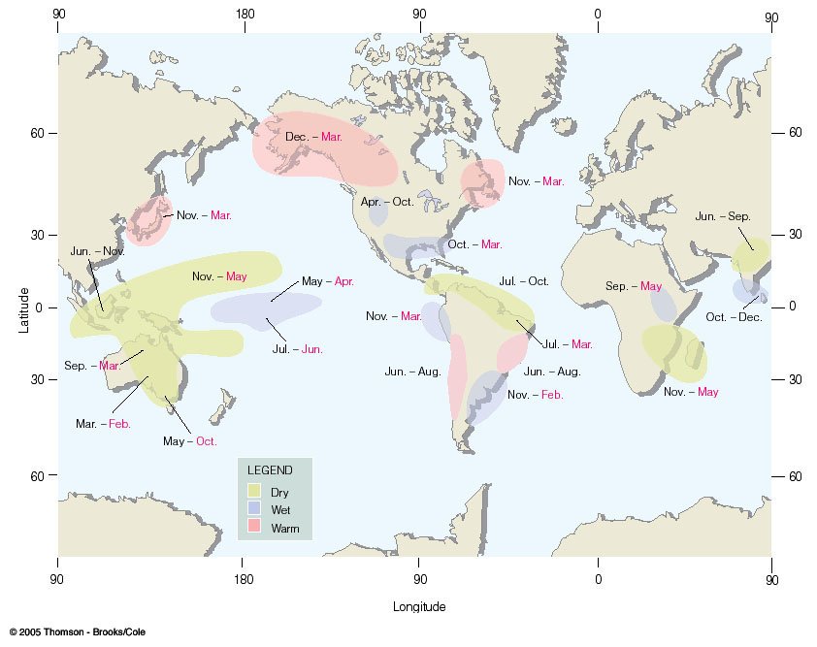
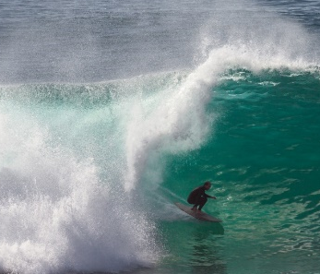
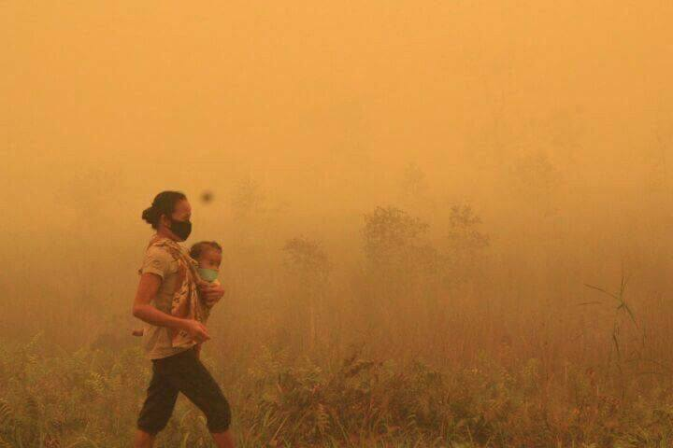
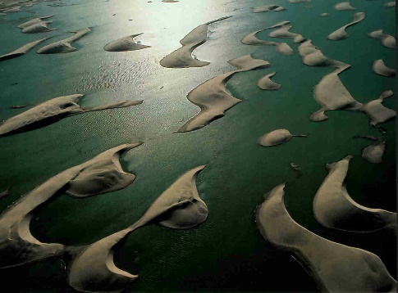
Global influence of El Nino
Indonesia
Peru
Notes:
FIGURE 7.29 Regions of climatic abnormalities associated with El Niño–Southern Oscillation conditions. A strong ENSO event may trigger a response in nearly all indicated areas, whereas a weak event will likely play a role in only some areas. Note that the months in black type indicate months during the same years the major warming began; months in red type indicate the following year.(After NOAA Climatic Prediction Center.)

Slide 14

Pacific-North American (PNA) Pattern:
Teleconnection out of tropics during El Nino winter
Stationary Rossby waves
Barotropic in the vertical
Phase propagation arrested by the westerly jet
Eastward (downstream) energy propagation
Active convection
29 Jan 2016, La Jolla
Geopotential anomalies in the upper troposphere during El Nino winter (shade: enhanced convection)
Notes:
Wallace & Horel 1981 MWR

Slide 15
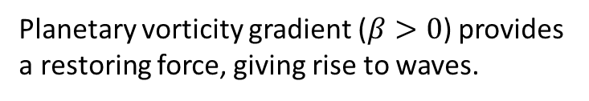

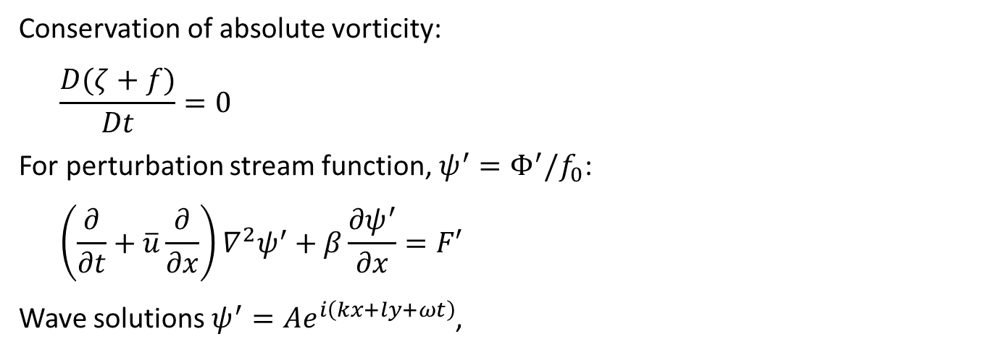


Barotropic Rossby wave
Conservation of absolute vorticity:
$$\frac{D(ζ+f)}{Dt}=0$$
For perturbation stream function, $ψ^{′}=Φ^{′}/f_{0}$:
$$\left(\frac{∂}{∂t}+\overline{u}\frac{∂}{∂x}\right)∇^{2}ψ^{′}+β\frac{{∂ψ}^{′}}{∂x}=F′$$
Wave solutions $ψ^{′}=Ae^{i\left(kx+ly+ωt\right)}$,
$ω=$ frequency
$k=$ zonal wavenumber
$=$ 2π/wavelength
$l=$ meridional wavenumber
$$K^{2}=k^{2}+l^{2}$$
y
Planetary vorticity gradient ($β>0$) provides a restoring force, giving rise to waves.
$$ζ^{′}<0$$
x
$$ζ^{′}>0$$

Slide 16




$$c=ω/k=\overline{u}−β/K^{2}$$
$$K^{2}≡k^{2}+l^{2}$$
Stationary waves: c=0 (westward Rossby wave phase propagation is balanced by eastward advection) at
$$K^{2}=β/\overline{u}≡{K_{s}}^{2}$$
only possible in westerly flow $\overline{u}$>0.
Ks: stationary wavenumber (L_{x} ~12,000 km)

Slide 17
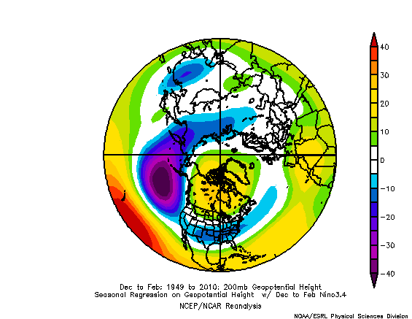
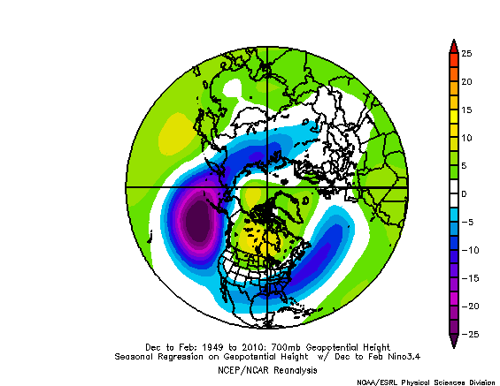
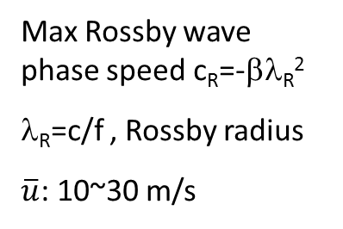
Given stratification in θ₀(p), Why are stationary waves barotropic in extratropics?
PNA
200 hPa
700 hPa
Karoly et al. (1989, JAS)
 | c (m/s) | Max c_{R} (m/s) | λ_{R} =c/f (km)
Barotropic | 300 | -22.5 | 3,000
Baroclinic | 50 | -3.8 | 500
Max Rossby wave phase speed c_{R}=-βλ_{R}²
λ_{R}=c/f , Rossby radius
$\overline{u}$: 10~30 m/s

Slide 18
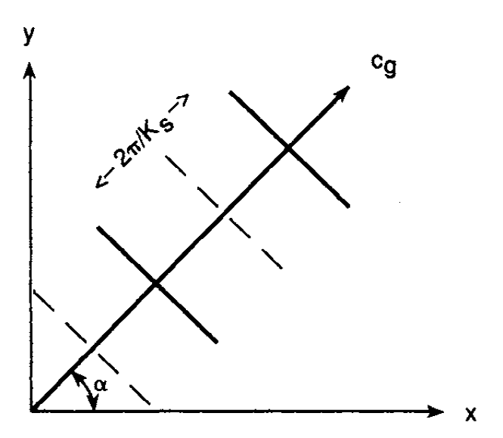
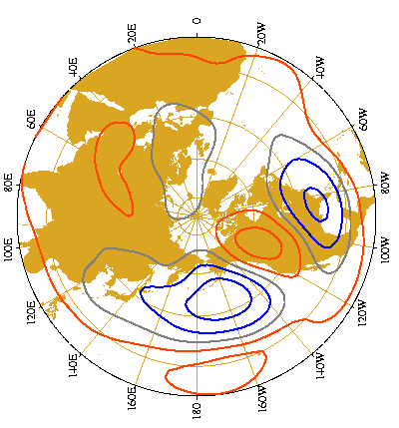
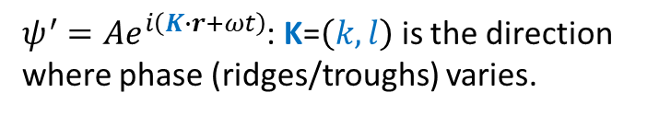

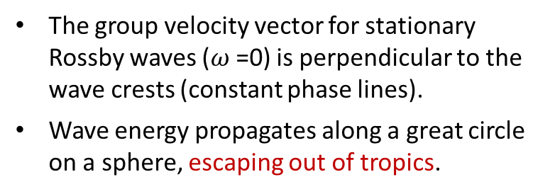
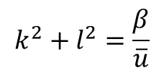

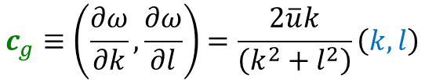
$ψ^{′}=Ae^{i\left(K∙r+ωt\right)}$: K=$\left(k,l\right)$ is the direction where phase (ridges/troughs) varies.
K=$\left(k,l\right)$
$${k^{2}+l}^{2}=\frac{β}{\overline{u}}$$
For stationary waves
crests
$$c_{g}≡\left(\frac{∂ω}{∂k},\frac{∂ω}{∂l}\right)=\frac{2\overline{u}k}{\left(k^{2}+l^{2}\right)}\left(k,l\right)$$
crests
The group velocity vector for stationary Rossby waves ($ω$=0) is perpendicular to the wave crests (constant phase lines).
Wave energy propagates along a great circle on a sphere, escaping out of tropics.
$$c_{g}$$
Pacific-North American (PNA) pattern
z₅₀₀ Corr with Nino3.4 SST
L
H
Fig. 9.23.
Notes:
(k,l) is a straight line corresponding to a great circle on a sphere.

Slide 19
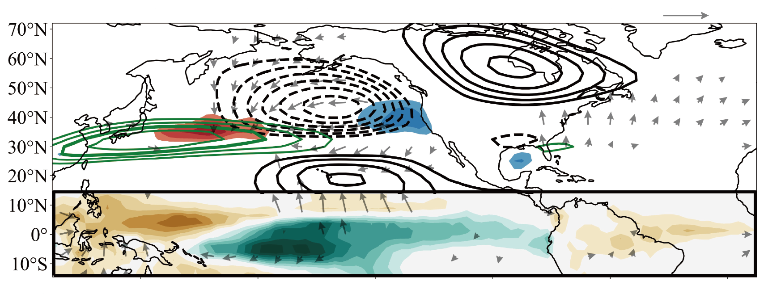
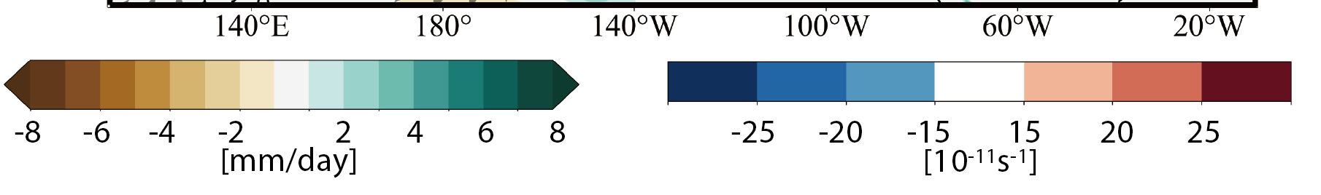

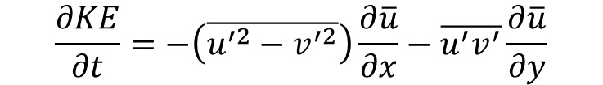

Effect of zonal variations in mean flow
$$\frac{∂KE}{∂t}=−\left(\overline{u^{′2}−v^{′2}}\right)\frac{∂\overline{u}}{∂x}−\overline{u^{′}v^{′}}\frac{∂\overline{u}}{∂y}$$
⬆
⬆
⬆
Barotropical energy conversion
Confluence term
Shear term
$$\overline{u}$$
Perturbations gain energy from mean flow at jet exit ($\frac{∂\overline{u}}{∂x}$<0)
z’ & $\overline{u}$
Tropical convection
→ divergent flow → PNA
Precip & divergent wind
El Nino composite at 200 hPa (JFM 1979-2010). Chapman et al. (2021)
Fig. 9.24.

Slide 20
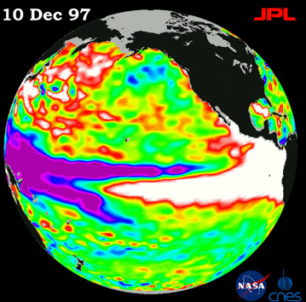
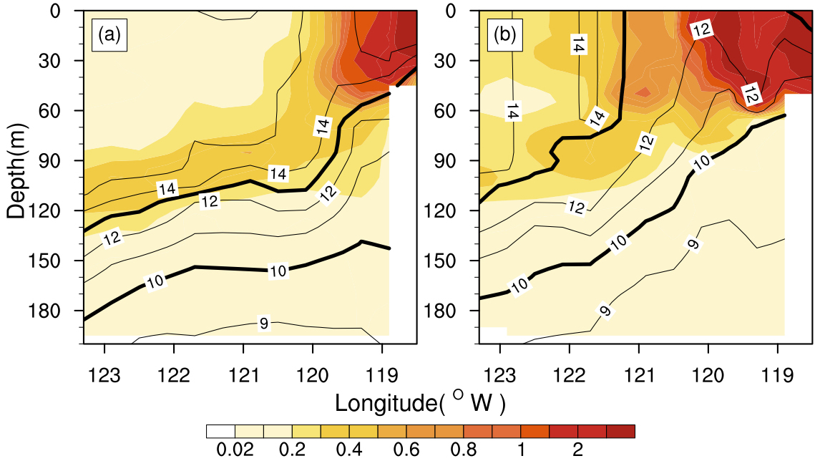
Ocean teleconnection (equatorial/coastal Kelvin wave)
Sea Level rise (cm) from the Galapagos to Alaska
April 1998
April 1999
Temperature (℃; contours) and chlorophyll-a concentration (mg/liter; shaded) off Los Angeles during (a) El Nino (April 1998) and (b) La Nina (April 1999).
1997 1998
Fig. 9.22.
Notes:
Figure 30. Cross-sections of temperature (℃; contours) and chlorophyll-a concentration (mg/liter; shaded) off Los Angeles during (a) El Nino (April 1998) and (b) La Nina (April 1999). During La Nina, the thermocline shoals, surface water cools, and the intensified upwelling increases biological activity off Southern California.

Slide 21
Key Points
Seasonal phase lock, equatorial waveguide
El Nino diversity, SST vs. convective view, moderate vs. extreme
ENSO cycle, slow thermocline adjustment (tilt and recharge modes), ENSO observing system
Seasonal prediction (vs. weather forecast)
ENSO excites Pacific North America (PNA) pattern, barotropic, effect on the N Pacific jet and impact on U.S. west coast
Barotropic stationary Rossby waves
  Rossby wave source and group velocity (east and pole-ward energy propagation)
  Amplification by barotropic energy conversion in the jet exit region.
  Westerly jet structures, westerly waveguide, seasonality
  PNA is strongest in winter ← intense subtropical jet close to equator, strong SST forcing locked to NDJ

Slide 22
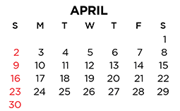
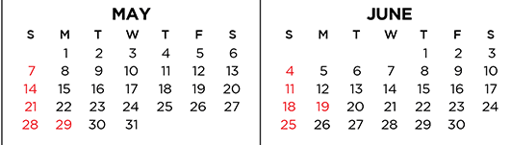
5/19, Choose paper(s)
6/2 (F) Student talks (1-350pm)
6/5 Review for final
6/9 (F) Final?

Slide 23
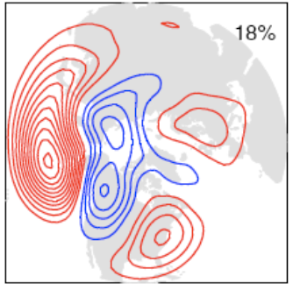
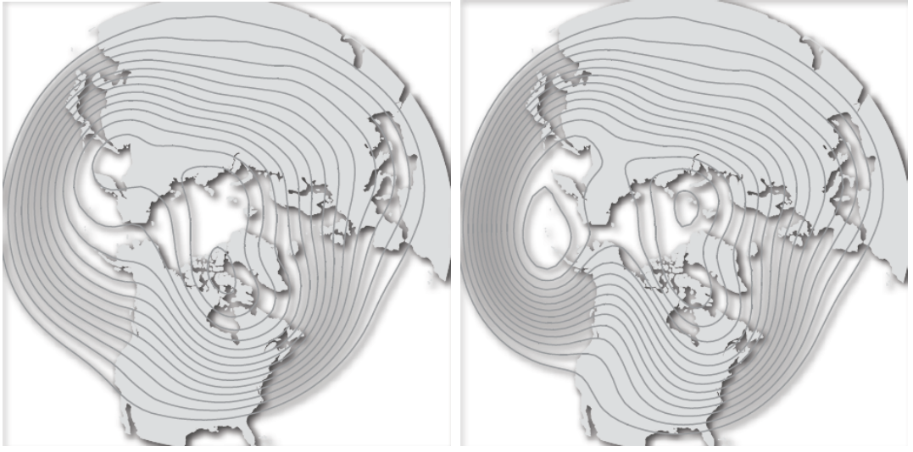
Pacific/North American pattern
Leading sectoral EOF of Z500 (>30 days) (Mike Wallace, Toronto lectures)
Pacific
PNA-
PNA+
N. Pacific blocking
Accelerated Pacific jet

Slide 24
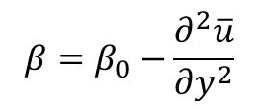
u300
$$β=β_{0}−\frac{∂^{2}\overline{u}}{∂y^{2}}$$
At the jet core, β/β0~3-4.

Slide 25
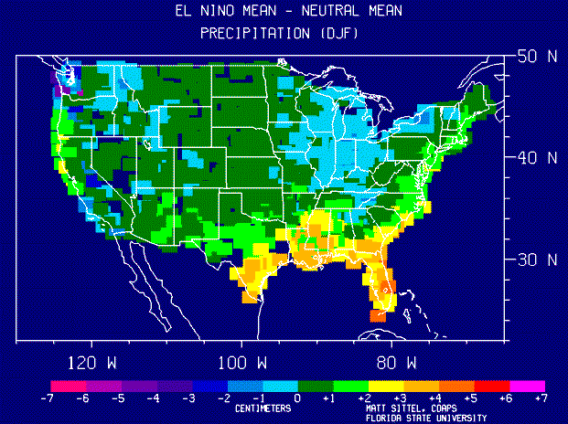
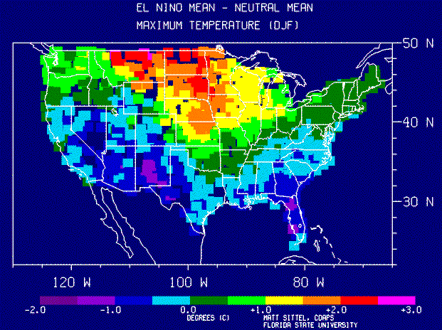
DJF regression on Nino3.4: Z250 (color) & Z850 (black)
El Nino’s influence on the US winter climate

Slide 26
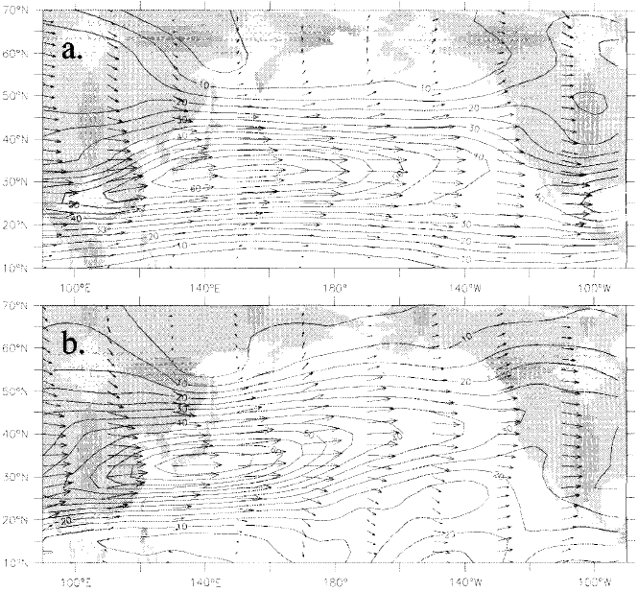
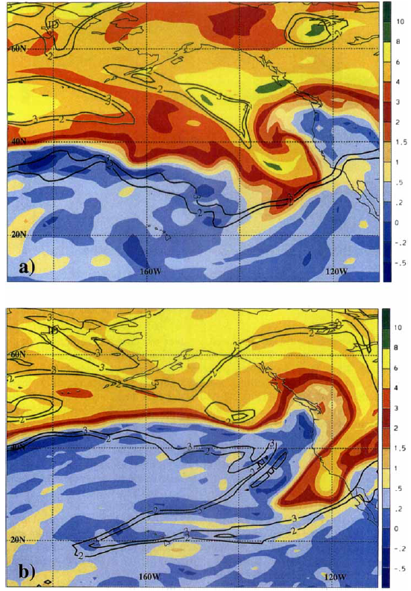
(u,v) & zonal wind
Jan-Mar 250 mb
LC2 in cyclonic shear
6 Feb 1998
1998 El Nino
1999 La Nina
LC1 in non-sheared environment
5 Feb 1999, long-tailed cold front
PV on 320 K (color) & 340 K (black) →
Shapiro, M. A., et al. (2001), The influence of the 1997–99 El Niňo Southern Oscillation on extratropical baroclinic life cycles over the eastern North Pacific. QJ Royal Met. Soc., 127: 331–342.
Notes:
Shapiro, M. A., Wernli, H., Bond, N. A. and Langland, R. (2001), The influence of the 1997–99 El Niňo Southern Oscillation on extratropical baroclinic life cycles over the eastern North Pacific. Quarterly Journal of the Royal Meteorological Society, 127: 331–342. doi: 10.1002/qj.49712757205

