Slide 1
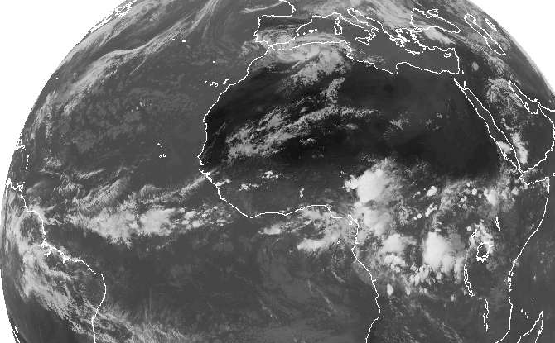
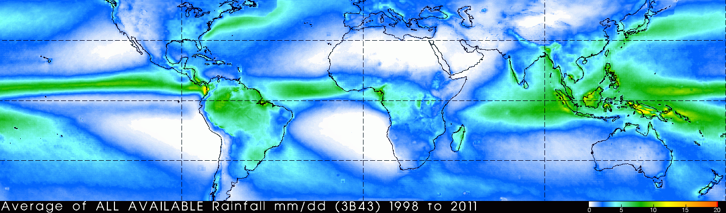
12. Tropical Atlantic Variability
Comparison of prevailing wind, basin size & land influence w/ Pac
Sahara
Sahel
Gulf of Guinea
Gulf of Guinea
NE
ITCZ
SE
Notes:
10.1.2, 10.2-3, 10.4.1, 10.5.1-3,

Slide 2
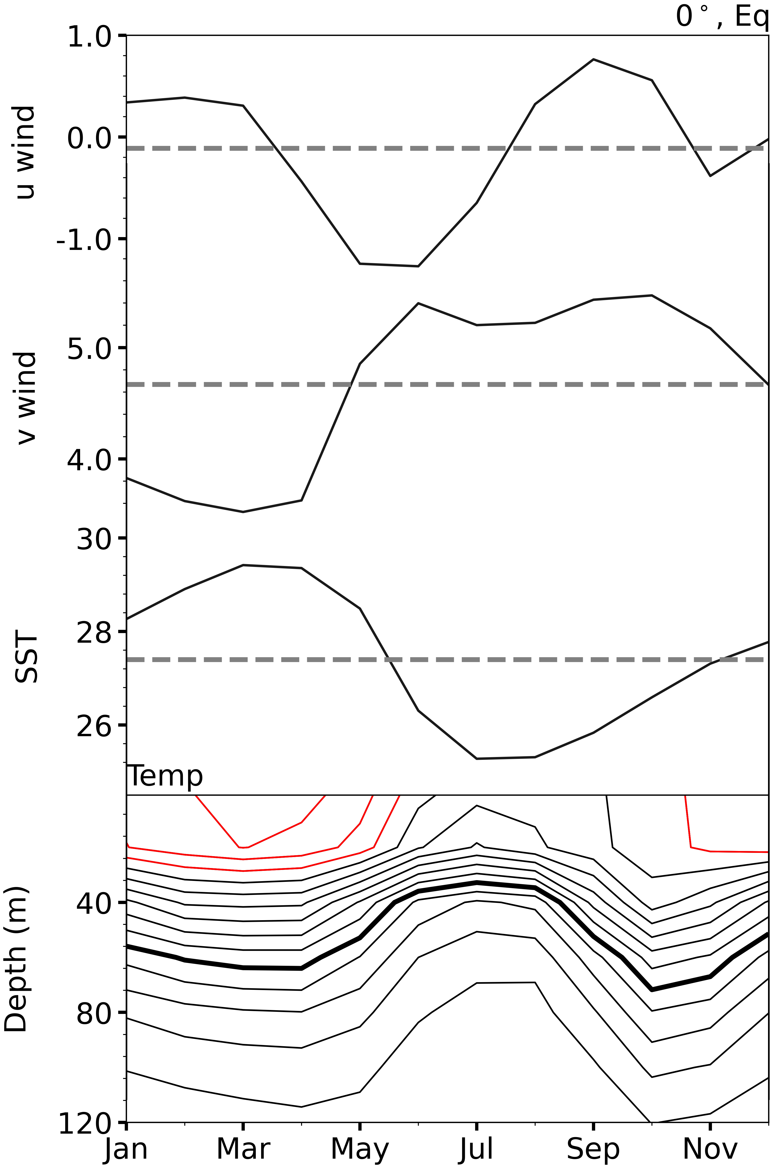
Annual cycle in the equatorial oceans
SST, precip & surface wind
Mar-Apr
EQ
Jul-Aug
27
EQ
20
Rapid development of cold tongue, triggered by W. African monsoon ← continental effect.
Figs. 10.1, 10.3.

Slide 3
West African monsoon
TRMM rainfall & QuikSCAT wind (10W-10E)
Sahel
Guinean coast
SST & wind at 0º
Rapid intensification of the southerlies in the Gulf of Guinea in May as the ITCZ moves northward towards the Guinean coast.

Slide 4
June-April difference
N displaced ITCZ
Strengthened southerly cross-eq. wind
Developed cold tongue
Climatology
Mitchell & Wallace (1992)

Slide 5
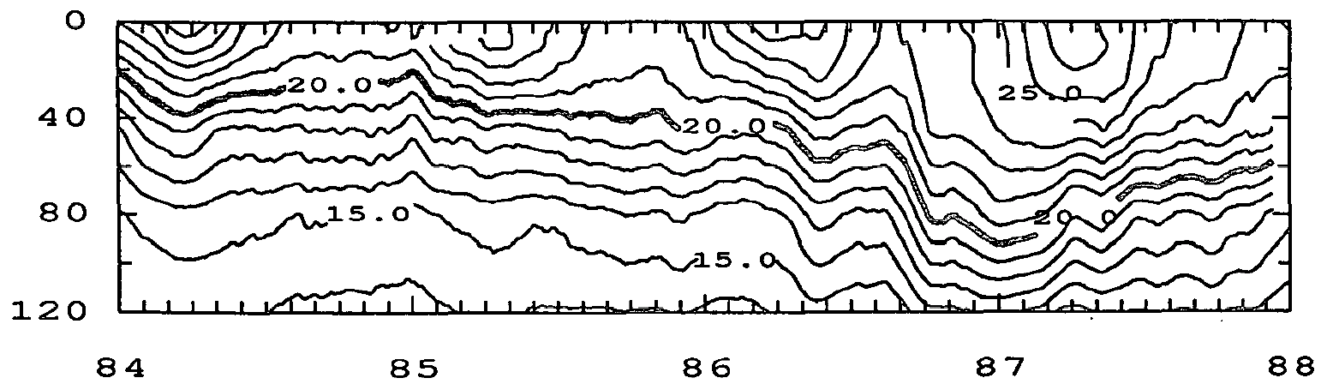
Importance of ocean dynamics
Ocean temperature in east equatorial ocean
Climatology
Atlantic: PIRATA (Eq, 10W)
SST
Depth (m)
Mar-Apr
Pacific: TAO (Eq, 110W)
Depth (m)
Depth (m)
Jul-Aug
Year
Atlantic thermocline: shoaling aids SST cooling
Pacific thermocline: little seasonal displacements

Slide 6
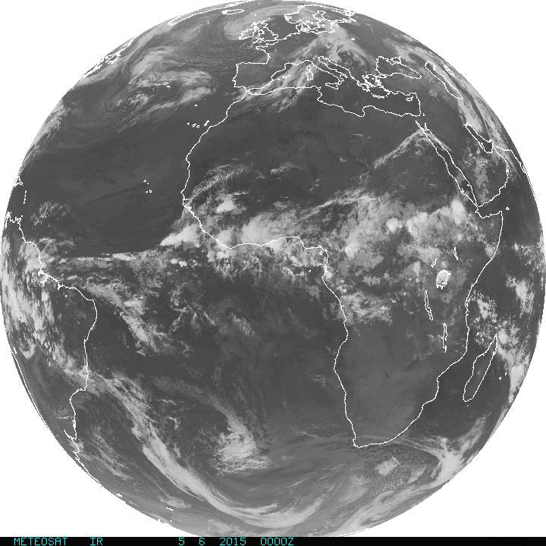
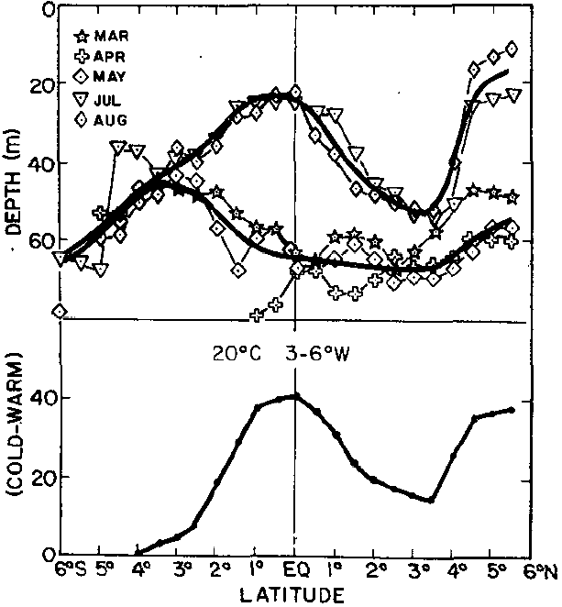
20ºC isotherm depth (3-6ºW)
Jul-Aug
Mar-May
-h
Cold - Warm
Ocean Kelvin waveguide
Kelvin wave
3S
EQ
3N
What causes the peak at equator & Guinea coast?
Thermocline shoaling aids SST cooling
Houghton (1983)

Slide 7
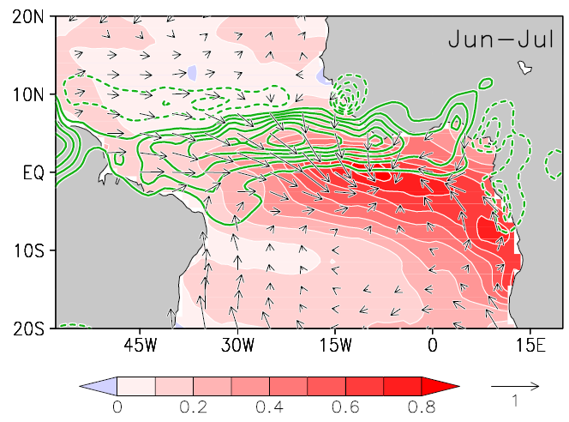
Atlantic Nino
Interannual variability
What is the coupled feedback?
Bjerknes: westerly wind → deepened thermocline → SST warming
Locked on Jun-Aug: seasonal shoaling of mean thermocline
Increased rainfall on Guinea coast
Climatology
20
Anomalies
Mar-Apr
SST
Precip
Wind
Depth (m)
Jul-Aug
Figs. 10.4, 10.6.

Slide 8
Thermocline depth control of SST variability
Seasonal shoaling intensifies SST interannual variability (JJA & ND)
T/P SSH (cm)
Rms SST (1982-2003)
Jun
Atlantic Nino
40W
20W
0
Contour interval=0.1
Okumura & Xie (2006, JC)

Slide 9
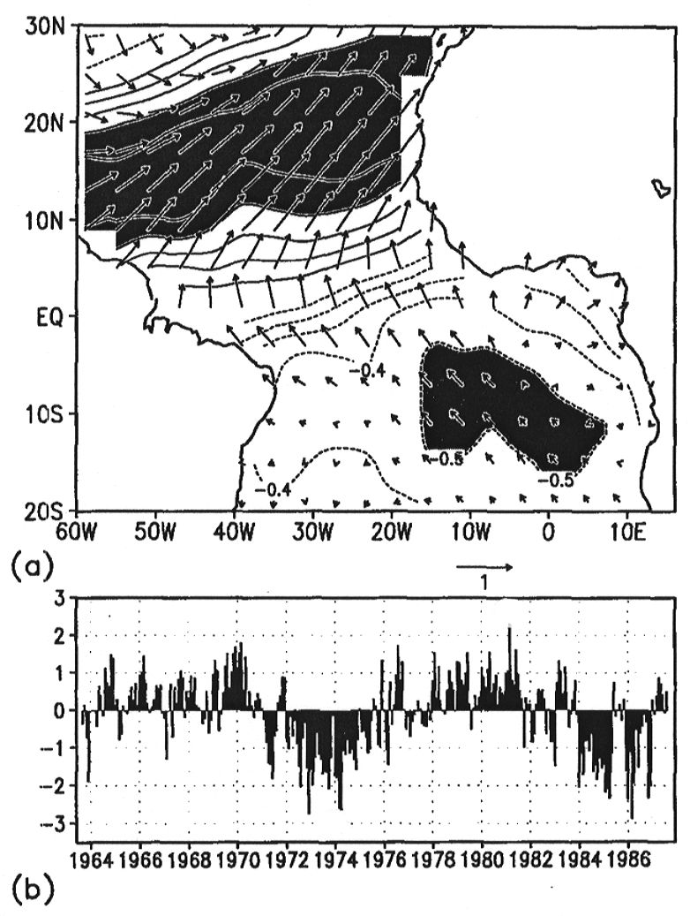
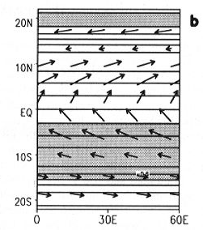
Meridional Mode
Interannual variability
Leading mode of joint EOF
Leading mode in a coupled model
SST &
Sfc Wind
+
0.4
What is the coupled feedback?
-
-0.5
Xie et al. (1999, GRL)
10 yr
Wind Evaporation SST (WES)
feedback
Nobre and Shukla (1996, JC)
Notes:
How to characterize the rest of the tropical Atlantic SST variability still remains controversial. The empirical analysis suggests that there is a dipole mode which is asymmetric about the equator (to be accurate, about the annual mean ITCZ) and it is oscillating in a decadal time scale.
(The upper panel → the leading mode of joint EOF analysis, shows SST in contours and surface winds in vectors.)
(The lower panel → time series of this mode.)
This SST anomaly pattern has been known in relation to the rainfall variability in Northeast Brazil and Sahel region. The northeastern Brazil receives significant rainfall only in boreal spring, when the oceanic ITCZ moves south of the equator. When there is a warm SST anomaly to the north and cold anomaly to the south, ITCZ does not migrate south of the equator, and this area experience a serious drought.
The surface wind pattern shows anomalous (south)-westerly over the warm SST and (south)-easterly over the cold SST. These westerly (easterly) winds weaken (strengthen) the mean trade winds and hence reduce (enhance) evaporation at the surface. So we can expect that these SST anomalies are forced by these anomalous trade winds. On the other hand, these SST anomalies would establish a southward SLP gradient and induce cross-equatorial southerlies. The Coriolis force acts upon these southerlies, inducing anomalous easterly winds to the south of the equator and westerly winds to the north of the equator.

Slide 10
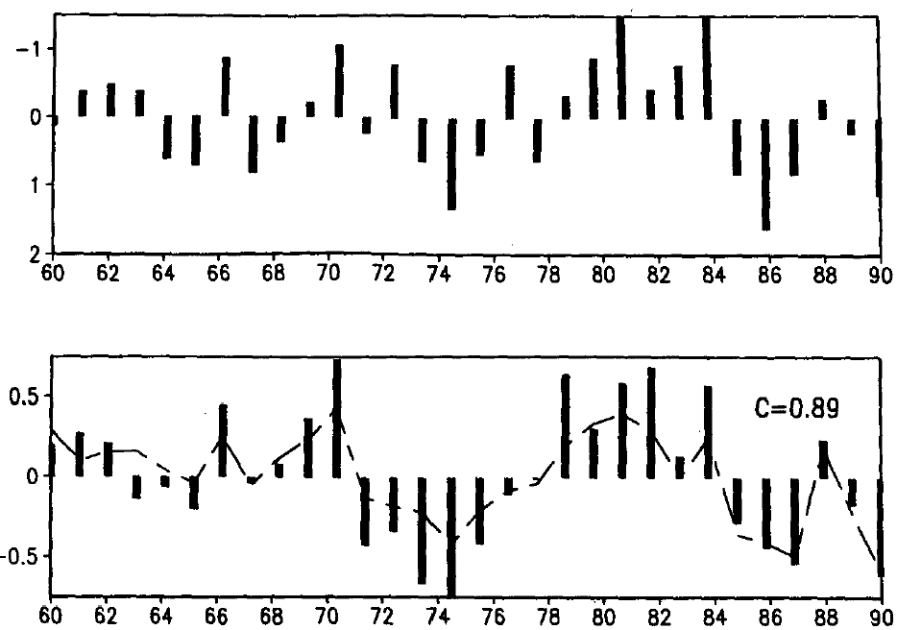
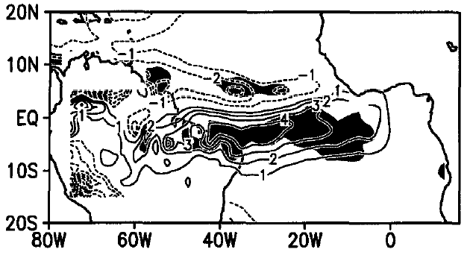
Meridional mode: Mar-Apr
Mean ITCZ is symmetric and close to equator.
Mean SST gradient is small
Winter ENSO/NAO forcing
Rainfall in NE Brazil
SST dipole
SST, precip & surface wind
Carton et al. (1996)
Mar-Apr
_
Rainfall
Mar-May
EQ
+
Nobre and Shukla (1996)

Slide 11
SST-cloud feedback
SST-stratus: positive (+)
SST-Cb (deep convective cloud): negative (-)
COADS SST (contours in ºC) and cloudiness (color in %) composite in Jan-Mar based on a cross-equatorial SST gradient index. SST-cloud correlation in subtropics is opposite to that in deep tropics. Xie (2004, BAMS)
Notes:
Large range of dC/dT regression coefficient in the last three cases: spatial correlation, IAV in SEP and the tropical Atlantic.

Slide 12
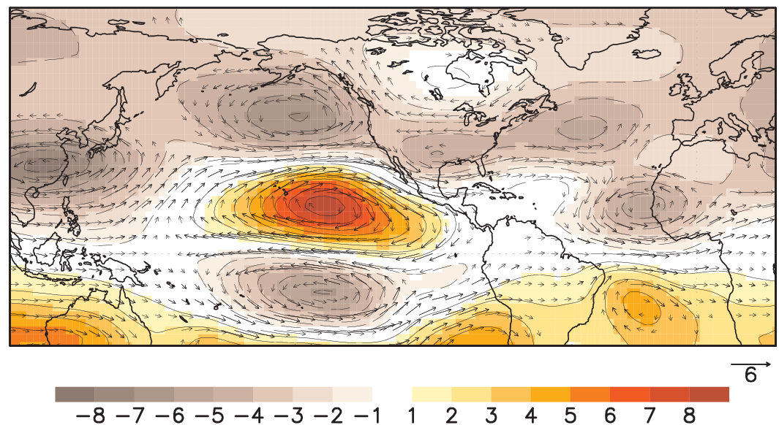

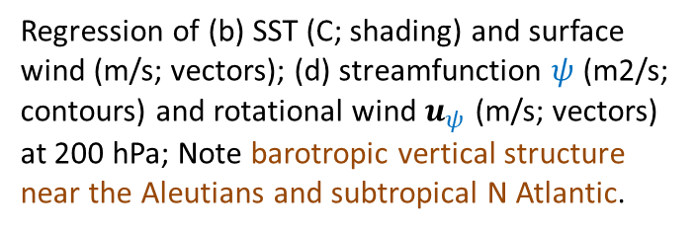
El Nino effects on tropical Atlantic
Winter PNA + eq. Walker teleconnections
Reduced NE trades → SST warming over trop N Atlantic
DJF rotational wind @200 hPa (Nino3.4)
$$u=k×∇ψ+∇χ$$
PNA
Regression of (b) SST (C; shading) and surface wind (m/s; vectors); (d) streamfunction $ψ$ (m2/s; contours) and rotational wind $u_{ψ}$ (m/s; vectors) at 200 hPa; Note barotropic vertical structure near the Aleutians and subtropical N Atlantic.
Rossby
Kelvin
DJF
FMA
Tropical N Atlantic warming & cross-eq wind
SST & 10m wind
Fig. 10.11.
Notes:
(1982-2011) García-Serrano et al. (2017, JC).

Slide 13
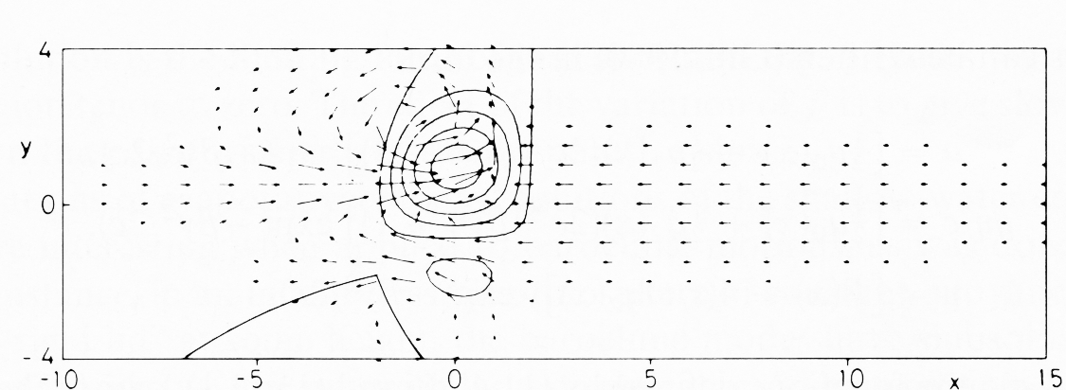
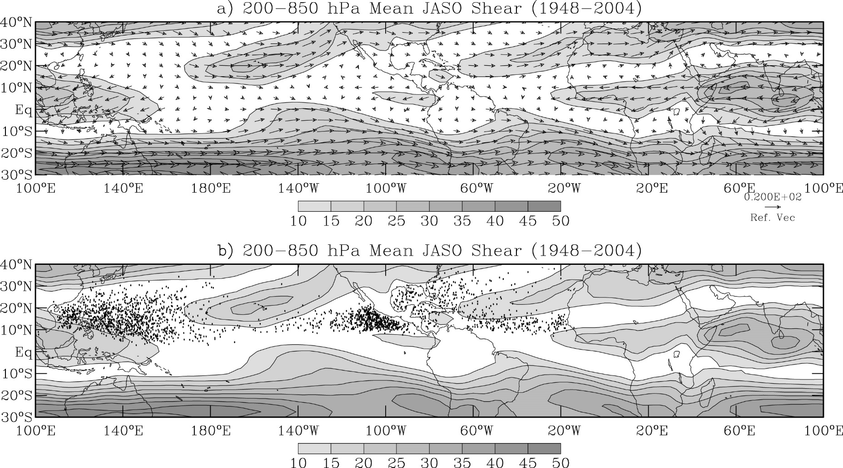
Why is vertical shear large in winter hemisphere?
How can Gill model explain the zonal variations?
Gill pattern: Tibetan High
shear vector
Hadley
TC genesis locations
Main Development Region
Fig. 10.16.
Aiyyer & Thorncroft (2006, JC)
Notes:
80-20W, 10N-20N

Slide 14
Environmental control on tropical cyclone statistics
Tracks of major hurricanes (1900-2009)
28 El Nino years
26 La Nina years
43 major hurricanes and
85 major hurricane days
82 major hurricanes and
186 major hurricane days
(Klotzbach 2011)
Fig. 10.17.

Slide 15
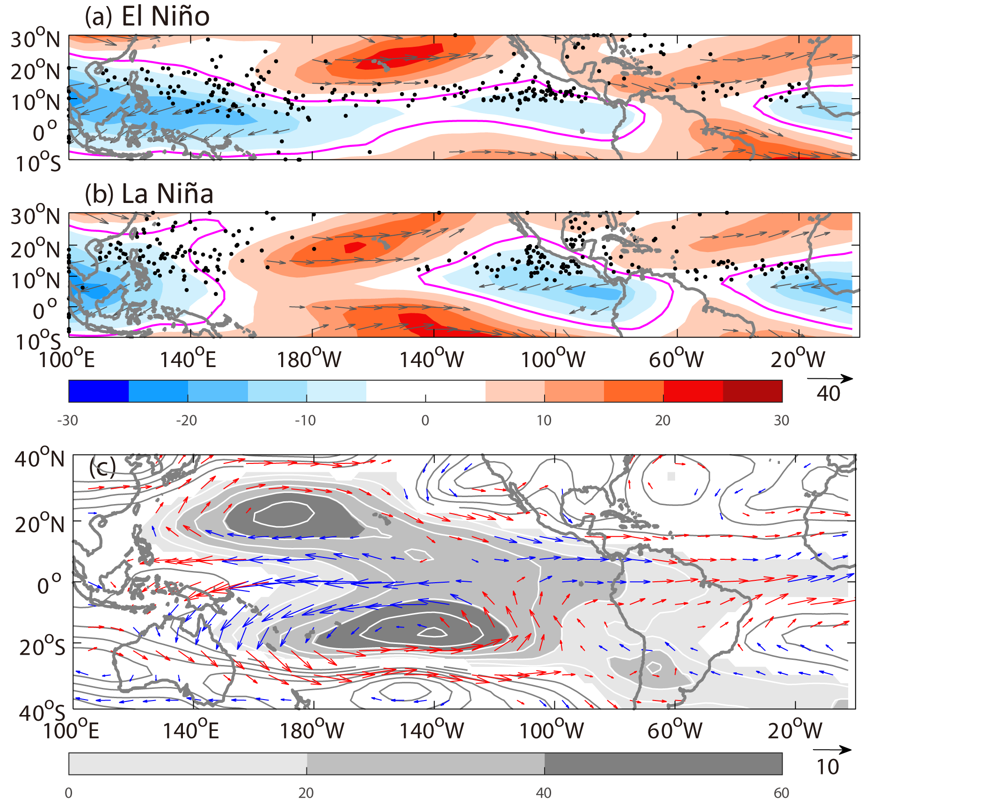
JASO 1982-2020
ENSO effect
El Nino → enhanced vertical shear
→ inactive TCs over N Atlantic
Main Development Region
Increased/deceased 200-850 hPa shear
Fig. 10.18. (a) El Niño and (b) La Niña composites : shear vectors (m/s, zonal component in color shading, zero highlighted in red contours) and TC genesis. (c) El Niño – La Niña differences in shear vectors and 850-200 hPa mean temperature (positive/negative in gray shading/contours). The anomalous shear vectors that strengthen/weaken the mean scalar shear are colored in red/blue. Courtesy Y. Shi.

Slide 16
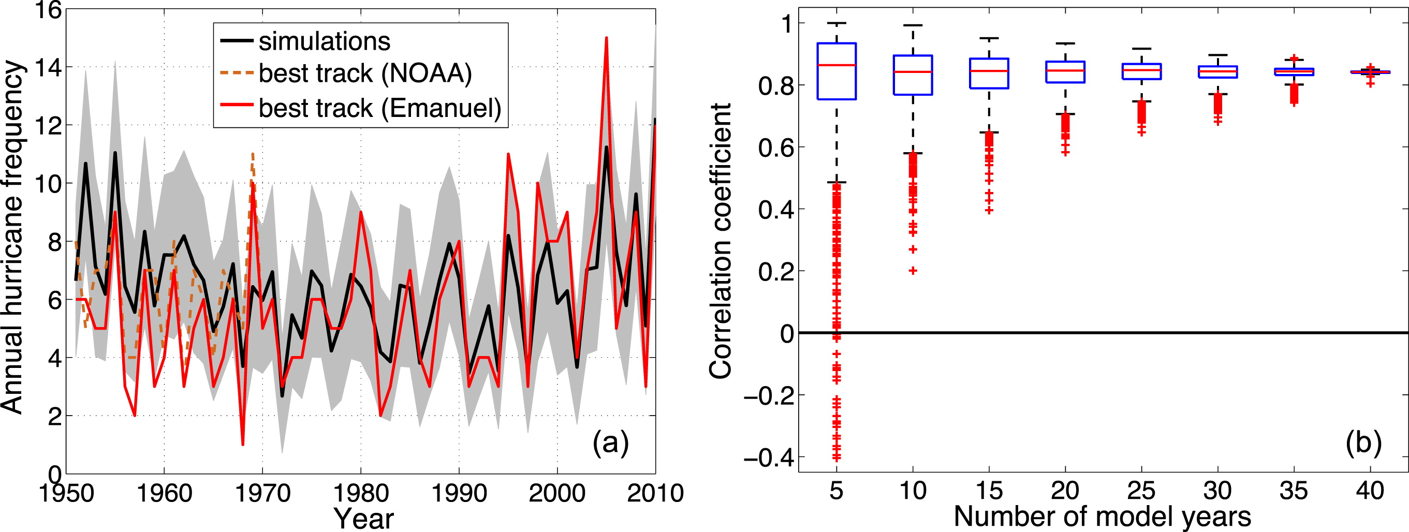
Interannual variability of N Atlantic hurricane counts
observations
simulations
r=0.84 (1970-2010)
High-resolution (~50 km) AGCMs simulate the observed TC count variability when forced by observed SSTs.
Fig. 10.19.
(Mei et al. 2019)

Slide 17
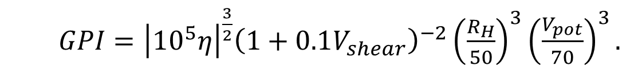
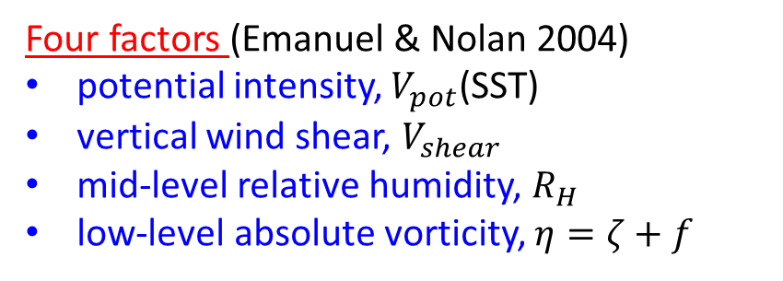
Genesis potential index (GPI)
Four factors (Emanuel & Nolan 2004)
potential intensity, $V_{pot}$(SST)
vertical wind shear, $V_{shear}$
mid-level relative humidity, $R_{H}$
low-level absolute vorticity, $η=ζ+f$
$GPI={\left|{10}^{5}η\right|}^{\frac{3}{2}}{\left(1+0.1V_{shear}\right)}^{−2}{\left(\frac{R_{H}}{50}\right)}^{3}{\left(\frac{V_{pot}}{70}\right)}^{3}.$
(Menkes et al., 2012)

Slide 18
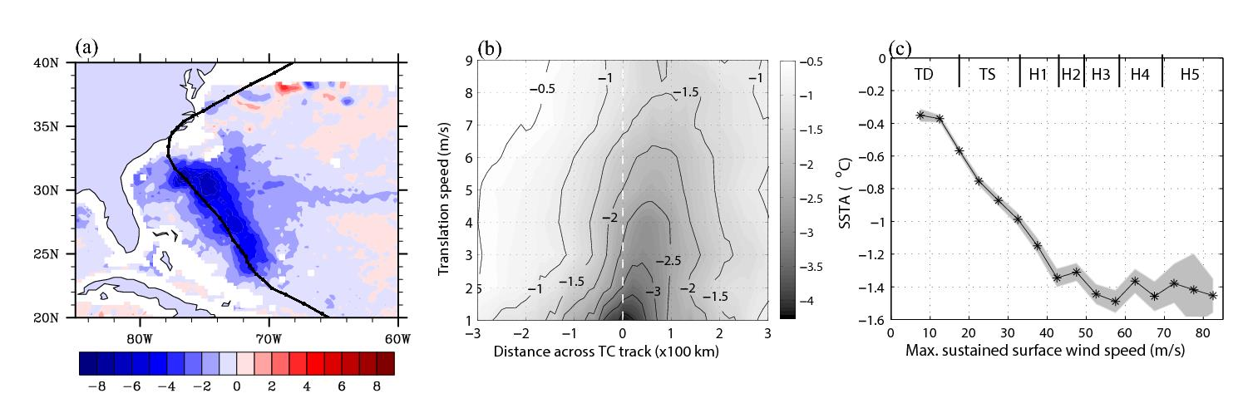
Hurricane-induced SST change (ºC)
Negative feedback of the cold wake
→ reduced effective potential intensity
Fig. 10.20. (a) SST change (ºC) for Hurricane Bonnie over a week of 19-26 August 1998 (Sriver and Huber (2007). (b) TC-induced SST cooling as a function of cross-track distance and translation speed. (c) TC-induced SST cooling as a function of maximum wind speed. Mei and Pasquero (2013).

Slide 19
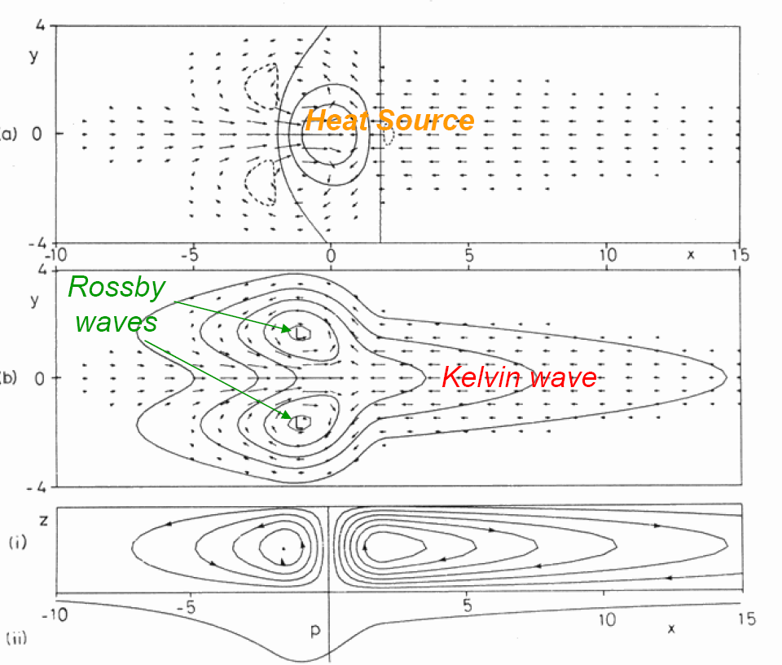
Synthesizing GPI factors for TC genesis with Gill model
(1)
Sea surface warming (1)
Deep convection (2)
p, (u ,v)
High relative humidity (mid-level) (3)
Positive low-level vorticity (4)
Weak vertical shear (5)
(modulating mean shear)
(4)
(5)
Stream function
Favorable for TC genesis
(2,3)

Slide 20
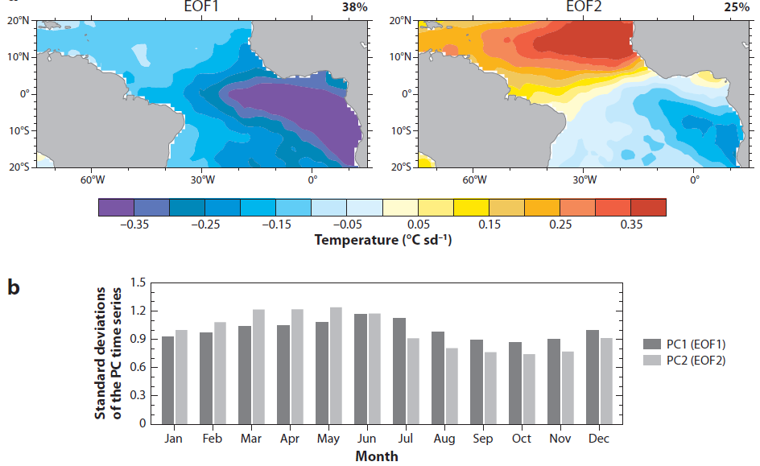
Tropical Atlantic modes of SST
PC2
PC1
Why does PC1 peak in June, and PC2 in April?

Slide 21
Atlantic
Nino
Meridional
Mode
Equatorial annual cycle in SST with contribution from thermocline displacement; influence from W. African monsoon (sawtooth in cross-eq. southerlies eq. cold tongue)
Large model errors in simulating eq. cold tongue & ITCZ;
Atlantic Nino mode in JJA due to seasonal shoaling of thermocline & Bjerknes feedback, w/ increased rainfall at the southern ITCZ;
Meridional mode with ITCZ shifts, WES & cloud feedbacks, rainfall in northeastern Brazil, active in FMA;
El Nino forces reduced trades & SST warming in N tropical Atlantic in spring;
Strong control of TC counts by environment, genesis potential index
Gill model of vertical wind shear, Kelvin response to ENSO

