Slide 1
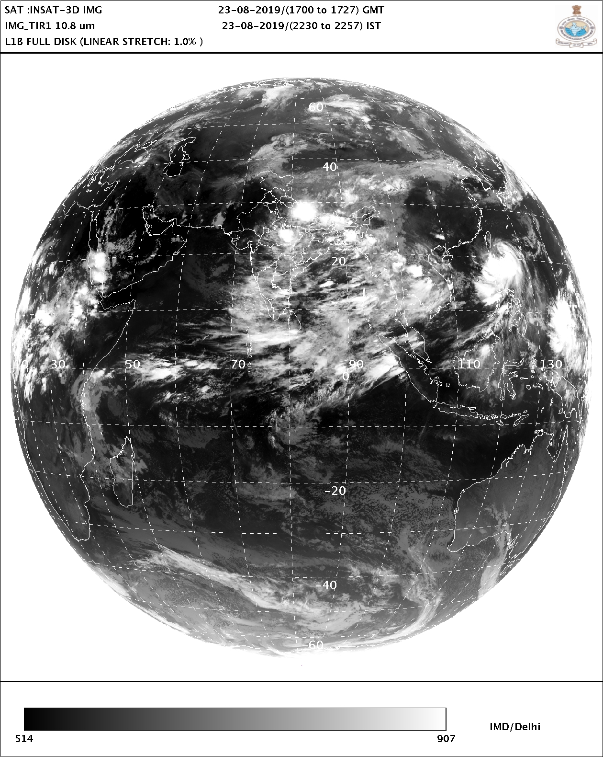
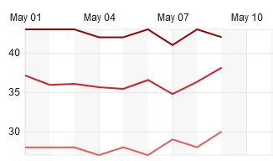
Lecture 13. Tropical Indian Ocean Climate Variability
Nagpur (central India, May 2022)
Tmax
Tmin
Prevailing winds over N IO?
August 2019
The southwest monsoon sets in over Kerala around 1 June. It advances northwards and covers the entire country around 15 July.
Indian Met Dept.
Indian summer monsoon w/ cirrus blown by strong easterlies.
Notes:
11.1-2, 11.4, 11.5.1

Slide 2
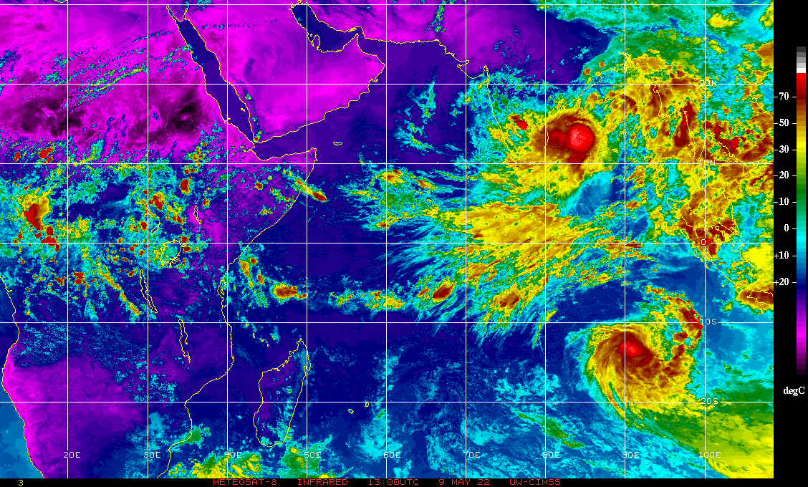
Twin cyclones on May 9, 2022

Slide 3
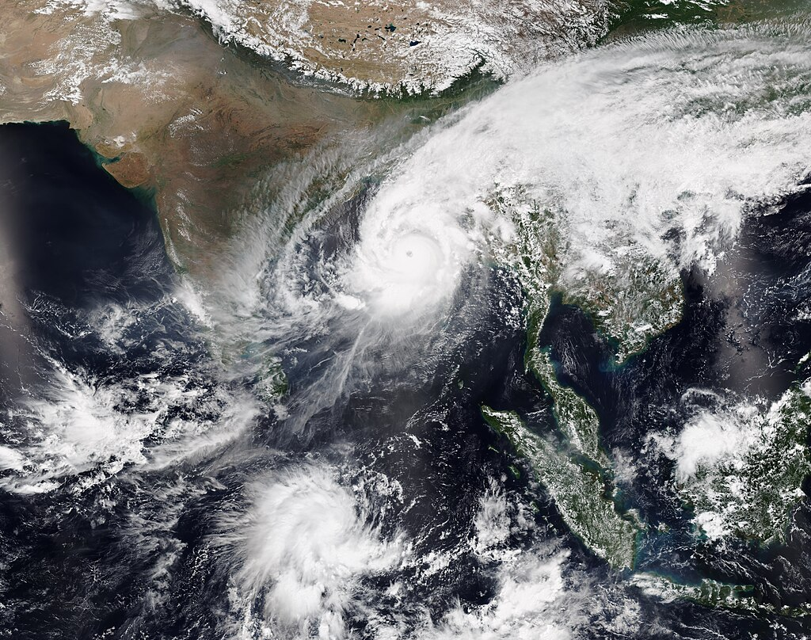
Eq
Extremely Severe Cyclonic Storm Mocha over BoB and a disturbance below the equator which later became Fabien on May 13, 2023

Slide 4
Comparative Climatology
SST & Precip
27
NIO winds are weak because of the seasonal wind reversal.
Z20
100
200
100
60
Depth (m)
Fig. 11.1.

Slide 5
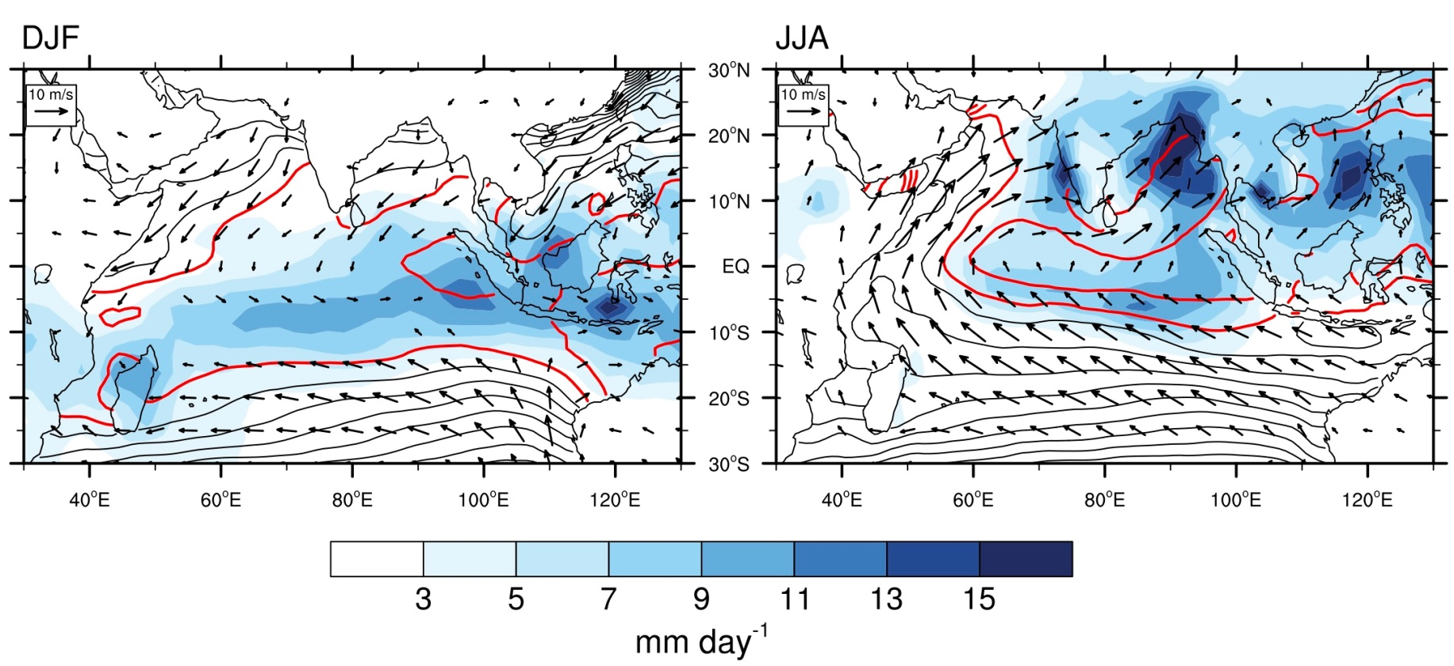
Monsoonal Ocean
North IO: SE wind, dry (DJF) vs. SW wind, rainy (JJA)
Summer upwelling: west Arabian, Sumatra/Java, 5-10S
Equinox
Solstice
Equinox
Upwelling-favorable during southerly monsoon
SST (≥ 28ºC in red), precipitation, & surface wind
Fig. 5.1.

Slide 6
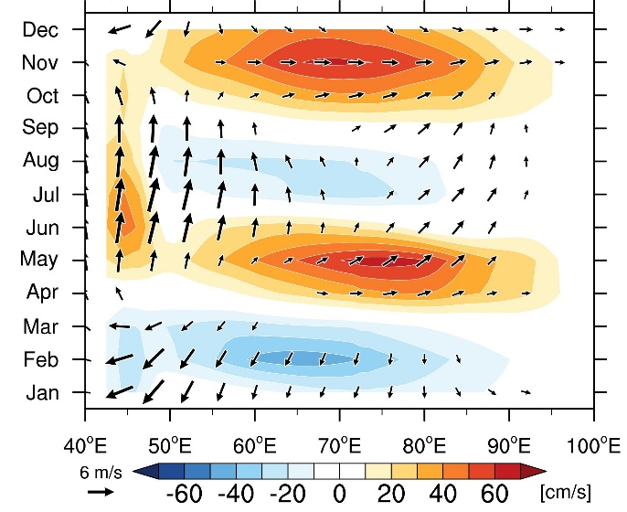
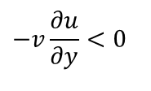
Eq IO seasonal cycle {
SST: 1 yr
Zonal wind & current: 0.5 yr
SST
Wyrtki jet
Wyrtki jet
SW monsoon
surface wind vectors (m/s) & surface zonal current (cm/s).
EQ
$$−v\frac{∂u}{∂y}<0$$
Cross-eq. easterly advection
SE trades
Figs. 11.3, 11.4a.
Notes:
Spring Wyrtki jet is robust but the fall Wyrtki jet fails to appear in certain years (IOD/El Nino years).

Slide 7


Basin-mode resonance at the semi-annual period
Jensen (1993, JGR, 22 533-); Han et al. (1999, JPO, 2191-)
K
wind
R
K
wind
For semi-annual resonance,
Cn= 163 cm/s, m = 1
Cn = 82 cm/s, m =2,
T resonance period
L = 5,632 km (basin width)
Cane and Sarachik (1981, JMR); Cane and Moore (1981, JPO)
Fig. 11.4b.

Slide 8
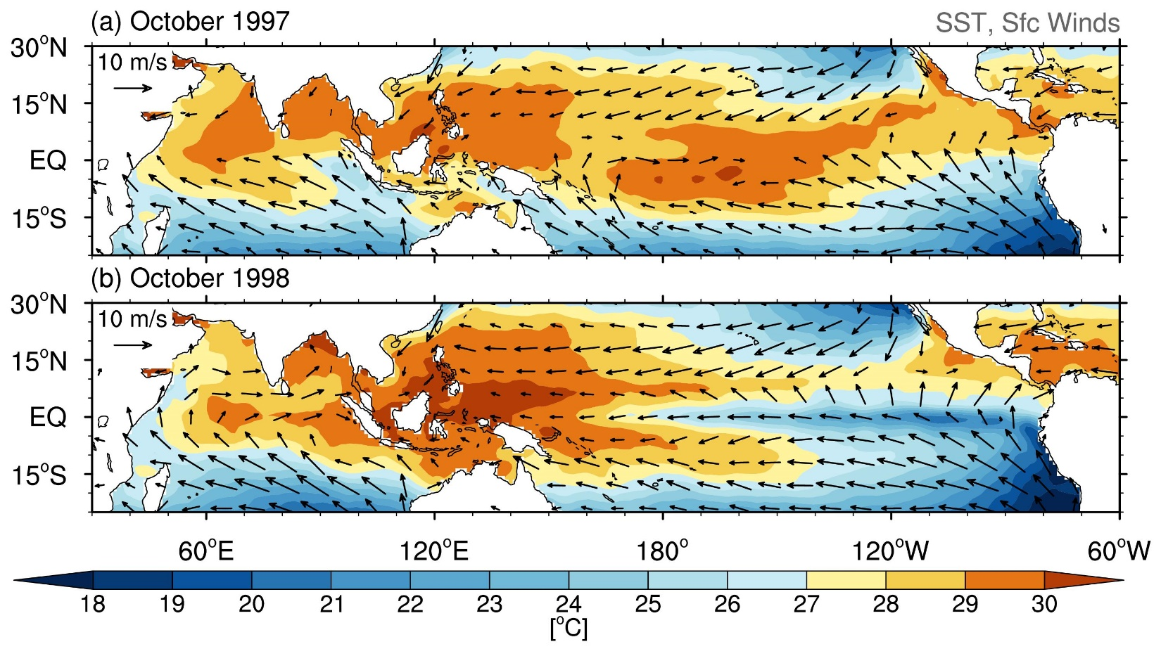
Is the mean state favorable for Bjerknes feedback?
Depth (m)
In the fall of 1997, the Pacific cold tongue failed to develop but a cold tongue appeared in the equatorial Indian Ocean.
Fig. 11.5.

Slide 9
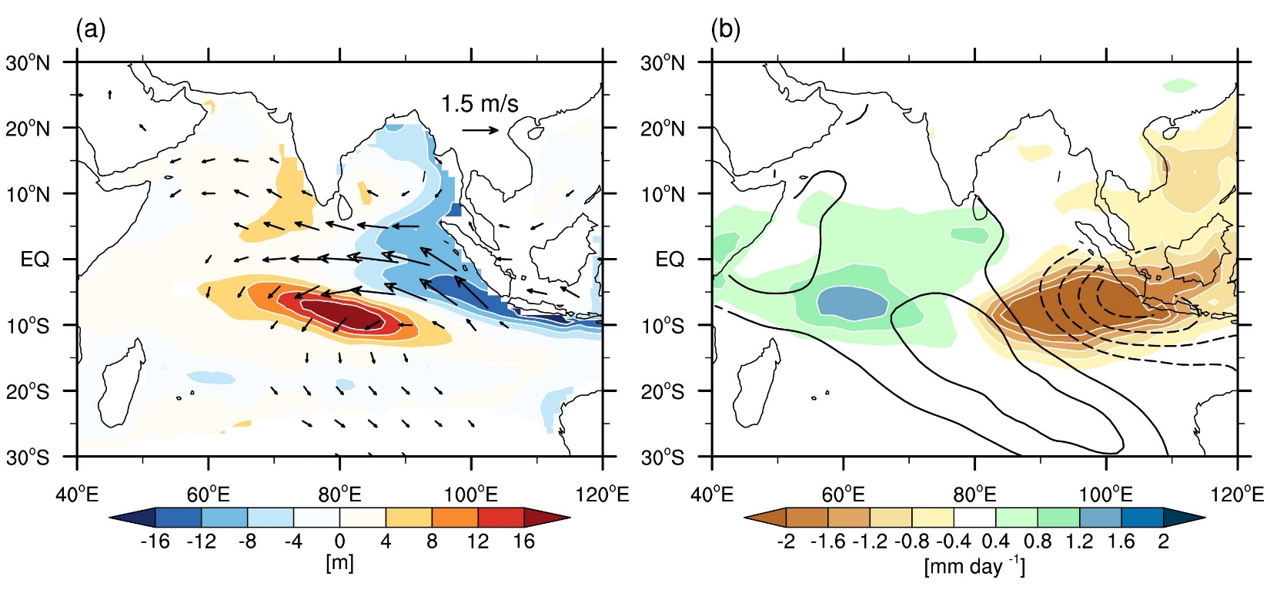
Sfc wind & Z20
SST & rain
SON precip anomaly
Indian Ocean dipole (IOD) mode
Bjerknes feedback: easterly anomalies, thermocline shoaling & SST cooling;
Suppressed rainfall in the east (Indonesia) & increased rainfall in the west (E Africa)
Peaks in Sept-Nov, the time with upwelling favorable SE alongshore wind;
Tends to occur with El Nino
Negative events weak & not well defined.
>
Weakened Walker in El Nino
Saji et al. (2006, JC)
>
>
Figs. 11.7, 11.8.
IO
Pacific
Notes:
Connect to failed fall Wyrtki jet

Slide 10
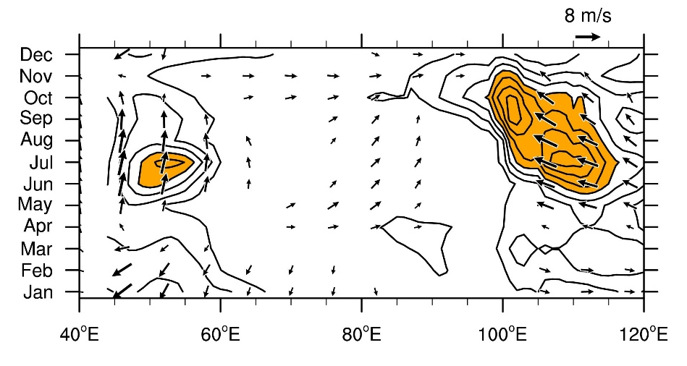
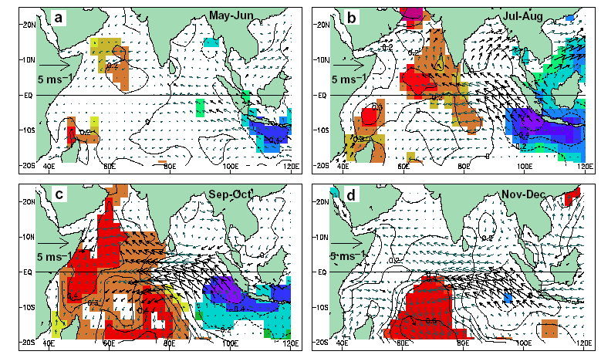
How is the mean alongshore wind related to seasonality of SST variability off Indonesia?
Equator
Indonesia
Narrow window for thermocline feedback in NH summer/fall
IOD anomalies (Saji et al. 1999)
Fig. 11.6.

Slide 11
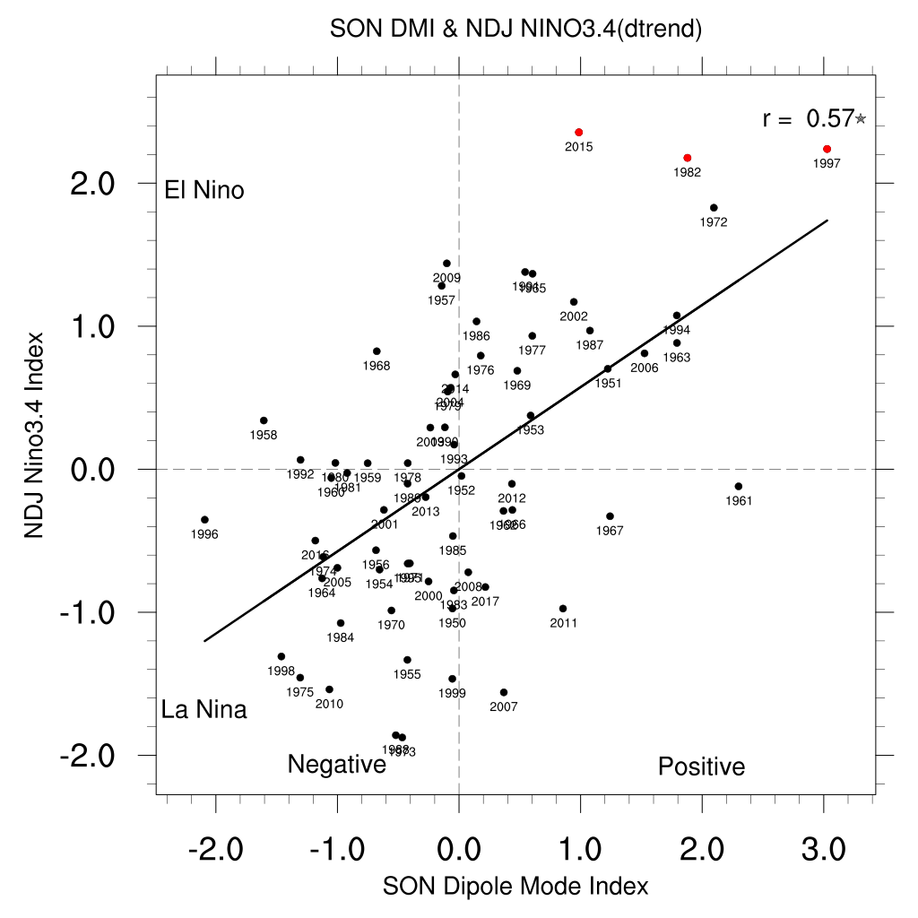
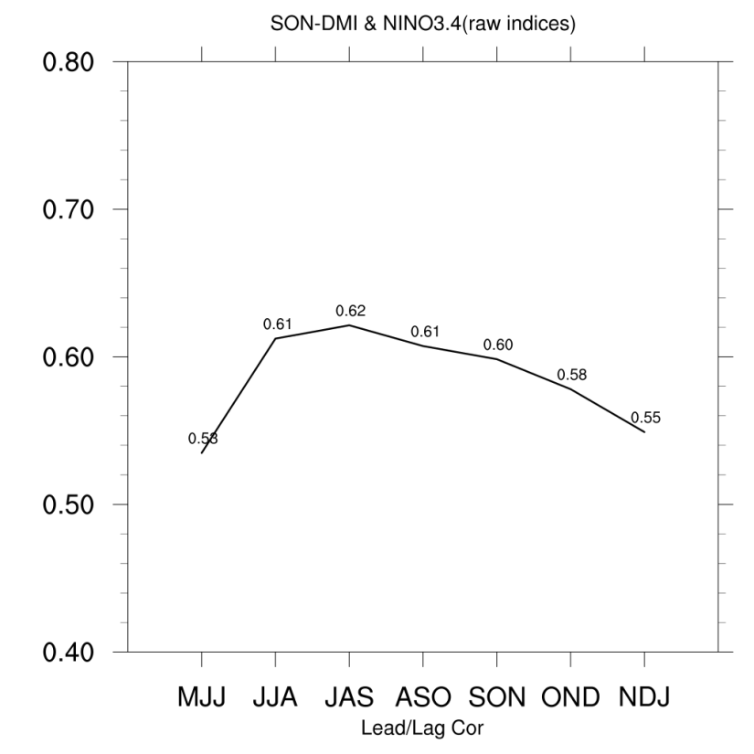
How is IOD related to ENSO?
Notes:
Fig. 10

Slide 12
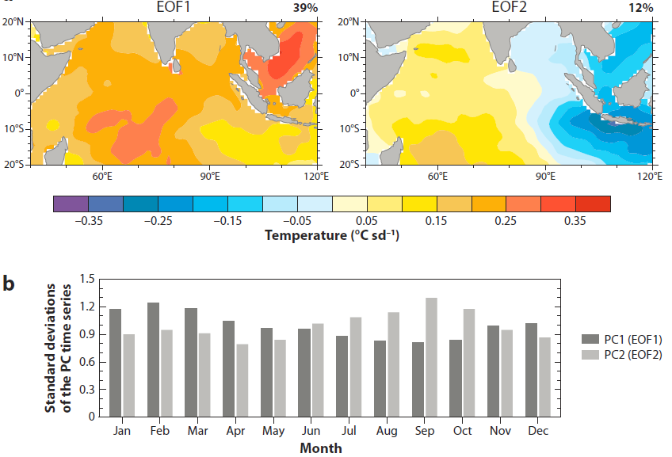
Nino
IO
PC1
PC2
Both PCs correlate with ENSO
Why does PC2 peak in September?
Fig. 11.9.
Notes:
Deser et al. 2010

Slide 13
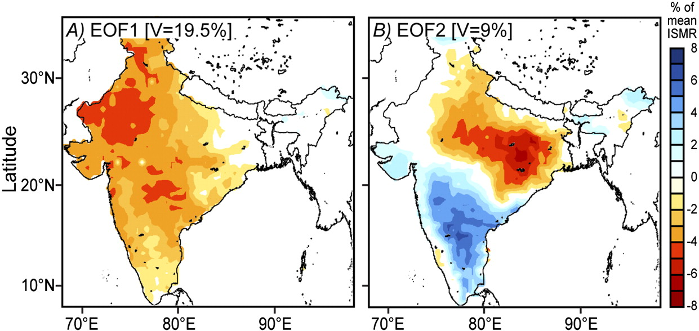
EOFs of JJAS rainfall variability over India for 1900-2008.
El Nino summer
r [PC, SOI]=0.52
Post-El Nino summer
r [PC, Nino3.4]=-0.xx
SST
Mishra et al. (2012, PNAS)
Fig. 11.19.
Notes:
Fig. 19. Mishra et al. 2012, PNAS

Slide 14
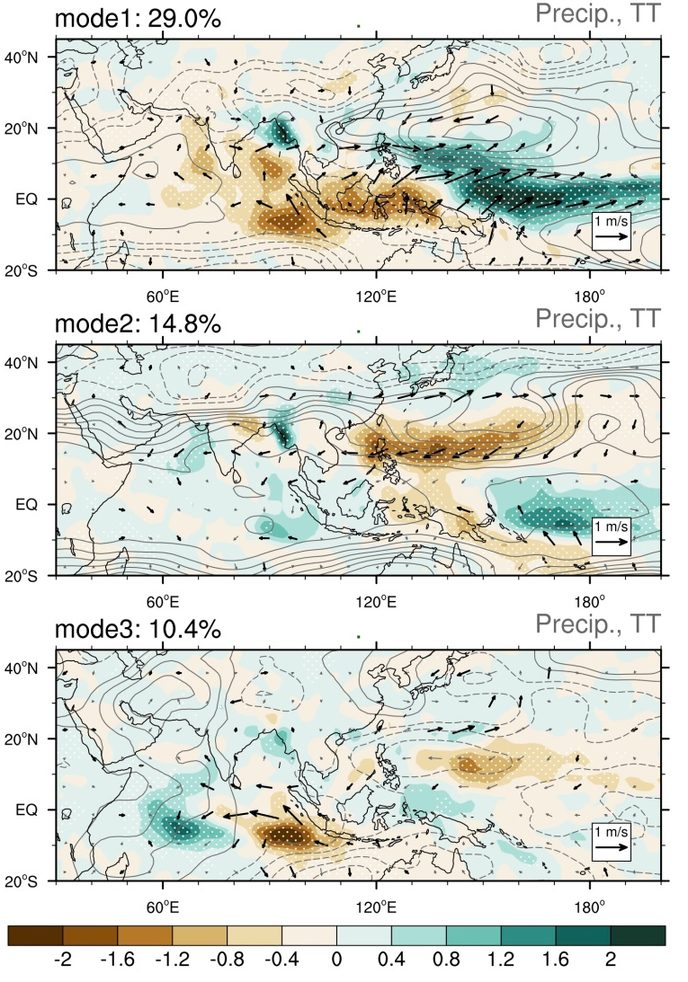
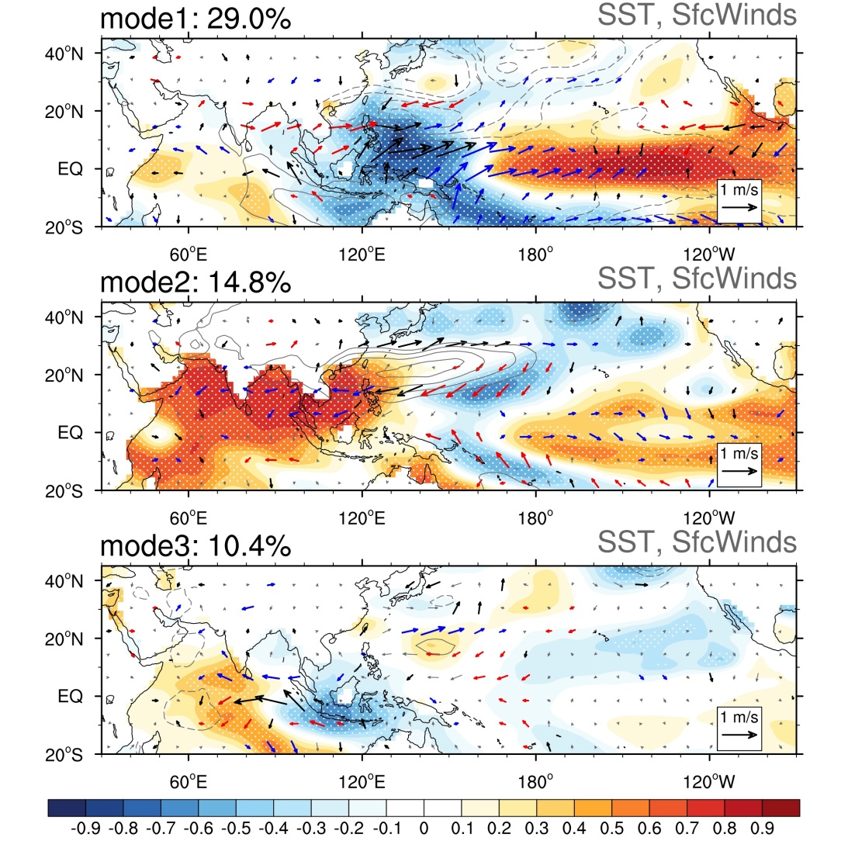
JJA Precip EOF over Indo-W Pacific
India EOF
1
2
Concurrent El Nino
Antecedent El Nino
Rainfall EOF | PC1 | PC2
JJA Nino 3.4 | 0.84
ND(-1)J Nino 3.4 |  | 0.69
JJA NIO |  | 0.84
How is mode 2 related to ENSO?
Notes:
Fig. 23

Slide 15
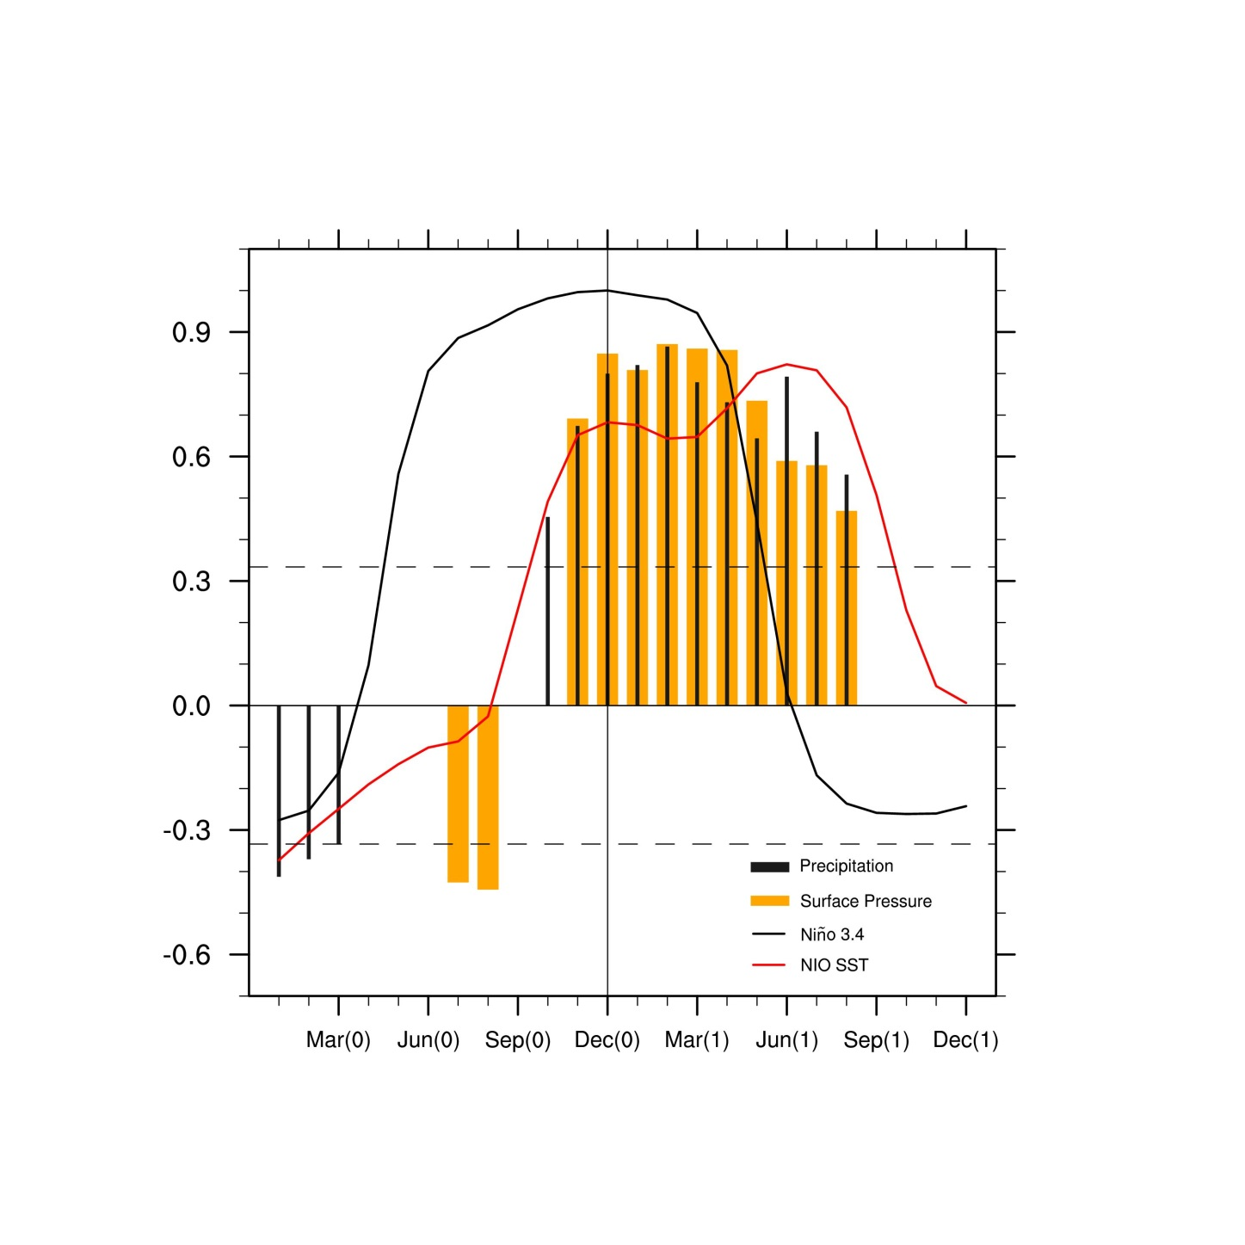
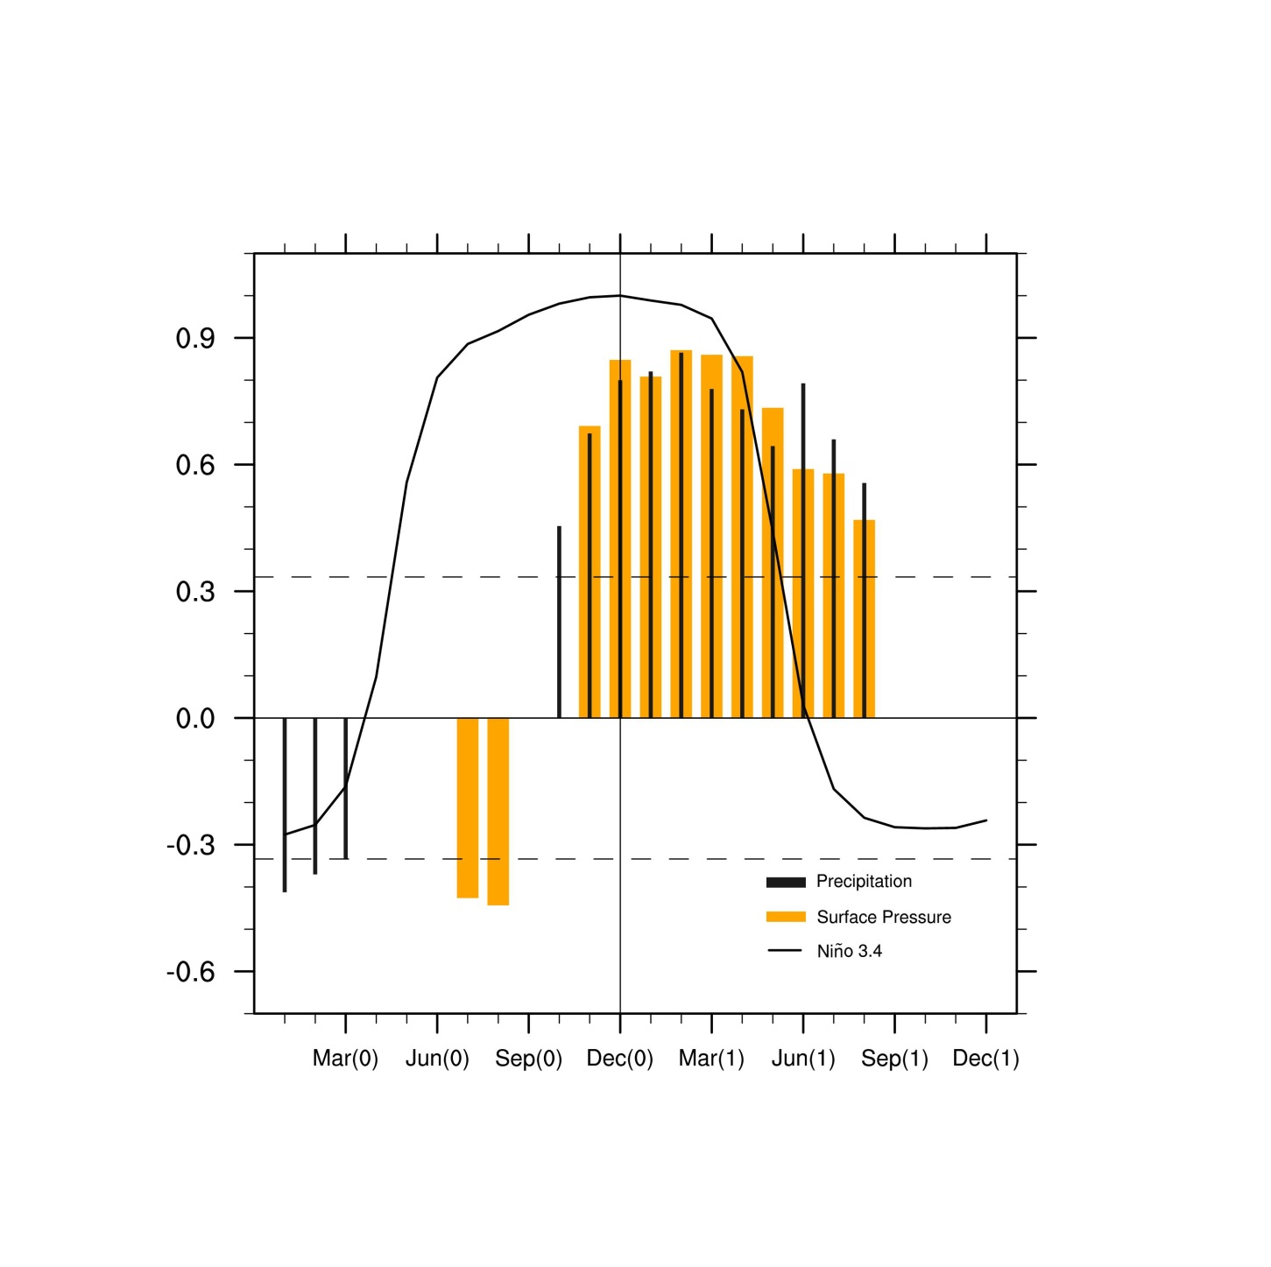
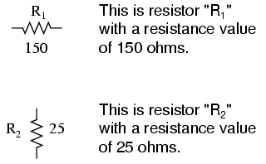
Nino
NIO
Indian Ocean warming persists through JJA(1), and could exert climatic influences after El Nino has dissipated.
But how?
NW Pac
IO
Capacitor
ENSO
-
+
Fig. 11.12.

Slide 16
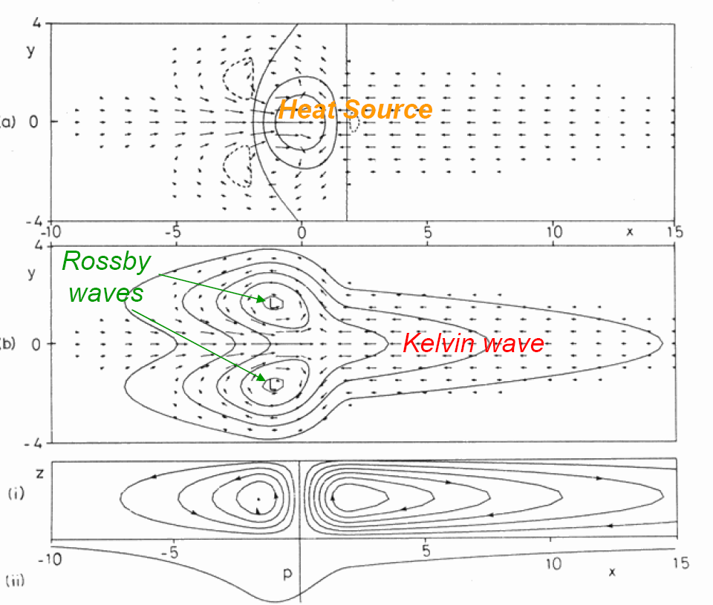
Thermal-induced circulation in the Gill model
Sfc friction → meridional flow under Kelvin wave
p, (u ,v)
Div
Div

Slide 17
Indo-western Pacific Ocean Capacitor Effect
IO warming → Warm Kelvin wave into the WP
Northeasterly winds to the north under friction
→ Divergence over NW Pacific ←→ Suppressed convection
JJA correlation with preceding ENSO (NDJ): Tropospheric temp, surface wind & rainfall

Slide 18
Indo-western Pacific ocean capacitor (IPOC)
IO Warming → NW Pacific anticyclone → Easterly anomalies
Reduced SW monsoon
Modes of IO variability
IOD
IO warming/IPOC
Jun
Sept
Dec
Mar
Jun
Sept
ENSO
Fig. 11.13a

Slide 19
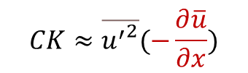
Anomalous anticyclonic circulation (AAC) as a mode of monsoon variability
$$CK≈\overline{{u^{′}}^{2}}(−\frac{∂\overline{u}}{∂x})$$
Barotropic energy conversion
AAC
JJA mean precip & wind
The AAC is anchored on the south flank by the mean confluence of the monsoon westerlies (orange) and easterly trades (blue block arrow).
Fig. 11.B1.2.
Notes:
Fig. B1.2

Slide 20
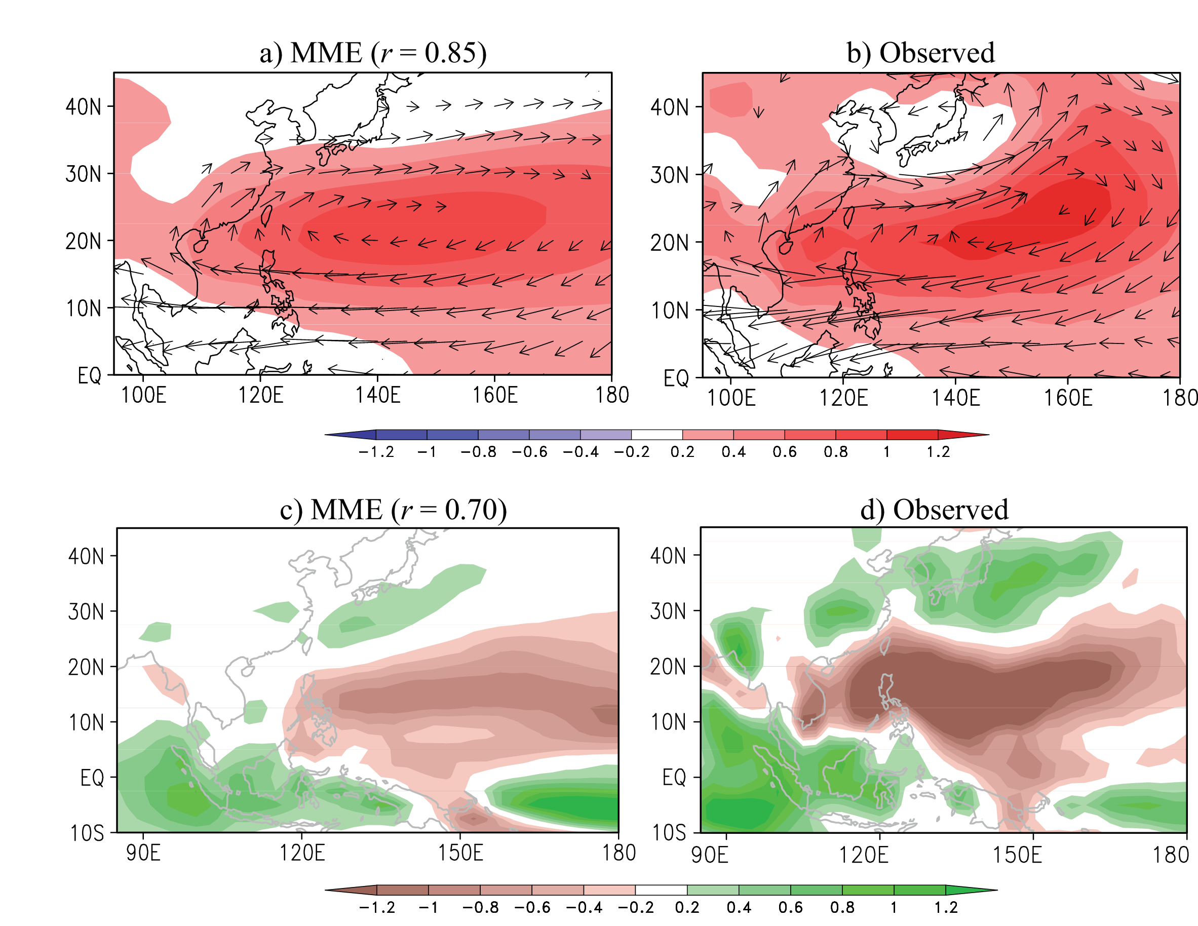
May 1 prediction of summer (JJA) anomalies
SLP & 850 hPa wind
AAC
Enhanced Meiyu
Precip
Fig. 11.17. EOF1 of JJA SLP (upper panel) and EOF2 of JJA precipitation (lower) variability for 1980-2001, obtained from (right) observations, and (left) 11-model mean prediction initialized in May. Temporal correlation in PC between observations and MME prediction is noted in parentheses. Vectors represent the 850 hPa wind anomalies (m s⁻¹) regressed against the SLP PC. Chowdary et al. (2010).
Notes:
Fig. Chowdary, J. S., S.-P. Xie, J.-Y. Lee, Y. Kosaka and B. Wang, 2010: Predictability of summer Northwest Pacific climate in eleven coupled model hindcasts: Local and remote forcing. J. Geophys. Res.-Atmos., 115, D22121, doi:10.1029/2010JD014595.

Slide 21
Summary
Semi-annual cycle of eq. zonal wind → Wyrtki jets, resonance of the IO dynamic basin mode
Indian Ocean dipole mode, Bjerknes feedback phase locked by alongshore wind, El Nino forcing via weakened Walker circulation
SW Indian Ocean thermocline ridge, thermocline feedback, ocean Rossby waves
IPOC: El Nino-induced basin warming interacts with the NW Pacific anticyclone → long persistence & last echoes of El Nino
ENSO and IPOC affect Asian monsoon regions, but project poorly on the spatial pattern of the mean monsoon.
Predictability of the IO-NWP coupled mode

Slide 22
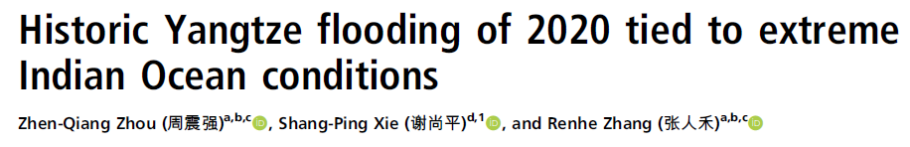

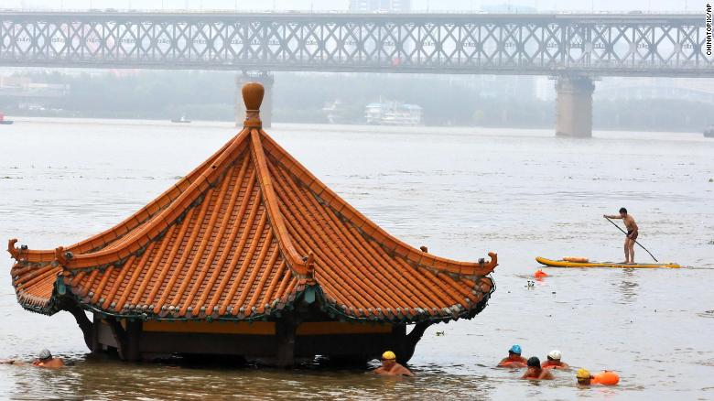


SST, June 2020
Indian Ocean warming → AAC → excessive rains
June-August 2020
locusts
wildfire
Both IOD and IPOC are mostly forced by El Nino but not during 12 months of Sept 19 - Aug 20.
Indian Ocean Dipole Sept-Nov 2019

Slide 23
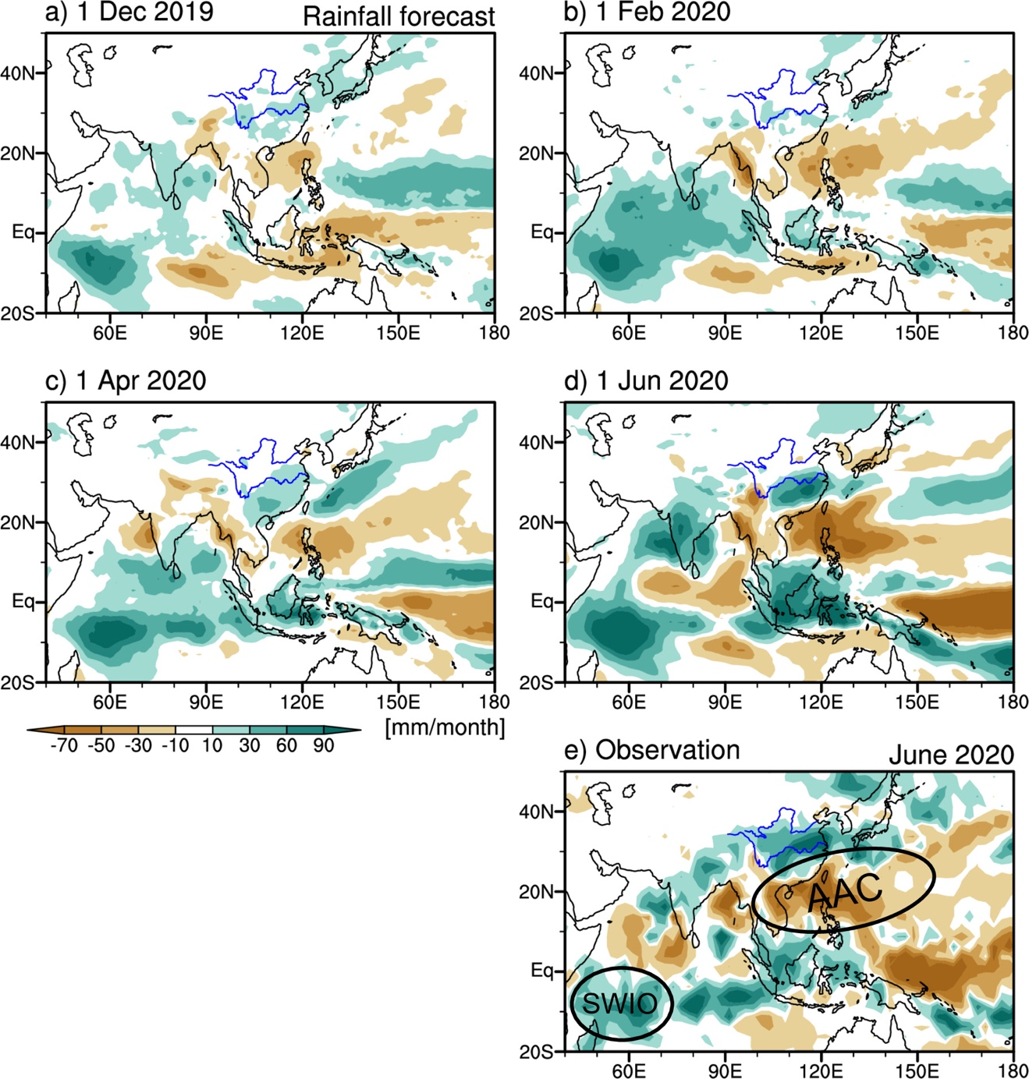
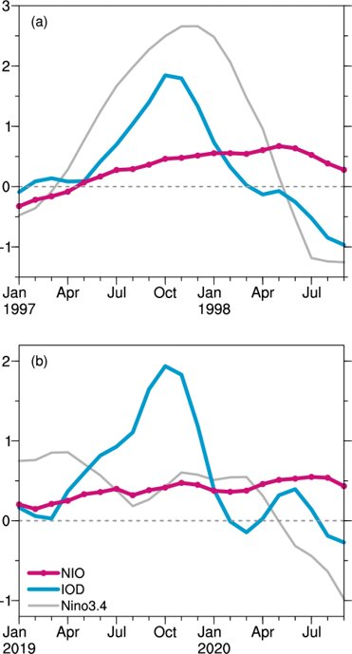

Extreme summer rainy season of 2020
El Nino → AAC→ wet Meiyu Official forecasts failed.
Precip anomalies
Dyn prediction initialized in April 2020
SST indices
Indian Ocean/East Asian climate is more predictable than thought.
2020 summer marks a milestone of dynamic models outperforming empirical forecast.
Zhou et al. (2021, PNAS)
Notes:
Zhou, Z.-Q., S.-P. Xie, and R. Zhang, 2021: Historic Yangtze flooding of 2020 tied to extreme Indian Ocean conditions. PNAS, 118, e2022255118.

Slide 24
Two modes of IO variability
Jun
Sept
Dec
Mar
Jun
Sept
ENSO
IOD
IO warming/IPOC
IPOC
IOD mode
Ocean Rossby wave
Notes:
Xie, S.-P., H. Annamalai, F.A. Schott and J.P. McCreary, 2002: Structure and mechanisms of South Indian Ocean climate variability. J. Climate, 15, 864-878.

Slide 25

Same forcing, different response.
Coupled modes (IOD & IPOC) are drums on the stage of climate variability.
characteristic pattern & phase-locking
IOD
IPOC
Notes:
A drum set is a collection of drums and other percussion instruments, typically cymbals,

Slide 26
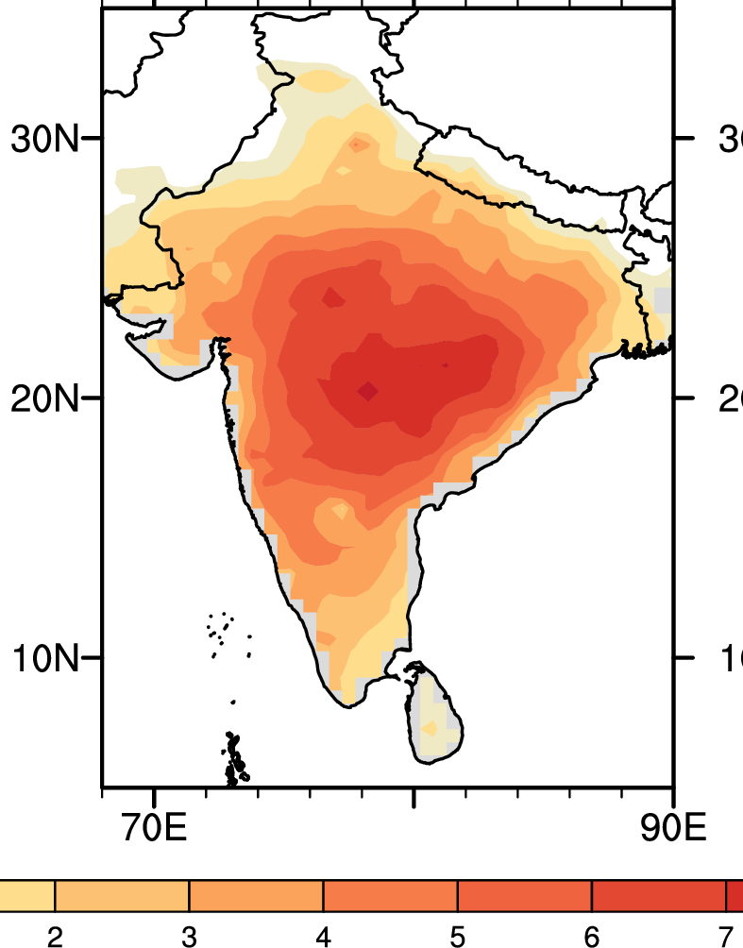
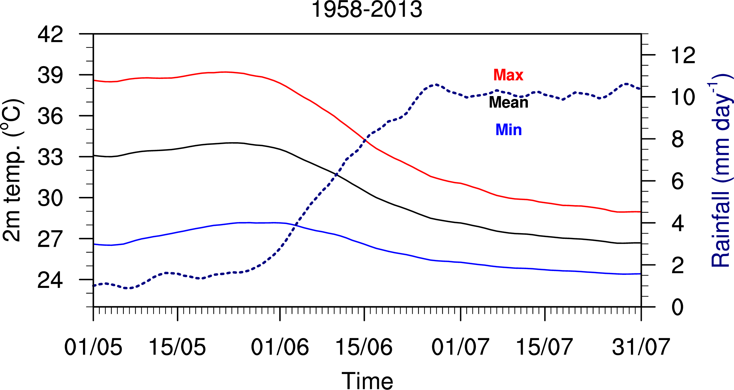
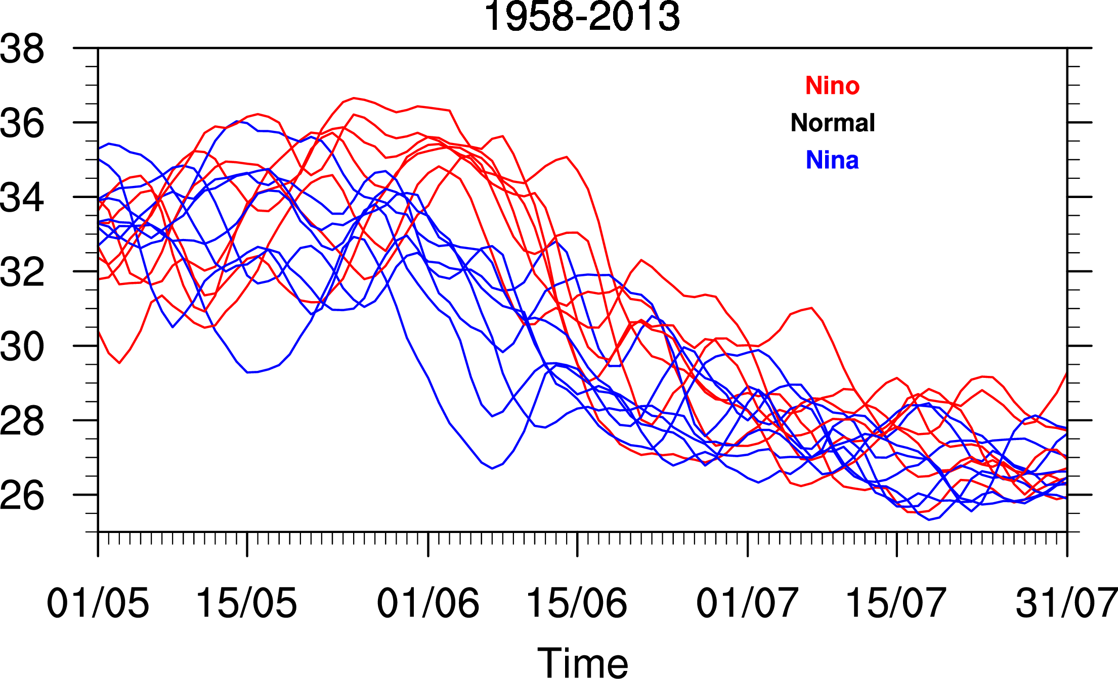
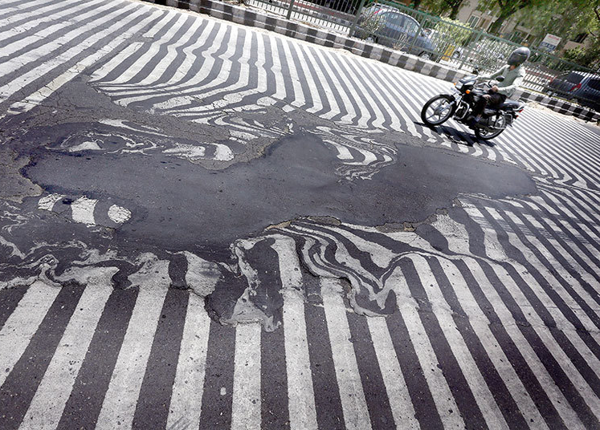
Post-El Nino effect on India
Tmax
Tmean
Rainfall
>8
Tmin
18-26N, 74-84E
May-July SAT
Post-El Nino
Post-La Nina
New Delhi, May 2015
Zhen-Qiang Zhou et al. (2019, J Clim)

Slide 27
100
200
100
60
Z20 (m)
Comparison of tropical oceans
Pacific & Atlantic
similar in annual mean (N displaced ITCZ), annual cycle (eq. cold tongue);
more pronounced Nino mode in the bigger Pacific basin.
Atlantic & Indian: similar in basin size
Atlantic: N displaced ITCZ → eq. annual cycle in τ_{x} induced by cross-eq. momentum advection; prevailing easterlies → frequent Nino occurrence
Indian: monsoons → semi-annual cycle in τ_{x} by cross-eq. momentum advection; weak zonal wind → infrequent IOD occurrence

Slide 28
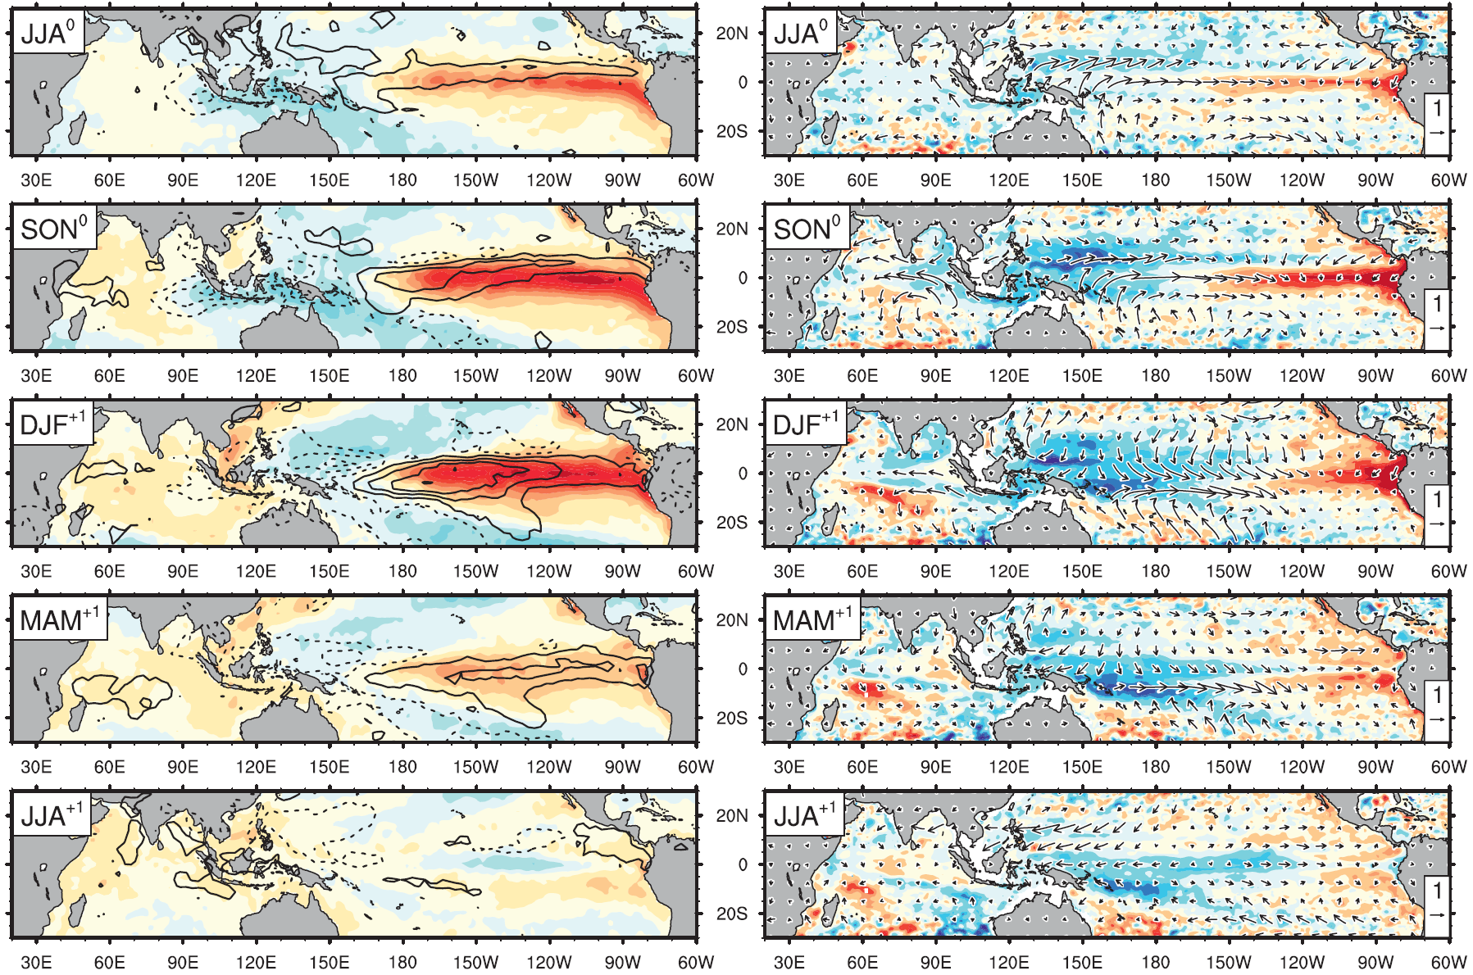
El Nino composite (1958-2007) (Deser et al. 2012, JC)
IOD
Tropical telconnection of El Nino → Weakened Walker circulation
Anomalous easterlies trigger the IOD mode
Reduced convection/cloud favors IO warming.
SST (C) & precip
Z15 (m) & sfc wind (m/s)

