Slide 1
Ch 12. Extratropical variability (Pat 2)
Atmospheric internal modes
Lagged correlation analysis
Ocean dynamical effect
Extratropical influence on tropical variability
a. WES feedback
b. Energy transport theory
Notes:
12.4, 12.6

Slide 2
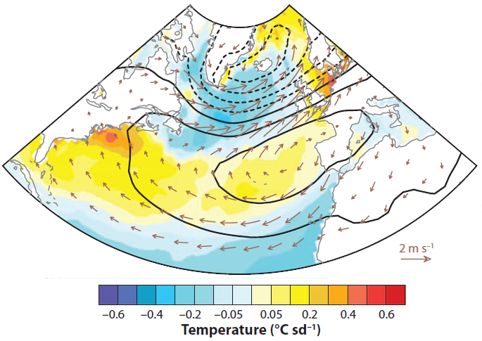
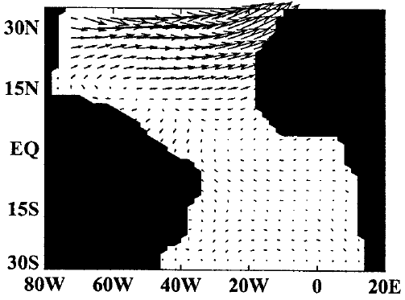
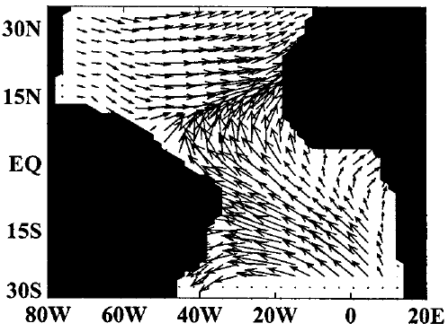
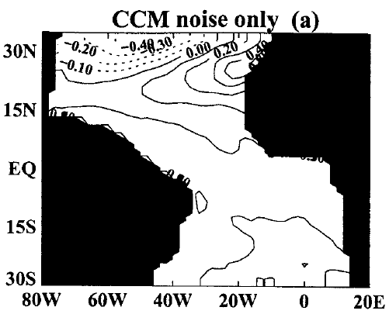
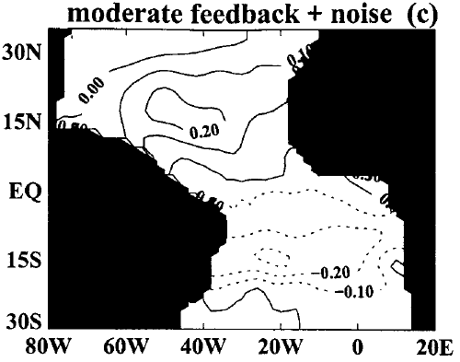
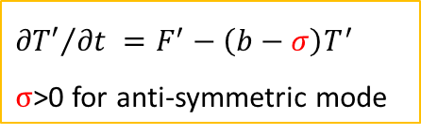
Extratropical effect on tropical climate: (1) WES feedback
Coupled response to NAO forcing (Chang et al. 2001, JC)
Uncoupled
Coupled
North Atlantic Oscillation (NAO)
SLP, SST & wind
Coupled feedback
Wind-SST response extends into deep tropics;
Why is the meridional mode preferentially excited?
SST
SST
$${∂T′}/{∂t} =F^{′}−\left(b−σ\right)T^{′}$$
$σ$>0 for anti-symmetric mode

Slide 3
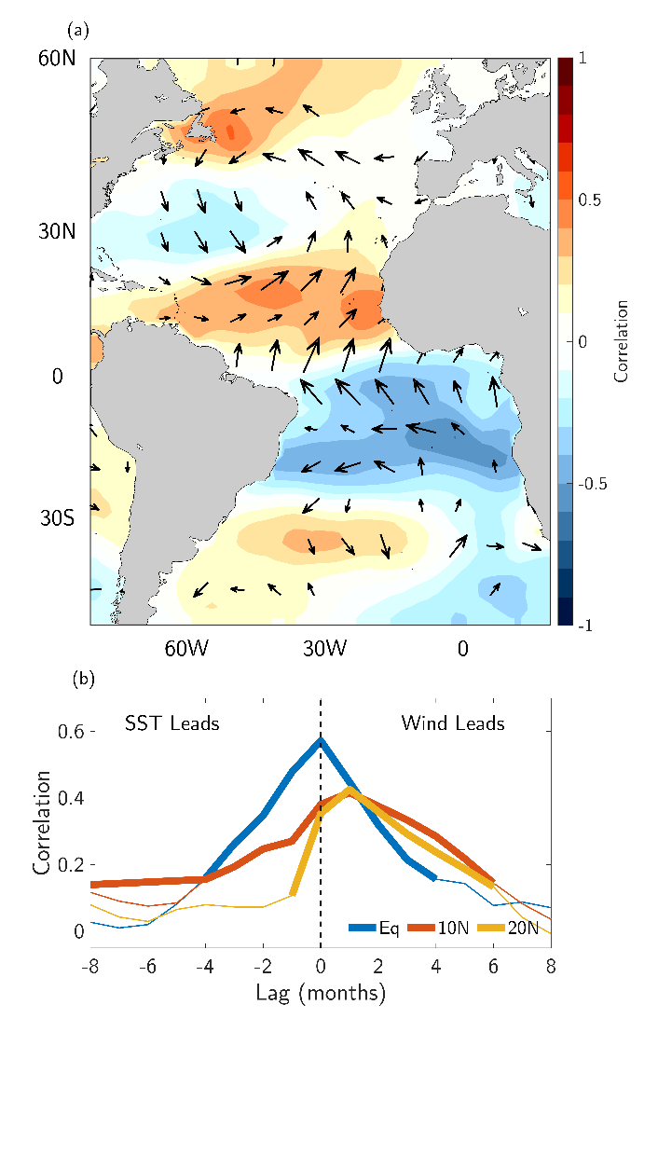
r(T, v) is nearly symmetric in lag at Eq → coupled w/ positive feedback
At which latitude are SST and wind most strongly coupled?
20ºN
10ºN
FIG. 12.6. Correlations between FMA Veq variability and anomalies in the preceding winter (DJF): SST (color shading) and surface wind (vectors). Based on Amaya et al. (2017)
Fig. 12.6

Slide 4
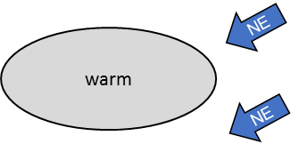
Extratropical effect on tropical climate: (1) WES feedback
Pacific Meridional Mode (PMM)
excited by winter atmos. variability (NPO);
persists/propagates SW-ward due to WES;
triggers ENSO.
N Pacific Oscillation (DJF)
SLP
SLP
Chiang & Vimont (2004, JC)
ENSO
SLP, wind & SST anomalies
in Feb-initialized forecast ensemble
J. Ma et al. (2017, JC)

Slide 5
Extratropical effect on tropical climate: (1) WES feedback
Pacific Meridional Mode (PMM)
excited by winter atmos. variability (NPO);
persists/propagates SW-ward due to WES;
triggers ENSO.
N Pacific Oscillation (DJF)
SLP
SLP
Chiang & Vimond 2004, JC)
SST & wind anomalies
Fig. 12.13

Slide 6
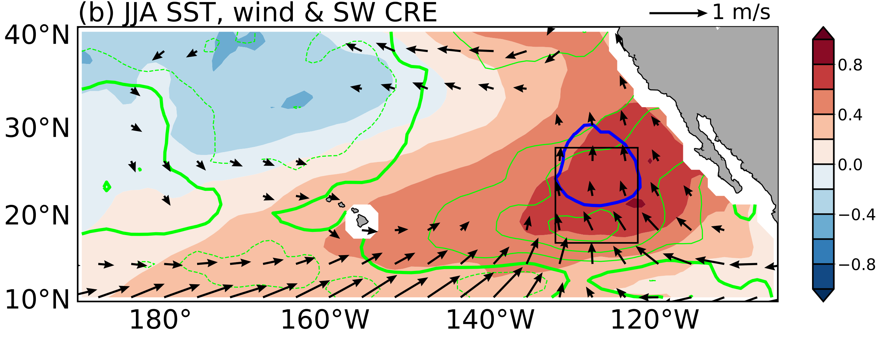
Joint cloud-WES feedback
JJA SST, wind &
shortwave cloud radiative effect
SST
Fig. 6.12 Regression coefficients of JJA shortwave CRE (green contours every 3 W m⁻² °C⁻¹; negative dashed), SST (shading, ºC) and surface wind (vectors, m s⁻¹) onto seasonal-average SST anomaly in the black box. The thick blue contour highlights the stratus deck (mean cloud cover=0.8). Adapted from Yang et al. (2023).

Slide 7
PNA
Atmos. Var.
ITCZ
Preferred pattern
?
PMM
ENSO
SST var.
Ocean predictability (e.g., Rossby waves)
Eq
30N
Fig. 12.21. Schematic of extratropical ocean-atmosphere interactions. Atmospheric variability is organized in large-scale spatial patterns and drives ocean variability (yellow curved arrow) with weak feedback from the ocean (gray arrow). Predictability remains to be exploited in slow ocean variables such SST and subsurface temperature. Also shown are the PNA teleconnection from the tropics as well as teleconnections into the tropics through PMM and cross-equatorial energy transport.

Slide 8
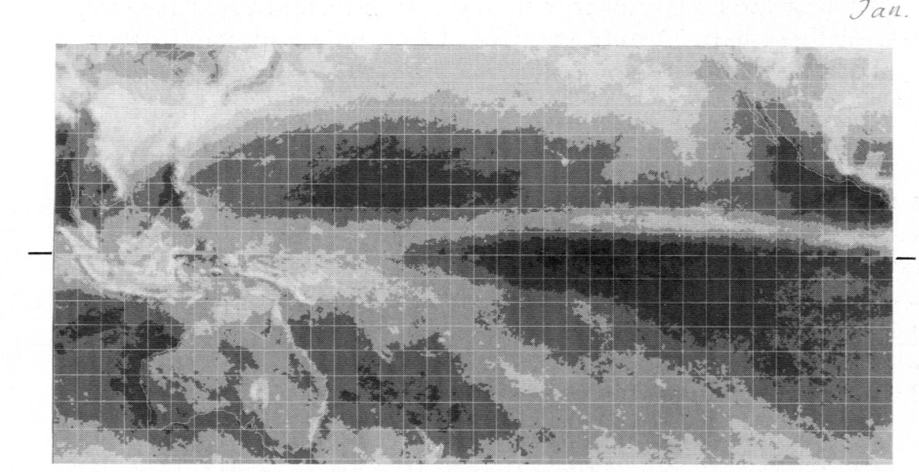
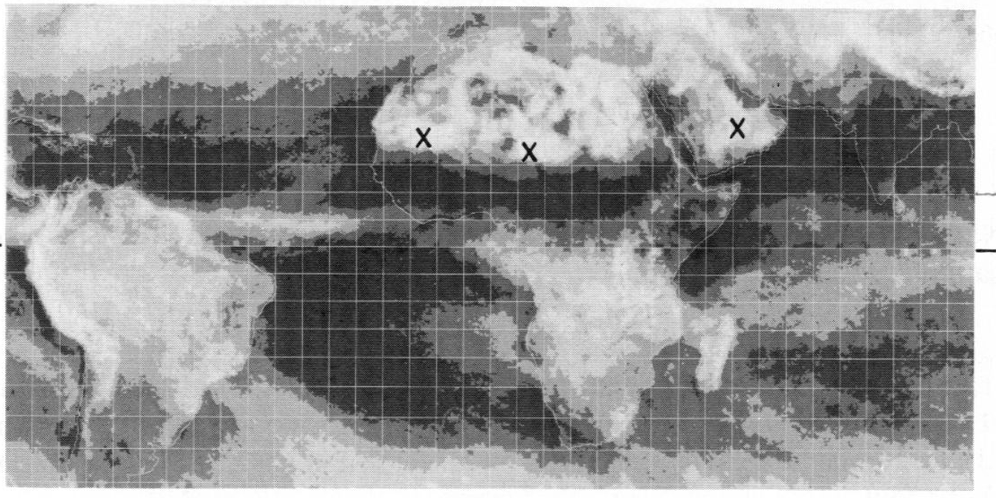
January 1967-70
Tropical view of ITCZ asymmetry
Coupled (WES/cloud) feedback
Continental geometry
Northward-displaced ITCZ

Slide 9
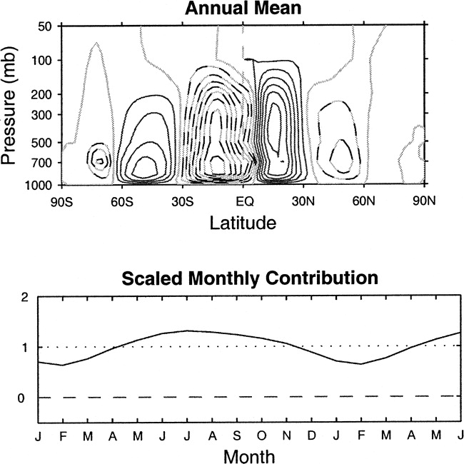

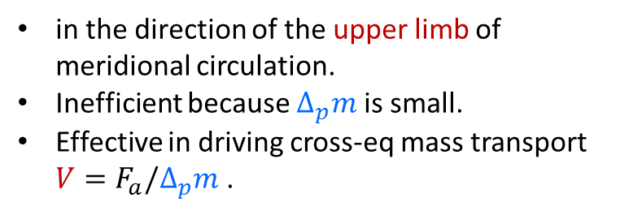
Extratropical effect on tropical climate: (2) Energy transport
dry static energy: s = c_{p}T + gz
moist static energy: m = s + Lq
Atmospheric energy transport
$F_{a}=V(m_{u}−$ $m_{l})$
in the direction of the upper limb of meridional circulation.
Inefficient because $∆_{p}m$ is small.
Effective in driving cross-eq mass transport $V=F_{a}/∆_{p}m$ .
Mass transport
Moist stability
Hadley Cells
Fig. 2.11. Moist static energy (MSE) in tropics is large in both lower and upper troposphere, making energy transport by Hadley cell inefficient
→ sensitive to cross-eq. energy transport.
Notes:
The Hadley circulation is an important agent for energy transport in the tropics. Potential temperature is stably stratified, increasing upward. The Hadley circulation transports dry static energy (s=cpT+gz; cpT d(ln theta) = ds) poleward, with higher potential-temperature air flowing poleward. In the moist atmosphere, things are slightly different as humidity is trapped in the lower troposphere and decreases rapidly upward. The Hadley circulation transports the latent energy equatorward by the equatorward flow near the surface. The moist static energy is greater at the tropopause than at the surface, leading a net poleward transport of moist static energy. Because of the opposing effects in transporting temperature and humidity, the total energy transport by the Hadley circulation is much weaker than the transport in the midlatitudes, where eddies transport both temperature and moisture poleward. Because of this efficient eddy transport, the atmospheric energy transport features a pronounced peak in the midlatitudes.
Back, L. E, and C. S. Bretherton, 2006: Geographic variability in the export of moist static energy and vertical motion profiles in the Tropical Pacific. Geophys. Res. Lett., 33, L17810, doi:10.1029/2006GL026672.

Slide 10
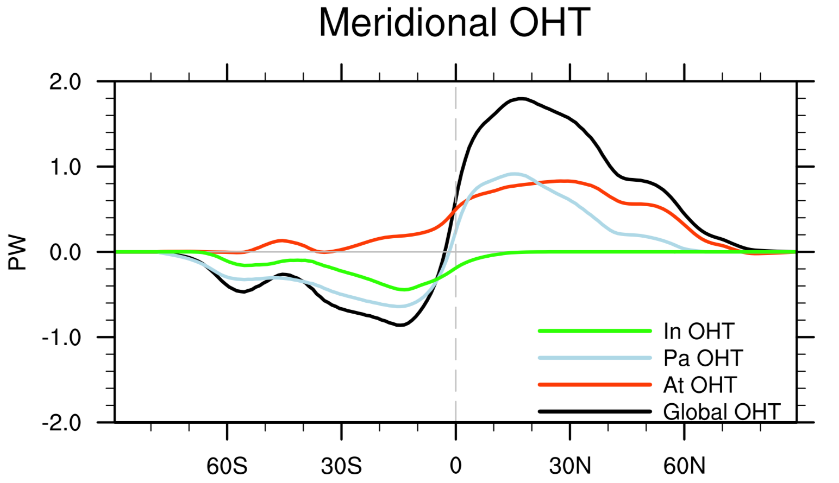

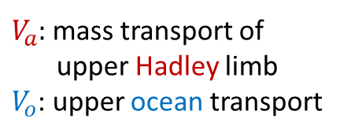
Global energy view of ITCZ asymmetry: Extratropical effect
$V_{a}$: mass transport of upper Hadley limb
$V_{o}$: upper ocean transport
$$V_{a}∆_{p}m+V_{o}∆_{z}T=0$$
I
T
C
Z
Hadley
Q
Q
colder
EQ
warmer
Ocean Meridional Overturning Circulation
Fig. 12.15.
Ocean heat transport
Kang et al. (2008, J Clim), Frierson et al. (2013, Nat Geosci)
Fig. 2.9b

Slide 11
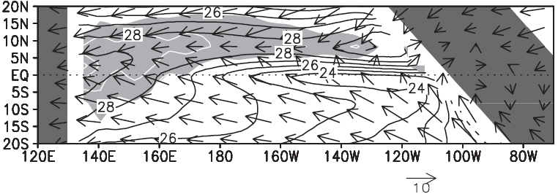

Slanted tropical coastline breaks equatorial symmetry
Downwelling
Eq
Upwelling
Fig. 8.5 Climatology of SST (contour interval 1C), surface wind (vectors, m/s), and precipitation (shade > 4 mm/day with white contours at intervals of 4 mm/day) in a coupled ocean-atmosphere model. Okajima et al. (2003, JMSJ)

Slide 12

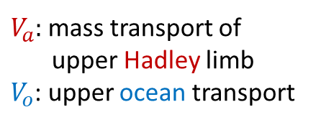
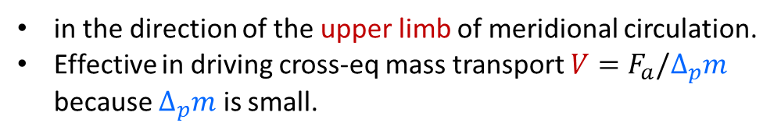
Global energy view of ITCZ asymmetry
Atmospheric energy transport
in the direction of the upper limb of meridional circulation.
Effective in driving cross-eq mass transport $V=F_{a}/∆_{p}m$ because $∆_{p}m$ is small.
$V_{a}$: mass transport of upper Hadley limb
$V_{o}$: upper ocean transport
$$V_{a}∆_{p}m+V_{o}∆_{z}T=0$$
I
T
C
Z
Hadley
Additional factors
Low-cloud (St) feedback
Continental forcing of upwelling (w)
St
Q
Q
colder
w
EQ
warmer
Ocean Meridional Overturning Circulation
Fig. 12.15.

Slide 13

Water-hosing response (Yr 81-100)
Heinrich events
GFDL_CM2.1
SST & wind stress
Ice sheet discharges
Reduced salinity in N Atlantic
AMOC shut down
NH cooling & slight SH warming
w/ WES feedback
S shift of ITCZ: wet NE Brazil, dry Asian monsoon
Timmermann et al. 2007, JC
Fig. 12.20

Slide 14

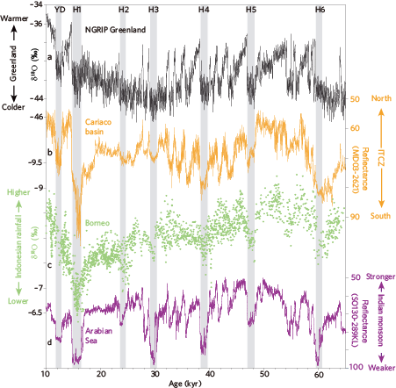
AMOC slowdown → widespread tropical rainfall change
Cold Greenland
Dry Tropical N Atlantic
Weak Indian
summer monsoon
Fig. 12.19.
Notes:
Schneider, T., Bischoff, T. & Haug, G. Migrations and dynamics of the intertropical convergence zone. Nature 513, 45–53 (2014). https://doi.org/10.1038/nature13636

Slide 15
Atmospheric internal modes
Lagged correlation analysis
Ocean dynamical effect
Extratropical influence on tropical variability
a. WES feedback
b. Energy transport theory

Slide 16
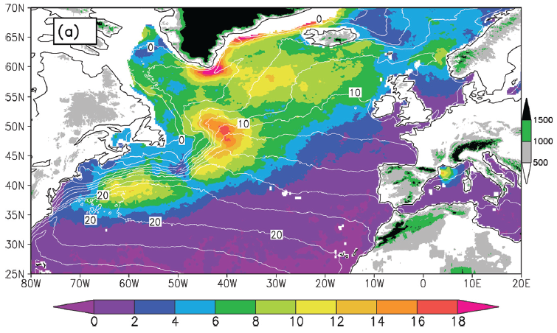
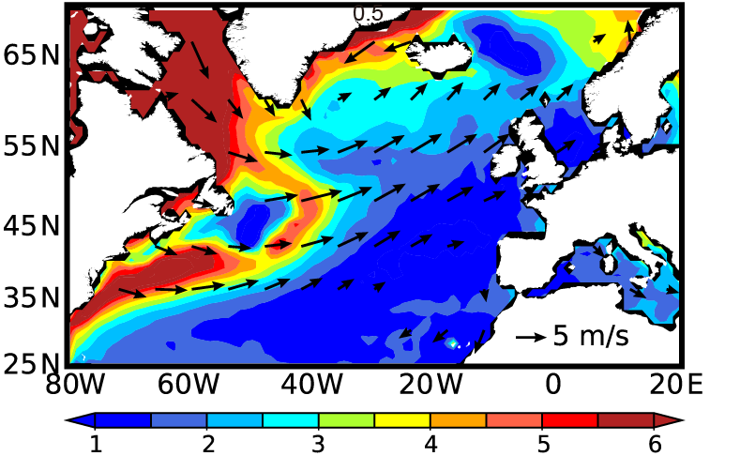
Ocean front-atmosphere interaction
Atmospheric stability → vertical mixing of momentum → wind acceleration on the warm flank;
Baroclinic instability → cyclogenesis & storm growth
DJF SST &
high-wind (>20m/s) occurrence
SST
Ta
SST-SAT & sfc wind
Fig. 12.B2.1.

Slide 17
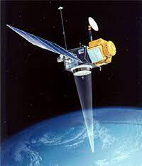
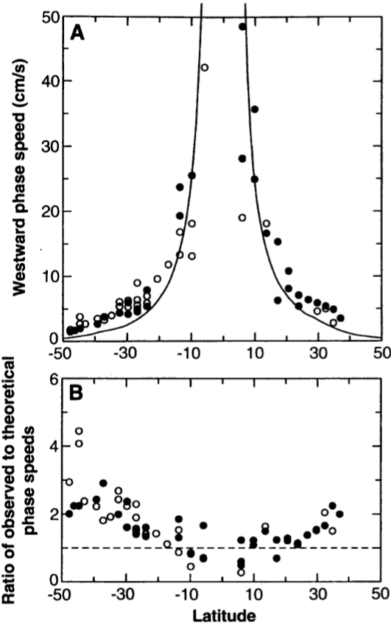
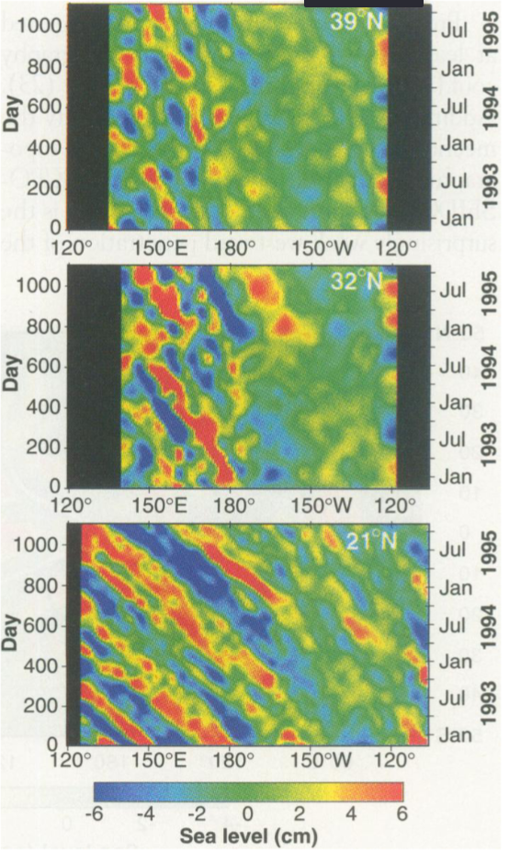

Ubiquitous Rossby waves
~ 100s km
Satellite altimeter
Dudley Chelton
SIO PhD 1980
“Analysis of 3 years of data reveals discrepancies between observed and theoretical Rossby wave phase speeds.”
Chelton & Schlax (1996, Science)
Time-longitude sections of filtered sea level in the Pacific.
Notes:
Chelton, DB & Schlax, MG, 1996: Global observations of oceanic Rossby waves. SCIENCE 272, 234-238

Slide 18
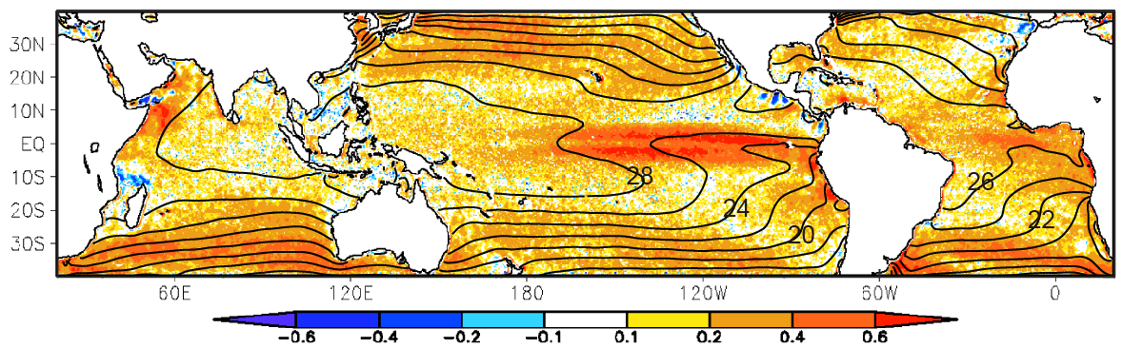
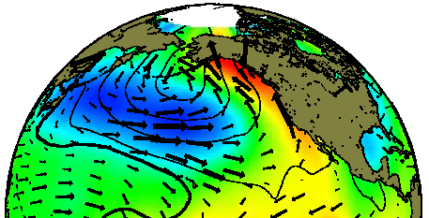
Corr. (SST, wind speed) >0 on short scales (<1,000 km), especially near SST fronts → SST forcing the atmospheric boundary layer.
SST-wind correlation < 0 on basin scale
Fig. 12.B2.2.

Slide 19
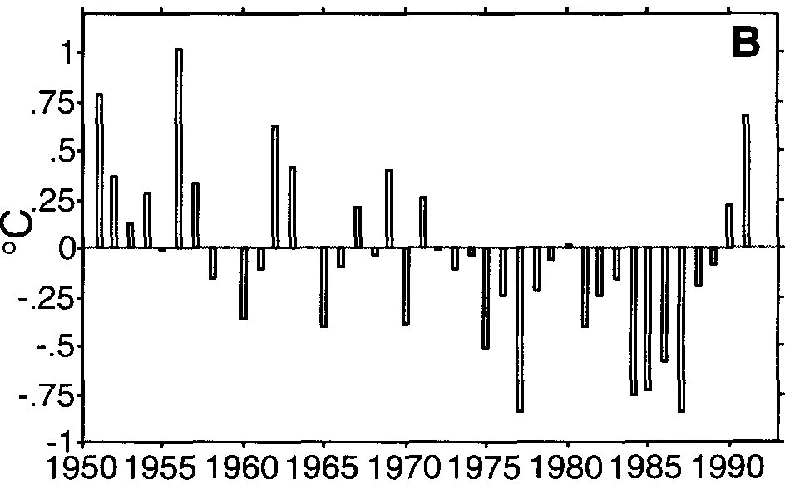
Kuroshio Extension
Ocean dynamic effects
SST variability is enhanced and of low frequency in the Kuroshio Extension (& Gulf Stream).
136E-176W, 32-42N
Deser et al. 1999
Standard deviation of interannual SST variability

Slide 20
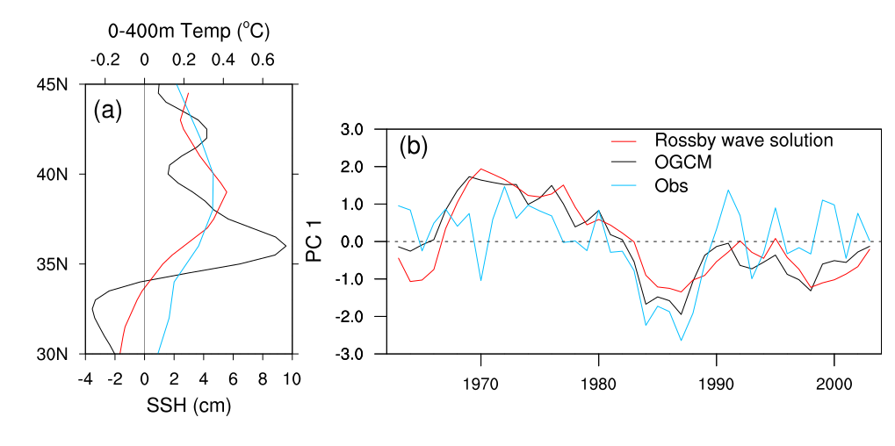
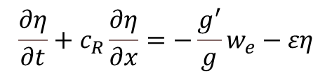
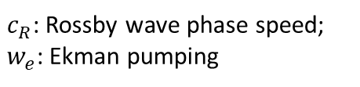
Wind-forced Rossby wave dynamics (Schneider & Miller 2001)
slow propagation of wind-forced Rossby waves → thermocline variability in Kuroshio Extension is predictable a few years in advance → climate & fisheries applications
$$\frac{∂η}{∂t}+c_{R}\frac{∂η}{∂x}=−\frac{g^{′}}{g}w_{e}−εη$$
$c_{R}$: Rossby wave phase speed;
$w_{e}$: Ekman pumping
Fig. 12.9. (a) Leading EOF and (b) PC of observed ocean temperature averaged in the top 400m (blue), sea surface height variability in an eddy-resolving ocean GCM (black) and a zonally one-dimensional, linear Rossby wave model forced with observed wind stress variability (red). All interannual anomalies averaged in 142-180ºE. Taguchi et al. (2007, JC)
Notes:
The altimeter observation doesn’t cover the whole OFES hindcast period.
To extend the comparison period, we also compare the OFES’s mode w/
the mode derived from the XBT-based subsurface temperature dataset by White.
The time series show a distinct jump in early 1980s between two quasi-steady periods,
indicating that this mode is associated w/ the late 70s regime shift.
Time series from both OFES and the observation show a good agreement.

Slide 21
Hypotheses:
1. Memory for variability longer than a month lies in ocean. Yes for ENSO; No for extratropics (decadal NAO)
2. Negative SST-wind correlation is indicative of WES feedback. Yes for tropics (Atlantic meridional mode); No for extratropics (lag cross-correlation as in PDO)
Extratropics
Strong internal variability at all timescales organized in space into large-scale modes (e.g., in AGCM runs with climatological SST);
Weak atmospheric response to local SST (small ratio of ensemble mean to spread) ← trapped in boundary layer under stable stratification; strong horizontal advection & storms;
Lagged cross-correlation is useful in diagnosing ocean-to-atmosphere feedback.
Extratropical influence on tropics
WES mode (NAO → AMM; NPO → PMM); oceanic pathways (e.g., ventilation)
Balance of cross-equatorial energy transport (Heinrich events connect AMOC to ITCZ) → possible global dynamics of N displaced ITCZ

