Slide 1

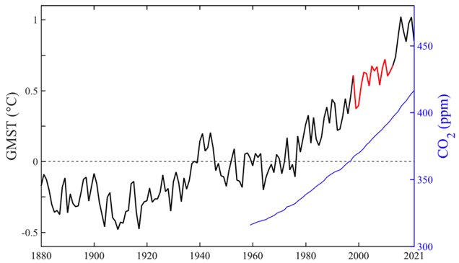
16. Regional Climate Change
Past 7 years are hottest on record.
steephill.tv
Fig. 13.1.
Notes:
13.3.5, 14.1, 14.4.1, 14.7

Slide 2
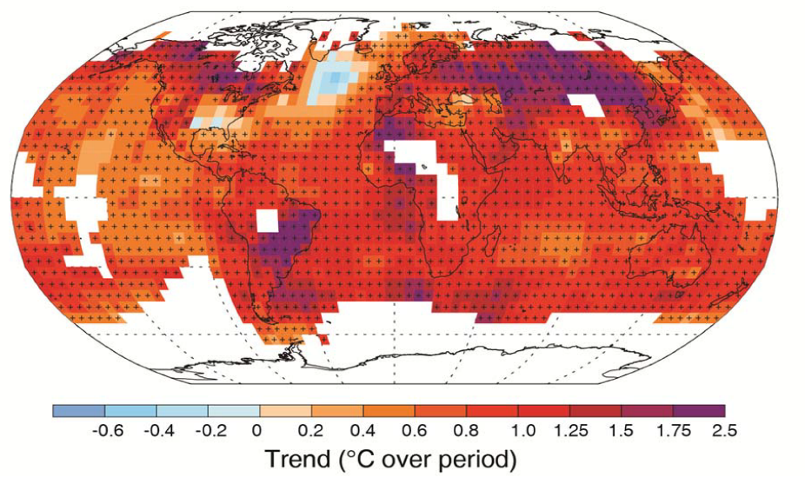
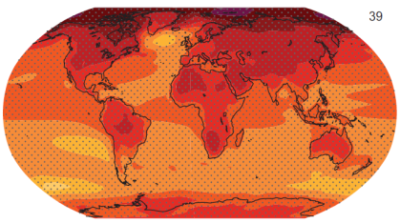
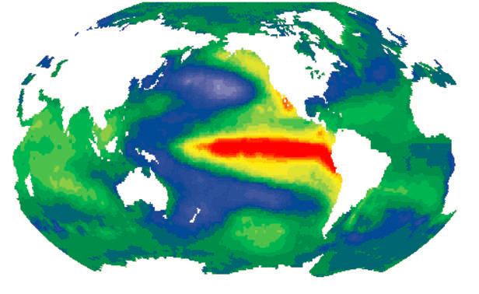
Observed and projected warming patterns agree
Warming nearly everywhere, matching the model simulation of greenhouse warming.
Internal variability feature regions of increase and regions of decrease.
Forced & internal changes are distinct in pattern and energetics
Temperature trend since 1901
El Nino
Projected temperature change
Larger on land than ocean;
Arctic amplification
Warming hole in subpolar N Atlantic
SST anomalies
Notes:
Run the animation of 10-Year Mean Anomaly

Slide 3
Dynamical Prediction: A triumph of science
physical understanding, numerical models, and observing system
Weather prediction (2 weeks): initialize atmosphere & predict individual storms.
Climate prediction (2-3 seasons): initialize ocean; predict El Nino/La Nina → seasonal-mean T, rainfall, storminess.
Climate projection: anthropogenic radiative forcing; predict long-term statistics (T, rainfall, ENSO amplitude).
Forecast ensemble
How can you predict climate decades ahead when you cannot forecast weather 2 weeks from now?
Nino3.4 SST
Obs.
El Nino prediction issued in July 2015

Slide 4
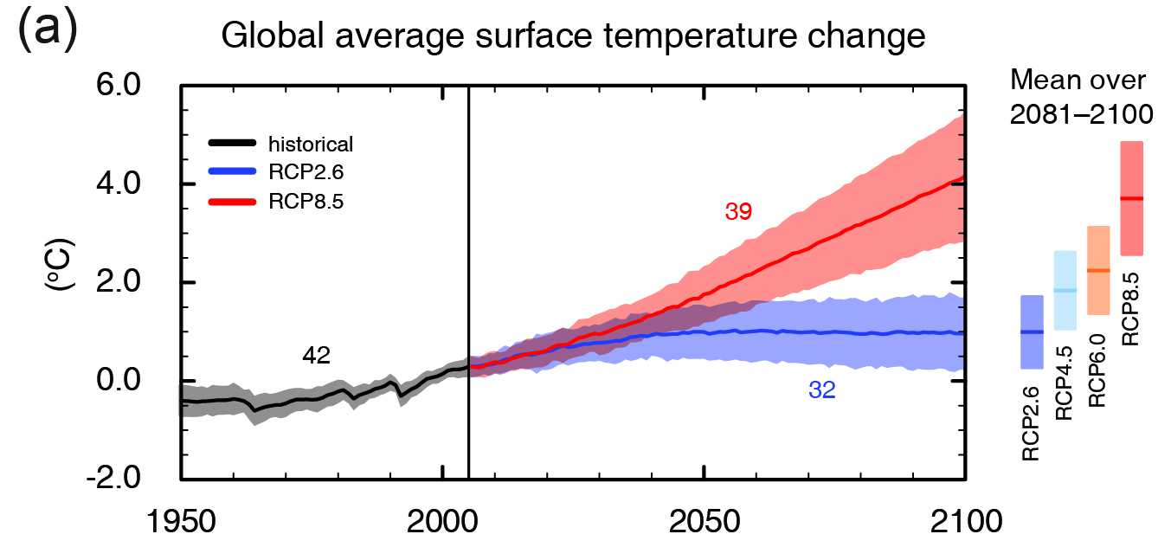
Model projections of
(IPCC 2013, Fig. SPM.7a)
Global surface temperature change for the end of the 21st century is likely to exceed 1.5°C relative to 1850.
We are in control of Earth’s thermostat.

Slide 5
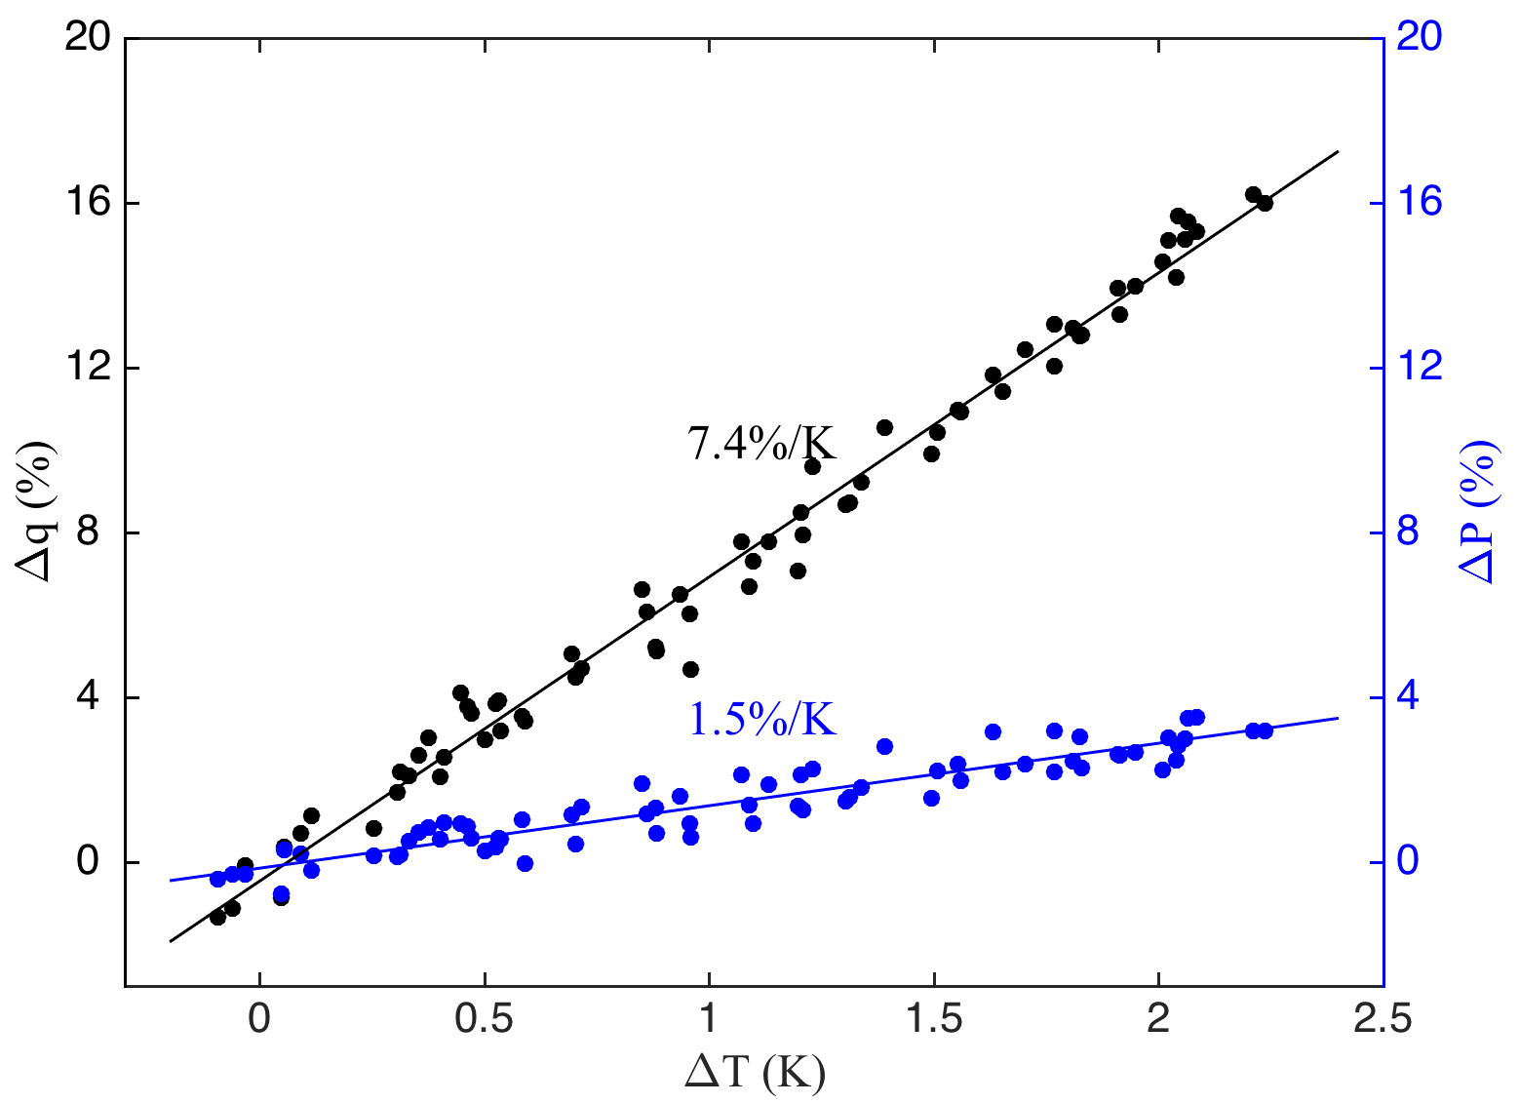
Changes in global-mean temp, humidity & precipitation
Implications from changes in hydrological cycle
P = precipitation
M = convective mass flux
q = specific humidity
Δq/q
Clausius-Clapeyron
Energetics
ΔP/P
P = M•q
ΔM/M=ΔP/P-Δq/q
ΔP/P ~ 2%/K
Δq/q ~ 7%/K
M has to decrease by 5%/K
tropical circulation slows down
Fig. 13.14.
Held & Soden (2006, JC)

Slide 6
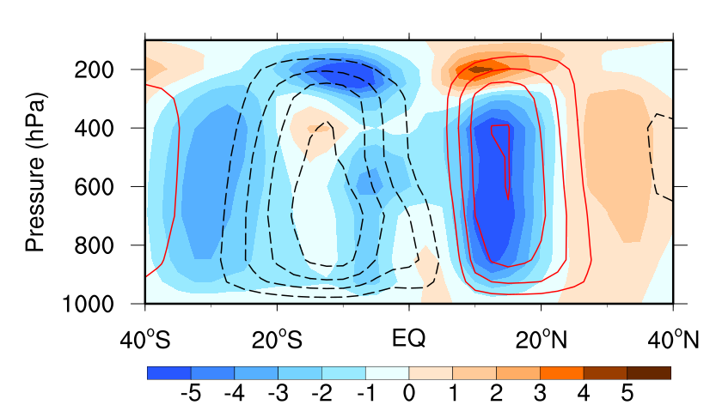
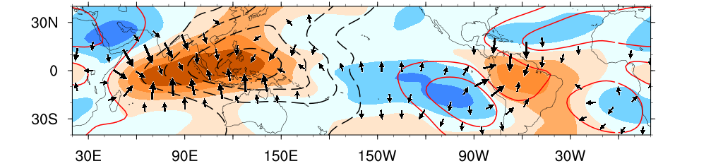
CMIP6 ensemble-mean Hadley circulation: Climatology (contours) & change (shading) 1%CO2 run.
Slowdown of the northern cell.
Poleward expansion in both hemispheres.
250 hPa velocity potential: change & mean
Fig. 13.15. CMIP6 ensemble, annual-mean atmospheric circulation change (color shading) at year 70 in the 1%CO2 run, along with the pre-industrial climatology (line contours, negative dashed). (a) Zonal-integrated streamfunction (10⁹ kg/s) and (b) velocity potential at 250 hPa with the divergent wind change (vectors).
Notes:
S Hadley cell not change much due to the gradient of SST warming

Slide 7
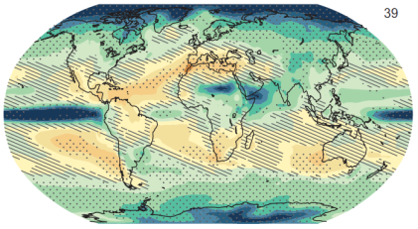
How do temp and precip changes differ in spatial pattern?
Precipitation change is to first order spatially variable.
What determines patterns of rainfall change?
Can we predict the pattern?
Climate change (1986−2005 to 2081−2100), Business as usual (RCP8.5); IPCC AR5
Temperature
precipitation
Larger on land than ocean;
Arctic amplification
Warming hole in subpolar N Atlantic
Increase in midlat-polar regions
Drying in subtropics
Increase in eq Pacific
Fig. 14.1
Notes:
7
The inherent difficulty with rainfall change in global warming is that to first order, it is spatially variable, increasing in some and decreasing in some other regions.
7

Slide 8
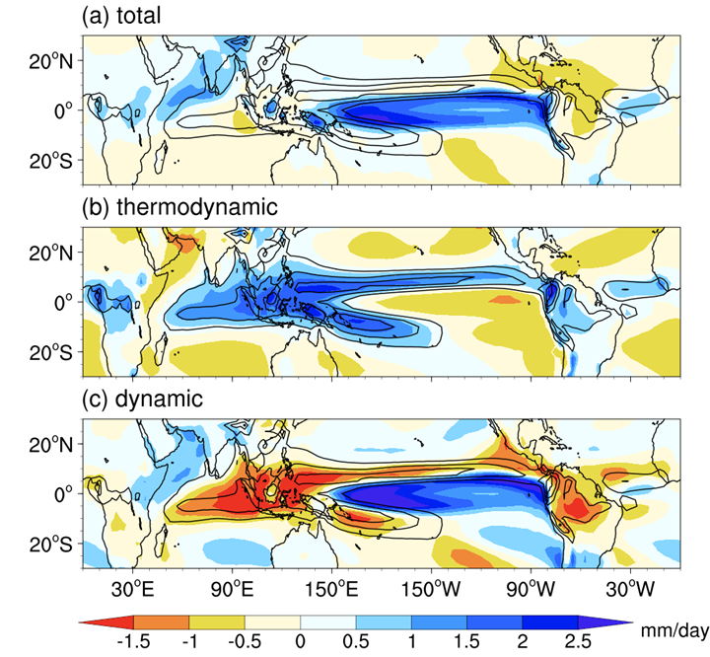
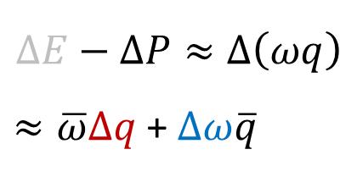
Decomposition of rainfall change
CMIP6 ensemble mean 1%CO2
Yr 101-150
$$∆E−∆P≈∆\left(ωq\right)$$
$≈\overline{ω}∆q$ + $∆ω\overline{q}$
Wet get wetter
thermodyn
dynamic
Circulation slowdown + SST pattern
Fig. 14.3. Annual-mean change in 1%CO2 run (year 101~150 mean), superimposed on the mean precipitation (thin gray line contours), based on CMIP6 34-model ensemble mean. (a) Precipitation (color shading; mm day⁻¹), (b) the thermodynamic and (c) dynamic components.

Slide 9
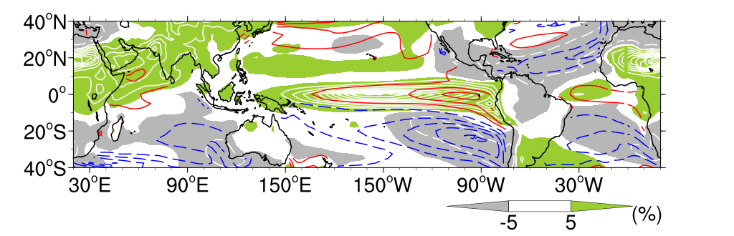
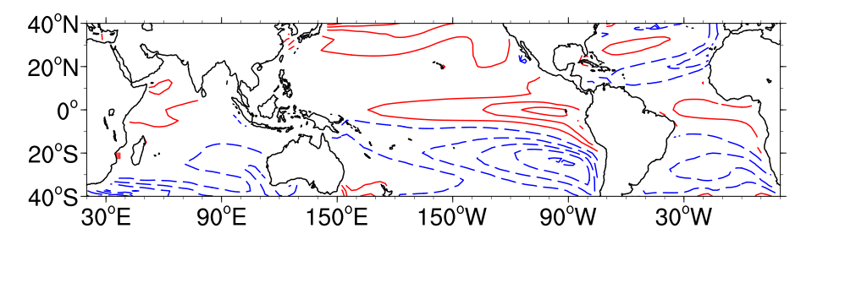
than the tropical mean
SST pattern effect: Warmer get wetter
SST change relative to the tropical mean
ΔP/P
Fig. 14.2. Annual-mean precipitation percentage change (ΔP/P, shading and white contours at 20% intervals), and relative SST change (color contours at intervals of 0.3 ºC, the zero contour omitted) to the tropical (20ºS-20ºN) mean warming in 1%CO2 run (year 101~150), shown as 37 CMIP6 model ensemble mean. The spatial correlation for the multi-model ensemble mean between the SST and precipitation fields is 0.49.

Slide 10
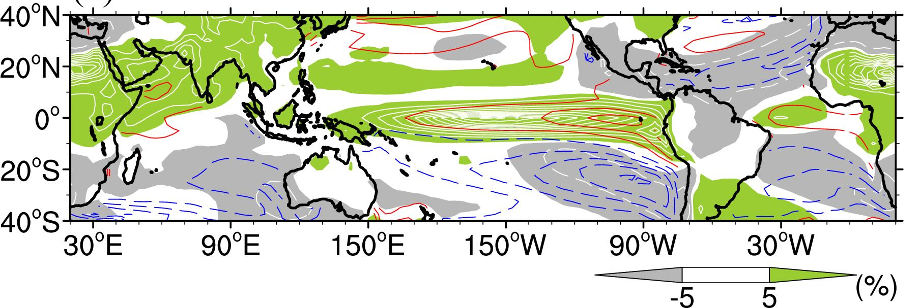
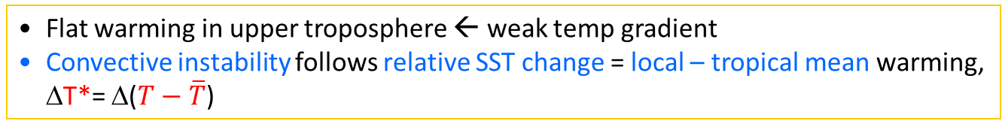
Flat warming in upper troposphere ← weak temp gradient
Convective instability follows relative SST change = local – tropical mean warming, ΔT*= Δ($T−\overline{T}$)
Convective Instability: ΔI_{M} = Δm_{sfc} - Δm_{300 hPa} = c_{p}(1+b_{e}) ΔT*
300 hPa ΔT
Fig. 14.2. Annual-mean precipitation percentage change (ΔP/P, shading and white contours at 20% intervals), and relative SST change (color contours at intervals of 0.3 ºC, the zero contour omitted) to the tropical (20ºS-20ºN) mean warming in 1%CO2 run (year 101~150), shown as 37 CMIP6 model ensemble mean. The spatial correlation for the multi-model ensemble mean between the SST and precipitation fields is 0.49.

Slide 11
Dynamic SST threshold for tropical cyclogenesis
Will TC genesis expand all the way to NYC?
Current TC genesis confined to SST>27ºC.
The SST threshold increases with the tropical mean.
Convective instability = local – tropical mean SST
Global counts decrease.
Regional count change follows SST pattern.
31
27
Model RCP8.5 Projection (2086-95)
Obs 1996-2005
27
GFDL HiRAM model (1996-2005)
Courtesy of Wei Mei
SST & tropical cyclone genesis/tracks

Slide 12
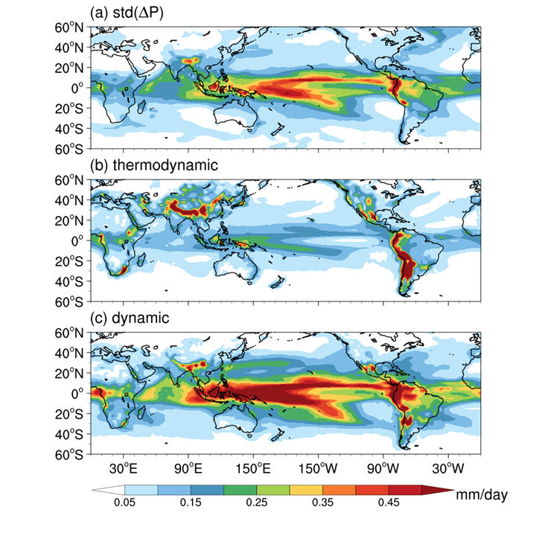
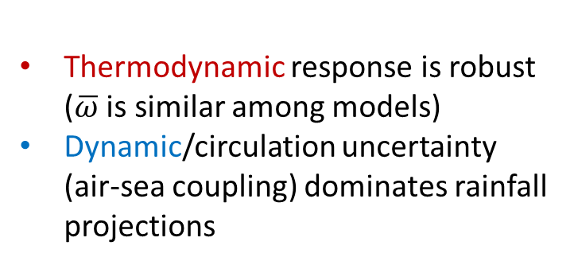
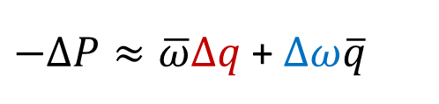
Dynamic component dominates regional uncertainty
CMIP6 ensemble spread (1%CO2)
$−∆P≈\overline{ω}∆q$ + $∆ω\overline{q}$
thermodyn
dynamic
Thermodynamic response is robust ($\overline{ω}$ is similar among models)
Dynamic/circulation uncertainty (air-sea coupling) dominates rainfall projections
Fig. 14.9. Inter-model standard deviation of (a) precipitation change, (b) the thermodynamic and (c) dynamic components in CMIP6 1%CO2 run (year 101~150 mean). Adapted from Geng et al. (2022).
Notes:
Inter-model spread skipped in favor of ensemble mean SST pattern and ocean heat uptake.

Slide 13
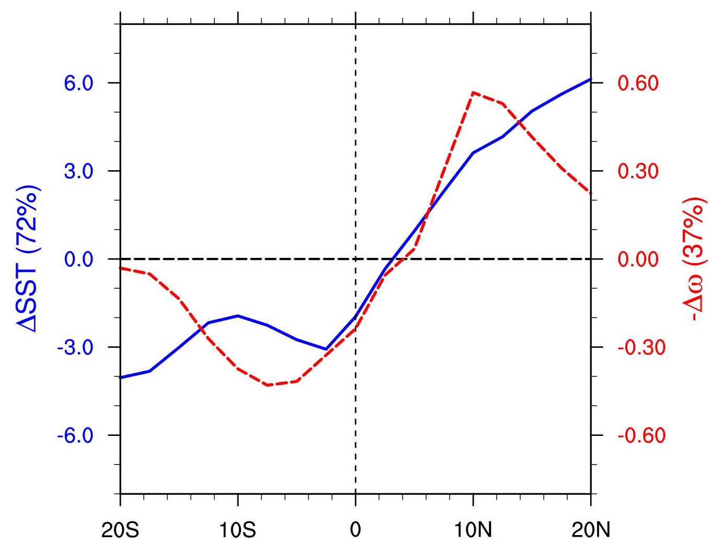
Atmospheric circulation uncertainty is coupled with SST pattern
SVD mode 1 of inter-model spread of zonal-mean ΔSST & Δω in CMIP6 1%CO2 run (yr 101~150).
-Δω
ΔSST
Uncertainty in cross-eq. gradient
Fig. 14.10.

Slide 14
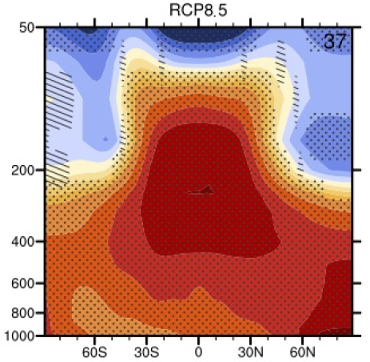
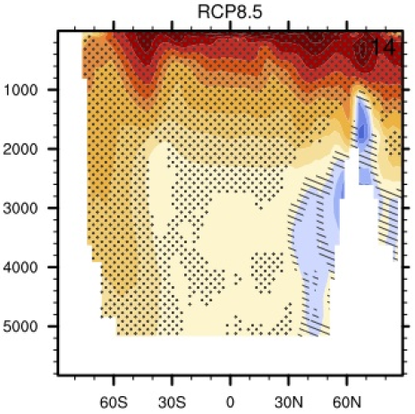
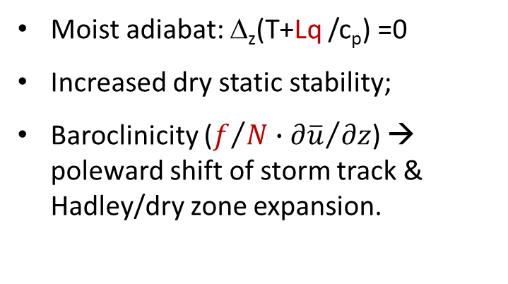
Why does tropical warming increase upward?
Moist adiabat: Δ_{z}(T+Lq /c_{p}) =0
Increased dry static stability;
Baroclinicity ($f/{N∙{∂\overline{u}}/{∂z}}$) → poleward shift of storm track & Hadley/dry zone expansion.
Pressure (hPa)
Ann-mean Temp change (2081-2100)
Depth (m)
CMIP5 multi-model changes in annual mean zonal mean temperature in the atmosphere and ocean relative to 1986–2005 for 2081–2100 under the RCP8.5 forcing scenario. Hatching indicates regions where the multi model mean is less than one standard deviation of internal variability. Stippling indicates regions where the multi model mean is greater than two standard deviations of internal variability and where 90% of the models agree on the sign of change.
Ocean
Fig. 13.11.

Slide 15
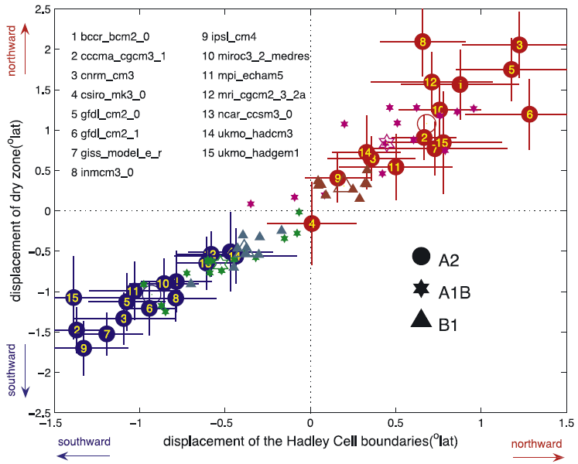
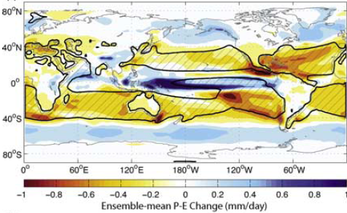
Poleward Expansion of Hadley Cells
Multi-model ensemble mean P-E in the A2 scenario. Shading indicates the difference between the first and the last 20 years of the 21st century and the black line denotes the 0-isopleths averaged from 2001 to 2020.
The breakdown by models and scenarios of the displacement of the northern (warm colors) and southern (cold colors) edges of the subtropical dry zone (y-axis) versus that of the HC (x-axis). Edges of the HC are defined as the first latitude poleward of the maximum at which ψ500 became zero (ψ500: zonal-mean mass flux stream function).
Simple scaling analysis supports the notion that the poleward extent of the Hadley cell is set by the location where the thermally driven jet first becomes baroclinically unstable. The expansion of the Hadley cell is caused by an increase in the subtropical static stability, which pushes poleward the baroclinic instability zone and hence the outer boundary of the Hadley cell.
Lu et al. (2007, GRL).
Notes:
Lu J., G. A. Vecchi, T. Reichler (2007), Expansion of the Hadley cell under global warming, Geophys. Res. Lett., 34, L06805, doi:10.1029/2006GL028443.

Slide 16
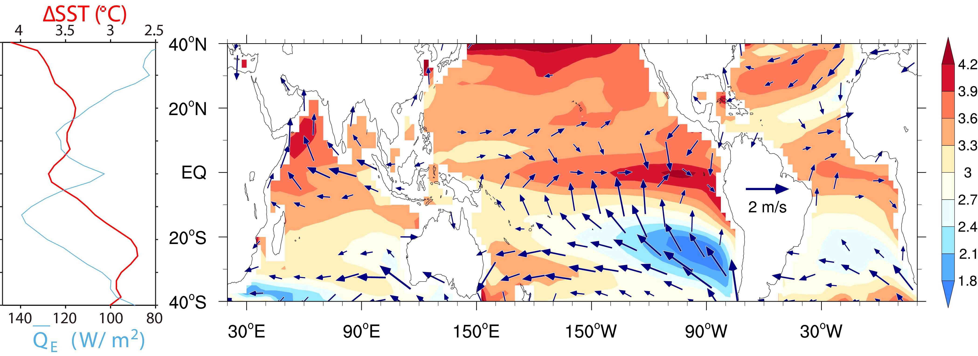
Pattern Dynamics: Ocean-Atmosphere coupling
Fig. 14.4. SST (ºC) and surface wind (m/s) change in the 1%CO2 run at year 140 (the time of 4xCO2), based on 31 CMIP6 model ensemble mean. (left inset) Zonal-mean SST change with the mean latent heat flux (W/m²).

Slide 17
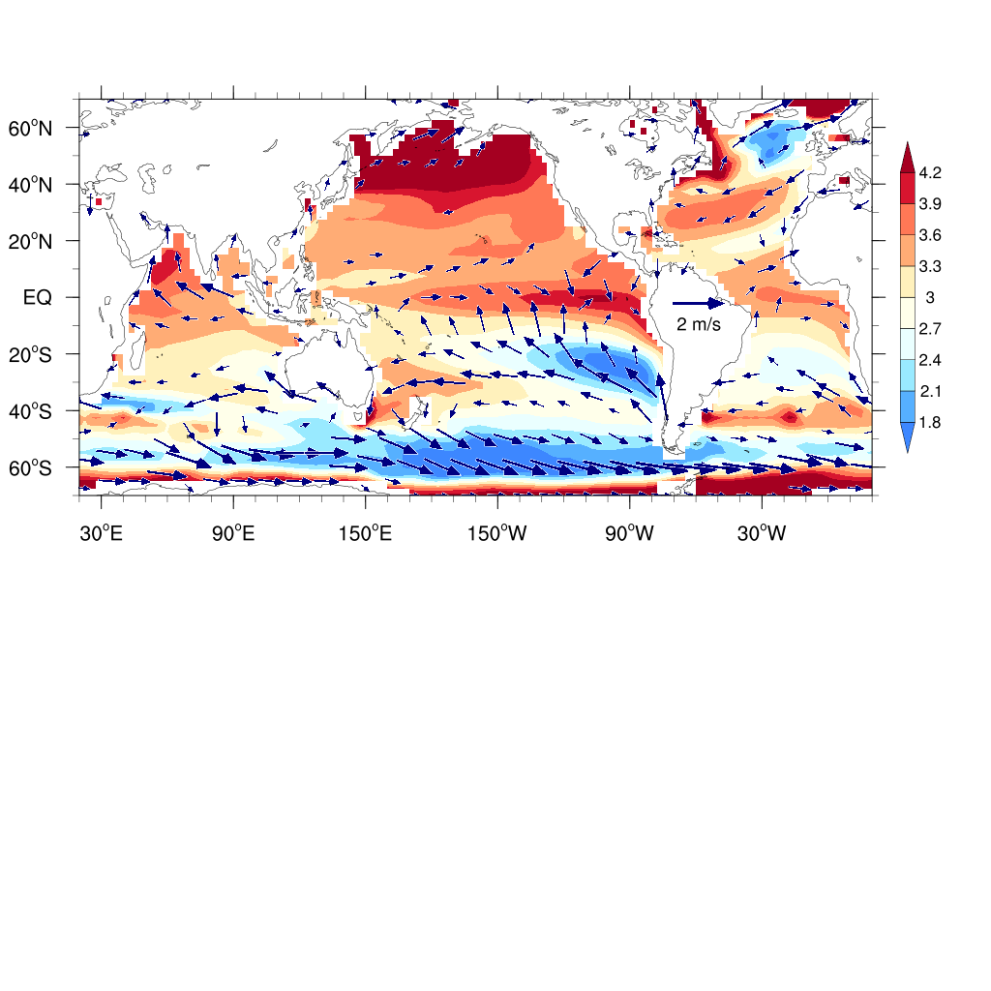
Pattern Dynamics: Ocean-Atmosphere coupling
Fig. 14.4. SST (ºC) and surface wind (m/s) change in the 1%CO2 run at year 140 (the time of 4xCO2), based on 31 CMIP6 model ensemble mean. (left inset) Zonal-mean SST change with the mean latent heat flux (W/m²).
Notes:
Accelerated SE trades in Pacific opposes the southern Hadley cell from decelerating.
Reduced warming over Southern Ocean and N Atlantic -> Hot spots of ocean heat uptake.

Slide 18
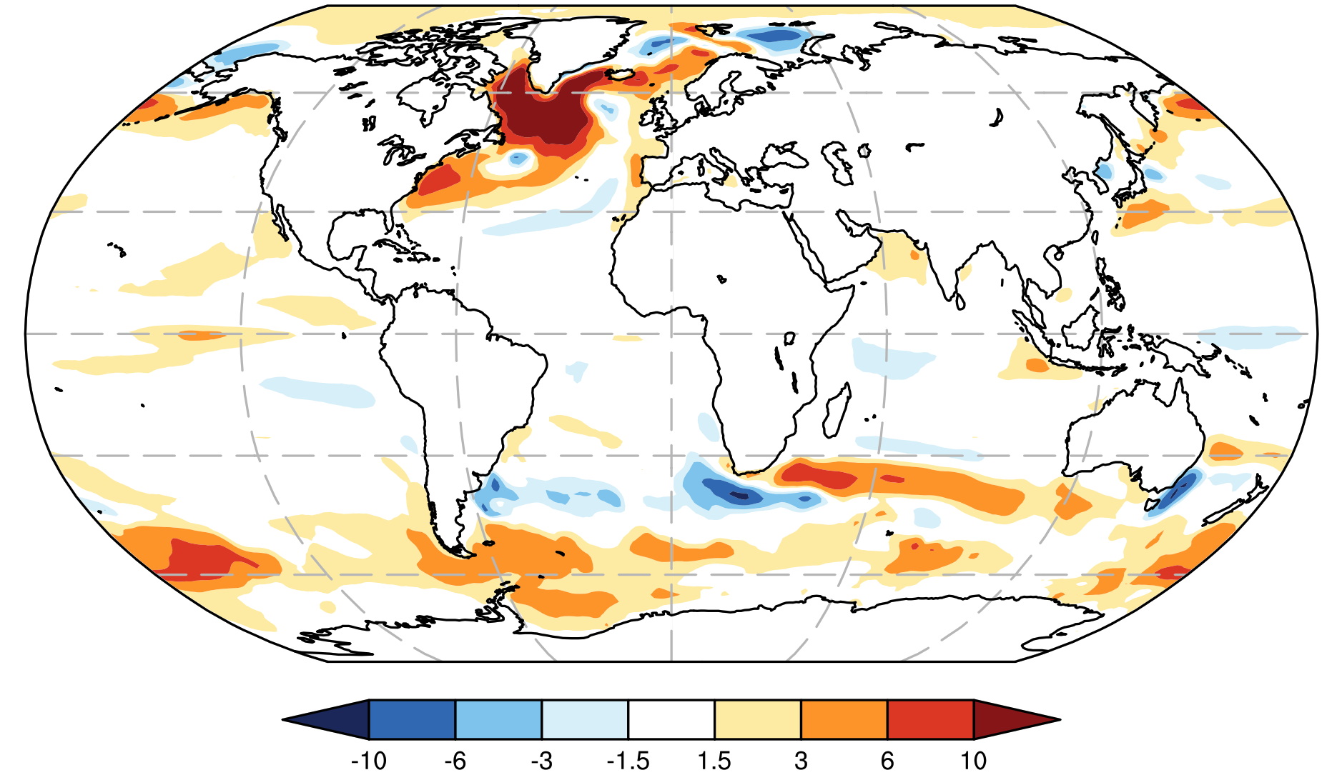
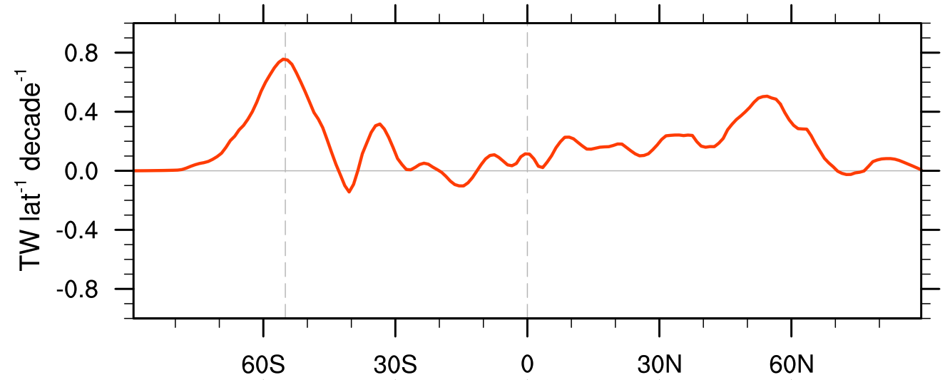
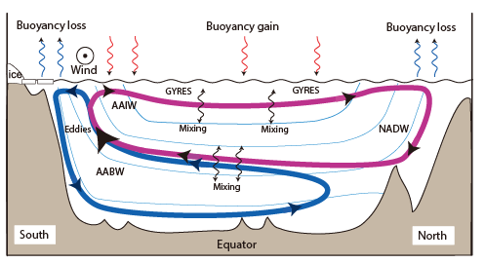
Ocean heat uptake
Surface heat flux due to greenhouse gas increase (1861-2005)
CMIP5 ensemble mean
AMOC slowdown
Zonal-integrated sfc heat uptake
Southern Ocean upwelling
Fig. 14.12. 1861-2005 trend in net surface heat flux (color shading in 10⁻¹ W m⁻² decade⁻¹). Positive downward into the ocean (J. Shi et al. 2018, J Clim).
Notes:
Figs. O1, 3, 5, 6, by Jiarui Shi, Nov 20, 2020

Slide 19
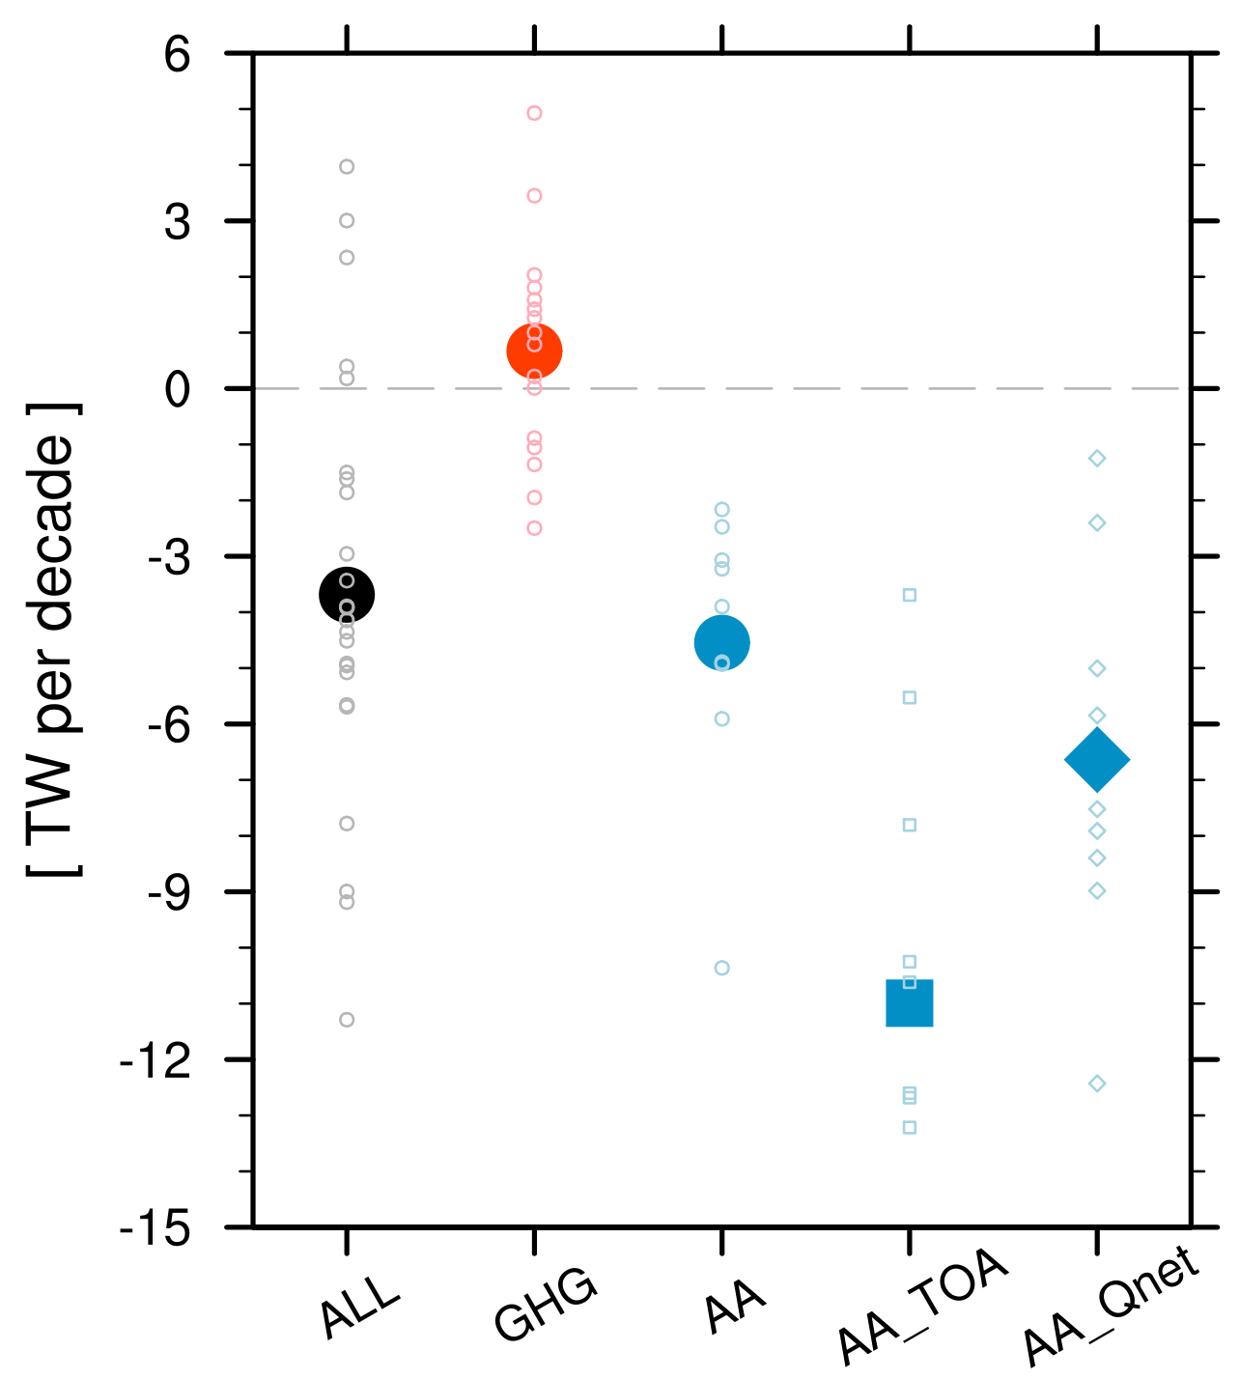

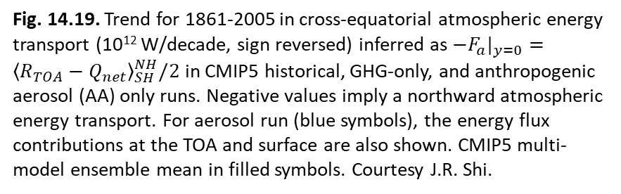
$−F_{a}$ at eq
TOA
Qnet
Ocean energy transport as a break on NH-SH energy asymmetry at TOA
Fig. 14.19. Trend for 1861-2005 in cross-equatorial atmospheric energy transport (10¹² W/decade, sign reversed) inferred as $−F_{a}|_{y=0}={\left\langle R_{TOA}−Q_{net}\right\rangle }_{SH}^{NH}/2$ in CMIP5 historical, GHG-only, and anthropogenic aerosol (AA) only runs. Negative values imply a northward atmospheric energy transport. For aerosol run (blue symbols), the energy flux contributions at the TOA and surface are also shown. CMIP5 multi-model ensemble mean in filled symbols. Courtesy J.R. Shi.

Slide 20
Radiative forcing
Coupled feedback:
Bjerknes, WES, cloud …
Modes of
climate variability (ENSO…)
Patterns of
climate change
Pattern Dynamics
Extreme events
Impacts
Fig. 14.22. Schematic of physical and conceptual connections between climate variability and change. They share common pattern dynamics due to coupled ocean-atmospheric feedbacks. These feedbacks manifest in unforced climate variability, offering insights into dynamic processes important for regional climate change. Climate variability drives, and climate change exacerbates, extreme events of large societal impact.

Slide 21
Summary
CO2 rose by 50% and GMST by 1.3ºC above pre-industrial, warming pattern distinct from internal variability but similar to model simulations
Climate projections based on radiative forcing, future scenarios
7 vs. 2 %/K rate for water vapor/global precip change → slowdown of overturning circulations
Precip change is highly variable in space, increasing in some regions and decreasing in some others
Wet get wetter; warmer get wetter, SST pattern effect, change in SST threshold for convection, relative SST
SST patterns are key to changes in atmospheric circulation and regional climate.
Robust thermodynamic effect, dynamic/circulation effect on rainfall change (that dominates regional uncertainty)
SST pattern dynamics: WES feedback, energy theory … (common to internal variability)
Upward intensification of tropical warming → increased dry static stability → poleward shift of storm track & Hadley dry zone expansion.
Ocean heat uptake large in the Southern Ocean and N Atlantic

Slide 22
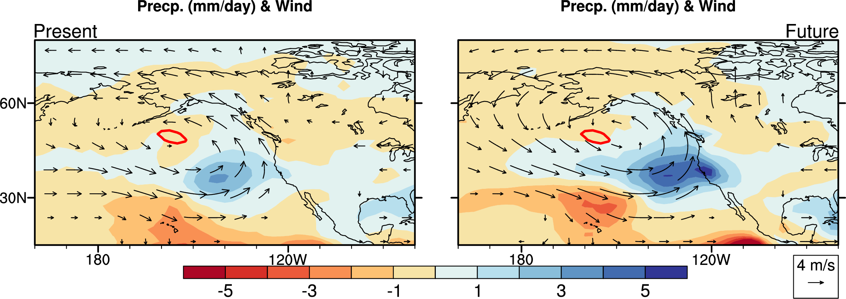
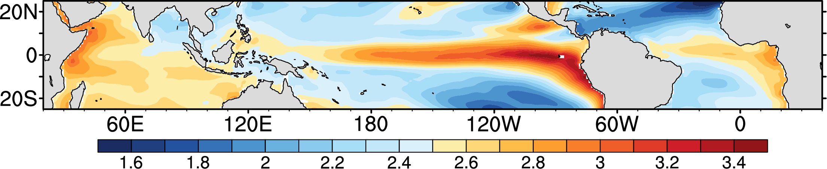
Increased rainfall & storminess in El Nino winter on U.S. west coast in warmer climate.
Intensified ocean warming in eastern Pacific
Z. Zhou et al. (2014, JC)

Slide 23
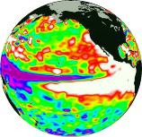

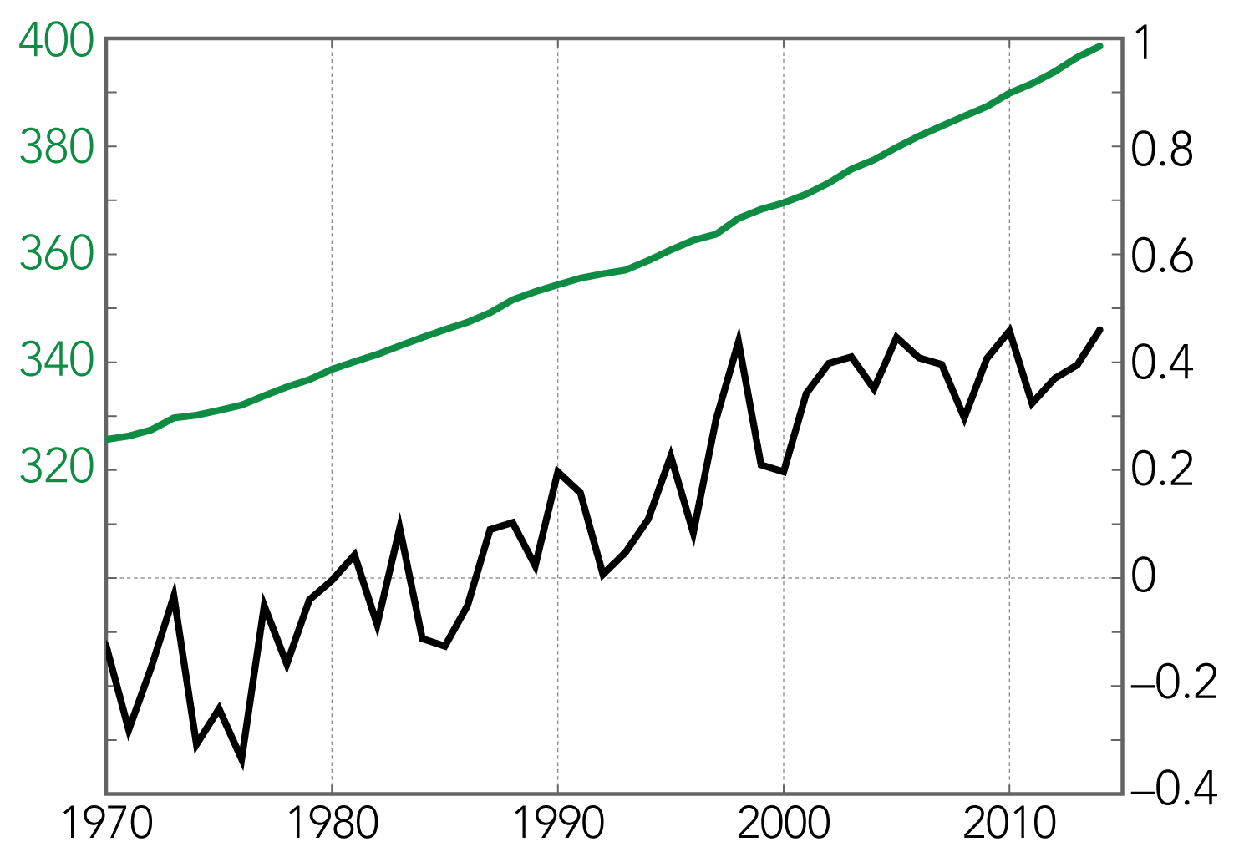
O-A interaction:
Patterns of variability
Global energy balance:
Radiative forcing, climate feedback, ocean heat uptake
ENSO
Global warming
CO₂
1998
2013
GMST
Variable warming rate

Slide 24
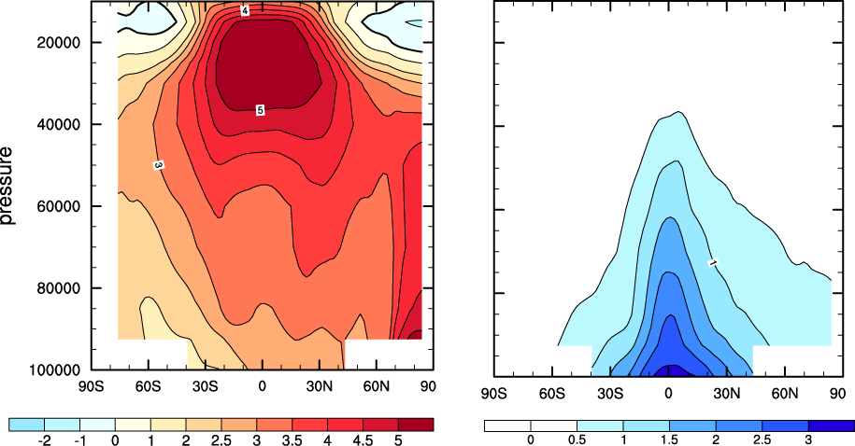
What determines rainfall change?
The wet gets wetter
(e.g., Neelin et al. 2003; Held & Soden 2006)
Precipitation increases in equatorial rain bands; decreases in subtropics; and increases in high-latitudes due to increase in moisture transport
200
Pressure
1000
Zonal-mean change in specific humidity
δq [g/kg]
Notes:
24

Slide 25
The warmer-get-wetter (Xie et al. 2010, JC)
The wet-get-wetter pattern is realized in atmospheric response to a uniform SST warming.
What happens in coupled model with patterned warming?
Coupled model: change in SST (contour) and precipitation
2K uniform SST warming: mean (contour) and change of precipitation
→ Wet-get-wetter pattern
Notes:
Put o-a interaction dynamics on the center stage
25

Slide 26
SST change in CM2.1
Pattern 1: Equatorial peak is due to weak evaporative damping (Knutson & Manabe 1995; Liu et al. 2005).
Q_{E}/100
SST
Evaporative damping (α: CC rate)
Zonal mean
Dynamic thermostat
Notes:
Fig. 11. SST & sfc wind change
26

Slide 27
Pattern: Cross-equatorial asymmetry (Xie et al. 2010, JC)
Weakened trades & enhanced warming in NH;
Intensified trades & reduced warming in SH.
Wind-evaporation-SST (WES) feedback
SST (color), wind speed (white contour: 0.1 m/s)
Tropical asymmetry
Muted Southern Ocean warming (due to upwelling of deep water)
Ocean-atmospheric coupling
Notes:
27

Slide 28
Summary
Tropical rainfall change follows ocean warming pattern.
Atmospheric circulation is the largest uncertainty in rainfall projection and coupled with ocean warming pattern.
Water vapor increases, following the Clausius-Clapeyron (CC) equation (6-7 %/K).
Global precip increases at a much slower rate than CC, at 2-3 %/K → slow down of the Walker circulation;
Inter-model uncertainty in ENSO amplitude change is closely related to that in mean state relative warming.
The response of tropical convection and PNA pattern intensifies under global warming.

