Slide 1
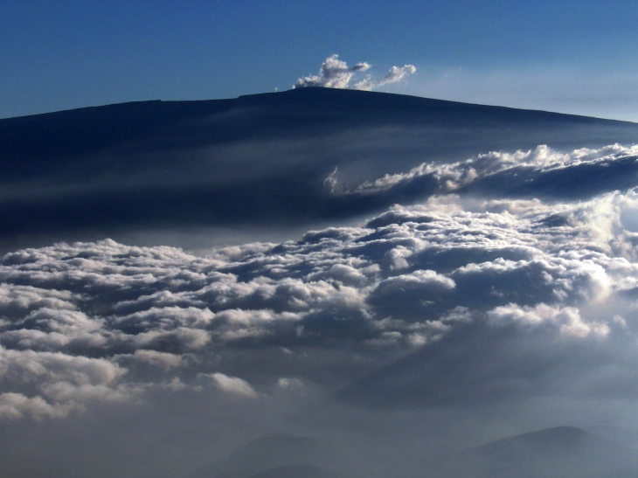
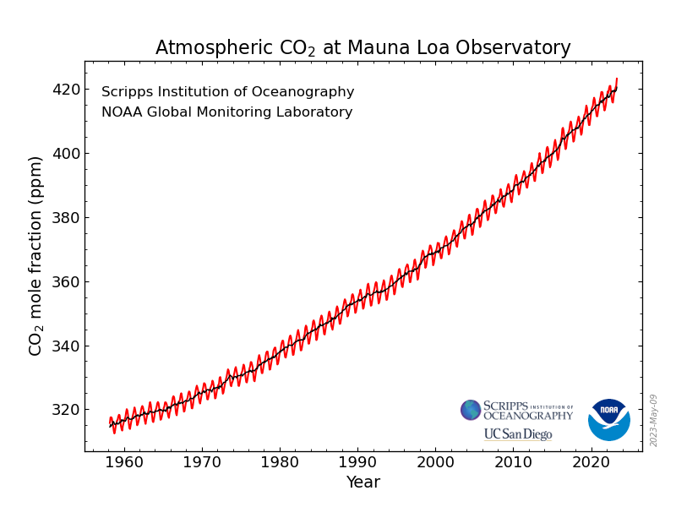
Anthropogenic climate change
Pre-industrial ~ 280 ppm
steephill.tv
Notes:
Scripps started the world’s first long-term continuous measurements of atmospheric CO2. Last month, Mauna Loa recorded the first daily mean CO2 reading that exceeds 400 ppm.

Slide 2
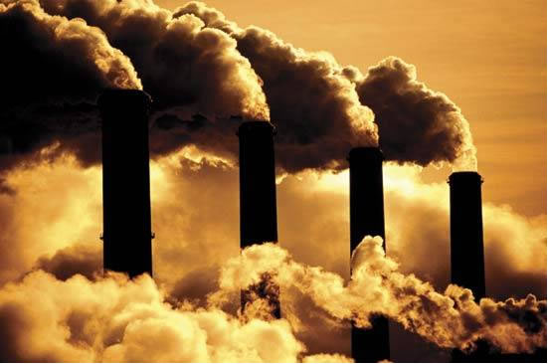
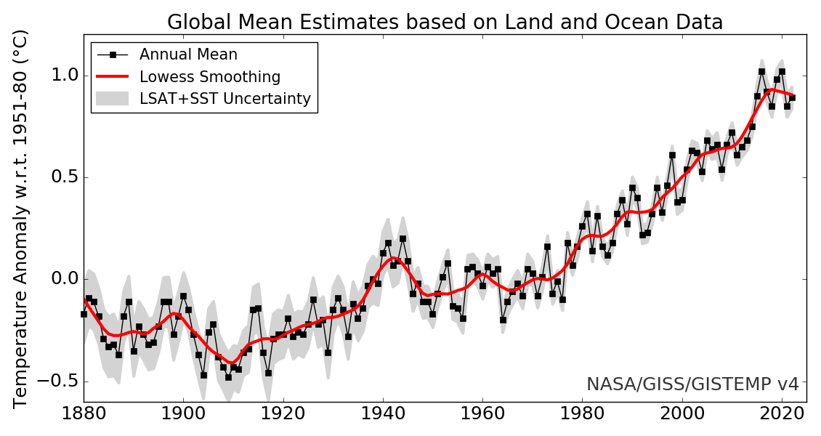
Greenhouse warming
13.1 Climate Feedback Analysis, X23
What caused the temperature rise?
How do we know?
Warmest 7 years all happened in the previous 7.
Over the past century
ΔCO2=140 ppm or 50% of pre-industrial level
ΔT=1.3 K

Slide 3
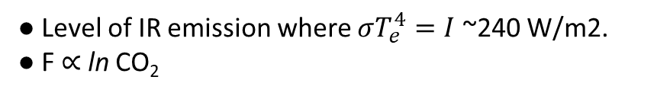
Radiative forcing (F): TOA downward radiation when CO2 is added before atmospheric adjustment.
F
ΔCO2
↓
Higher level of emission
↓
Reduced emission temp
↓
Reduced OLR→ F=ΔR>0
10
Level of emission
Height (km)
5
Moist adiabat: Γ_{m}=6.5 K/km
Radiative-convective equilibrium
-50
0
Temperature (ºC)
● Level of IR emission where $σT_{e}^{4}=I$ ~240 W/m2.
● F $∝$ ln CO₂
Fig. 13.2. Atmospheric temperature profile in the present climate (blue). The black dot indicates the level where outgoing longwave radiation (OLR) originates. By making the atmosphere more opaque to infrared radiation (IR), increased CO2 concentration lifts the level of IR emission (red dot) and reduces the emission temperature. The reduced OLR is called radiative forcing.

Slide 4

Radiative forcing (F) and climate response (ΔTs)
F
σ($\overline{T}$s+ΔTs)⁴
ΔCO2
↓
Higher level of emission
↓
Reduced emission temp
↓
Reduced OLR→ F=ΔR>0
↓
Tropospheric warming ΔT to restore TAO radiative balance.
10
Levels of OLR
Height (km)
5
Moist adiabat: Γ_{m}=6.5 K/km
Radiative-convective equilibrium
-50
0
ΔTs
Temperature (ºC)
For CO2 doubling (with fixed T),
ΔZ_{E}~150 m
F~ 3.7 W/m² reduction in OLR.
Fig. 13.2. Atmospheric temperature profiles in the present climate (blue) and in equilibrium with increased CO2 concentration (red). The dot indicates the level where outgoing longwave radiation originates.

Slide 5
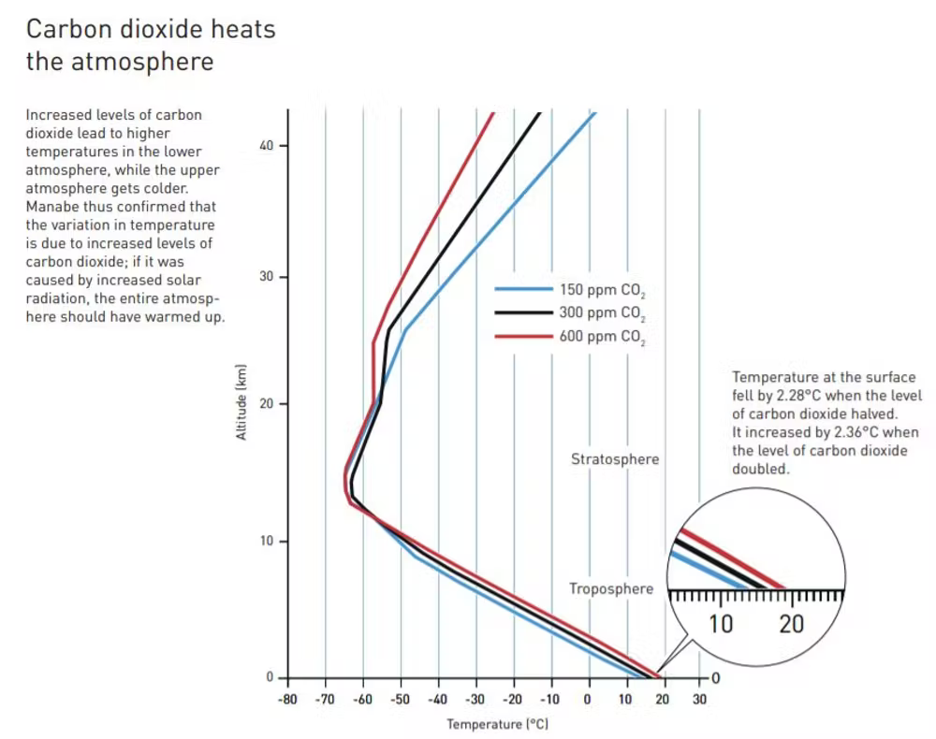
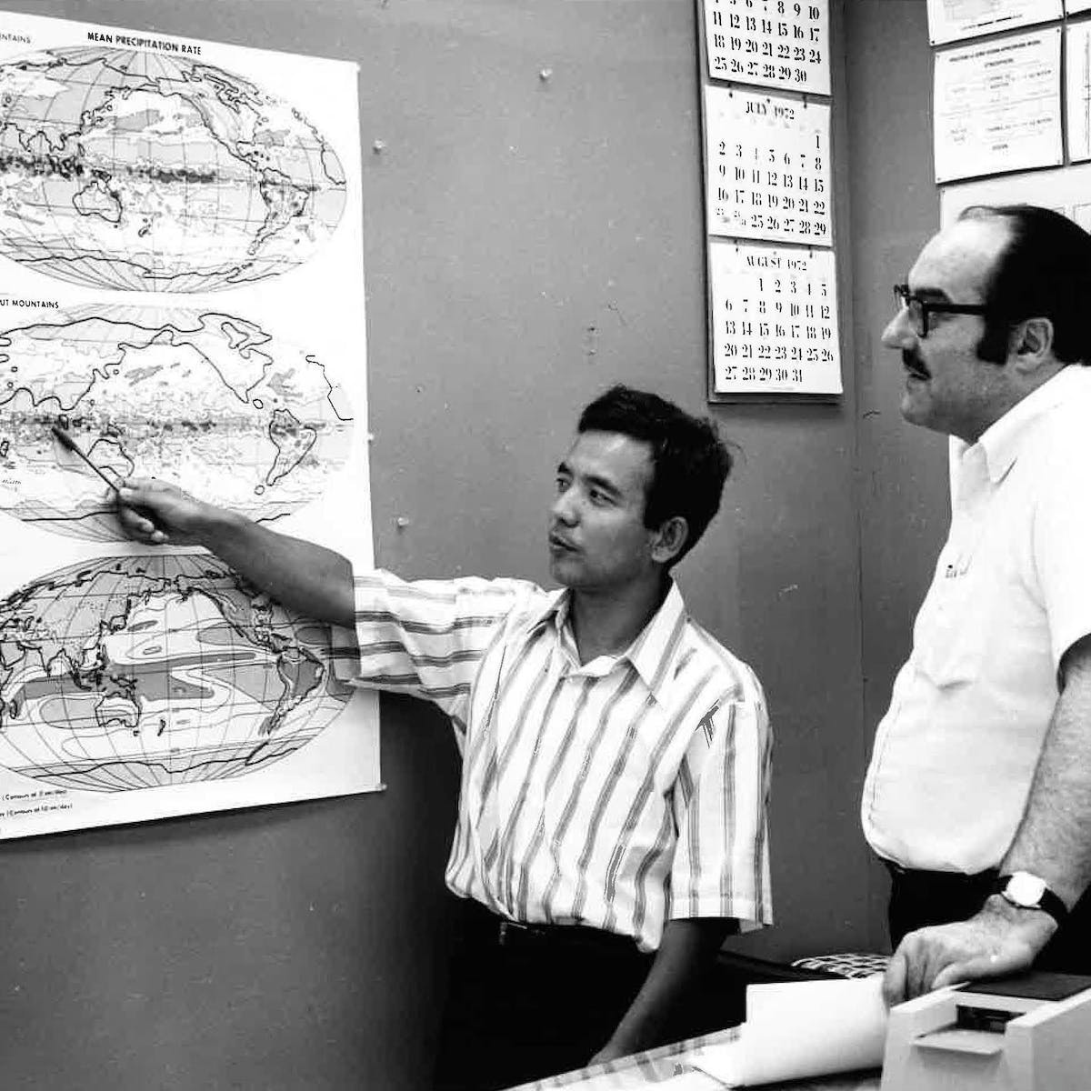
This vertical temperature response won Suki Manabe the Nobel Prize.
2. How do we know climate change is not natural?
Notes:
”Most influential climate change paper of all time.”
Left: Swedish Academy of Sciences, adapeted from Manabe & Wetherald (1967)
Right: https://theconversation.com/the-most-influential-climate-science-paper-of-all-time-169382

Slide 6
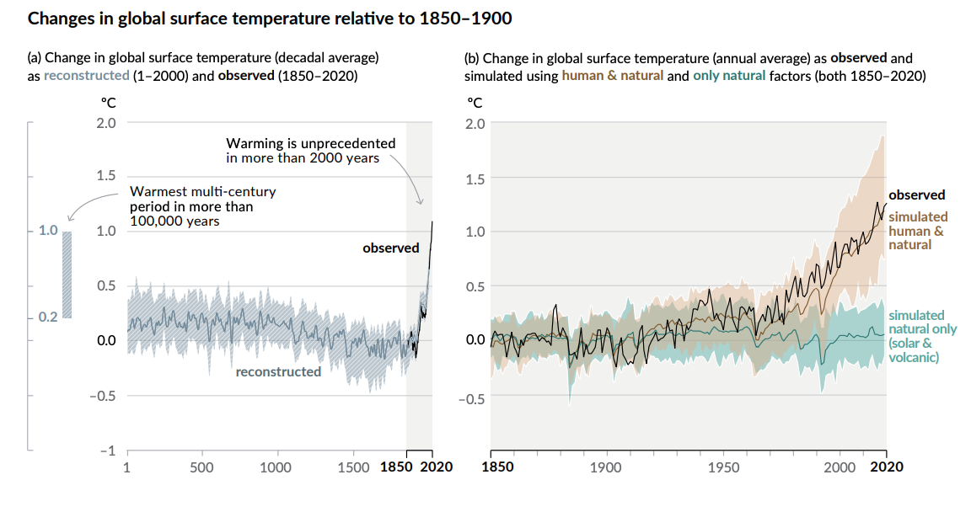
Climate models simulate observed global warming only when anthropogenic factors are included.
→ Volcanic or solar forcing alone cannot explain observations.
2. How do we know climate change is not natural?
IPCC AR6 SPM
Notes:
More comprehensive simulations hammer Manabe’s point home– you cannot explain the observed warming with just solar or volcanic variability.
So what’s the root cause?

Slide 7
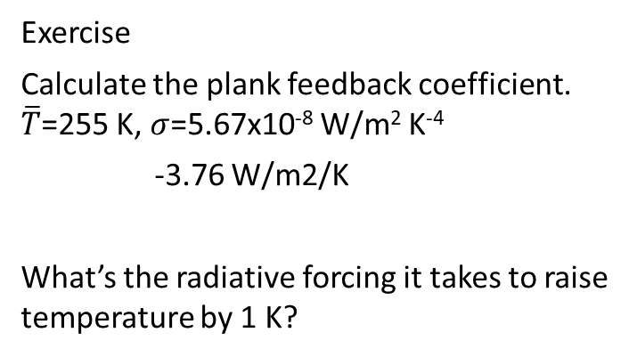
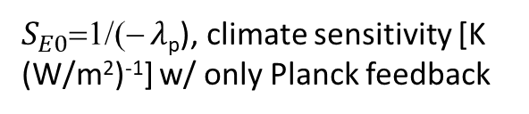

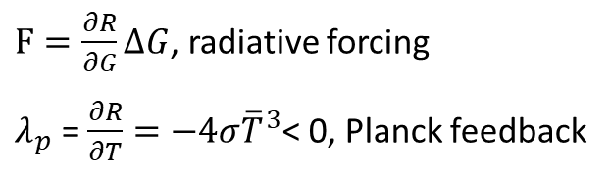

Planck feedback (negative: stabilizing)
Greenhouse gas
Sfc temperature
R=R(G, T), TOA radiation (positive downward)
$$∆R=\frac{∂R}{∂G}∆G+\frac{∂R}{∂T}∆T=0$$
Exercise
Calculate the plank feedback coefficient. $\overline{T}$=255 K, $σ$=5.67x10⁻⁸ W/m² K⁻⁴
-3.76 W/m2/K
What’s the radiative forcing it takes to raise temperature by 1 K?
$F=\frac{∂R}{∂G}∆G$, radiative forcing
$λ_{p}$ = $\frac{∂R}{∂T}=−4σ{\overline{T}}^{3}$< 0, Planck feedback
$$∆T=\frac{F}{−λ_{p}}=S_{E0}F$$
3.76 W/m2
which is about the radiative forcing due to CO2 doubling F~ 3.7 W/m² in OLR.
$S_{E0}$=1/(− $λ$_{p}), climate sensitivity [K (W/m²)⁻¹] w/ only Planck feedback

Slide 8

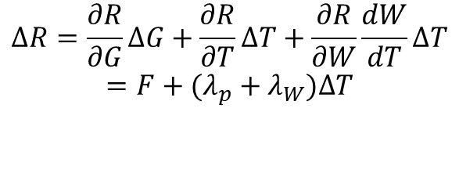
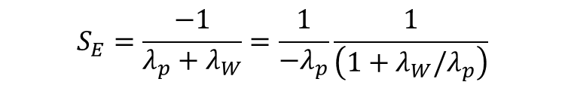
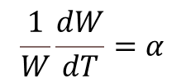
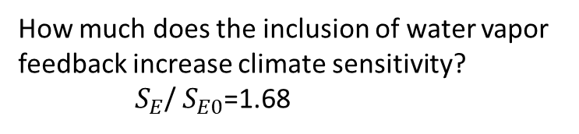

Water vapor feedback (positive: amplifying)
Anthropogenic GHG
Water vapor
Water vapor is a strong greenhouse gas (GHG). Its mixing ratio W(T) is a strong function of temperature (relative humidity change is small), hence a feedback.
Anthropogenic CO2 is GHG independent of temp and an external forcing.
Sfc temperature
R=R(G, T, W), TOA radiation (positive downward)
$$∆R=\frac{∂R}{∂G}∆G+\frac{∂R}{∂T}∆T+\frac{∂R}{∂W}\frac{dW}{dT}∆T$$
$$=F+(λ_{p}+λ_{W})∆T$$
$$S_{E}=\frac{−1}{λ_{p}+λ_{W}}=\frac{1}{{−λ}_{p}}\frac{1}{\left(1+λ_{W}/λ_{p}\right)}$$
$λ_{W}=\frac{∂R}{∂W}\frac{dW}{dT}≈$1.3
$$\frac{1}{W}\frac{dW}{dT}=α$$
$λ_{p}$=-3.2; $λ_{W}$=1.3 W/m² K⁻¹
How much does the inclusion of water vapor feedback increase climate sensitivity?
$S_{E}$/ $S_{E0}$=1.68
Clausius-Clapeyron Eq: 7% increase per 1 K warming
Notes:
SE/SE0=1.68 -> 68% increase

Slide 9




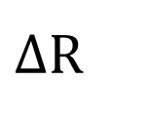
Climate Feedback
F
Energy balance
$∆$R
$$∆W$$
Feedback
Radiative flux
Water vapor is a positive or amplifying feedback

Slide 10
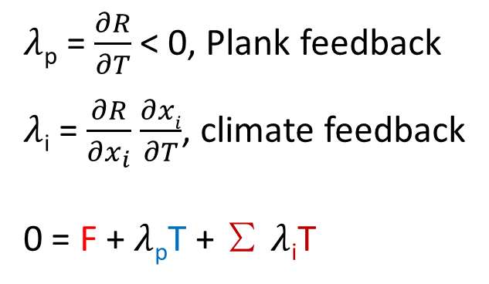
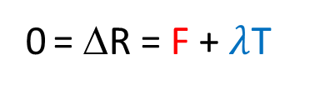
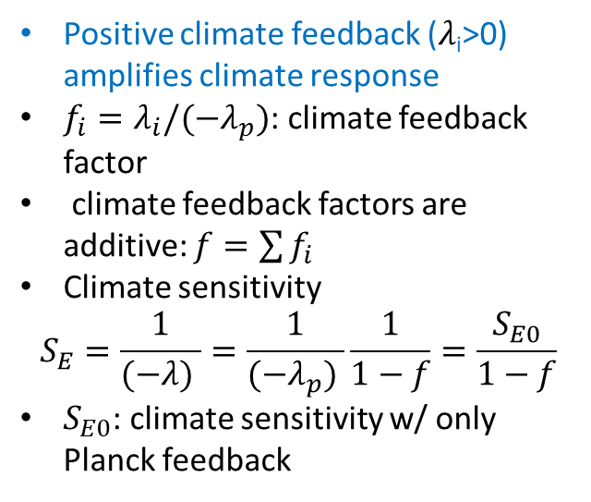
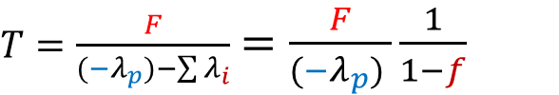

Climate feedback analysis
Radiative forcing
Climate feedback
$T=\frac{F}{{(−λ}_{p})−\sum{λ_{i}}}$ $=\frac{F}{{(−λ}_{p}) }\frac{1}{1−f}$
0 = ΔR = F + $λ$T
R = R(G; T, W, C, A)
Temperature
Ice albedo
Positive climate feedback ($λ$_{i}>0) amplifies climate response
$f_{i}=λ_{i}/{(−λ}_{p})$: climate feedback factor
climate feedback factors are additive: $f=\sum{f_{i}}$
Climate sensitivity
$$S_{E}=\frac{1}{(−λ) }=\frac{1}{{(−λ}_{p}) }\frac{1}{1−f}=\frac{S_{E0}}{1−f}$$
$S_{E0}$: climate sensitivity w/ only Planck feedback
Water vapor
Cloud
$λ$_{p} = $\frac{∂R}{∂T}$ < 0, Plank feedback
$λ$_{i} = $\frac{∂R}{∂x_{i}}$ $\frac{∂xi}{∂T}$, climate feedback
0 = F + $λ$_{p}T + ∑ $λ$_{i}T
$λ$ = $λ$_{p} + ∑ $λ$_{i}

Slide 11
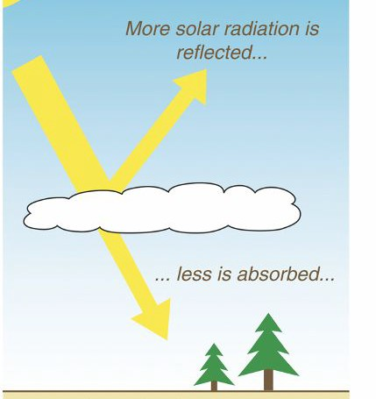
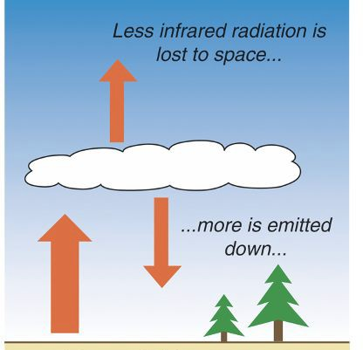
Cloud Feedbacks
Clouds reflect sunlight (shortwave, SW)
cooling effect
Clouds emit longwave (LW) radiation at lower temp
warming effect
Images: Hakim and Patoux, 2018
Cloud radiative effect (CRE) at TOA
Deep cloud: SW+LW~0
Low cloud: negative SW, LW~0.
Low cloud cover tends to decrease in warmer climate → positive feedback
Notes:
In climate feedback research, why do scientists focus on low-cloud response to climate warming?

Slide 12
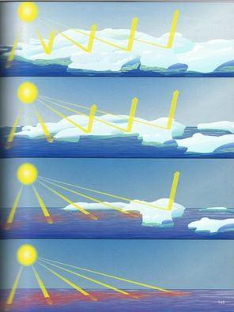
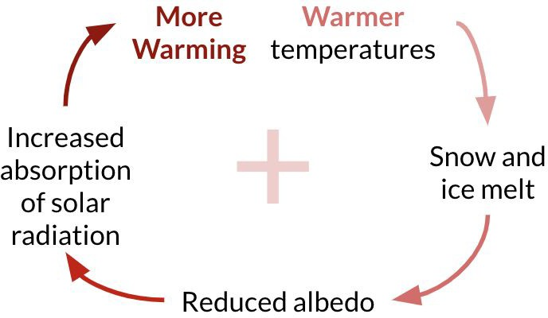
Climate Feedbacks
Surface albedo feedback
This is a positive or destabilising feedback

Slide 13
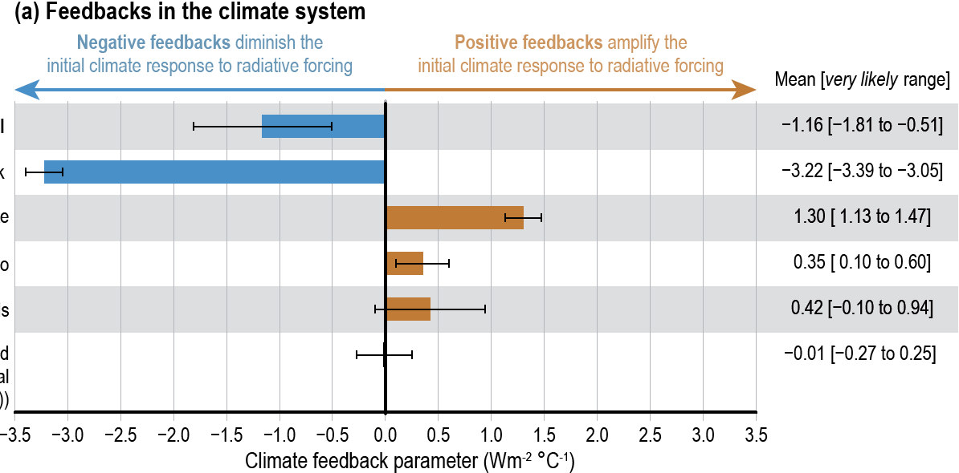
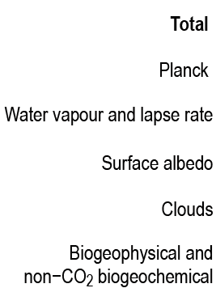



$$N=F+λT$$
$$S_{E}=−\frac{1}{λ}$$
$$λ$$
$λ$_{p}
Figure TS.17 | Physical and biogeochemical feedbacks in the climate system. IPCC AR6

Slide 14
Climate feedback analysis
Radiative forcing F≡(ΔR)_{T} by holding T constant.
Climate feedback λ ≡ dR/dT (additive)
Climate equilibrium N=0
Equilibrium (N=0) climate sensitivity (ECS) S_{E}=F/T=1/(-λ)
Ocean’s role
Large thermal inertia keeps climate off equilibrium → ocean heat uptake = N > 0
Transient climate sensitivity (TCS): S_{T} = S_{E} (F-N)/F = S_{E} (1-N/F) ~ (2/3) S_{E}
N = F + λΤ
λ = λ_{p}+∑λ_{i} ~ -1.2 W/m²/K, compared to λ_{p} = -3.2 W/m/K.

Slide 15

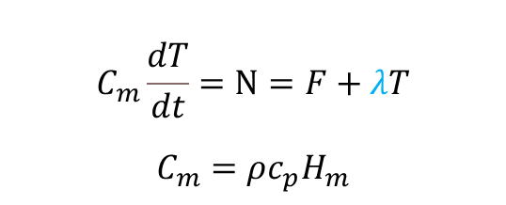
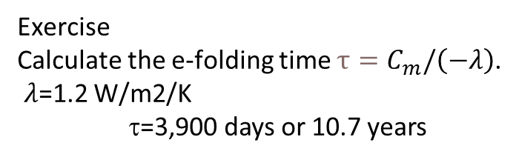
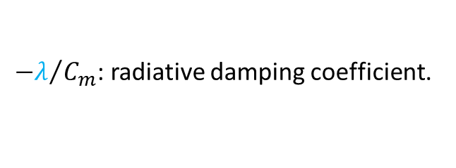

Transient (time-dependent) response of slab ocean mixed layer of depth H_{m} (insolated base)
Ocean takes up >90% of TOA energy flux N
F
λT
H_{m}
$$C_{m}\frac{dT}{dt}=N=F+λT$$
$$C_{m}=ρc_{p}H_{m}$$
H_{d}
${−λ}/{C_{m}}$: radiative damping coefficient.
Exercise
Calculate the e-folding time $τ=C_{m}/\left(−λ\right)$.
$λ$=1.2 W/m2/K
τ=3,900 days or 10.7 years
Slow warming, e.g., 1% per year increase in CO2
$$C_{m}\frac{dT}{dt}≈F+λT$$
$T≈F/\left(−λ\right)$

Slide 16
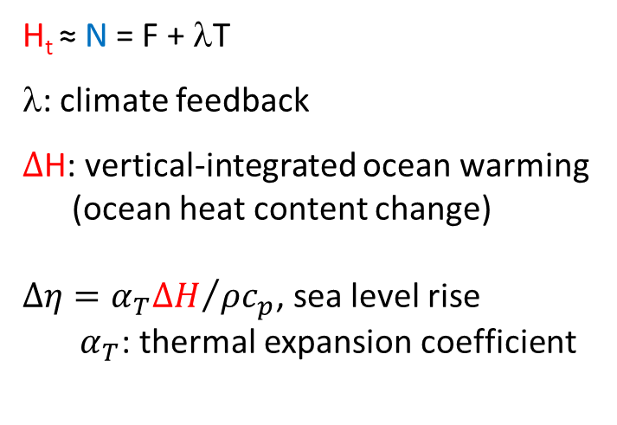
Ocean takes up >90% of TOA energy imbalance
N~F/3 → slow down surface warming
Net TOA flux
F
λT
H_{t} ≈ N = F + λT
λ: climate feedback
$Δ$H: vertical-integrated ocean warming (ocean heat content change)
$Δη={α_{T}ΔH}/{ρc_{p}}$, sea level rise
$α_{T}$: thermal expansion coefficient
H_{m}
ε(T-T_{d})
H_{d}
Fig. 13.3. Two-layer ocean model.
F=2.3, N=0.8 W/m² at 2011 relative to pre-industrial (IPCC AR6)

Slide 17

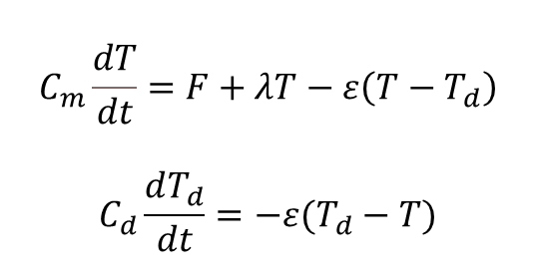
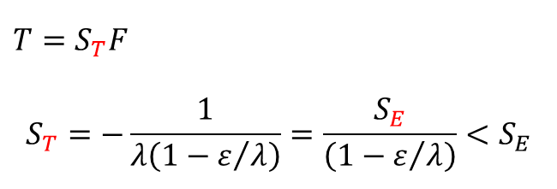
F
λT
Transient (time-dependent) response
H_{m}
$$C_{m}\frac{dT}{dt}=F+λT−ε\left(T−T_{d}\right)$$
$$C_{d}\frac{dT_{d}}{dt}=−ε(T_{d}−T)$$
ε(T-T_{d})
Mixed layer
H_{d}
Deep ocean
Fig. 13.3. Two-layer ocean model.
T_{d}/T~H_{m}/H_{d} <<1
Slow warming, e.g., 1% per year increase in CO2
$$C_{m}\frac{dT}{dt}≈F+\left(λ−ε\right)T$$
$T=S_{T}F$
$$S_{T}=−\frac{1}{λ\left(1−ε/λ\right)}=\frac{S_{E}}{\left(1−ε/λ\right)}<S_{E}$$
Transient climate sensitivity

Slide 18
Exercise
At 2011, the radiative forcing is estimated to be 2.3 W/m2 (IPCC AR6 Table 7.8), and TOA net downward radiative flux is 0.8 W/m2 relative to 1750. Estimate global-mean surface temperature increase from global energy balance
N=F+ λT
Use climate feedback parameter λ=-1.2 W/m2/K. Compare with the observed warming of 1.1 K relative to 1900.

Slide 19
Climate feedback
Water vapor: strong greenhouse gas but dependent on temperature → a positive feedback (unlike anthropogenic CO2)
Cloud feedback: likely positive but with large uncertainty (in changes of low-level cloud extent).
Snow/ice albedo: positive feedback but confined to high latitudes.
Ocean (transient) feedback: slow down the warming but cause sea level rise.
0 = F + λΤ
λ = λ_{p}+∑λ_{i} ~ -1.2 W/m²/K

Slide 20
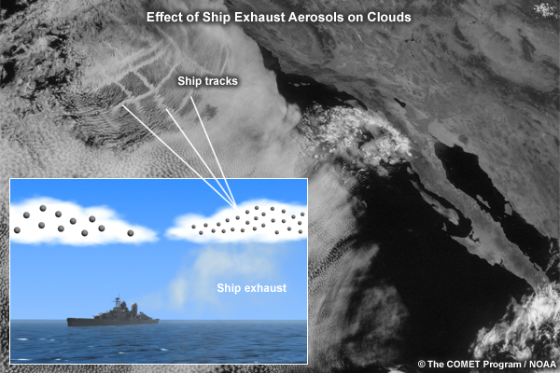
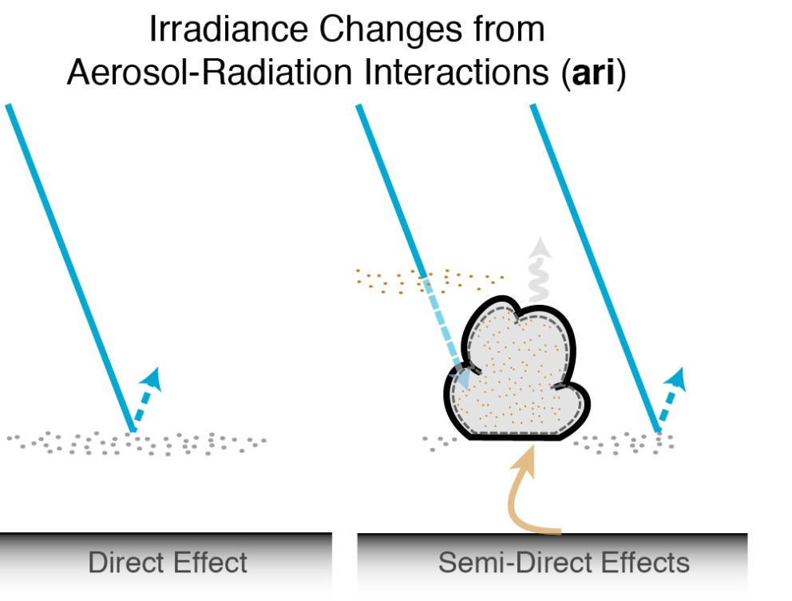
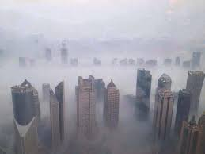
Aerosol effect
Reflect solar radiation
Increase number but decrease size of cloud droplets → more reflective of sunlight
Negative radiative forcing that cools the planet.

Slide 21
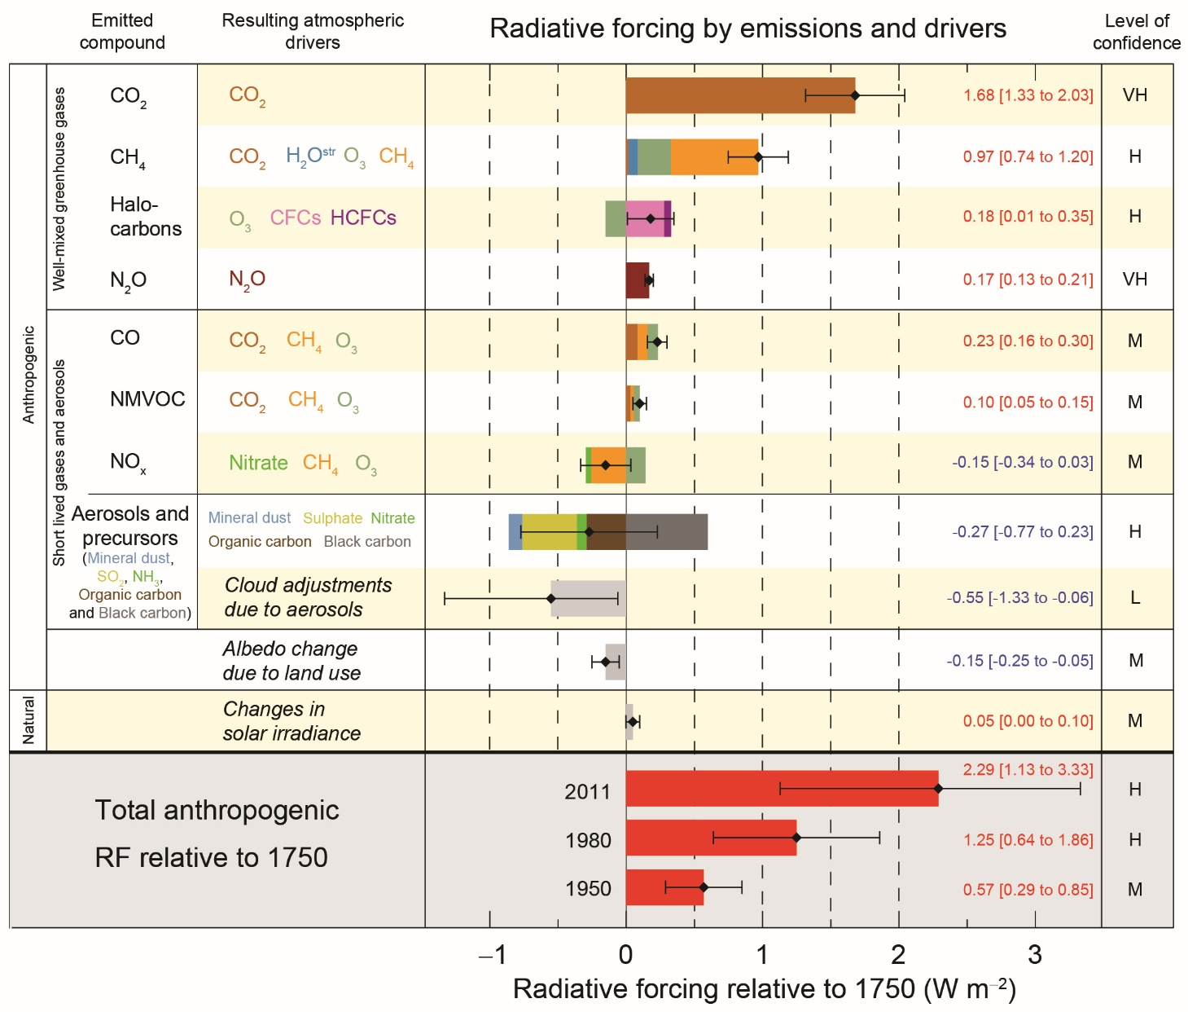
Aerosols remain the largest uncertainty in radiative forcing.
Figure SPM.5: Radiative forcing estimates in 2011 relative to 1750 and aggregated uncertainties for the main drivers of climate change. Values are global average radiative forcing (RF15) partitioned according to the emitted compounds or processes that result in a combination of drivers. The best estimates of the net radiative forcing are shown as black diamonds with corresponding uncertainty intervals; the numerical values are provided on the right of the figure, together with the confidence level in the net forcing (VH – very high, H – high, M – medium, L – low, VL – very low). Albedo forcing due to black carbon on snow and ice is included in the black carbon aerosol bar. Small forcings due to contrails (0.05 W m–2, including contrail induced cirrus), and HFCs, PFCs and SF6 (total 0.03 W m–2) are not shown. Concentration-based RFs for gases can be obtained by summing the like-coloured bars. Volcanic forcing is not included as its episodic nature makes is difficult to compare to other forcing mechanisms. Total anthropogenic radiative forcing is provided for three different years relative to 1750.

Slide 22
Dynamical Prediction: A triumph of science
physical understanding, numerical models, and observing system
Weather prediction (2 weeks): initialize atmosphere & predict individual storms.
Climate prediction (2~3 seasons): initialize ocean; predict El Nino/La Nina → seasonal-mean T, rainfall, storminess.
Climate projection: anthropogenic radiative forcing; predict long-term statistics (T, rainfall, ENSO amplitude).
Forecast ensemble
How can you predict climate decades ahead when you cannot forecast weather 2 weeks from now?
Nino3.4 SST
Obs.
El Nino prediction issued in July 2015

Slide 23
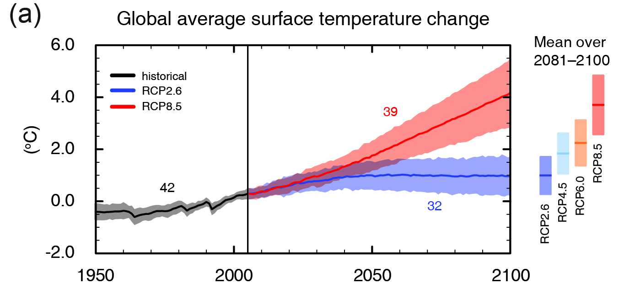
Model projections of
(IPCC 2013, Fig. SPM.7a)
Global surface temperature change for the end of the 21st century is likely to exceed 1.5°C relative to 1850.
We are in control of Earth’s thermostat.

Slide 24
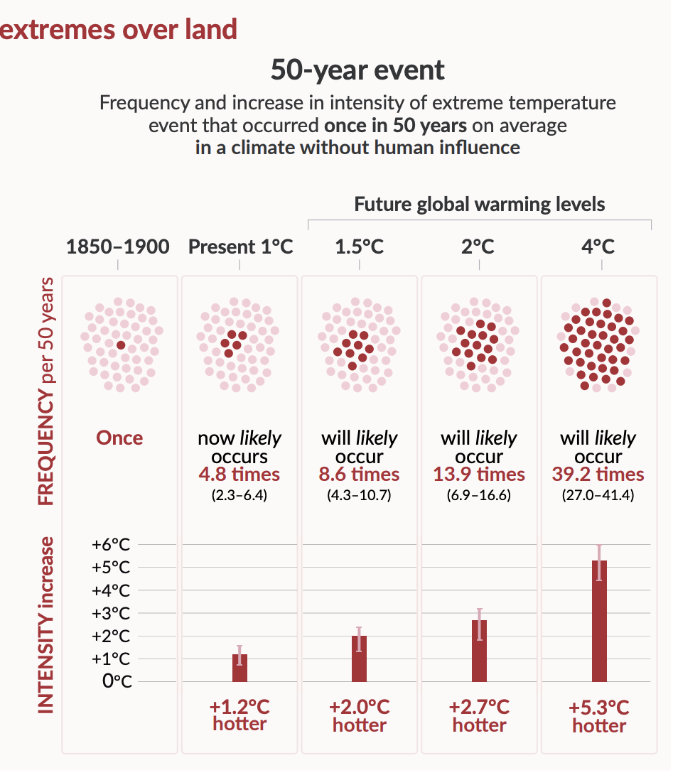
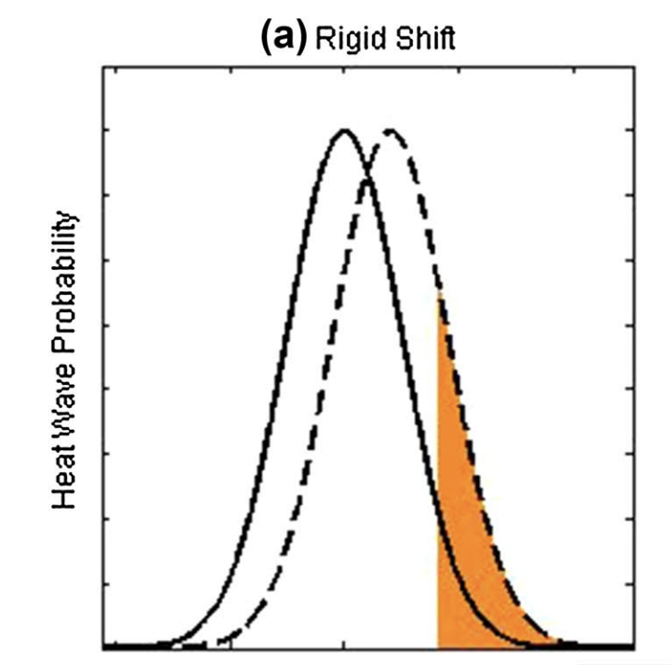
Heat extremes are projected to increase.
Guirguis et al. (2017)
IPCC AR6 SPM

Slide 25
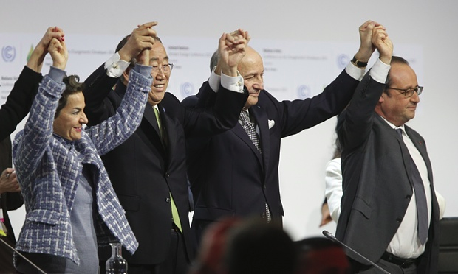
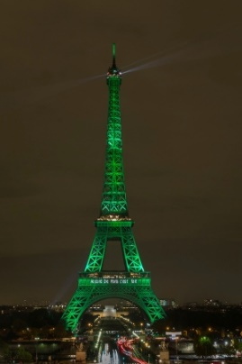

U.N. CLIMATE CHANGE CONFERENCE (COP 21)
December 12, 2015, PARIS
Limiting global temperature increase well below 2ºC, with an aspiration of 1.5ºC (relative to the pre-industrial value);
196 countries commit to nationally determined contributions (NDCs);
Current NDC pledges would give 2.7 to 3ºC warming;
Notes:
Geoffroy Van Der Hasselt/Anadolu Agency/Getty
Green lights illuminate the Eiffel Tower to celebrate the Paris climate agreement.

Slide 26
Summary
Radiative forcing (greenhouse gases, aerosol direct and indirect effects)
Climate feedback (Plank, water vapor, cloud, ice albedo); climate sensitivity
Equilibrium and transient response
How do we know that the 20th century warming is anthropogenically forced?
Historical simulations with & w/o anthropogenic forcing.
Difference in spatial patterns
Energy budget closure, ocean heat uptake, and sea level rise
Sea level budget closure for the satellite era
CO2 feedback on glacier-interglacier cycles
…

Slide 27
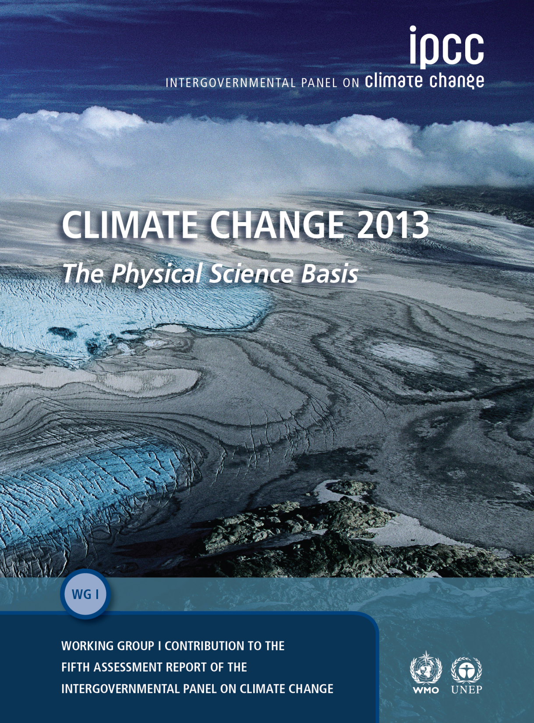
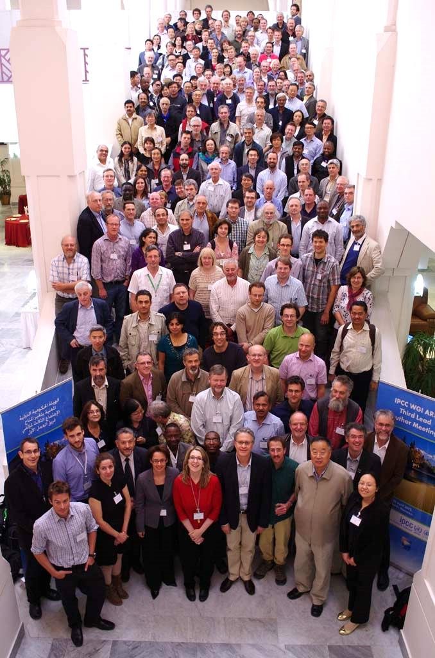

IPCC Fifth Assessment Report (AR5, 2013)
54,677 Review Comments
by 1089 Experts
259 Authors
2007 Nobel Peace Prize

Slide 28
Question
Which of the following do you feel represents the most compelling evidence for anthropogenic warming?
A. Climate model simulations
B. Observed uniform warming unseen in natural variability
C. Ocean warming and planetary energy budget
D. Ocean warming and sea level rise
E. Consensus among climate scientists

Slide 29
Question
Which of the following statement is correct.
Since water vapor has a stronger greenhouse effect, carbon dioxide increase is unimportant for climate.
Without reducing greenhouse gas emissions, GMST is likely to increase further by 3-5ºC by the end of this century.
The collective pledges at the Paris Agreement are enough to keep GMST from increasing by 2ºC relative to pre-industrial.
GMST: global mean surface temperature
GHG: greenhouse gas

