Slide 1
Student presentations: Building on and extending class lectures
Narrow down your focus (just part of a long paper).
Build a story around the focus, with additional material as necessary.
Provide the background and context for fellow students
Highlight novel contributions & surprises.
Connect to the material covered in class (PNA pattern, monsoon, low clouds …).
Step out of the authors’ confines by asking: what are the fundamental drivers/mechanisms?
Student presentations:
12 min talk + 3 min Q&A
Time: 6/2 (F) 1-3:50pm. Place: Eckart 227
Submit
- written summary (1~2 pages), with reference to your paper(s).
- Paper(s) and your talk in PDF

Slide 2
Agenda
Ankitha. Boos, W. R. and Z. Kuang, 2010: Dominant control of the South Asian monsoon by orographic insulation versus plateau heating. Nature, 463, 218-222.
Sourita. Lin W. et al. 2009: Seasonal Variation of the Physical Properties of Marine Boundary Layer Clouds off the California Coast. J Climate, 22, 2624–2638.
Jeep. Ault et al. 2009: Impact of emissions from the LA port region on San Diego air quality during regional transport events. Environ. Sci. Technol., 43, 3500-3506.
Kylie. Wang, M. et al. 2017: Mechanism of seasonal eddy kinetic energy variability in the eastern equatorial Pacific Ocean. J. Geophys. Res. Oceans, 122, 3240– 3252.
Madat. Berg, N., A. Hall, S. B. Capps, M. Hughes. (2013) El Niño-Southern Oscillation impacts on winter winds over Southern California. Climate Dynamics 40, 109-121.
Laney. Cayan, D., et al., 1999: ENSO and Hydrologic Extremes in the Western United States. J. Climate, 12, 2881-.
Ben. Deser et al. 2012: Communication of the role of natural variability in future North American climate. Nat. Clim. Change, 2, 775-779.
Brandon. Zhou, C., Zelinka, M. D., and Klein, S. A. (2017), Analyzing the dependence of global cloud feedback on the spatial pattern of sea surface temperature change with a Green's function approach, J. Adv. Model. Earth Syst., 9, 2174– 2189.

Slide 3
Class topics
1. Introduction & radiative imbalance
2. Zonal-mean (Hadley) circulation
3. Convection and hydrological cycle
4. Planetary-scale circulation & equatorial waves
5. Madden-Julian Oscillation
6. Monsoons
7. Subtropical high and trade wind climate
8. Equatorial oceanography
9. Coupled feedback and tropical climate
10. El Nino/Southern Oscillation
11. ENSO cycle, predictability and teleconnections
12. Atlantic variability, large-scale control of tropical cyclones
13. Indian Ocean & monsoon variability
14. Extratropical ocean-atmospheric variability
15. Extratropical modulations of tropical climate
16. Climate change: Hydrological cycle and SST pattern
Atmos dynamics
Coupled dynamics

Slide 4
100
200
100
60
Z20 (m)
Basin size, mean h, & seasonality
Comparison of tropical oceans
Pacific & Atlantic: similar in annual mean (N displaced ITCZ), and annual cycle (eq. cold tongue); much more pronounced Nino mode in the bigger Pacific basin (higher Bjerknes instability).
Atlantic & Indian: similar in basin size
Atlantic: N displaced ITCZ → eq. annual cycle in u induced by cross-eq. momentum advection; prevailing easterlies → frequent Nino occurrence
Indian: monsoons → semi-annual cycle in u by cross-eq. momentum advection; weak zonal wind → infrequent IOD occurrence

Slide 5
Z20
100
200
100
60
Basin size, mean h, & seasonality
SST Std Dev
> 0.6
> 1.0

Slide 6
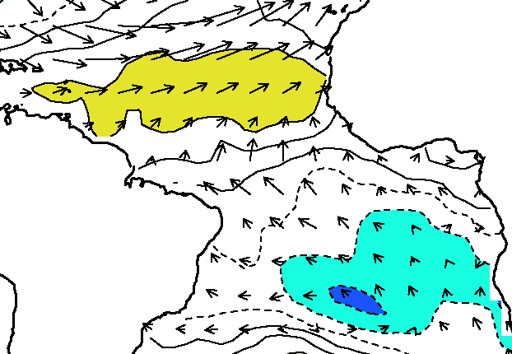
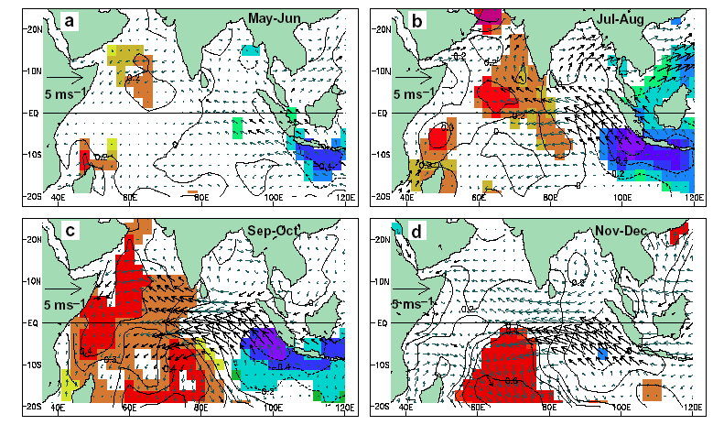
PMM
IPOC
IPOC
AMM
IOD
ENSO
AZM
Zoo of climate modes
Bjerknes feedback
El Nino/Southern Oscillation (ENSO)
Atlantic zonal mode (AZM)
Indian Ocean dipole (IOD)
Eq. upwelling, shallow thermocline
WES feedback
Cross-equatorial: AMM (FMA season, symmetric mean state)
Generalized: PMM (inducing ENSO), IPOC
Off-equatorial downwelling, aided by low-cloud feedback
Notes:
A zoo of climate modes arising from coupled ocean-atmospheric feedbacks: Anomalies of sea surface temperature (SST; color shading/line contours) and surface wind velocity (vectors) in tropical oceans. (We can replace the background with a simple, blank world map of 40S-40N.)

Slide 7
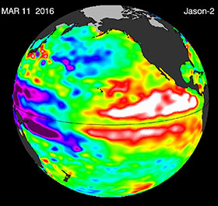
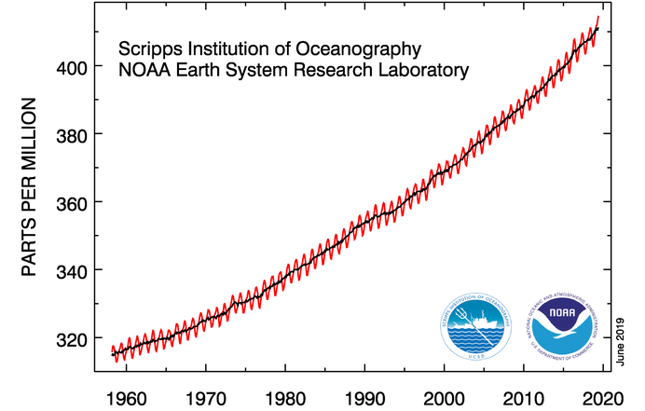
 | Target | Not predictable | Source of predictability | Max lead
Weather forecast | Rainstorms, Santa Ana wind, TC landfall | Rainfall amount tomorrow 10pm | Atmospheric initial condition | 2 weeks
Climate prediction | ENSO phase, seasonal mean temp, precip & storminess | Sunny or rainy in 3 months (e.g., on 4th July) | Ocean initial condition, h(x, y) | 1 year
Climate projection | GMST, ENSO intensity | ENSO phase in 2059 winter | Radiative forcing (CO2…) | decades
Gap: 3-4 weeks
Gap: 1-10 yrs
CO2
Sea surface height
Notes:
3-4 week predictability gap is not real as SST is highly persistent.

Slide 8

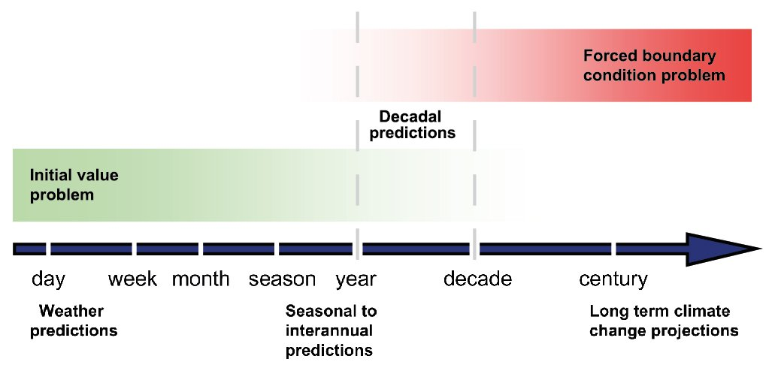
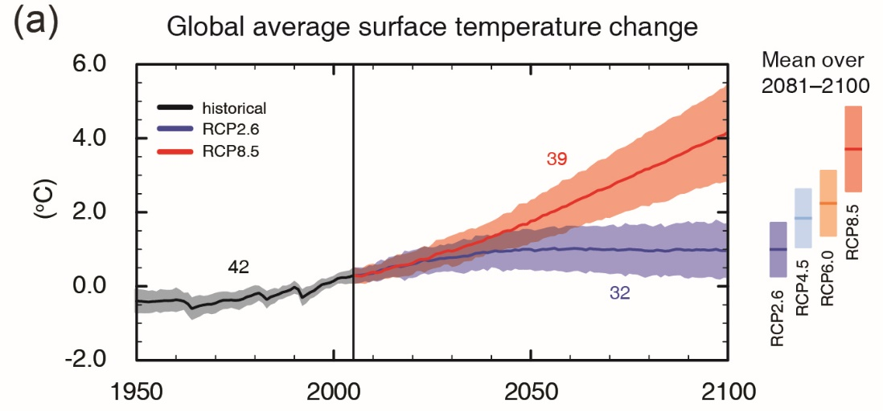

Dynamical Prediction
Atmos. initial condition (IC) → storms
Ocean IC
→ ENSO
CO2 emissions
→ global warming
gap
gap
Nino34. SST anomalies
Obs.
Forecast issued in July 2015
Notes:
Fig. 2 (Box 11.1) in AR5-WG1. https://www.ipcc.ch/site/assets/uploads/2018/02/FigBox11.1-2-1.jpg

Slide 9
Radiative forcing
Coupled feedback:
Bjerknes, WES, cloud …
Modes of
climate variability (ENSO…)
Patterns of
climate change
Pattern Dynamics
Extreme events
Impacts
Fig. 14.22. Schematic of physical and conceptual connections between climate variability and change. They share common pattern dynamics due to coupled ocean-atmospheric feedbacks. These feedbacks manifest in unforced climate variability, offering insights into dynamic processes important for regional climate change. Climate variability drives, and climate change exacerbates, extreme events of large societal impact.

Slide 10
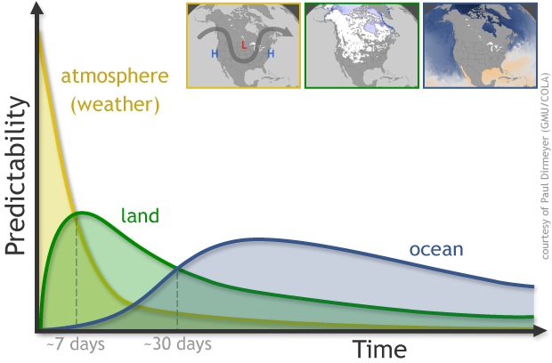
Coupled ocean-atmosphere feedback is an important source of seasonal predictability
Mixing weather and climate predictability in soil and ocean

Slide 11
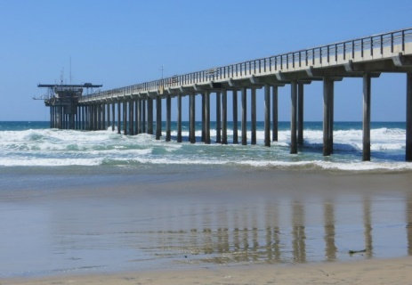
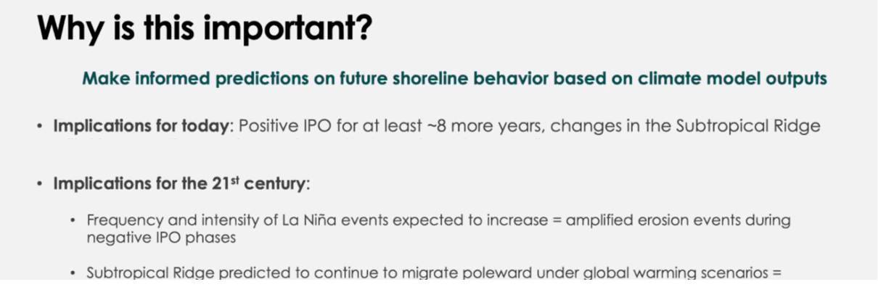
Coupled OA dynamics guiding data analytics
Not all the modes are equal;
A label does not mean predictability.
Correlate beach morphological variations with
El Nino/Southern Oscillation (ENSO),
Interdecadal Pacific Oscillation (IPO),
Annular Mode…
Is IPO predictable? Why?
Is the projection robust & reliable? Why?

Slide 12
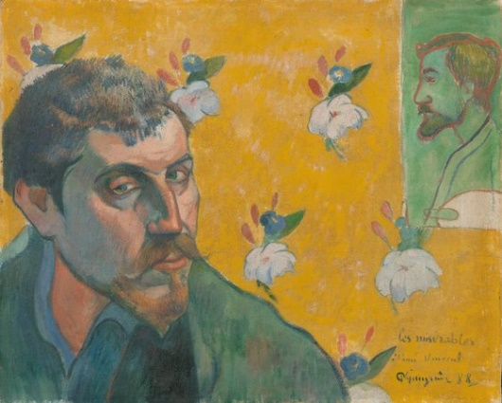
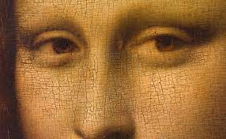
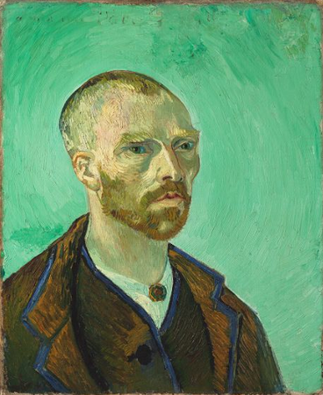
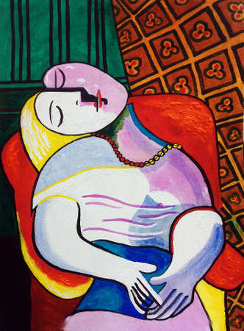
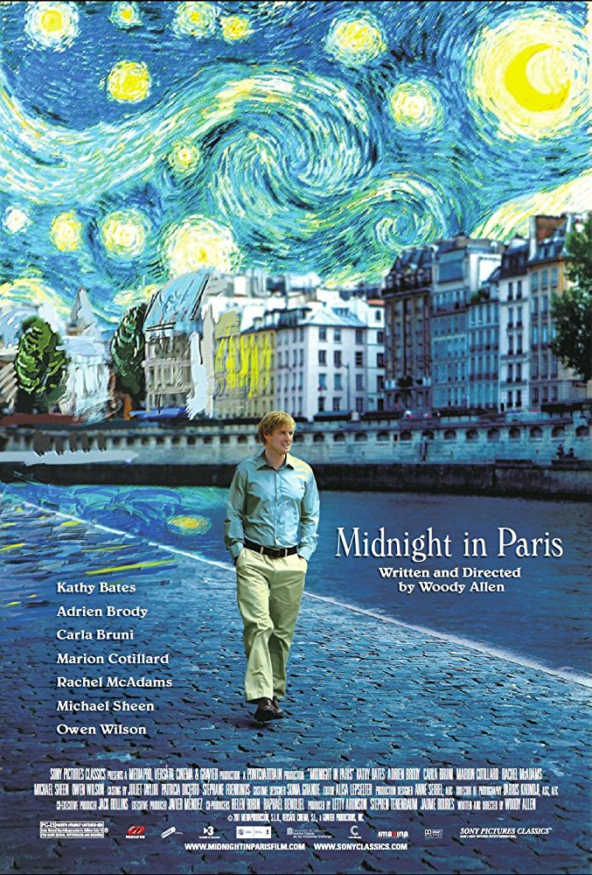
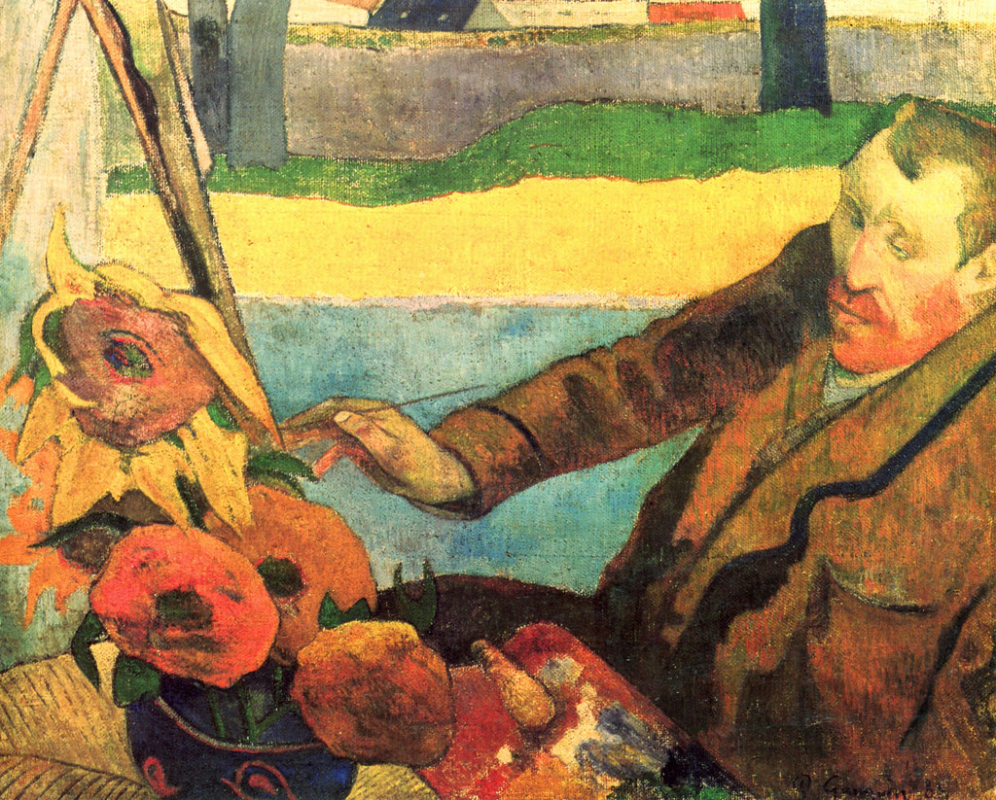
Vincent van Gogh, Self-Portrait Dedicated to Gauguin, 1888
Paul Gauguin, Self-Portrait Dedicated to van Gogh, 1888
Best era?
Portrait of Vincent van Gogh, sunflowers painting; by Paul Gauguin (1888)
Notes:
Does the field have a future? What are the most important problems?
2011 movie ($17 M costs, 154 M box office). Gil asks what they believe the best era was, and the three agree it is the Renaissance. Gauguin had strong influence on Picasso & Matisse.

Slide 13
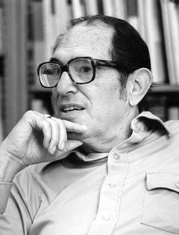
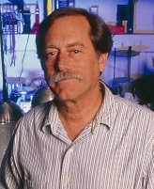
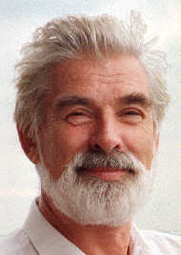
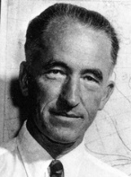
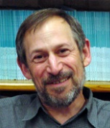
Weather forecast
NorPac
Namias
Ocean integrating atmos noise w/o feedback
Davis; Hasselmann (1976)
X
PNA
PMM
SST effect in N or Eq Pacific?
Equatorial waves in stratosphere (Matsuno 1966)
Bjerknes FB
Ocean waves
1969, 75, 84
Seasonal forecast
Cane (1986)
QG
X
Eq Undercurrent
Trans-Pacific TAO array
Zoo of coupled modes

Slide 14
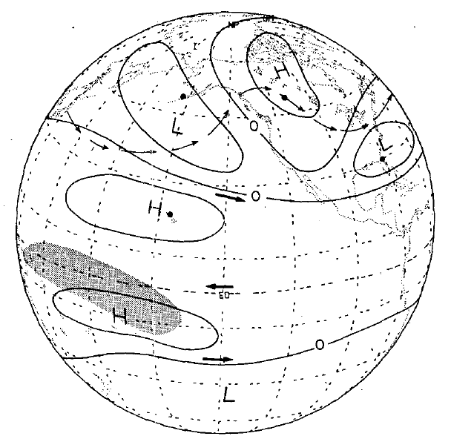

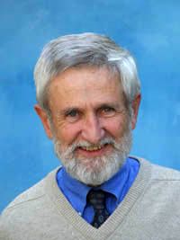
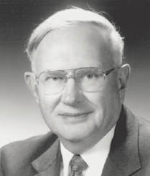

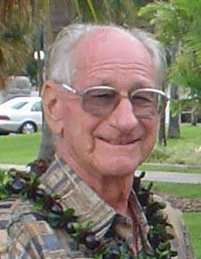
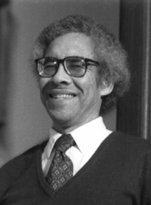

Integrate atmos-ocean dynamics: El Nino-Southern Oscillation
Few people live in eq. Pacific so why care?
Mike Wallace
Gene Rasmussen
J. Bjerknes
Taroh Matsuno
Atmos response
Matsuno (1966); Gill (1980)
Rowntree (1972)
PNA
Wallace & Guzler (1981)
Hoskins & Karoly (1981)
ENSO teleconnections
Rasmusson & Carpenter (1982)
Ropelewski & Halpert (1987)
Ocean response
Busalacchi et al. (1981)
Philander & Siegel (1985)
Coupled instability
Philander et al. (1984)
Hirst (1985)
Delayed oscillator
McCreary (1983)
Schopf & Suarez (1988)
ENSO prediction
Cane et al. (1986)
Walker (1923)
Bjerknes (1969)
Wyrtki (1975)
Klaus Wyrtki
George Philander
Jay McCreary
Mark Cane
Notes:
Xie et al. (1989), Xie (1995), Xie et al. (2002), Xie et al. (2009)

Slide 15
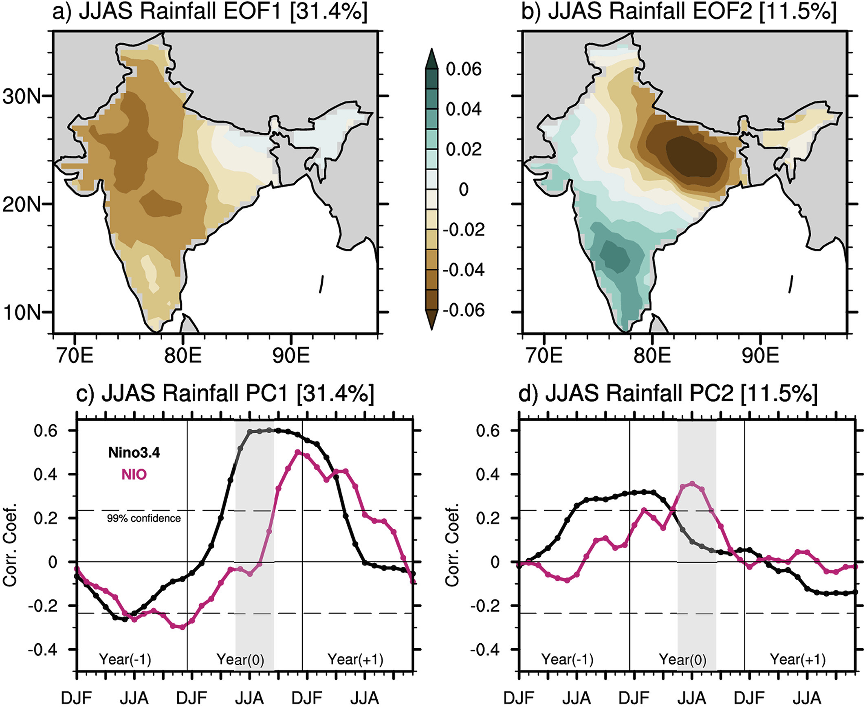
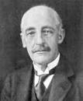
1901–2018
G. Walker
Antecedent Nino3.4
ENSO forecast
Your slides remind me of Gilbert Walker’s attempt (in 1920s) to predict Indian summer rainfall. The correlation with D(-1)JF(0) Nino3.4 indicates that Southern Oscillation can be a predictor for EOF2, but not for EOF1. Walker would be pleased at advances in meteorology over past 100 years...
Email from T. Sampe, 6/1/2021

